Slide 2
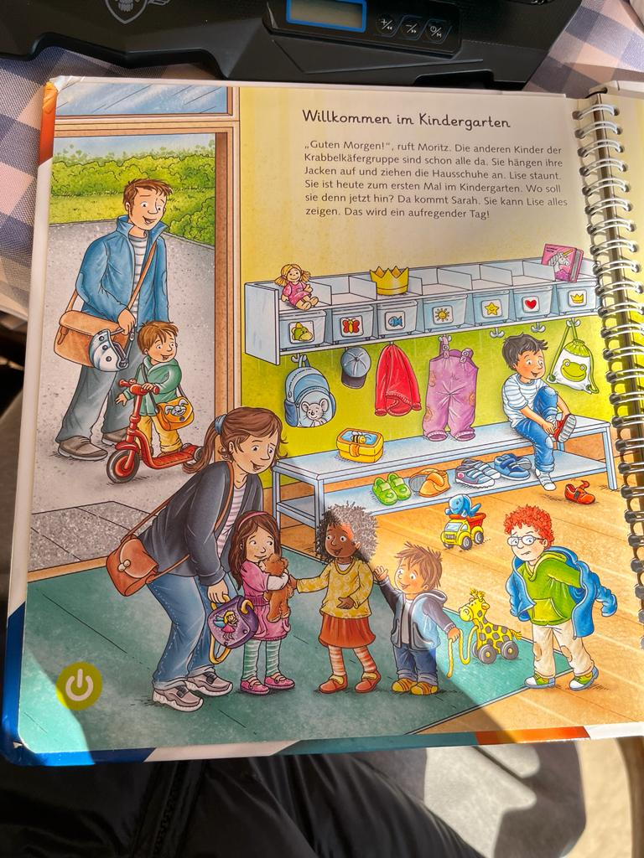
Title
Heading - Explanation
Upload files box , when uploaded it should be displayed below
Heading - German Text
Text
XX
XX
XX
Heading - English Text
Text
XXX
XXX
Xx
Extract , button
Previous Page button
Next Page button

