Slide 1

Port Authority Bus Terminal: Demand Forecasting & Capacity Planning for 2026–2030
Graduate Analytics Project
University of New Haven | Spring 2026

Slide 2
Agenda
Passenger Forecast 2026 – 2030
Terminal level weekly annual passenger demand using SARIMAX, ETS, and Prophet
Key Drivers of Ridership
Multiple Linear Regression identifies Bus Count, Temperature, and Snowfall as primary factors
Carrier Level Projections
Individual forecasts for 10 carriers using best-fit model per carrier
Busiest Weeks, Months, and Years
Peak Periods Identified
Recovery vs 2019 Pre-Covid Baseline
Terminal reached 89% recovery in 2026, projected to fully surpass by 2029

Slide 3
Forecasting Dataset
2550
Total Observations
12
Bus Carriers Tracked
237 Weeks
Nov 2020 – Jul 2025
4 External Variables
Weather + Holidays
Primary Dataset: Weekly Ridership with External Variables
Column | Description | Role in Analysis
Week Start Date | Start day of the week (Usually Monday) | Time index for all models
Carrier | Name of the Carrier | Segmentation Variable
Bus Count | No. of weekly bus departures | Strongest ridership predictor
Passenger Count | No. of weekly passenger departures | Target (Y) variable
avg_wind, avg_temp, avg_precipitation | Weekly weather averages for wind, temperature and precipitation | External demand drivers
Is Holiday Week, Holiday In Week | Binary variable( 1 = is a holiday week); name of the holiday | Seasonal adjustment flag

Slide 4
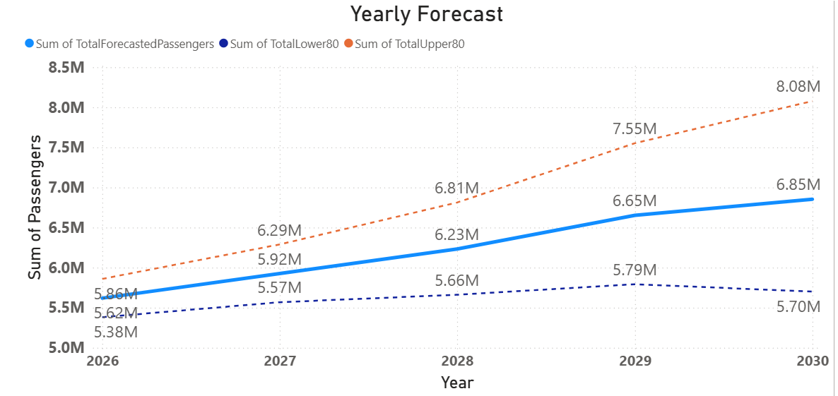
Terminal Passenger Forecast: 2026 - 2030

Slide 5
Terminal Passenger Forecast Takeaways
5.6 M
2026 Forecast
6.85 M
2030 Forecast
+22 %
5 – Year Growth
+140 K
Highest Peak Weekly
Year | Annual Total | Average Weekly Peak
2026 | 5.6 M | ~ 108 K
2027 | 5.9 M | ~ 114 K
2028 | 6.2 M | ~ 120 K
2029 | 6.7 M | ~ 125.5 K
2030 | 6.85 M | ~ 132 K
A jump from 108K to 132K weekly passengers between 2026 and 2030 means the terminal needs to process roughly 3,400 additional passengers per day by 2030 compared to opening day.

Slide 6
Forecasting Methodology: Why Prophet was Selected?
Designed for real-world business forecasting
Captures seasonality, holidays, and trend shifts
Handles post-COVID recovery patterns effectively
Generates prediction intervals for planning uncertainty
Strong performance on terminal-driving demand
NJ Transit represents ~75% of total terminal volume
Prophet achieved very high fit for NJ Transit (R² = 0.987)
Forecast Accuracy Summary
High-reliability carriers (MAPE <10%) | 4
Moderate-volatility carriers | 6
Dominant carrier forecast quality | R² = 0.987
Forecast horizon | 2025-2030
Prediction intervals included | Yes

Slide 7
Key Drivers of Ridership
Passenger Count = −1.917×107 + 42.32×BusCount + 166.0×Temp − 2425×Snow + 9448×Year + (Monthly Seasonal Variations)
Bus Count
Temperature
Snowfall
42.32
166
2425
Variable | Coefficient | Business Meaning
Bus Count | 42.32 | Each additional bus deployed in a week adds ~42 passengers
Temperature | 166 | Each 1°F warmer adds ~166 passengers — summer peaks are real
Snowfall | -2425 | Each additional inch of snow suppresses ~2425 passengers

Slide 8
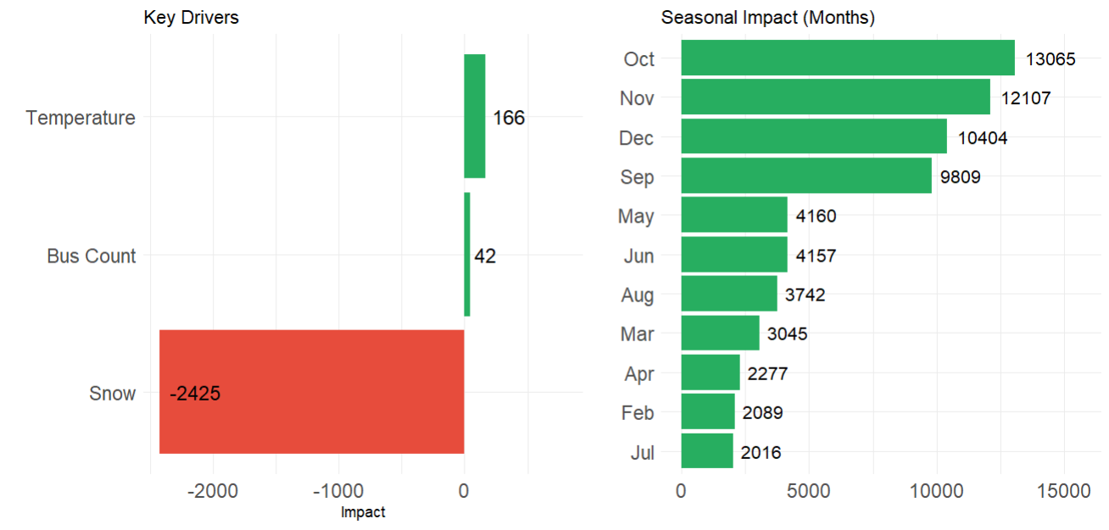
Key Drivers of Ridership

Slide 9
Passengers Per Bus
Carrier | 2021 | 2022 | 2023 | 2024 | 2025 | Capacity
Academy | 23 | 31 | 32 | 30 | 32 | 54
Coach USA | 24 | 31 | 33 | 29 | 29 | 56
Greyhound | 27 | 29 | 27 | 26 | 21 | 40-56
Lakeland | 26 | 35 | 38 | 33 | 34 | 50-55
Martz | 38 | 40 | 40 | 41 | 41 | 55-58
NJ Transit | 18 | 26 | 31 | 34 | 35 | 50-57
Peter Pan/Bonanza | 29 | 32 | 32 | 34 | 30 | 50-55
Trailways | 25 | 22 | 25 | 25 | 21 | 50-55
TransBridge | 30 | 30 | 30 | 28 | 30 | 56
Assuming a baseline capacity of 56 for all carriers, in 2025:
- the highest load factor is at 73% for Martz
- NJ Transit and Lakeland at 63%
- The lowest load factor is at 38% for Greyhound and Trailways.

Slide 10
Carrier Level Projections
Carrier | 2026 | 2028 | 2030 | Trend
NJ Transit | 4.8 M | 5.3 M | 5.8 M | ↑ Dominant
Coach USA | 307 K | 336 K | 366 K | ↑ Growing
Peter Pan/Bonanza | 111 K | 161 K | 211 K | ↑ Strong
Academy | 87K | 105 K | 123 K | ↑ Steady
HCEE-Community | 91 K | 100 K | 108 K | ↑ Steady
TransBridge | 34 K | 34 K | 34 K | → Flat
Greyhound | 53K | 29 K | 6 K | ↓ Declining
Martz | 37 K | 36 K | 36 K | → Flat
Lakeland | 74 K | 75 K | 76 K | ↑ Steady
NJ Transit dominates total volume (4.8M → 5.8M annually). Peter Pan Bonzana shows the strongest relative growth (~2135 in 2026 to ~4057 passengers per week in 2030). Coach USA also grows aggressively. Transbridge and Martz are relatively flat. Lakeland has slight increase anf greyhound declines.

Slide 11
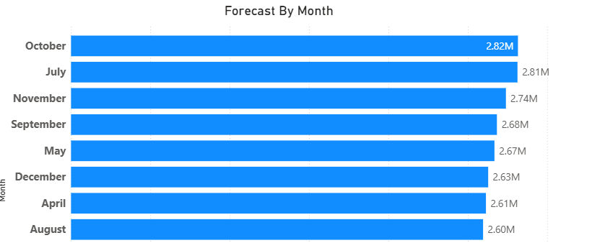
Peak Periods : When Staging Capacity is Most Critical
2030
Peak Year
July, Sep, Oct, Nov
Peak Months
38, 39, 43, 44
Peak Weeks
2030 is the peak year (6.85M passengers). By month, July, Sep, Oct and Nov are consistently the busiest across all five forecast years. Weeks 38, 39, 43, 44 carry the highest single-week loads (average of over 129K)— critical for staffing and gate planning.

Slide 12
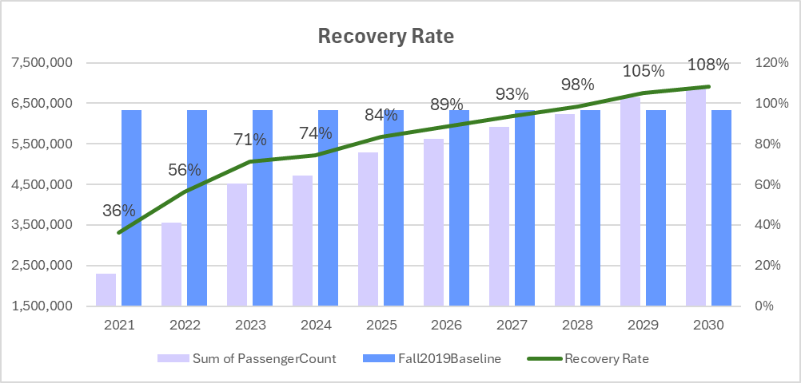
Fall 2019 Comparison

Slide 13
Recommendations:
Size for 2030 Peak
Design temporary staging facilities for a minimum 171,000 (Highest Peak of 142.5*1.2) passengers/week plus a 20% surge buffer. Sizing for the average will create bottlenecks by 2028.
Refresh forecasts quarterly
Re-run the R forecasting pipeline every quarter as new ridership data arrives. The model framework is established — updates require minimal manual effort and keep projections current.
Expand the Regression Model
Incorporate employment data, fuel prices, and remote-work indices as additional exogenous variables. These factors explain residual ridership variance not captured by weather and bus count alone.
Monitor the NJ Transit trajectory closely
NJ Transit accounts for roughly 75% of terminal throughput. Its forecast from 4.37M to 5.13M annual passengers is the primary driver of all staging decisions — any service change has outsized impact.

Slide 14
Thank You

