Slide 1
Fitness landscapes; LTEE
Lecture 10
Oct 8, 2010

Slide 2
Topics, ‘til now
Basic computational stuff
Running programs remotely
Extracting data, some graphing techniques
Thinking about computational approaches
Basic computational science
Reproducibility
Tractability
Doing vs thinking vs doing science
Avida
Running avida & some intro configuration

Slide 3
Remainder of course
Doing an actual experiment with Avida
LTEE-like Avida
The long-term evolution experiment (Lenski)
Basic approach
Resequencing the lines: technology
Analyzing resequencing data
Big! data
Research-y question of analyzing next-gen sequencing data
…intermixed with misc lectures by people on Avida and E. coli research

Slide 4
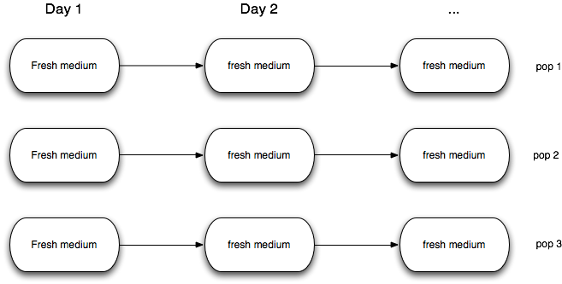
Long-term evolution experiment w/E. coli
Serial transfer of 12 populations of E. coli

Slide 5
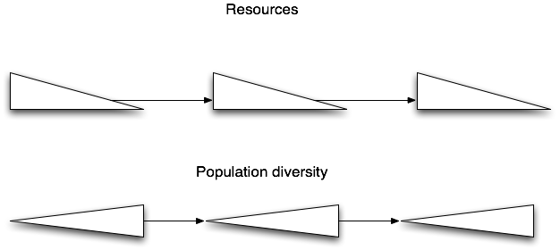
Similar conditions (boom/bust), day after day

Slide 6
Population diversity (?)

Slide 7
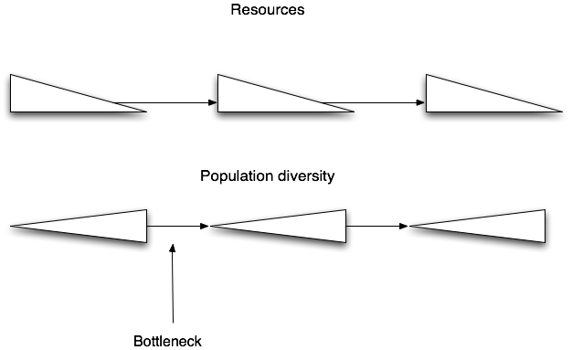
Bottlenecking effect…

Slide 8
Questions…
Do we see same dynamics, same “conclusion”, for each line?
What are the targets of selection?

Slide 9
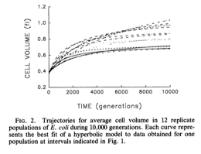
Change in cell volume

Slide 10
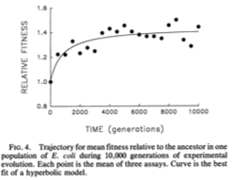
Change in mean fitness relative to ancestor

Slide 11
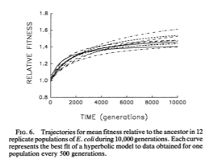
Change in mean fitness relative to ancestor

Slide 12
Questions…
Do we see same dynamics, same “conclusion”, for each line? (No)
What are the targets of selection? (Don’t know, but can see some correlates)
How are the genomes evolving? (We’ll talk about that later ;)

Slide 13
Can we do a similar experiment in Avida?
YES
What can we control?
EVERYTHING
What can we measure?
EVERYTHING

Slide 14
Questions
How to do serial transfer?
Dominant genotype only; or randomly chosen subset of varying sizes; or …?

Slide 15
Population size?
How big a population?
How many to transfer?

Slide 16
Population structure
Nearest neighbor/2D?
Well-mixed?

Slide 17
Starting organism?
Do we want a highly evolved starting organism?
If so, should we change the environment prior to starting the serial experiment?

Slide 18
Varying resources
Constant influx (chemostat)
Boom/bust
Bust/boom
Etc.

Slide 19
Do we want to have sex?
1- or 2-point recombination with neighbors.
Does it favor modularity of genome?
How would you measure that, anyway?

Slide 20
Limited resources?
With Avida, it’s possible to require that a given resource exist in order to gain fitness from a particular action.
We can emulate boom-bust vs steady, for example.

Slide 21
What to measure & compare?
Up to you.

Slide 22
Some hand-wavy hypotheses
There is a critical point in dilution factor for serial transfer: below this point, evolution stops (or regresses). IDENTIFY THAT POINT.
Boom-bust / serial transfer dynamics will accelerate evolution relative to a single evolving population. TEST ME.

Slide 23
Your HW
For Monday, come up with either an experiment (and then a hypothesis) or a hypothesis (and then an experiment).
(Groups of 2-5 are fine.)
Write this down in a paragraph.
Send it to me and Heather.

Slide 24
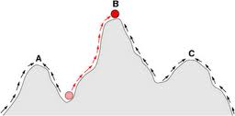
Fitness landscapes
Goal: reach high fitness!
1D evolution: your “number” (a genotype) can only move some small amount delta.

Slide 25
Fitness landscapes
1D evolution w/o phenotype: your “number” (a genotype) can only move some small amount delta.
How do you go from point A to point B??

Slide 26
Fitness landscapes
1D evolution w/o phenotype: your “number” (a genotype) can only move some small amount delta.
An analogy for multi-dimensional fitness landscapes with genotype-phenotype.

Slide 27
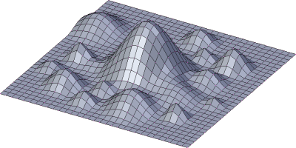
More complicated fitness landscapes

Slide 28
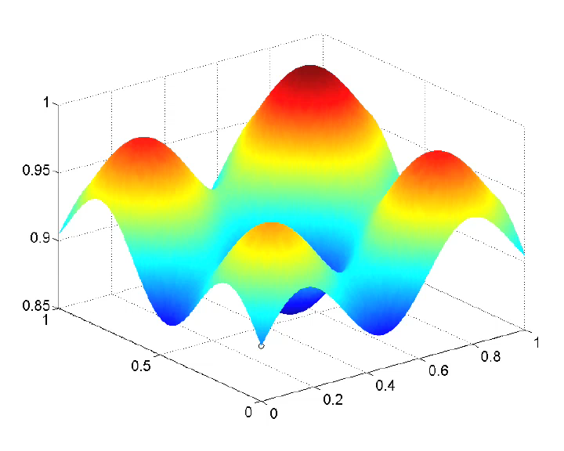
Populations
Bjorn Ostman

Slide 29
Thinking about serial passage experiment re fitness landscapes
With each transfer, what are you doing to the population in terms of its presence on the fitness landscape (bottlenecking)?
How does the fitness landscape change within each run over time (as, for example, resources are depleted; or the neighborhood fills up)

