Slide 1
A different take on more scripting stuff;& version control
Lecture 13
Oct 18, 2010

Slide 2
But first…
Whither the LTEE project?
Many of you are still working out the details with Heather (and occasionally me)
Those that aren’t should try running it.
What do you all want the output to be?
Report?
2-5 minute presentation?
A general feeling of satisfaction?
And when?

Slide 3
Class #2
The Ian and Charles show
All BEACON grads, anywhere, must take the second class.
(New) groups will be formed across discipline and institution boundaries
View this class as a warm-up

Slide 4
Back to this class
Where do you want this class to go?
More practice?
More Cool Science?
More on programming?

Slide 5
Version control
Think of it as Word’s “change tracking” on text files.
Many different version control “systems” –
Centralized:
Subversion
CVS
Distributed:
git
Mercurial
Arch, Bzr, Darcs, …

Slide 6
Version control vocabulary
Repository – location of all the files
Working directory – copy of repository where you “do work” (make changes, use code, etc.)
Linked to the main repository
Created via a “checkout” or a “clone” command.
“Push” changes to the repository and “pull” changes from the repository.
Similar to “commit” (push) and “update” (pull) in Subversion

Slide 7
Github is a hosting service for git repositories
I’m hosting the BEACON class scripts on github.
This means that all of you can make a checked-out copy of the files.
You can also pull updates. More on that in a bit.
You can also sign up for github and make your own changes.

Slide 8
Other reasons to use version control
It keeps a complete history of changes to the source code, so you can always go back and figure out when a feature was removed or a bug was introduced.
You can “checkpoint” your source code for later reference (“this was the version I used for paper XXX”)
You can “branch” your source code to work on independent features/scripts/etc., and then later on “merge”.
It’s essential to multi-developer projects.

Slide 9
Other reasons to use version control, #2
It’s a backup! And with github and other hosting services, it’s a free backup! (But your code does have to be open source…)
It’s a pretty convenient way to transfer files around.

Slide 10
Version control is critical to replication
Being able to say “this code is identical to the code I ran a year ago” is really important! (Or, “this is the version I ran a year ago”)
You can make that source code available to others quite easily via a version control system.
It’s also nice to be able to see “hey, feature XXX isn’t working any more, and person YYY is the person who broke it.”

Slide 11
Version control isn’t a panacea!
Just because it’s in version control doesn’t mean it’s right.
Just making code available to someone doesn’t mean they can actually run it.
Many people don’t include all their code.

Slide 12
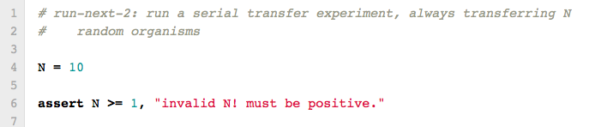
beacon/ltee/run-next-2.py
Parameters at top!
Make sure that the parameters are not stupid!

Slide 13
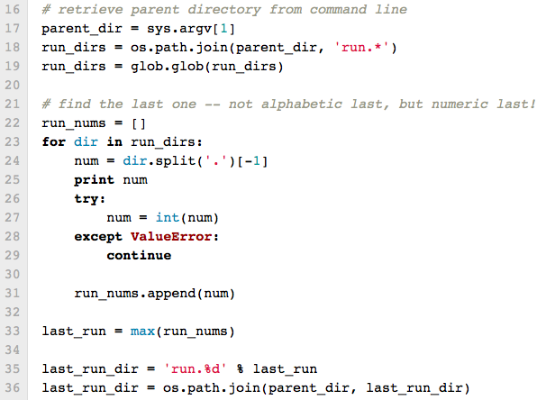
beacon/ltee/run-next-2.py
Load in the existing run dirs

Slide 14
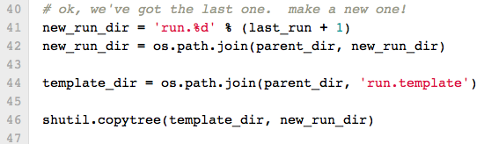
beacon/ltee/run-next-2.py
Make a new directory and copy the template to it.

Slide 15
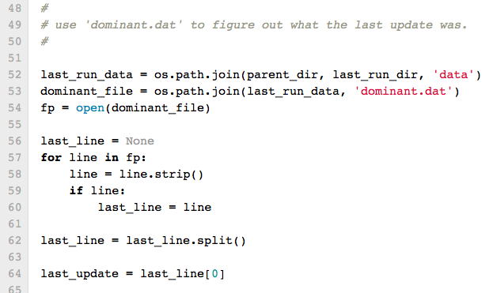
beacon/ltee/run-next-2.py
Use ‘dominant.dat’ to get the last update.

Slide 16
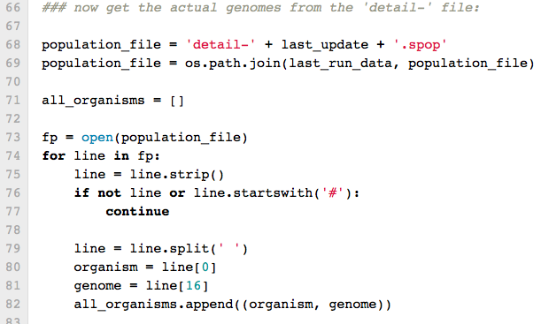
beacon/ltee/run-next-2.py
Load the genomes into ‘all_organisms’ list.

Slide 17
beacon/ltee/run-next-2.py
Self-explanatory!

Slide 18
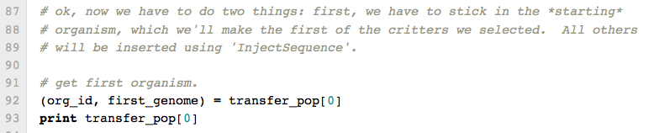
beacon/ltee/run-next-2.py
Seed Avida with the first organism.

Slide 19
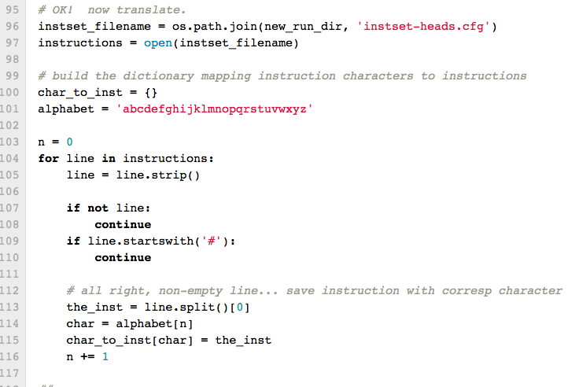
Load in the instruction
translation table:
a => nop-A
b => nop-B
w => h-alloc
etc

Slide 20
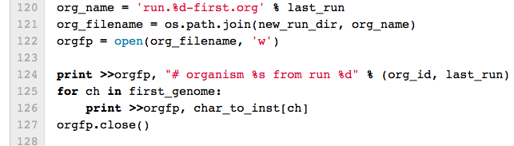
Here, we’re outputting the translation of ‘first_genome’ into the file ‘run.N-first.org’

Slide 21
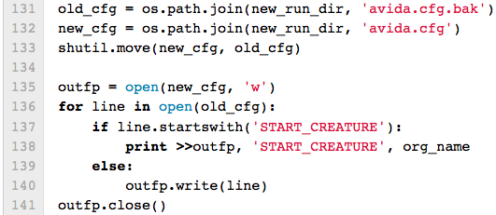
Run-next-2.py
Update the config file

Slide 22
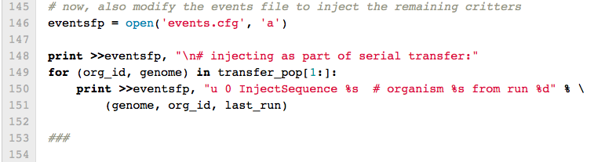
Run-next-2.py
Inject the rest!

Slide 23
Simple version control commands
git clone <git repository> - make a working copy
git pull <git repository> - update from repo
git log - see log of changes
git diff <revision ID> - see ‘diff’

Slide 24
