Slide 1
Hardware, software, and thinking.

Slide 2
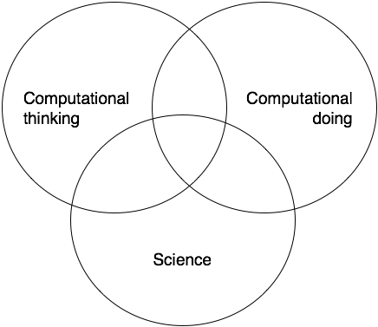
Computational science

Slide 3
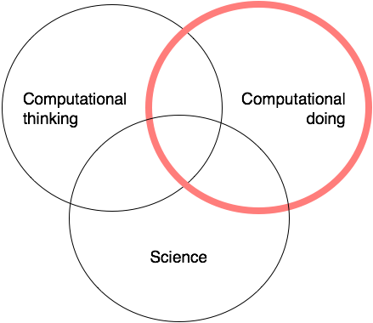
Computational science

Slide 4
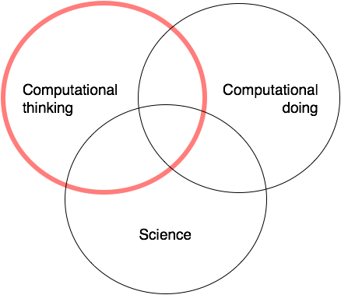
Computational science

Slide 5
Outline
Some basic thoughts on hardware
Implementing your software
Mowing your lawn
Outsmarting the evil dean
Heuristics in computation
Algorithms and scaling
Two ways to calculate prime numbers
Breaking down algorithms
Sorting
Software reliability

Slide 6
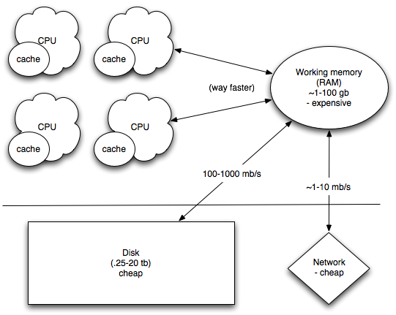
Computer architecture

Slide 7
Computer architecture
Computation is cheap

Slide 8
Computer architecture
Communication between CPUs is pretty cheap.

Slide 9
Computer architecture
Retrieving/sending data from/to the disk or the network is slow.

Slide 10
Computer architecture
Retrieving/sending data from/to the disk or the network is slow.

Slide 11
Questions to ask
Can I split my problem up into small chunks?
(because, if so, I can use multiple, small computers effectively. Small computers are cheap!)
How does my computation scale?
How does my memory use scale?

Slide 12
Communication between CPUs/computers slows you down; this is main factor in splitting up tasks.

Slide 13
More important than raw computer speed…
How does your approach scale with the problem size?
If your approach scales well, then bigger problems can be tackled by throwing more computation at it, or by “micro optimizing”.
If not, well… you may need to think more. Or it may be impossible to scale.

Slide 14
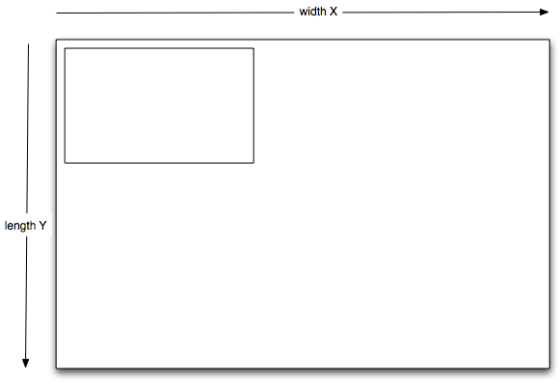
Example: mowing the lawn

Slide 15
Mowing the lawn scales… how?
The time it takes to mow the lawn is related to the area of the lawn, X * Y.
We say O(mowing) = X*Y, therefore.
Note: this is independent of the speed of your mower, the width of your mower blades, the height of the grass, etc. Those are all details that tell you how fast you can actually mow a lawn. Unrelated to scaling.

Slide 16
Can you parallelize lawn mowing?
If you have four times as many lawn mowers, can you mow the lawn five times as fast?
YES.
But why??

Slide 17
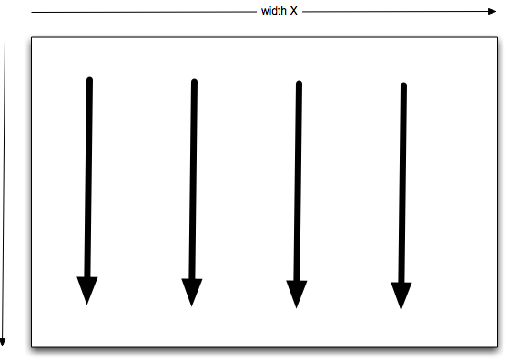
Can you parallelize lawn mowing?
Yes, because you can subdivide the task in advance.

Slide 18
Terminology
“Massively parallel” or “pleasantly parallel” – if you throw M resources at an N-sized problem, it becomes N/M-sized for each resource. Think lawn mowing.
Google has figured out how to do something close to this with search.
(Does anyone have any intuition as to why Web search isn’t actually pleasantly parallel?)

Slide 19
Is Google search massively parallel?

Slide 20
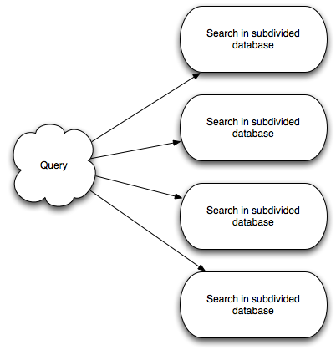
Google search

Slide 21
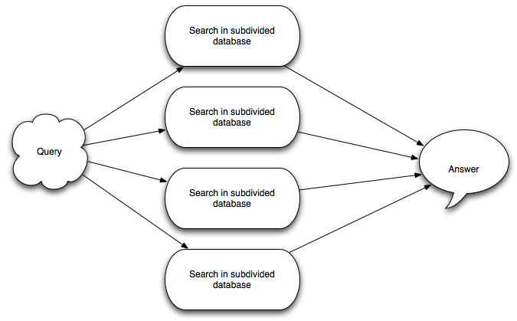
Google search

Slide 22
Why is this relevant?
First, because I’m trying to teach you how to recognize mean & nasty problems.
This is especially important when someone tells you that they’ve managed to scale a difficult problem well. What tradeoffs?
Second: is Avida parallelizable?
(If you already know the answer, keep quiet.)

Slide 23
Is Avida parallelizable?

Slide 24
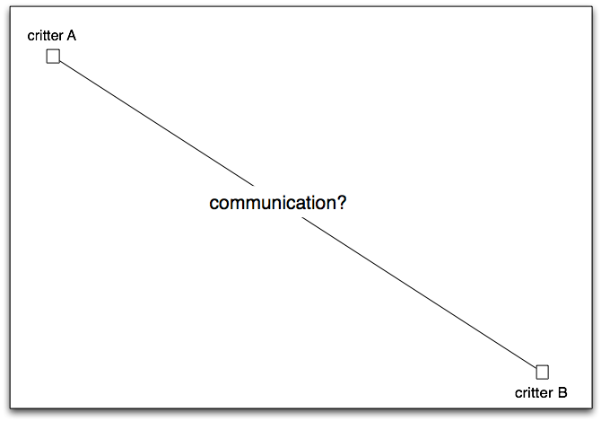
Avida parallelization

Slide 25
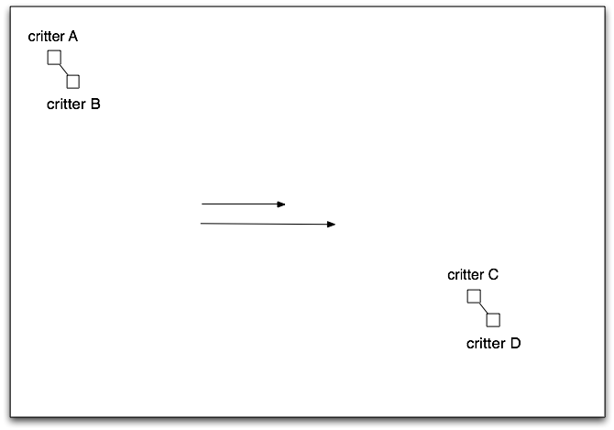
Avida parallelization

Slide 26
Avida scaling
Note that computation/generation scales with the size of the world, which is X*Y.
Parallelizing Avida is therefore possible but not trivial.
How big a world can you run usefully/easily? And how can you figure it out without trying to run Avida?

Slide 27
Reminder
Algorithm scaling is independent of the actual time and resources it takes to run the algorithm.
Scaling tells you how time-to-run (or linked resources) scales as the problem size changes, nothing more.
Language note:
“non trivial” means “wow, that’s hard” in computer-speak.
“hmmmmmmmm” means “wow, that’s realllly hard.”

Slide 28
Combinatorics is the devil
Think about chess…
The number of possible moves from any given position is usually quite large. Say it’s N.
So to explore all paths (to find the best next move) out to 3, you need to:
Explore N moves
For each of those, explore N moves
For each of those, explore N moves
N * N * N => scales badly!

Slide 29
Easy-to-check vs easy-to-find
Given a number, factor it into only prime numbers.
This is hard.
Given a set of prime numbers, verify that they multiply to yield a particular number.
This is easy.
(This is actually the basis of modern encryption…)

Slide 30
Is a number prime?
Dumb algorithm:
For N < P:
Does N divide P evenly? If so, not prime.
Smarter algorithm:
For N < sqrt(P):
Does N divide P evenly? If so, not prime.
(try “100”. If N > 10 divides it, then it must be multiplied by a number smaller than 100, too)
Even smarter algorithm:
For prime p < sqrt(P):
Does p divide P evenly? If so, not prime.

Slide 31
Is a number prime?
Smarter algorithm:
For N < sqrt(P):
Does N divide P evenly? If so, not prime.
Even smarter algorithm:
For prime p < sqrt(P):
Does p divide P evenly? If so, not prime.
Which one is faster?
Which one requires more memory?

Slide 32
The Evil Dean
Suppose:
50 dorm rooms, two students per room
100 students can be admitted, of 400 total
Dean provides list of students that cannot be paired.

Slide 33
The Evil Dean
Suppose:
50 dorm rooms, two students per room
100 students can be admitted, of 400 total
Dean provides list of students that cannot be paired.
It is easy to check any particular list of student/room combinations for validity.
In general, it is extremely hard to quickly find a guaranteed solution.

Slide 34
Checking your “evil dean” solution
For each pair, you need to verify that they’re not on the list together.
This is not combinatorial –
50 pairs
However big a list
At worst, you can take each pair and look them up on the list. 50 x length of list.

Slide 35
Finding a guaranteed solution strategy for your evil dean…
That’s much harder to do quickly. THAT’s combinatorial.
First assignment: 400, choose 2. (79,800)
Second assignment: 398, choose 2. (79003 ways to do that.)
Or, 400*399 possible pairs to check against list… find 50 (of 156k) and you’re good! (“Greedy algorithm”)
Etc. Scales REALLY badly with size of dorm, size of rooms, size of list, number of students.

Slide 36
Finding a probably-correct solution for your evil dean…
That might be much easier. (Randomly pick roommates? Or by alphabetical last?)
…you can probably rely on roommates to tell you if they hate each other, and then you switch just those. Odds are you won’t get in too much trouble.
Unless you end up with a murder, of course.

Slide 37
Heuristics
“Heuristics” are short cuts that usually work (but can go horribly wrong).
Not all problems are amenable.
Prime numbers? No good, fast short cut.
Evil dean & housing? Sure – start with a random solution, eliminate one of each pair that conflicts, until you find a non-conflict..
Heuristics rely on assumptions about the specific type of problem you’re going to tackle, and don’t always work.
If the Dean is evil, he can construct a list of incompatible roommates that breaks your process.
Or he can just gives you a really long list of incompatible roommates.

Slide 38
Heuristics, again
You can choose the problem so that any given heuristic fails, and it’s just as difficult to figure out what the best heuristic is as it is to… run the approach.

Slide 39
In summary, about algorithms
Many useful problems are also NP-complete, because of the way they scale.
Heuristic solutions (planning for the best!) or approximate solutions (it’s ok if we’re wrong some small amount of the time) are much easier than exact solutions.

Slide 40
What (some) Computer Scientists do: re lawn mowing
How does the problem scale?
Notes:
How you know you’re a computer scientist…

Slide 41
What (some) Computer Scientists do: re lawn mowing
If you have trees, what’s the right way to subdivide?
Notes:
How you know you’re a computer scientist…

Slide 42
What (some) Computer Scientists do: re lawn mowing
Suppose you have a Mad Gardener planting new trees while you mow?
Notes:
How you know you’re a computer scientist…

Slide 43
What (some) Computer Scientists do: re lawn mowing
Or, suppose the lawn is on a hill – how do you subdivide?
Notes:
How you know you’re a computer scientist…

Slide 44
What (some) Computer Scientists do: re lawn mowing
Suppose you run a lawn mowing company, and you face all of the above problems? What’s the best approach?
Notes:
How you know you’re a computer scientist…

Slide 45
What (some) Computer Scientists do: re lawn mowing
Suppose you run a space habitat lawn mowing company? How do you mow arbitrarily shaped 2-D spaces?
Notes:
How you know you’re a computer scientist…

Slide 46
What (some) Computer Scientists do: re lawn mowing
Suppose you run a space habitat lawn mowing company? How do you mow arbitrarily shaped 2-D spaces?
(You know you’re a mathematician/computer scientist if you can’t go to sleep at night because you’re thinking about how to do that.)
Notes:
How you know you’re a computer scientist…

Slide 47
What (some) Computer Scientists do: re lawn mowing
Suppose you run a space habitat lawn mowing company? How do you mow arbitrarily shaped 2-D spaces?
(You know you’re a mathematician/computer scientist if you can’t go to sleep at night because you’re thinking about how to do that.)
(You’re a writer if you immediately think, neat! I could write a sci fi story about a space habitat lawn mowing company!)
Notes:
How you know you’re a computer scientist…

Slide 48
Classifying problems
The main classification you need to know is: NP-complete.
Easy to verify.
Hard to compute.
Asymmetric.
Our dean problem is NP-complete.
Many (most?) hard problems I run across are NP-complete, I think.

Slide 49
Black box nature of algorithms
When you listen to a computational scientist explain their clever algorithm…
…it’s a mistake to think that they necessarily know what’s going on.
Software is full of bugs and unintended consequences.

Slide 50
Tracking the process
How do you know that your software today is doing the same thing it was doing last month? Or last year? Or in the hands of that other graduate student?
There are some tools & techniques for dealing with change in software. We’ll talk about them in a week or two.

Slide 51
Avida stochasticity: why?
Sarah Jones:
UD: 500 Gen: 38.53015 Fit: 0.2479998 Merit: 97.69530
Robert Heckendorn:
UD: 500 Gen: 39.12720 Fit: 0.2561943 Merit: 98.58119
Max Maliska:
UD: 500 Gen: 39.35769 Fit: 0.2472624 Merit: 94.19189
Jeannine McLean:
UD: 500 Gen: 37.32764 Fit: 0.2461677 Merit: 99.99727

Slide 52
Avida stochasticity: uh-oh?
Read the Nature paper.
How easy would it be to replicate those results today?

Slide 53
Computational science
Who gets what wrong?
- scaling
- implementation details
- Good Science

