Slide 1
Replication & misc
BEACON CLASS
Sep 24th

Slide 2
Today’s topics
Replication and reproducibility
How much memory does Avida use?
Saving highly evolved critters.

Slide 3
Replication vs Reproducibility
Replication: identical results.
Same parameters => same results
Reproducibility: similar results.
Similar parameters => similar results
(What’s “similar”?)
Corroboration:
Similar results seen in a different system

Slide 4
First: why did everyone get different results?

Slide 5
Avida is stochastic
You really don’t want to run exactly the same simulation every time you fix parameters…!
But computers aren’t (shouldn’t be) random! So how??
“Pseudo-random number generator”
Basically, take a number. Generate another number from it using a deterministic process, but make the process return a very different number from the first one, using complex math functions.

Slide 6
Avida is stochastic
But this just pushes the problem back – how do you choose that first number differently for each run!?
…take the time of day and use that as your random “seed”, from which all your other numbers will be generated.
This “seed” can then be used to replicate the run exactly.

Slide 7
Avida is stochastic
So, if two of you had run Avida at the same microsecond, you should have gotten the same results!

Slide 8
Suppose…
You cannot replicate the results in the 2003 paper.
What are your options?
(Posit no evildoing)

Slide 9
Suppose…
You find a copy of the source from 2003, and run the same program with the same parameters. And you get different results!
Why might this happen?

Slide 10
Suppose…
You get a copy of the source from 2003, and you run it hardware from 2003, and still get different results!?

Slide 11
What should our standards be?
For scientists, reproducibility is extremely important.
Replication … less so. It’s very challenging to exactly replicate a given experimental situation.
But, there is a pragmatic reason to think about replication, too.

Slide 12
Replication in computational science
We have spent mucho time making sure that computers do the same thing every time, at the micro level.
If you observe unplanned variation in a computational system, then:
You either are using one of the approximate subsystems, like floating point;
Or you have a bug.

Slide 13
Replication in computational science
So, proximate to an experiment, you should be able to exactly replicate a particular result from a computational experiment.
Then, changing
Data sets
Hardware
Underlying software
…may result in observed differences.

Slide 14
Engineering vs Science mindset
Engineering mind set is aimed at construction. They care if it does as they intended it to do, and if they can reproduce the construction process.
Scientists are trying to constrain the situation and figure out which characteristics are general and which ones aren’t.

Slide 16
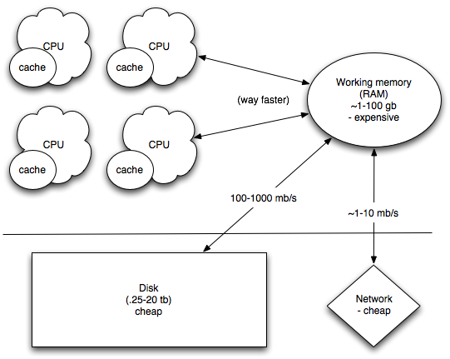
Computer architecture

Slide 18
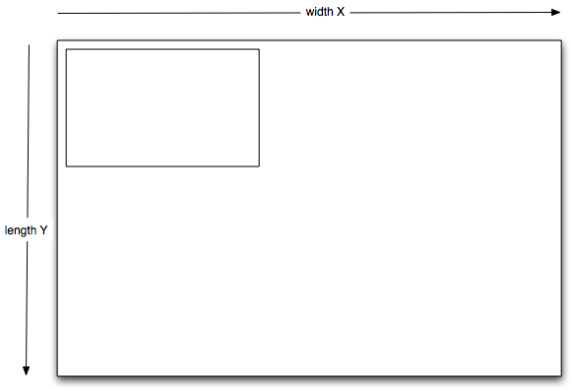
Example: mowing the lawn

