Slide 1
Building computational pipelines
Lecture 7
Sep 27, 2010

Slide 2
Programming: Scripting vs Software Engineering
There are several kinds of programming.
Scripting (from “writing little scripts”) is centered on fairly small tasks.
Software Engineering (from, um, “engineering”) is centered on building bigger programs (like Avida).
The skill sets do not actually overlap much.

Slide 3
Scripting
Building small scripts is useful for many things:
Automating things you do again and again
Configuring machines
Running programs repeatedly
Doing simple kinds of data analysis:
Combining data sets
Various kinds of statistical analyses
Graphing

Slide 4
Several kinds of languages used for scripting
Shell scripts
Useful for task automation
Python (and Perl, and Ruby, and …)
Particularly useful for text data manipulation.
More general languages, too.
Can be used for graphing and statistics.
R (and Matlab)
Statistics, statistics, statistics!
Graphing

Slide 5
The real challenge in programming
Computers are dumb.
You need to match what computers can do with what problems you need to solve.
This is the “computational thinking” part of things, basically.

Slide 6
The annoying challenge in programming
I know what I need to do.
How can I make the computer understand me??
Analogous to speaking a foreign language in another country.
This is “just details” as opposed to culture-shock aspect (“Ground floor” in Europe… floor 1 in US!)

Slide 7
Introduction to scripting
Shell script to install an EC2 machine
Shell script to compile Avida
Shell script to run Avida 10 times
Python script to “parse” summary data from running Avida 10 times
Python script to extract dominant organism

Slide 8
Here’s the real secret
Don’t ever write your own scripts from scratch!
Take mine (or someone else’s) and modify them!
Iterative process:
Run script, verify that it “works”
Modify slightly
Repeat
SAVE EACH WORKING VERSION!

Slide 9
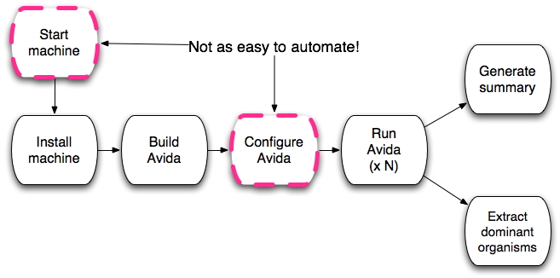
What we did, in diagram form

Slide 10
The Trap
Once you know how to automate programs and analyses, it becomes really, really easy to generate extremely large amounts of data.
However,
Keeping track of this data (and your scripts) gets difficult.
Keep your eye on the ball: “easy” doesn’t necessarily mean worthwhile!
“Easy” also doesn’t mean “correct.”

