Slide 1
Scripting, take 2

Slide 2
Outline
More scripting
Pipelining scripts
Proving the scripts (and me) right (or wrong)

Slide 3
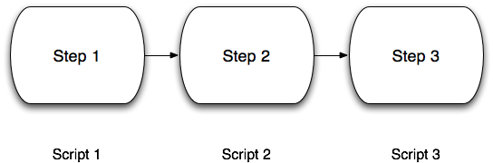
Pipelining scripts

Slide 4
Why pipeline scripts?
Each script is easily reusable, by you and others;
Each script can be developed in isolation;
Each script can be tested in isolation;
Each script is easier to understand;
If you plug & play properly, you can use one script in multiple pipelines.

Slide 5
Pipelining scripts

Slide 6
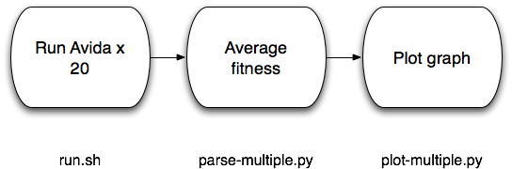
Pipelining scripts

Slide 7
Analyzing multiple runs
Say we want to average average fitness, per update, across all the runs.
To do this, we have to have the following information:
For each run, for each update, the average fitness

Slide 8
Analyzing multiple runs
Say we want to average average fitness, per update, across all the runs.
To do this, we have to have the following information in one place:
For each run, for each update, the average fitness
In what form is this information now?
Each update / average fitness
In separate files, one per run! (data/average.dat)

Slide 9
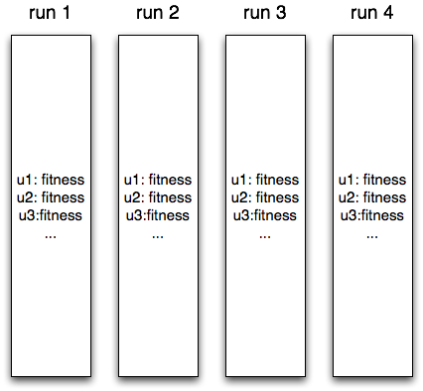
Current organization of data

Slide 10
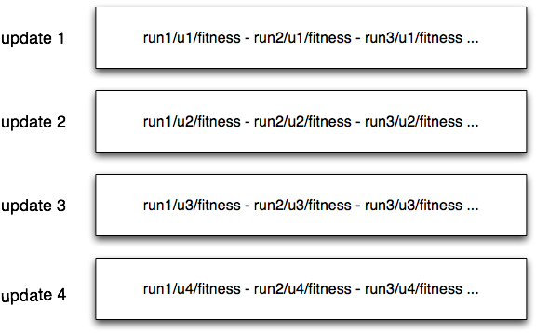
Desired organization of data

Slide 11
Pipelining scripts

Slide 12
Scripting!

Slide 13
How to test?

Slide 14
HW for next week:
Read paper on Lenski LTEE
Try running the scripts yourself!

