Slide 1
Making sense of data

Slide 2
Why pipeline scripts?
Each script is easily reusable, by you and others;
Each script can be developed in isolation;
Each script can be tested in isolation;
Each script is easier to understand;
If you plug & play properly, you can use one script in multiple pipelines.
Each script can be in a different language.

Slide 3
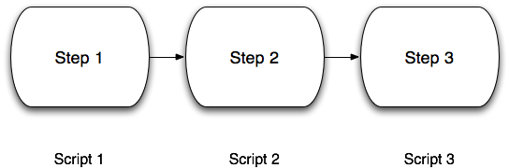
Pipelining scripts

Slide 4
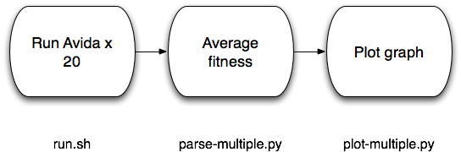
Pipelining scripts

Slide 5
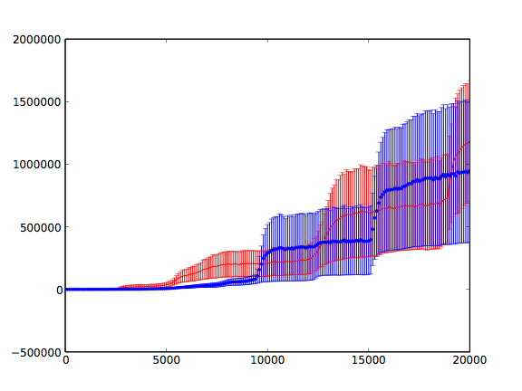
Plotting average fitness doesn’t make sense…

Slide 6
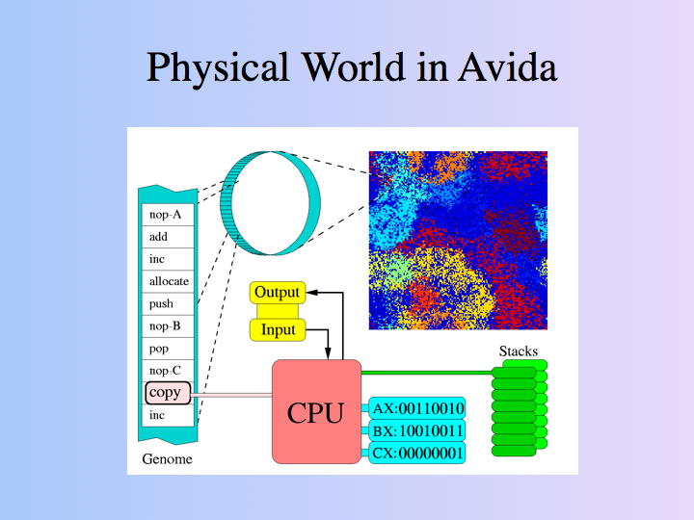

Slide 7
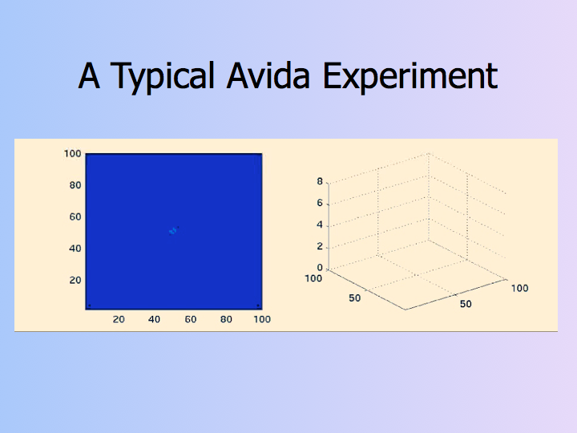
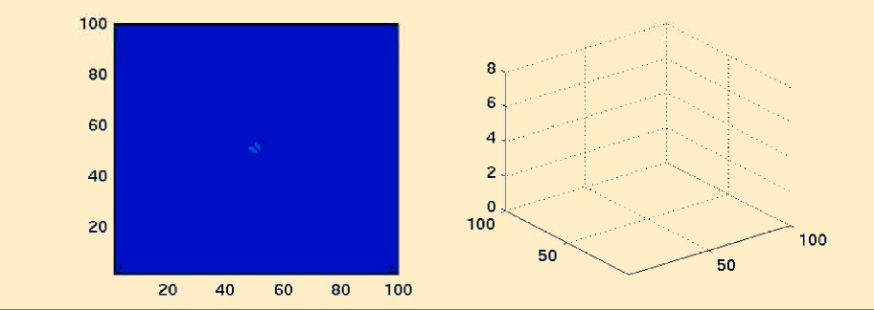

Slide 8
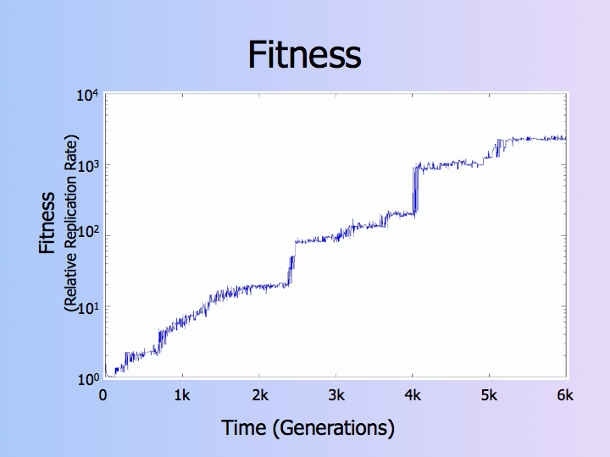

Slide 10
Plotting average fitness doesn’t make sense…

Slide 11
What does make sense?

Slide 12
Comments and notes
Often while exploring your data, you must invent ad hoc “data analysis” techniques, especially if it’s a new kind of data, or a new kind of data gathering technique.
What’s a good interval in time for measuring jumps? What’s a good fitness interval for determining whether a jump has happened?
The trick is to eventually reach an understanding of how these ad hoc choices should be made.
But first, spend some time “playing” with your data.

Slide 13
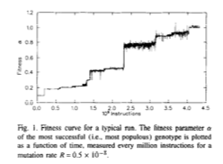
Measuring properties of fitness progression
Adami, Phys. Lett. A, 1994

Slide 14
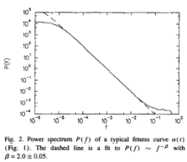
Fitness curve is a power spectrum
Adami, Phys. Lett. A, 1994

Slide 15
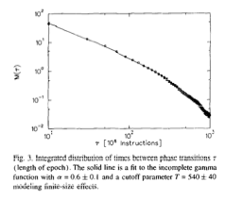
So is time between fitness transitions
Adami, Phys. Lett. A, 1994

