Slide 1
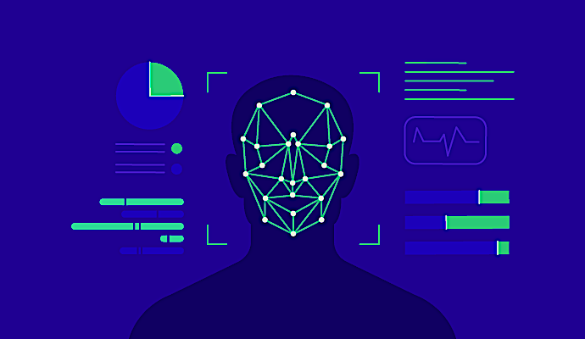

face recognition
Presented By:
Somia Ahmed Mohamed
Sahar Maher Abdelmonem
Sherine Tarek Berges
Rehab Mohamed Roziek
Supervised by:
DR. Mona Farouk
Eng Hassan Ahmed

Slide 2
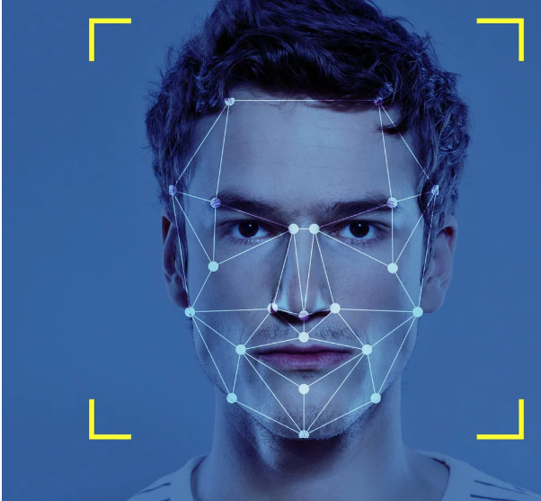
Objective
Build a functional face recognition app using Python.
Gives feedback based on recognition status:
Draw a boundary box around their face and display their name inside the box.
If the person is not recognized, draw a boundary box and label it as "Unknown."

Slide 3
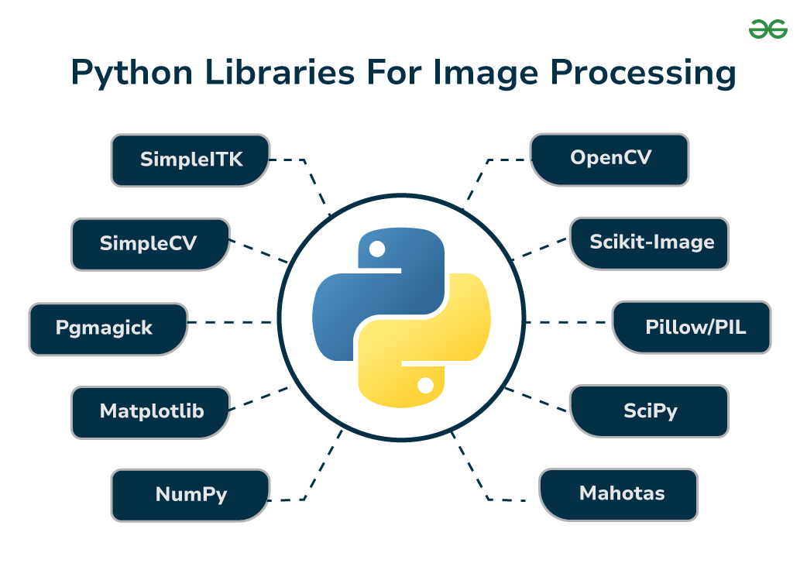
Tools and Libraries Used
Numpy
OpenCV
Face recognition
Tenserflow
Flask framework
Pickle
Zipfile

Slide 4
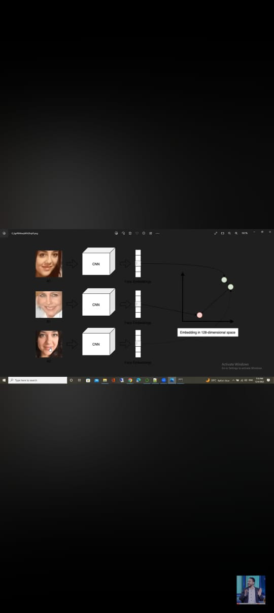
Model
Install face recognition libaray
Load images (faces of different persons)
Detected faces in Images using function called face_locations which return
(tuple of top,right,bottom,left) {face_recognition.face_locations()}
Face encoding :once face is detected use function called face encoding which is a numeric representation of the facial features (then can be compared with other face encoding) {face_recognition.face_encodings()}
Each encoding is a 128 dimensial vector that uniqualy represents face in image
face recognition : compare face encodings to check if 2 faces belong to the same person

Slide 5
Challenges
Resource Limitations:
Limited time and local storage.
Technical Issues:
face_recognition library dependencies.
Video streaming limitations in Google Colab.

Slide 6
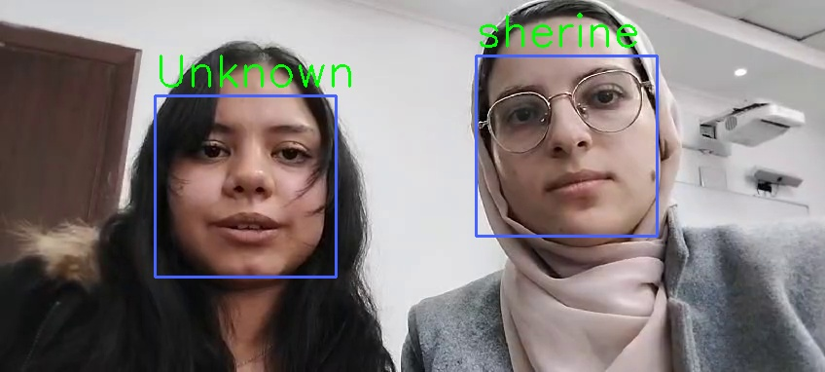
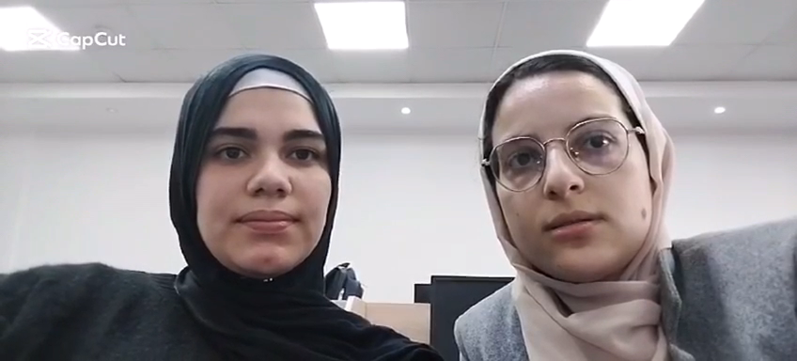
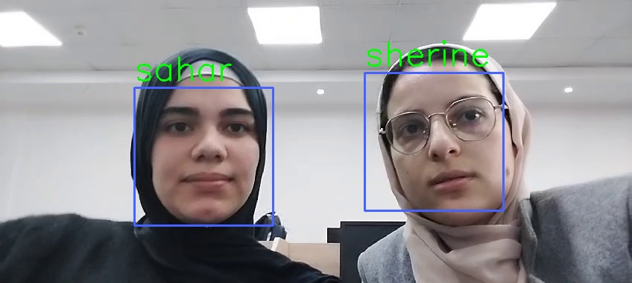
Results

Slide 7

Thank you
https://colab.research.google.com

