Slide 1
Mnemonic Similarity Task
& Event Segmentation
N = 160 participants
3 conditions: Item-Only · Task-Only · Both Item+Task
160
24,000
5
3
Participants
Test Trials
Lure Bins
Event Positions

Slide 2
01 Introduction & Background
The domain, the task, and why it matters
Replication of Morse et al. (2023)

Slide 3
The Hippocampus & Pattern Separation
Why similar memories don't interfere with each other
Pattern Separation
Pattern Completion
MST Paradigm
🧠
🔁
🔬
Hippocampal process that orthogonalises similar inputs into non-overlapping neural representations
Retrieving a full memory from a partial cue, the complementary process to pattern separation
Behavioural proxy for hippocampal pattern separation using perceptually similar lure images

Slide 4
Mnemonic Similarity Task — Design
Replication of Morse et al. (2023) with event boundary manipulation
Encoding
Test
Response
280 images
40 events × 7 items
"Fits in a shoebox?" (f/j)
150 items
60 targets + 60 lures
+ 30 foils
O = Old
S = Similar
N = New
→
→
Lure Similarity Bins:
1 — Most Similar
2
3
4
5 — Least Similar

Slide 5
Event Segmentation Theory (EST)
Zacks et al., 2007 · Morse et al., 2023
Core Idea
Position × Memory Prediction
◆ Experience is continuously parsed into discrete events
Pre-boundary
Standard encoding; pre-boundary context active
◆ Event boundaries occur when predictions fail
◆ Boundaries trigger a cognitive reset → reallocation of processing resources
Mid-event
Deep within event; stable event model; best context
◆ Post-boundary items may benefit from enhanced encoding
Post-boundary
After boundary; fresh encoding start; episodic reset
◆ Response times should increase at boundaries

Slide 6
02 Hypotheses & Methods
Research questions, planned analyses, and statistical approach

Slide 7
Research Hypotheses
Confirmatory (H1–H4) and Exploratory (H5–H7)
H1
Memory above chance: REC and LDI > 0 for all groups (verified)
H5
Exploratory: Longer RT at test for post-boundary/mid-event items
✓
H2
Boundary benefit: Post-boundary items show higher REC/LDI than mid-event
H6
Exploratory: Positive correlation between REC and LDI within-subjects
H3
Lure gradient: LDI lower for Bin 1 (most similar) vs Bin 5 (verified)
H7
Exploratory: Position × lure bin interaction on LDI
✓
H4
Group differences: Both/Task-Only differ from Item-Only in memory

Slide 8
Methods: Data Processing Pipeline
320 CSV files → per-participant REC and LDI
1
2
3
4
5
Load CSVs
Classify
Assign Bins
Extract RT
Compute Indices
320 files across 3 groups
Participant ID = first 5 digits
→
a.jpg = Target
b.jpg = Lure
Foils/ = Foil
→
Merge Set6/SetScC bins.txt
Bin 1–5 per lure
→
key_resp_9.rt or
3 + key_resp_8.rt
→
REC = P(old|Target) − P(old|Foil)
LDI = P(sim|Lure) − P(sim|Foil)

Slide 9
Statistical Analysis & Multiple Comparison Control
Confirmatory + Exploratory framework with correction hierarchy
Tests Conducted
Multiple Comparison Strategy
One-sample t-test vs 0: REC & LDI above chance per group
Bonferroni
α = 0.0125
Confirmatory H1–H4 (÷ 4 hypotheses)
Independent t-tests: Between-group comparisons (3 pairs)
Holm-Bonferroni
stepwise
One-way ANOVA: Position effect (pre/mid/post) within groups
Post-hoc pairwise between groups
Paired t-tests: Pre vs post position per participant
BH–FDR
q = 0.05
Lure bin family (5 tests)
Pearson r: REC–LDI correlation
Uncorrected
α = 0.05
Linear regression: LDI ~ lure bin (continuous)
Exploratory H5–H7 (labelled)

Slide 10
03 Descriptive Statistics
Sample overview, response distributions, and preliminary findings

Slide 11
Sample Overview & Dataset Structure
160
24,000
9,600
9,600
Total Participants
Test Trials
Lure Trials
Target Trials
Group | N | Targets | Lures | Enc. Acc.
Item-Only | 56 | 3,360 | 3,360 | 62.7%
Task-Only | 53 | 3,180 | 3,180 | 62.4%
Both | 51 | 3,060 | 3,060 | 61.0%
Response breakdown: old 37.9% · similar 34.5% · new 27.8%

Slide 12
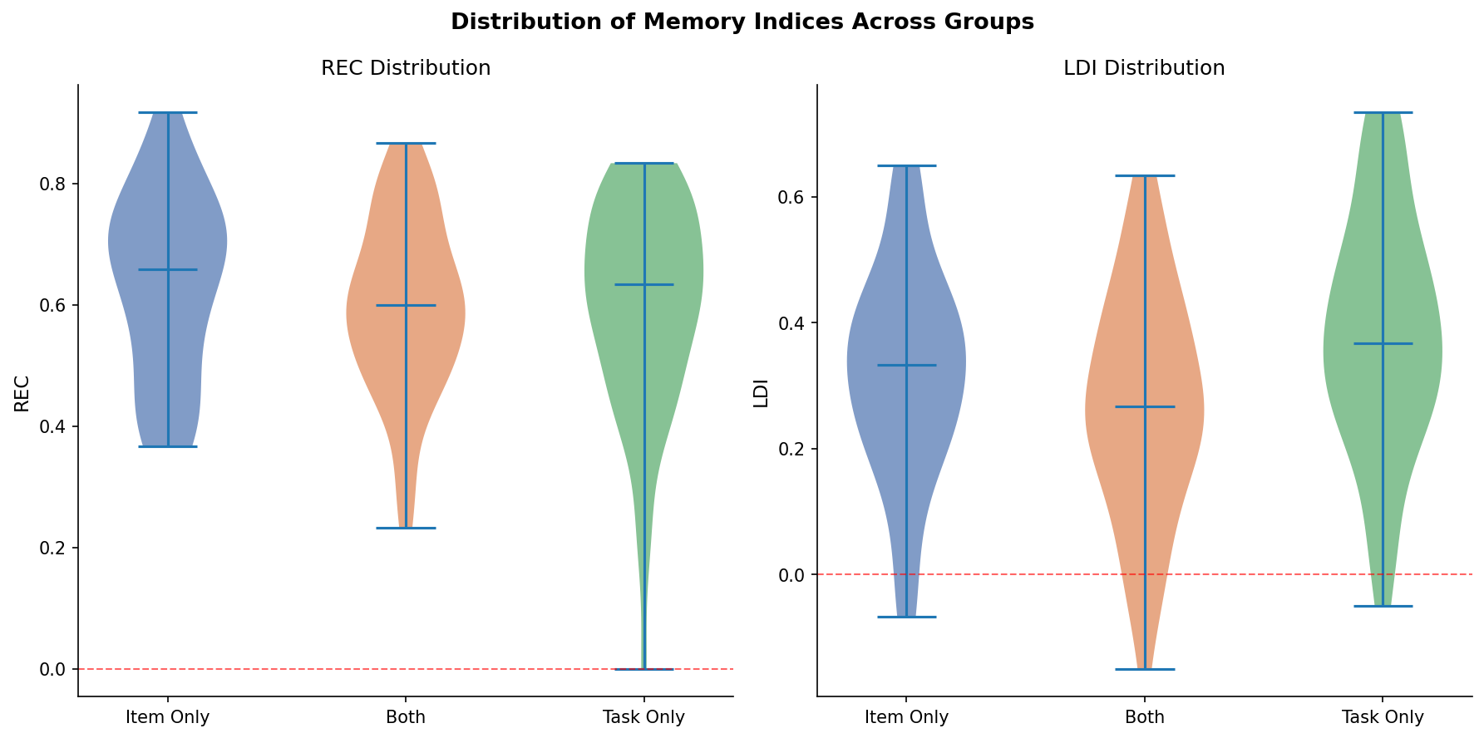
Overall REC and LDI — Descriptive Statistics
All groups show robust memory well above chance
Group | REC M | REC SD | LDI M | LDI SD
Item-Only | 0.634 | 0.153 | 0.319 | 0.169
Task-Only | 0.596 | 0.174 | 0.381 | 0.188
Both | 0.596 | 0.144 | 0.270 | 0.179
Task-Only shows significantly higher LDI than Both (t=−3.08, p=.003)
All groups: REC & LDI >> 0 (all p < .001, d > 1.3)
Fig. Distribution of REC and LDI by group

Slide 13
04 Results
Recognition memory · Lure discrimination · Position effects · Lure bins · RT

Slide 14
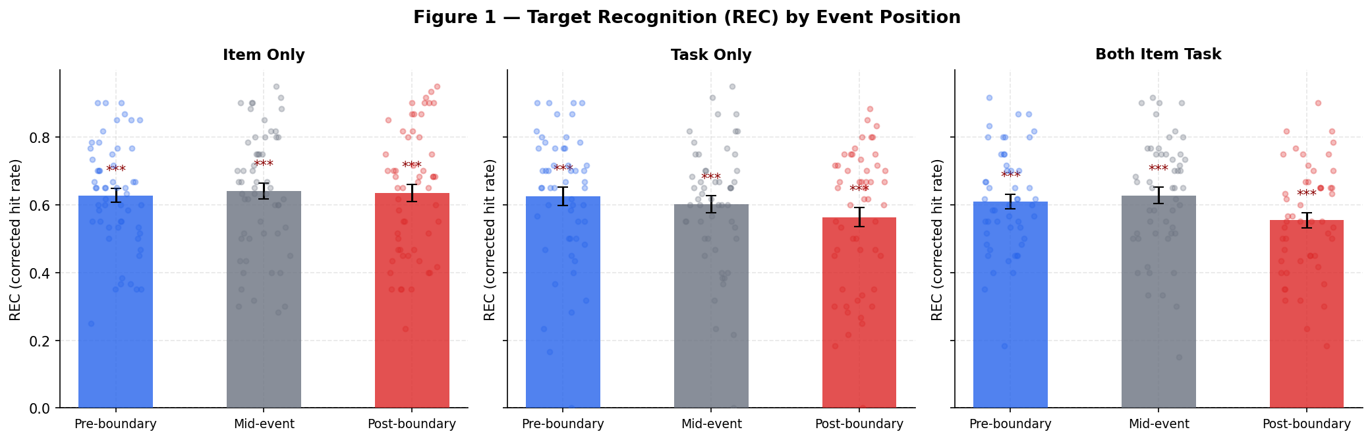
Figure 1 - Target Recognition (REC) by Event Position
All positions show strong recognition; post-boundary shows numerical decrease in Task-Only & Both
Key Stats
Item-Only:
No position effect
F < 0.1, p = .93
Task-Only:
Pre > Post trend
t = 2.69, p = .010
Both:
Mid > Post (sig)
t = 3.48, p = .001

Slide 15
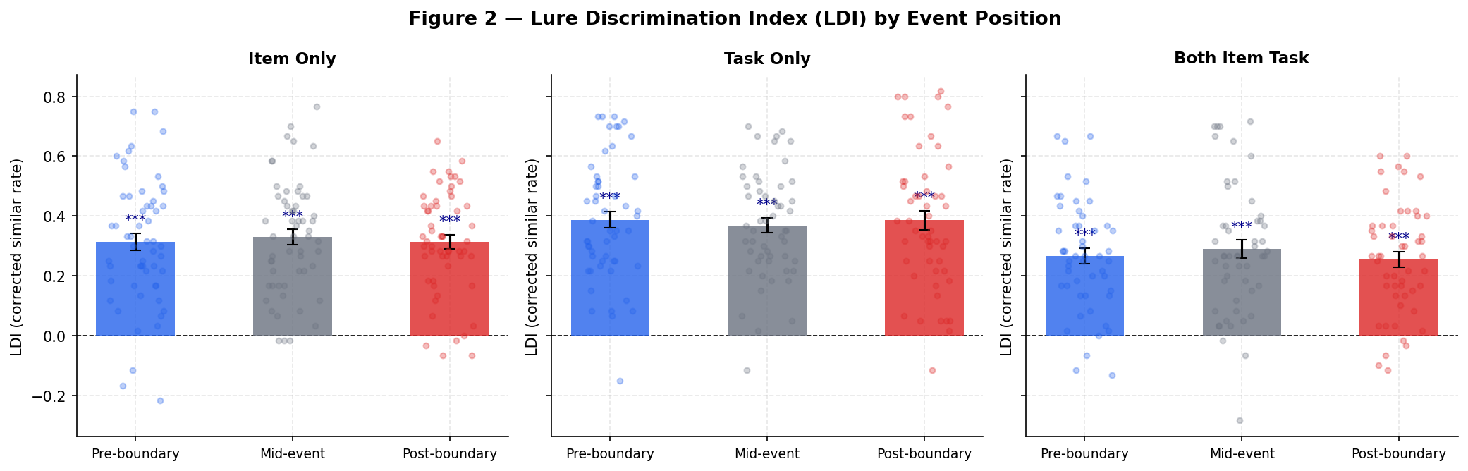
Figure 2 - Lure Discrimination (LDI) by Event Position
Task-Only: balanced across positions; Both: slight post-boundary drop
Key Stats
LDI Pre-Post:
ANOVA across
all groups:
F(2,157)=0.087
p = .917 (ns)
All positions:
LDI >> 0
(d > 1.3)
Task-Only LDI
highest overall

Slide 16
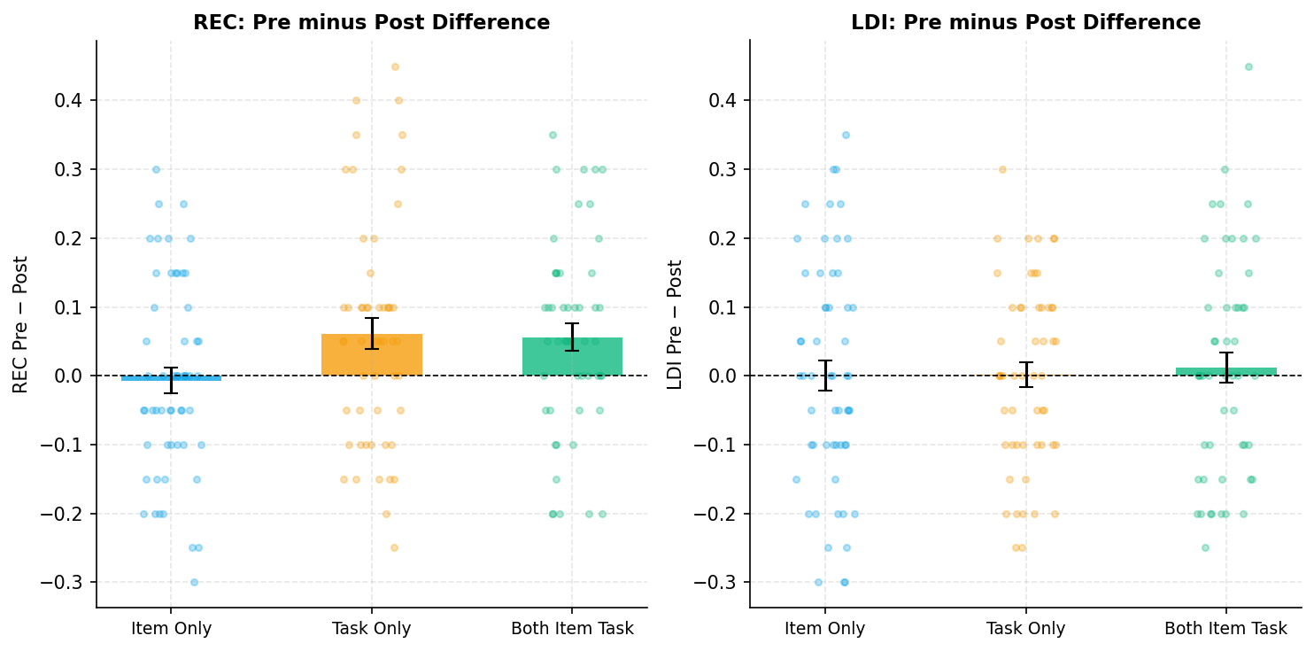
Pre - Post Boundary Effect: REC and LDI
Directional boundary effect on REC in Task-Only and Both; no effect on LDI
Interpretation
REC: Pre > Post
Task-Only: Δ = +0.061, t(52)=2.69, p=.010, d=0.37
Both: Δ = +0.056, t(50)=2.80, p=.007, d=0.39
Item-Only: Δ = −0.007 (ns)
ANOVA across groups:
F(2,157) = 3.52, p = .032
LDI: No position effect
F(2,157) = 0.087, p = .917
Boundary impairs rather than
enhances recognition when
encoding task is present

Slide 17
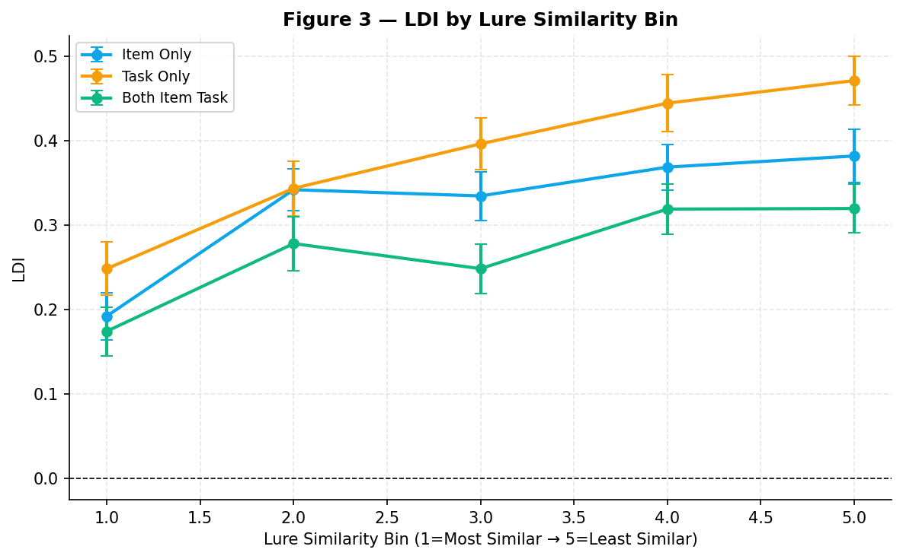
Figure 3 - LDI by Lure Similarity Bin
Monotonic increase confirms graded hippocampal pattern separation — H3
All bins sig. > 0
(BH-FDR corrected)
LDI Bin 1 -> Bin 5:
Item-Only:
0.19 -> 0.38
Task-Only:
0.25 -> 0.47
Both:
0.17 -> 0.32
Task-Only shows
steepest gradient
best discrimination

Slide 18
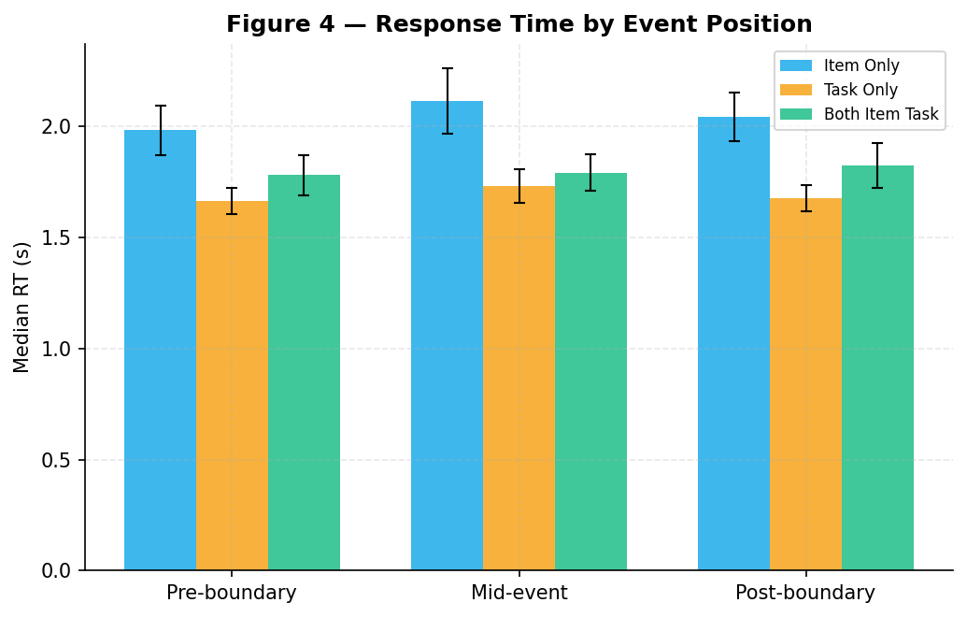
Figure 4 - Response Time by Event Position
Mid-event items elicit longest RTs — consistent with Event Segmentation Theory
RT (median, seconds)
Group | Pre | Mid | Post
Item-Only | 2.00 | 2.13 | 2.05
Task-Only | 1.67 | 1.74 | 1.68
Both | 1.81 | 1.81 | 1.84
EST prediction confirmed:
Mid-event > Pre consistently
across all groups
Longer mid-event RT suggests
greater cognitive engagement
during stable event models

Slide 19
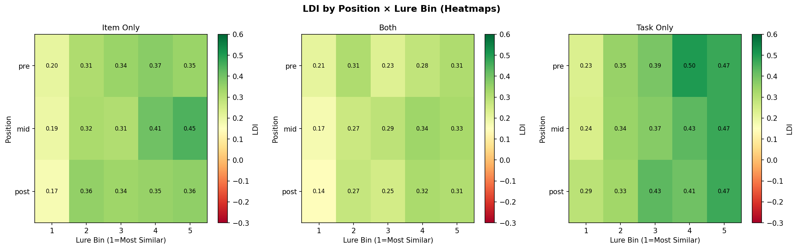
LDI: Position × Lure Bin Interaction
Post-boundary + low similarity = highest discrimination; exploratory finding (H7)
Reading the Heatmap
Green = high LDI
(better pattern separation)
Red = low LDI
(poor discrimination)
Rows = pre/mid/post
Cols = bins 1→5
Pattern: Bin 5 + post
consistently highest
Bin 1 (most similar)
challenges all positions

Slide 20
Between-Group Comparisons — All Statistical Tests
Key finding: Task-Only > Both for LDI (p = .003); no REC differences
Comparison | Metric | t-stat | p-value | Cohen's d | Result
Item-Only vs Both | REC | 1.30 | .195 | 0.25 | ns
Item-Only vs Both | LDI | 1.47 | .146 | 0.28 | ns
Item-Only vs Task-Only | REC | 1.21 | .229 | 0.23 | ns
Item-Only vs Task-Only | LDI | -1.79 | .076 | 0.34 | ns (trend)
Both vs Task-Only | REC | 0.04 | .970 | 0.01 | ns
Both vs Task-Only | LDI | -3.09 | .003 | 0.61 | ** SIGNIFICANT
Bonferroni-corrected α = 0.0125 for confirmatory tests | LDI: Both vs Task-Only significant even after correction

Slide 21
05 Conclusions & Future Directions
Summary of findings and next steps

Slide 22
Conclusions
What we found and what it means
1
Memory above chance (H1)
3
Lure similarity gradient confirmed (H3)
REC (M≈0.61) and LDI (M≈0.32) significantly > 0 in all groups (all p < .001, d > 1.3). Shoebox encoding question produces robust recognition memory.
LDI monotonically increased from Bin 1 → Bin 5 in all groups (all BH-FDR corrected p < .001). Task-Only shows steepest gradient — best fine-grained discrimination.
2
Boundary impairs REC in dual-task groups (H2 partially)
4
Task-Only > Both for LDI (H4 partial)
Pre > Post REC in Task-Only (p=.010) and Both (p=.007). Item-Only showed no boundary effect. Cognitive reset at boundaries may compete with encoding.
Concurrent image viewing during encoding may interfere with item-specific encoding. Task-only semantic processing enhanced pattern separation.

Slide 23
Future Directions
Next steps to deepen understanding of boundary–memory interactions
🔬
🧲
⏰
Increase Statistical Power
Neuroimaging Integration
Delayed Testing
Collect >20 trials per position/bin cell to detect small effects; use mixed-effects logistic regression treating items as random effects
fMRI to measure hippocampal pattern separation signals at event boundaries; EEG for temporal dynamics
24-hour delay test to reveal whether boundaries differentially protect memories during overnight consolidation
🎯
💊
📊
Individual Differences
Clinical Applications
Computational Modeling
Trait anxiety, working memory capacity, and event segmentation ability as moderators of the boundary effect
Test MST boundary manipulation in MCI, depression, and stress cohorts as a sensitive hippocampal biomarker
Bayesian hierarchical models; signal detection theory; computational model of event-driven encoding

Slide 24
References
Kirwan, C. B., & Stark, C. E. L. (2007). Overcoming interference: An fMRI investigation of pattern separation in the medial temporal lobe. Learning & Memory, 14(9), 625–633.
Morse, S. J., et al. (2023). Event boundaries directionally influence item-level recognition memory. Cognition, 234, 105358.
Stark, S. M., & Stark, C. E. L. (2017). Age-related deficits in the mnemonic similarity task for objects and scenes. Behavioural Brain Research, 322, 76–84.
Zacks, J. M., Speer, N. K., Swallow, K. M., Braver, T. S., & Reynolds, J. R. (2007). Event perception: A mind-brain perspective. Psychological Bulletin, 133(2), 273–293.
DuBrow, S., & Davachi, L. (2013). The influence of context boundaries on memory for the sequential order of events. Journal of Experimental Psychology: General, 142(4), 1277–1286.
Baldassano, C., et al. (2017). Discovering event structure in continuous narrative perception and memory. Neuron, 95(3), 709–721.
Benjamini, Y., & Hochberg, Y. (1995). Controlling the false discovery rate: A practical and powerful approach to multiple testing. JRSS-B, 57(1), 289–300.
Cohen, J. (1988). Statistical power analysis for the behavioral sciences (2nd ed.). Lawrence Erlbaum Associates.

Slide 25
Thank You
BRSM 2026 · MST & Event Segmentation Analysis
160
H1
H3
RT
Participants
Memory confirmed
Lure gradient
EST prediction

