Slide 1
AIRLINE PASSENGER SATISFACTION
I215 - Sherlin Retna R

Slide 2
OBJECTIVE
Analysing the AIRLINE PASSENGER SATISFACTION Dataset
to find the satisfaction of the passengers based on factors
Applying Classification models to predict the satisfaction of the
passengers.
Applying Hyperparameter Tuning, to choose the best model

Slide 3
TABLE OF CONTENTS
)00
02
03
04
05
06
FEATURES
EDA
FEATURE ENGINEERING
MODELLING
HYPERPARAMETER TUNING
CHOOSE THE BEST MODEL

Slide 4
01
IMPORTANT FEATURES
103904 ROWS & 25 COLUMNS
Check in Service
On-board Service
Cleanliness
Inflight-Service
Baggage Handling
Ease of Online Booking
Satisfaction
Seat Comfort
Inflight Entertainment

Slide 5
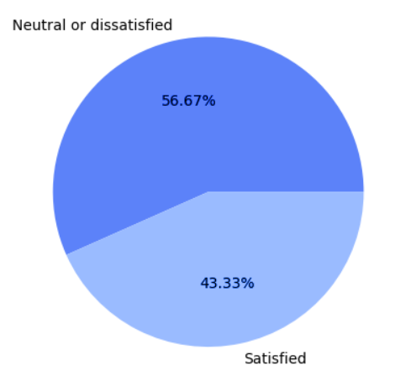
EDA – Univariate & Bivariate analysis
Satisfaction: Target Variable
Satisfied – 43.33%
Neutral & Dissatisfied – 56.67%
Satisfied Rate is lesser than Dissatisfied Rate

Slide 6
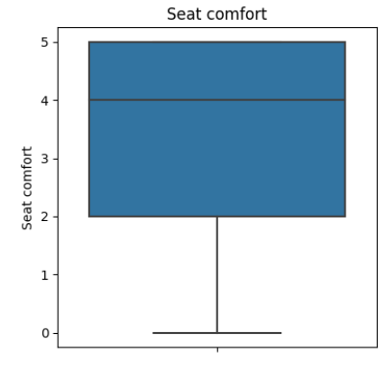
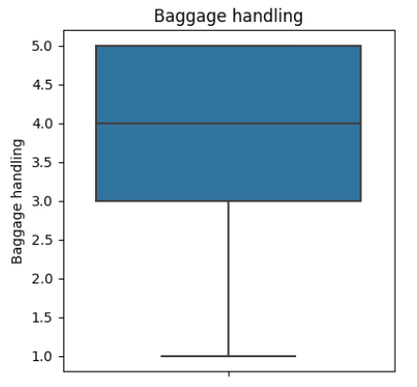
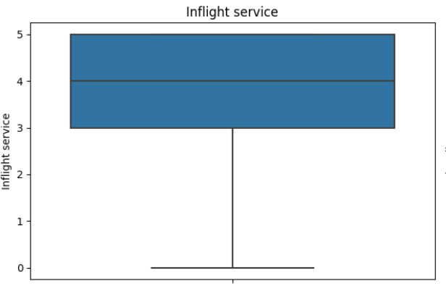
EDA (cont.)
These services have no outliers.

Slide 7
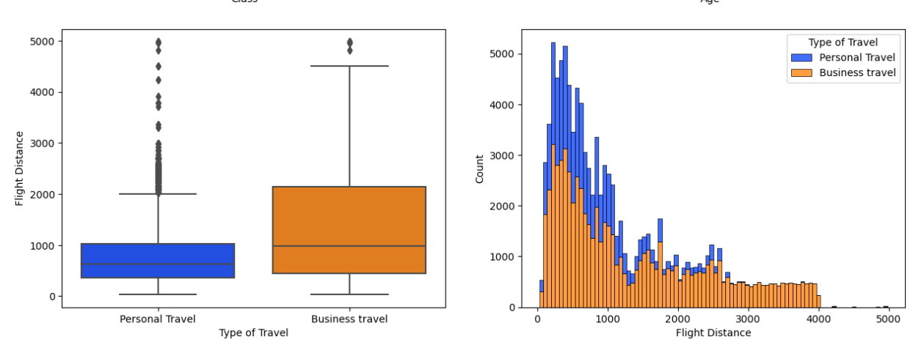
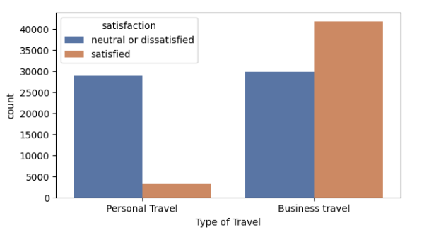
If the distance is more than 1000kms, The purpose of travelling is for Business.
People travelling because of Business are satisfied more than Personal Travel.

Slide 8
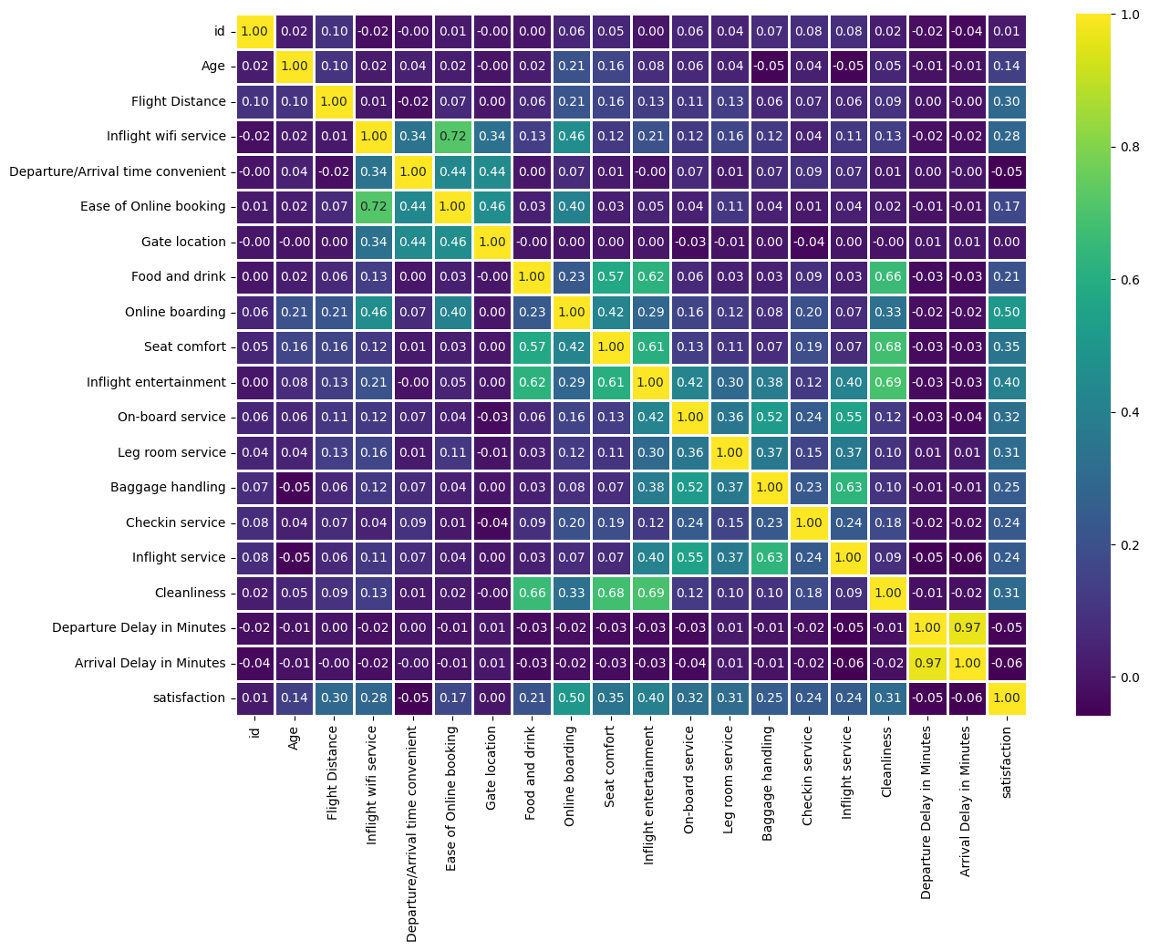

Slide 9
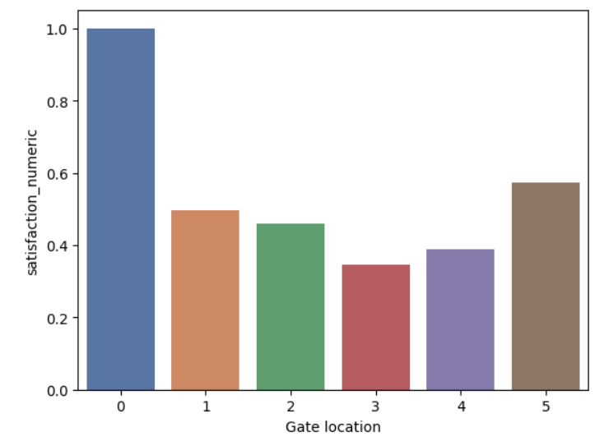
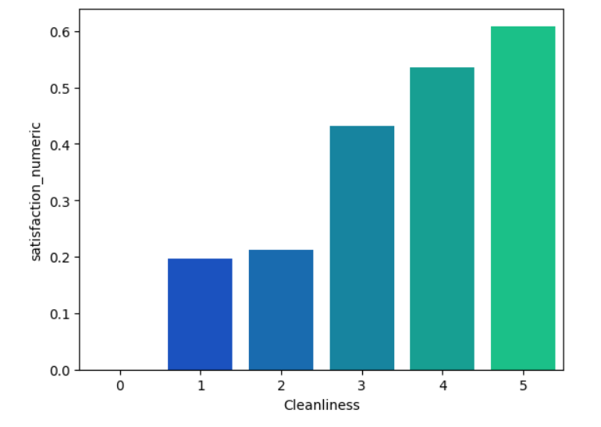
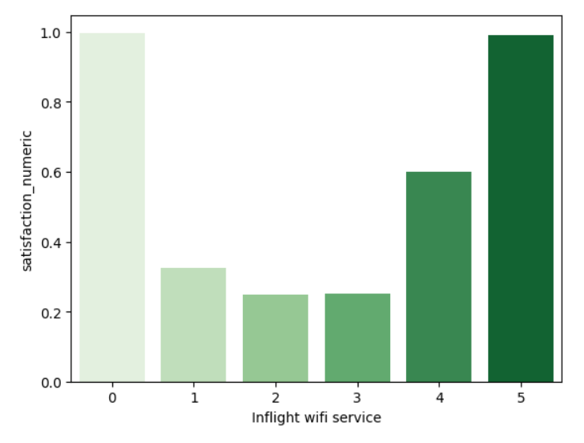
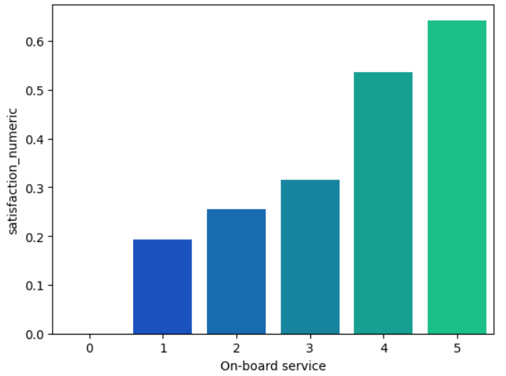
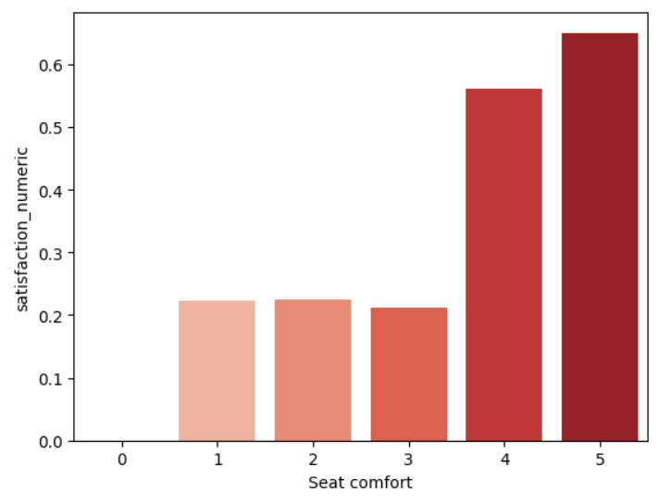
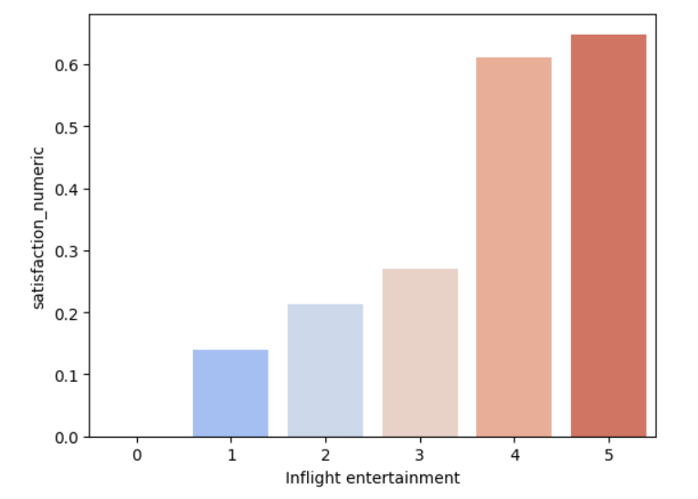

Slide 10
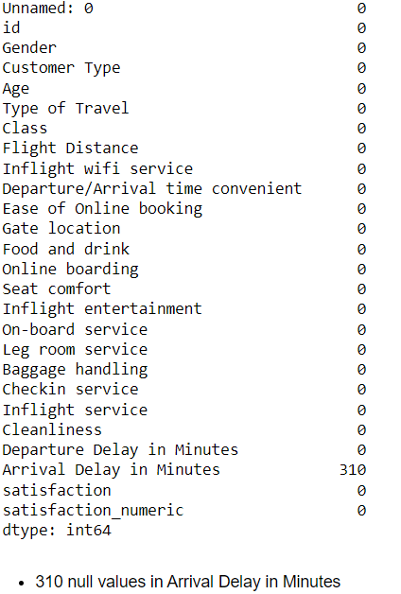
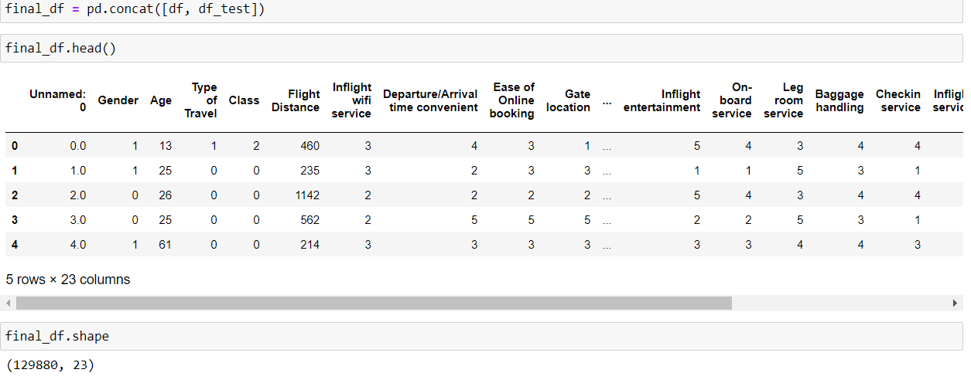
FEATURE ENGINEERING
IDENTIFYING NULL VALUES:
310 NULL values in Arrival Delay in Minutes Column
After concatenating Test & Train datasets, the shape of final_df is 129880, 23

Slide 11
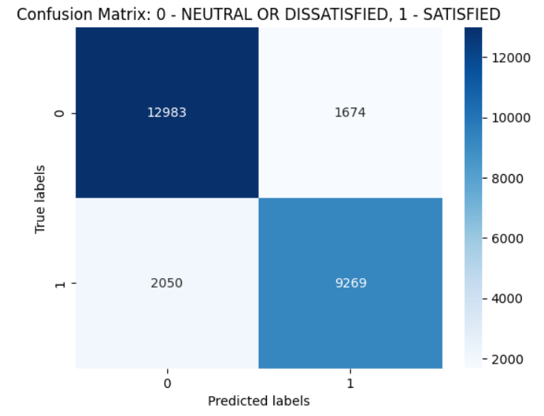
MODEL SELECTION & ACCURACY 1. LOGISTIC REGRESSION
The accuracy score for Logistic Regression is 85.6636%

Slide 12
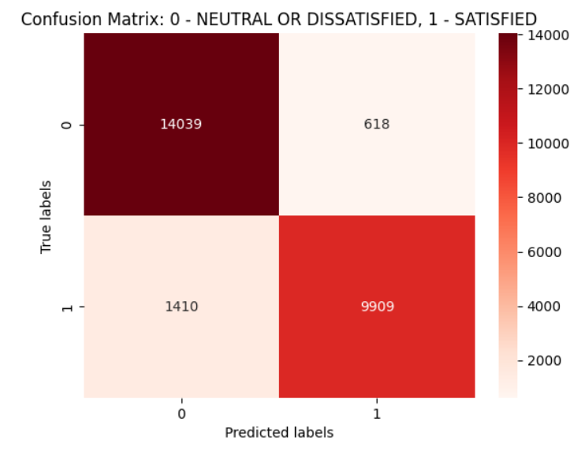
MODEL SELECTION & ACCURACY 2. K-NEAREST NEIGHBORS CLASSIFIER
The accuracy score for K-Nearest Neighbors Classifier is 92.1927%

Slide 13
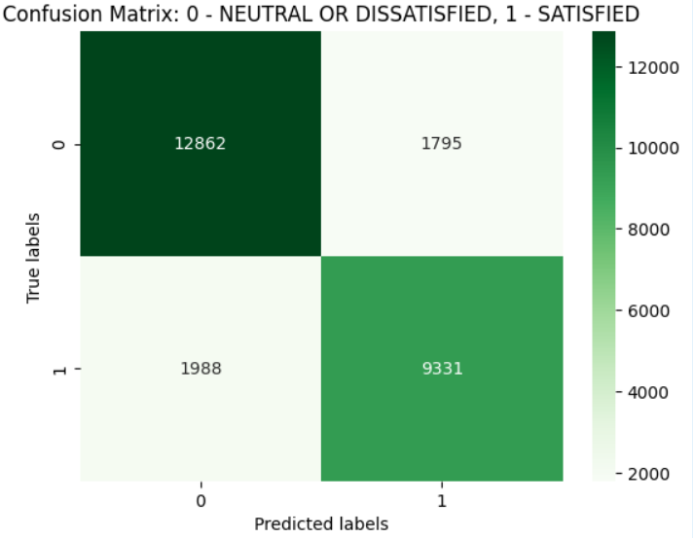
MODEL SELECTION & ACCURACY 3. GAUSSIAN NAÏVE BAYES
The accuracy score for Gaussian Naïve Bayes is 85.4365%

Slide 14
MODEL SELECTION – HYPERPARAMETER TUNING
MODEL | SEARCH TYPE | OPTIMUM K/C | ACCURACY | CROSS-VALIDATION FOLDS
LOGISTIC REGRESSION | GridSearchCV | Best Hyperparameters: {'C': 0.1, 'penalty': 'l1'} Best Score: 0.8574549422528603 | 85.65% | 5
K-NEAREST NEIGHBORS | GridSearchCV | {'n_neighbors': 7} | 92.48% | 5

Slide 15
CONCLUSION
Airlines should highly focus on inflight Wi-Fi experience, Gate location.
Ease of online booking is important for business customers
The best model is K-Nearest Neighbors Classifier with an accuracy of 92.28%.

