Slide 1
FTI PCaaS Project Kickoff
Author : SA Dzoan.Nguyen@rackspace.com
Meeting Date: April 10, 2025 | Time: 09:00 - 11:00 | Format: Hybrid (Online + On-site)
Notes:
ESPG AWS Linux RedHat7 Migration Plan

Slide 2
Kickoff Agenda
Project Team & Roles
Project Phases & Timeline
Scope of Work & Deliverables
OpenStack Cloud Architecture
Governance & Support Model
Communication Plan
Risk & Issue Management
Next Steps
Discussion / Q&A

Slide 3
Project Team
Person/Role | Responsibility | Email | Location / Timezone
Trung (FTI PM) | SPOC for FTI; manages internal coordination, kickoff preparation, timeline follow-up, setup readiness. | trunghd9@fpt.com | Ho Chi Minh City /
Gravius (Rackspace CSM) | Coordinates with Rackspace OpenStack PM and Accounts team; manages billing and solution delivery; not PM. | gavius.khoo@rackspace.com | Singapore / +1h
Huy | Introduced Trung; shared overall project timeline and key milestones. | huytx8@fpt.com | Ho Chi Minh City /
Jenk | Confirmed English as main language; responsible for sharing financial data and group setup. | jenk.balikcioglu@rackspace.com | Australia / +3 h

Slide 4
Project Phases & Deliverables
Phase 1
Procurement & Setup
Phase 2
Architecture Design
Phase 3
Deployment (HN & HCM)
Phase 4
Testing & Validation
Phase 5
Go-Live
Cloud Design Docs
Cloud Design Docs
Infra Reports
Operational Playbooks
Test Cases & Acceptance Docs
Deliverables

Slide 5
Scope of Work
In Scope:
HW procurement & installation (FTI)
Cloud design, security config (Rackspace)
L1-L3 support structure setup
OpenStack deployment (HA, compute, storage, network)
Out of Scope:
Application migration
ServiceNow & VPN system (FTI Internal)

Slide 6
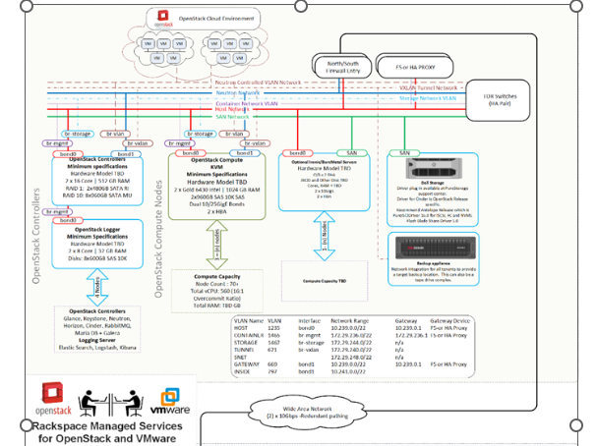
Architecture

Slide 7
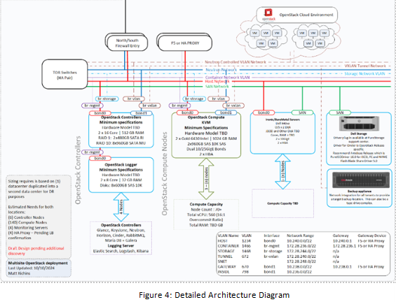
Architecture

Slide 8
Core Platform Components

Slide 9
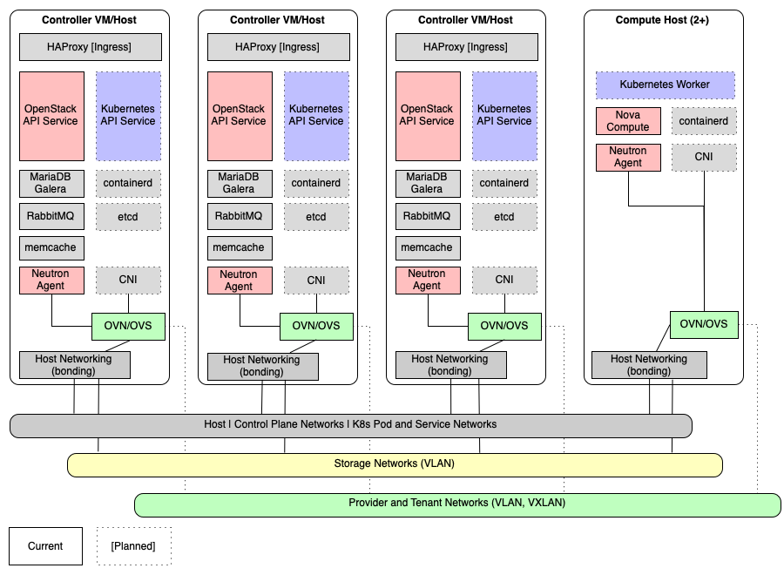
OpenStack Cloud Architecture
HA OpenStack Control Plane
Redundant Control Plane
The OpenStack and Kubernetes API services are deployed active-active while the database is clustered with Galera and accessed active/passive. All services are load-balanced with an included TCP/HTTP load balancer on metal or in a virtualized format for special use cases such as branch locations and smaller clusters.

Slide 10
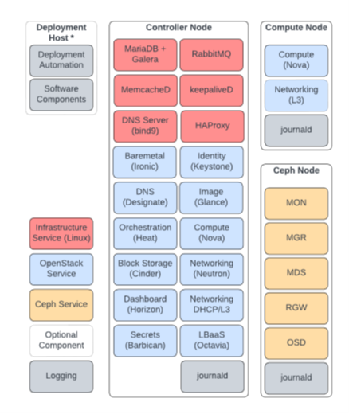
OpenStack Cloud Architecture
The compute node, also known as the hypervisor, utilizes Linux VM CPU-based acceleration and is typically scaled to the desired number.
The standard control plane (2+3 nodes) can manage up to 500 physical hypervisor and in special use cases exceed that limit once the build frequency of virtual machines is determined.
Bare Metal Nodes
OpenStack does allow for the management of physical servers grouped in a bare-metal pool. These servers can be built like virtual machines by using custom flavours in a self-service capacity. End users or operators will be able to provision physical servers, including hypervisors themselves, per the OpenStack project and configure the bare-metal servers into existing networks (VLANs).

Slide 11
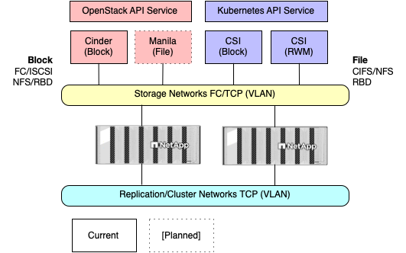
OpenStack Cloud Architecture
Block and File Storage Management
The OpenStack Block Storage API communicates with the physical storage to provision and attach block volumes to virtual machines.

Slide 12
Network and CIDR Requirements
Rackspace-managed OpenStack required infrastructure networks to operate and scale out the cluster. These networks are present for each cluster and isolated in separate VLANs. No cluster shares the same IP space; the non-routed networks can technically be copied for other environments within the same or other data centre, but the general recommendation is to use unique CIDRs per cluster. The CIDR displayed here are listed as examples and are expected to be changed in actual builds. The network mask must be /24 or smaller.
Also if the cluster is implemented in a leaf-spine network model, custom CIDR which as subnet of a super network must be provisioned. These configurations are specialised and require specific network designs, the standard architecture allows only for flat networks.

Slide 13
Identity and Access Management
Keystone, OpenStack’s identity management service, provides centralised authentication and access control, ensuring that users can only access resources they are authorised to use:
Multi-Factor Authentication (MFA): Adds a layer of security for administrative and API access, reducing the risk of unauthorised access.
Federated Identity: Allows integration with existing identity management systems, such as Active Directory, providing seamless access for banking staff.
Role-Based Access Control (RBAC): Ensures that resource access is controlled at a granular level, in alignment with each bank’s security policies.

Slide 14
Governance & Support Model L1/L2: FTI Support Team L3: Rackspace OpenStack Team Weekly reports, escalation matrix defined Daily 15-min standup (GMT+7, 8:00 AM)

Slide 15
Governance & Support Model L1/L2: FTI Support Team L3: Rackspace OpenStack Team Weekly reports, escalation matrix defined Daily 15-min standup (GMT+7, 8:00 AM)

Slide 16

Risk/Issue Management
Risks:
Delivery Delays
Misalignment (Timezone)
Skill Gaps
Security Misconfigurations
Mitigation:
Pre-checks, rollback strategy
Regular syncs
Training sessions

Slide 17
Next Steps
Share kickoff deck
Confirm Go-Live test plan
Assign access to documentation folder
Finalize procurement and infra plan

Slide 18
SUM UP
Project Summary:
Two-site Private Cloud (HN & HCM) led by FTI & Rackspace
OpenStack-based architecture with shared support model
Timely delivery and tight coordination are key to success
Communication, risk management, and readiness planning fully in place
Success depends on:
Clear roles and ownership
Adherence to milestones
Collaboration across time zones
Ongoing feedback and documentation

Slide 19

Q&A
Open floor for questions and clarification. Contacts:
Trung Ho Dac: trunghd9@fpt.com
Gravius Khoo: gravius.khoo@rackspace.com

