Slide 1
Presentation
Food Delivery

Slide 2
Introduction
What is Food Delivery?
Delivering or serving food at different place or in- place by taking orders from customers.
What is our goal with Food Delivery?
We want to create a suitable program design based on practical food delivery system to convert it into digital form.

Slide 3
Description
Our goal
Creating digital program of a food delivery system
Motivation
Nowadays everything operated by software based marketing system

Slide 4
Program Description
Storing all foods in the link list
Taking price, food quantity and stock information as input data
Providing customer information about stored food
Taking order from customer
Searching customer’s demand in food list
Serving food
Taking Bill
Waiting for next order.

Slide 5
mystore
Food store
Linked list
Variables
Name
Price
Amount
Function
storeFoodList()
searchTheFood()
displaymystore()
servingCustomer()
myearning()
Object of
Food
Stack
Of
Desired food
POP OUT Request
Customer
Request
Queue
Name of customer
How many food !

Slide 6
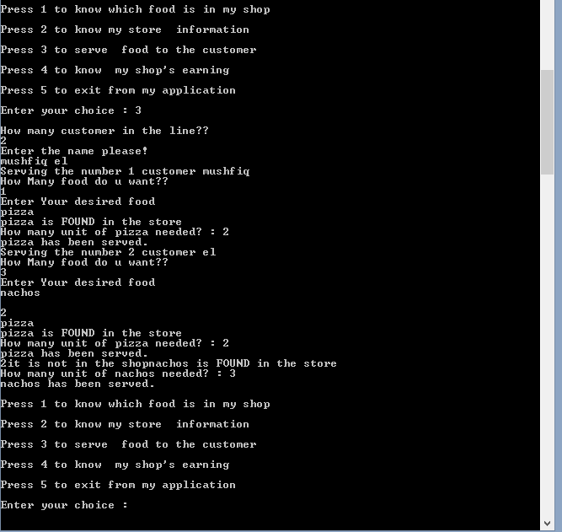
Output Example

Slide 7
Additional possible systems
Counting daily orders
Counting total earning everyday
Storing new food items
Discount offers for customer
Time count for taking each order
Any delivery notice announcement
Membership counting
Taking order for Home service
Building system with multiple operators

Slide 8
Our Decision and Observation
We tried our best to create a user based food delivery storage system.
Our system has very good and detail information process.
For our criteria and service limitation, it is possible to build a more complex and wide area based program depending on ours one.
We used link list, Stack, Queue, Structure, Switch, function and other necessary codes to complete our project.
We tried to encourage others to research and find programming solution on these criteria. We also encourage others to give us proper suggestions and support doing more for our hard work.
Thank You All

