Slide 1
Deep Multi-scale Convolutional Neural Network for Dynamic Scene Deblurring
物联网工程学院
171619020056 赵灵霄

Slide 2
Blur model
B = KS + n
B:vectorized blurry image K:sparse matrix contains local blur kernels
S:latent sharp image
N:noise

Slide 3
Problems for estimating kernels
Difficult to model complex cases
Subtle and sensitive to noise and saturation
Require huge amount of memory and computation

Slide 4
Solution
new realistic blurry image dataset
multi-scale CNN without blur kernel model
multi-scale loss training

Slide 5
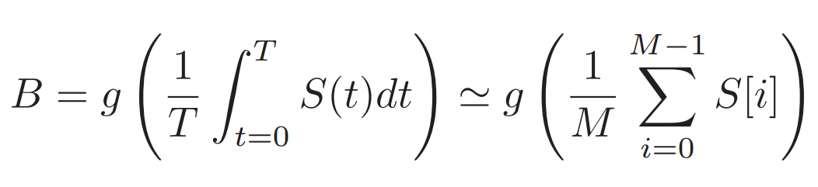
Blur Dataset
T: exposure time
S(t): sensor signal of a sharp image at time t
M: number of sampled frames
S(i): i-th sharp frame
g: camera reflecting function(GRF)

Slide 6
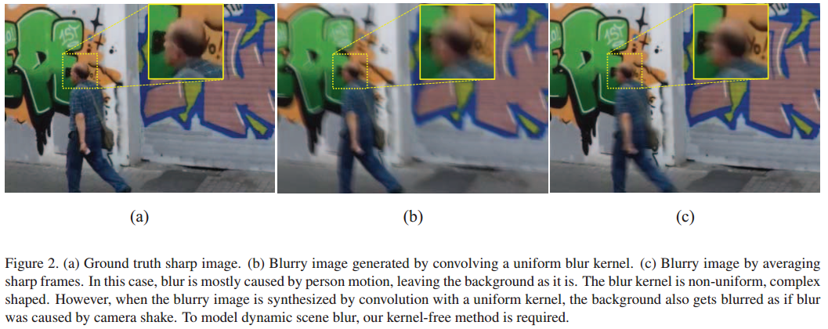

Slide 7
Model
Multi-scales architecture
Modified residual network structure

Slide 8
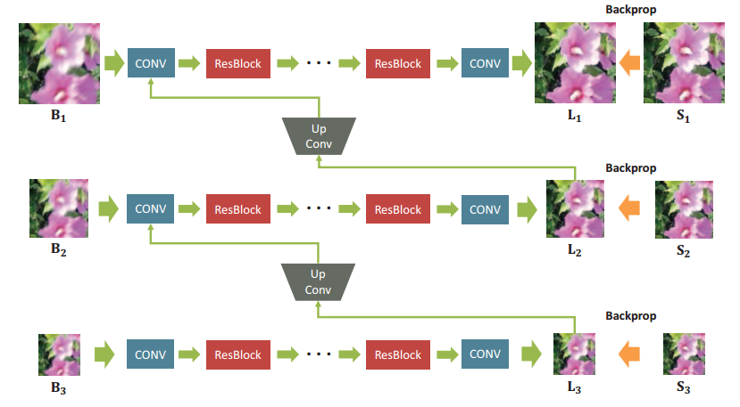

Slide 9
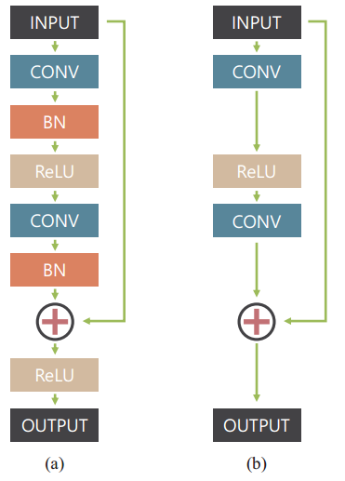
Batch normalization layers and rectified linear unit has been removed.

Slide 10



Loss function
Content loss
Adversarial loss
Final loss

