Slide 1

8th
Jan.
模式识别与智能系统
171307030007
2017 ICCV
刘仁春
Multi-scale Deep Learning Architectures for Person Re-identification
@Xuelin Qian，Yanwei Fu，Yu-Gang Jiang，Tao Xiang，Xiangyang Xue
上海市智能信息处理重点实验室（复旦大学计算机科学学院）/复旦大学数学科学学院/腾讯AI实验室/伦敦大学玛丽皇后学院/悉尼科技大学

Slide 2
1
Part Ⅰ
Introduction

Slide 3
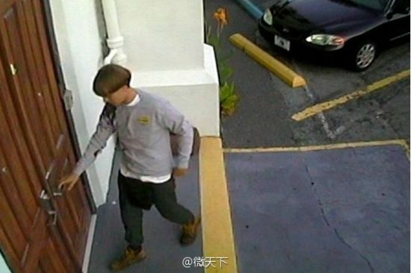
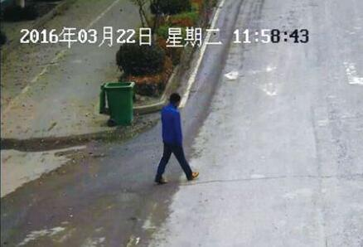
1
problem
Person re-identification
VS
Same / Different?

Slide 4
1
limitation
match people at a single scale
multi-scale discriminative feature learning

Slide 5
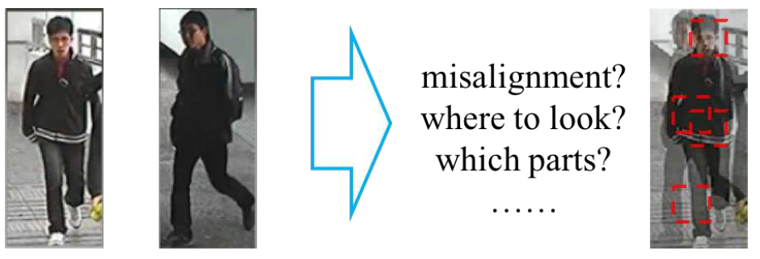
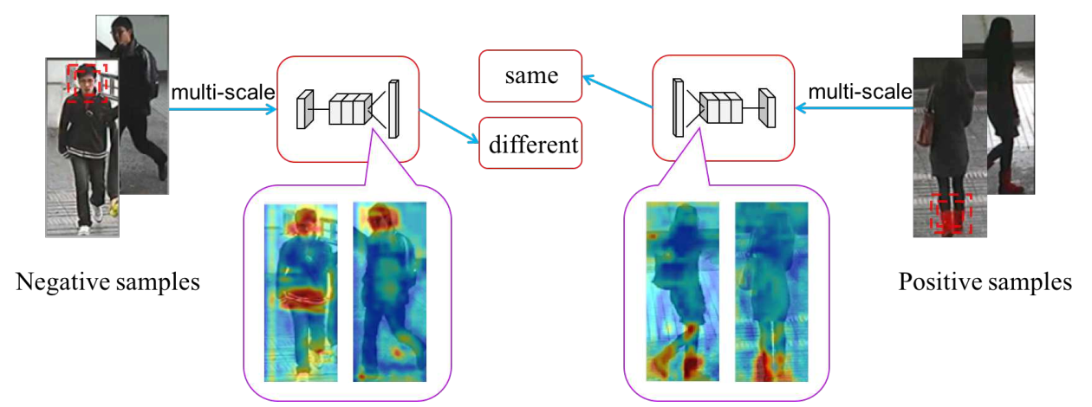
1
multi-scale
A
B

Slide 6
2
Part Ⅱ
Multi-scale Deep Architecture (MuDeep)

Slide 7
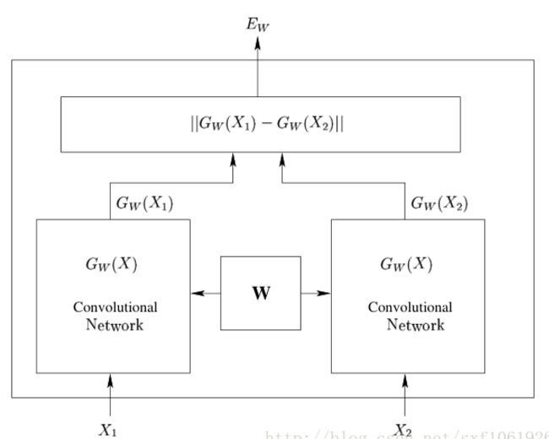
2
basis
Siamese Network

Slide 8
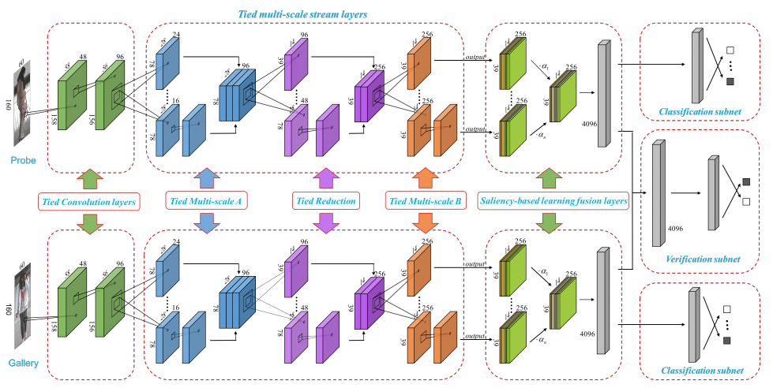
2
Core
a
b
Overview of MuDeep architecture

Slide 9
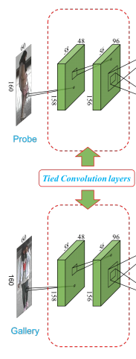
2
CNN
48@3 × 3 × 3 (C-filters)
96@3 × 3 × 48 (C-filter)
1@3 × 3 × 96 (M-filter)
reduce both length and width by half

Slide 10
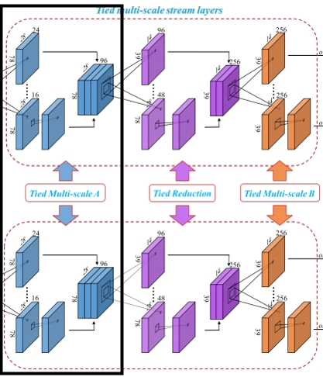
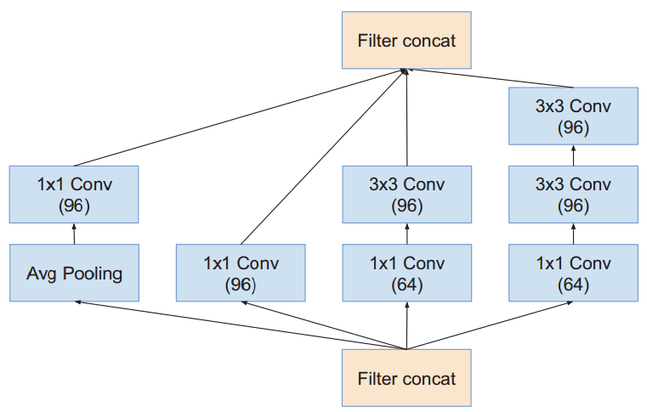
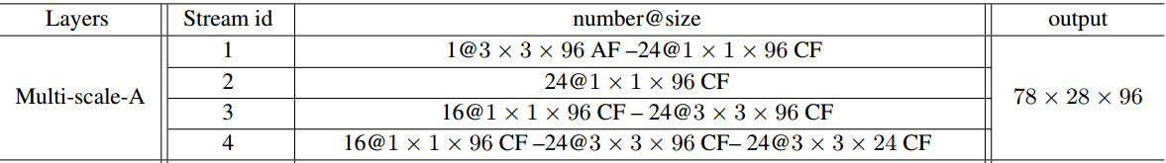
2
M-scaleA
B1
A1
C1

Slide 11
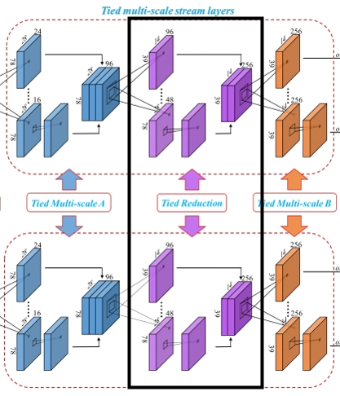
2
reduction
Reduction (avoid representational bottlenecks)
VS
Max-pooling(decrease feature map size)
A2
C2

Slide 12
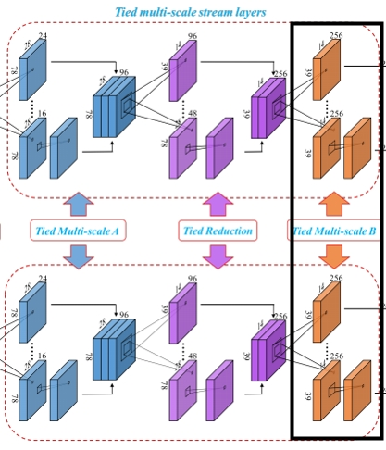
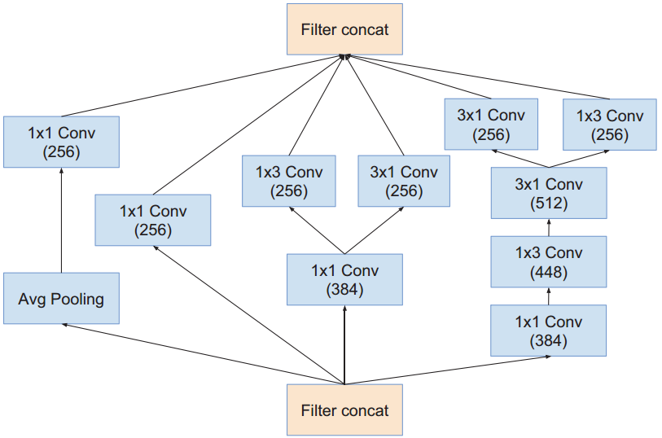
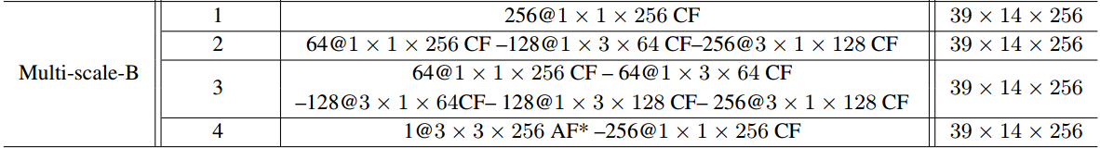
2
M-scaleB
B3
A3
C3

Slide 13
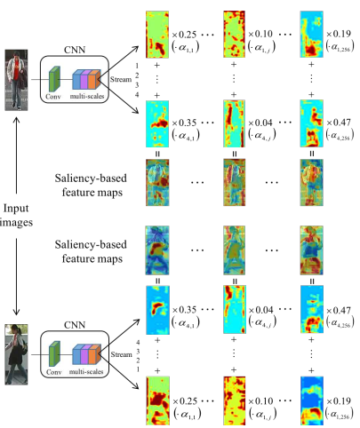
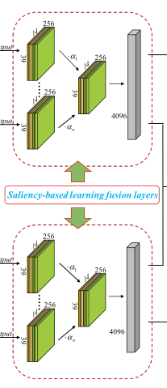

2
Saliency
i-stream，j-channel

Slide 14
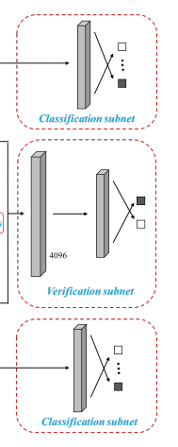
2
C-V
Classification
Verification
Classification

Slide 15
2
Core2
a
b
Overview of MuDeep architecture2

Slide 16
3
Part Ⅲ
Experiments & Contributions

Slide 17
3
experiment
Datasets
Setting
CUHK03
CUHK01
iLIDS-VID
PRID-2011
VIPeR
……
Jointly
Clusively

Slide 18
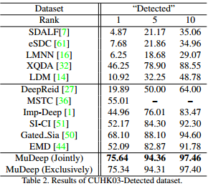
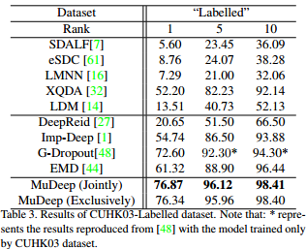
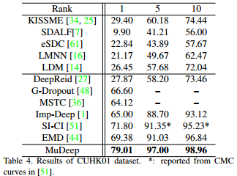
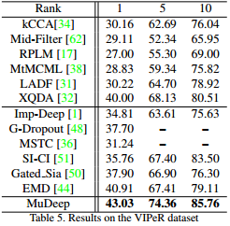
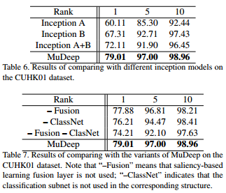
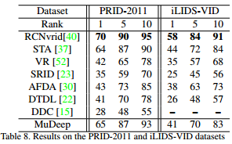
3
results
state-of-the-art
state-of-the-art
state-of-the-art
state-of-the-art
state-of-the-art
state-of-the-art

Slide 19

3
contribution
A novel multi-scale representation learning architecture is introduced into the deep learning architectures for person re-id tasks.
We propose a saliency-based learning fusion layer which can learn to weight important scales in the data streams in a saliency-based learning strategy

Slide 20
8th
Jan.
Thanks！
The End

