Slide 1
To Stay or to Leave: Churn Prediction for Urban Migrants in the Initial Period
Yang Yang¹, Zongtao Liu¹, Chenhao Tan², Fei Wu¹, Yueting Zhuang¹, Yafeng Li³
¹Zhejiang University
²University of Colorado Boulder
³China Telecom
Notes:
Here we present our work To [Stay] of to [Leave], [Churn] prediction for Urban Migrants in the initial Period
I am Zongtao Liu from Zhejiang University. This is a joint work with my advisor Yang, Chenhao from Boulder, Fei and Yueting who are also from Zhejiang University, and Yafeng from China Telecom.

Slide 2
Urban Migrants
In China, 260 million people migrate to cities to realize their urban dreams.
Urban migrants also pose great challenges including segregation and social inequality.
Understanding migrant integration helps policymakers with urban planning.
We conduct quantitative explorations of migrant integration based on mobile communication networks.
Notes:
A series of work
Millions of migrants come to cities to pursue their [urban dream]. Taking China as an example, there are over 260 million migrants, who have become a very important group in the cities. Migrants make great contribution to the prosperity of cities. They constitute a major part of the workforce, strength the political and economic status of the cities and bring [diverse] cultures. However, the fast rate of migration also poses great [challenges] such as [segregation] and social inequality. For instance, migrants may settle in slums with health hazards and they tend to be overworked but underpaid. To address these challenges, we aim to quantify and understanding the process of migrant integration, which can help policymakers with urban planning.
In this work, We conduct quantitative explorations of migrant integration based on mobile communication networks.

Slide 3
Telecommunication Metadata
One-month complete call data in Shanghai
born in
698M+ call logs and
54M+ users provided by China Telecom¹
born in
born in
China Telecom Corporation is a Chinese state-owned telecommunication company and the third largest mobile service providers in China.
Notes:
To be more specifically, our work is based on a dataset provided by China telecom .For more detail, we employ a one month complete telecommunication metadata in Shanghai, an International City. !! In total, we have 698M call logs with 54 million users. In addition, for each calling logs, we have its corresponding GPS location.
From this data, we extract a telecommunication network, where each vertex indicates a user, and we create a undirected link between two users if there is at least one call between them.
For each user, we have his or her demographical information, and the city where he or she was born.
Using this data, we can build a telecommunication networks to study how individuals build new connections and keep relationships in the first few weeks after moving to a new city.
Here is an example of an ego-network centered by a certain user. We study characteristics of a user and his friends such as demographics, birthplaces, and connections to other people

Slide 4
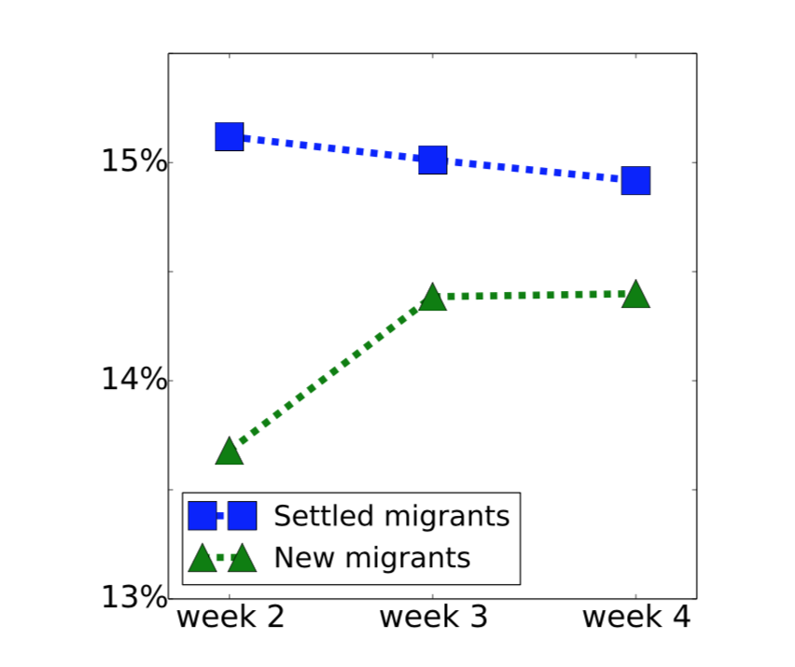
Integration and Disintegration
Migrant Integration
We observe an increasing trend for new migrants misclassified as locals over the three weeks .¹
Fraction of migrants classified as locals.
Yang Yang, Chenhao Tan, Zongtao Liu, Fei Wu, and Yueting Zhuang. Urban Dreams of Migrant: A Case Study of Migrant Integration in Shanghai. AAAI’18.
Notes:
In our previous study, we construct an interesting experiment. Given by a user’s behavior pattern, we learn a classifier to determine if the user is a local or a migrant. We observed an increasing trend for new migrants misclassified as locals over the three weeks , suggesting that they become more similar to locals over time.

Slide 5
Integration and Disintegration
Migrant Integration
We observe an increasing trend for new migrants misclassified as locals over the three weeks .¹⁻
Departure of New Migrants
Around 4% of new migrants ended up leaving early.
To Stay or to leave?
Initial period of a migrant’s integration process in Shanghai
A migrant’s first step -> Eventual integration
Yang Yang, Chenhao Tan, Zongtao Liu, Fei Wu, and Yueting Zhuang. Urban Dreams of Migrant: A Case Study of Migrant Integration in Shanghai. AAAI’18.
Notes:
Although many migrants [succeed] to integrate into cities , some of them [fail] to settle down and eventually leave the city. Our data shows that around 4% of new migrants ended up leaving early.
A natural question arise here is: how the initial period of a migrant’s integration influences her final decision to leave the city or not?
To answer the question why some migrants choose to stay or to leave, we use Shanghai as an example to investigate how migrants’ [behavior] in their first weeks relates to early departure. In this paper, we focus on the initial period of a migrant’s inte- gration process because a migrant’s first steps are important for her eventual integration
We explore the factors that cause the eventual departure of some migrants.

Slide 6
How Many Migrants are Leaving in the First Weeks?
Based on people’s birthplaces and call history, we define locals and new migrants:
Locals: who were born in Shanghai
New migrants: who were not born in Shanghai and had no call logs in the first 4 days in our dataset
Notes:
Based on people’s birthplaces and call history, we then define different groups of people. We refer to people who were born in Shanghai as locals. We consider people who were not born in Shanghai and had no call logs in the first 4 days in our dataset as new migrants. To answer the question how many new migrants are leaving in the first weeks, we identify new migrants that ended up leaving Shanghai early, that is, before the last week in our dataset. To make sure that people did not leave temporarily, we omit the last 5 days’ data for all users as the National Day holidays were close to that time, which may lead to temporal travel. That is, the last week in our datasets is from Sep 19 to sep 25. We consider new migrants as leaving migrants if they were active in the rest two weeks and have no record since Sep. 19, and as staying migrants if they were active in all the three weeks.
By our definition, we have 180M locals, 34K staying migrants and 1.5K leaving migrants.

Slide 7
How Many Migrants are Leaving in the First Weeks?
Based on people’s birthplaces and call history, we define locals and new migrants:
Locals: who were born in Shanghai
New migrants: who were not born in Shanghai and had no call logs in the first 4 days in our dataset
Notes:
Based on people’s birthplaces and call history, we then define different groups of people. We refer to people who were born in Shanghai as locals. We consider people who were not born in Shanghai and had no call logs in the first 4 days in our dataset as new migrants. To answer the question how many new migrants are leaving in the first weeks, we identify new migrants that ended up leaving Shanghai early, that is, before the last week in our dataset. To make sure that people did not leave temporarily, we omit the last 5 days’ data for all users as the National Day holidays were close to that time, which may lead to temporal travel. That is, the last week in our datasets is from Sep 19 to sep 25. We consider new migrants as leaving migrants if they were active in the rest two weeks and have no record since Sep. 19, and as staying migrants if they were active in all the three weeks.
By our definition, we have 180M locals, 34K staying migrants and 1.5K leaving migrants.

Slide 8
How Many Migrants are Leaving in the First Weeks?
Based on people’s birthplaces and call history, we define locals and new migrants:
Locals: who were born in Shanghai
New migrants: who were not born in Shanghai and had no call logs in the first 4 days in our dataset
Notes:
动画改 sensitive data，rebuttal encourage other to try more days.
Based on people’s birthplaces and call history, we then define different groups of people. We refer to people who were born in Shanghai as locals. We consider people who were not born in Shanghai and had no call logs in the first 4 days in our dataset as new migrants. To answer the question how many new migrants are leaving in the first weeks, we identify new migrants that ended up leaving Shanghai early, that is, before the last week in our dataset. To make sure that people did not leave temporarily, we omit the last 5 days’ data for all users as the National Day holidays were close to that time, which may lead to temporal travel. That is, the last week in our datasets is from Sep 19 to sep 25. We consider new migrants as leaving migrants if they were active in the rest two weeks and have no record since Sep. 19, and as staying migrants if they were active in all the three weeks.
By our definition, we have 180M locals, 34K staying migrants and 1.5K leaving migrants.

Slide 9
How Many Migrants are Leaving in the First Weeks?
Based on people’s birthplaces and call history, we define locals and new migrants:
Locals: who were born in Shanghai
New migrants: who were not born in Shanghai and had no call logs in the first 4 days in our dataset
Notes:
动画改 sensitive data，rebuttal encourage other to try more days.
Based on people’s birthplaces and call history, we then define different groups of people. We refer to people who were born in Shanghai as locals. We consider people who were not born in Shanghai and had no call logs in the first 4 days in our dataset as new migrants. To answer the question how many new migrants are leaving in the first weeks, we identify new migrants that ended up leaving Shanghai early, that is, before the last week in our dataset. To make sure that people did not leave temporarily, we omit the last 5 days’ data for all users as the National Day holidays were close to that time, which may lead to temporal travel. That is, the last week in our datasets is from Sep 19 to sep 25. We consider new migrants as leaving migrants if they were active in the rest two weeks and have no record since Sep. 19, and as staying migrants if they were active in all the three weeks.
By our definition, we have 180M locals, 34K staying migrants and 1.5K leaving migrants.

Slide 10
How Many Migrants are Leaving in the First Weeks?
Based on people’s birthplaces and call history, we define locals and new migrants:
Locals: who were born in Shanghai
New migrants: who were not born in Shanghai and had no call logs in the first 4 days in our dataset
1.8M locals, 34K staying migrants and 1.5K leaving migrants.
Notes:
动画改 sensitive data，rebuttal encourage other to try more days.
Based on people’s birthplaces and call history, we then define different groups of people. We refer to people who were born in Shanghai as locals. We consider people who were not born in Shanghai and had no call logs in the first 4 days in our dataset as new migrants. To answer the question how many new migrants are leaving in the first weeks, we identify new migrants that ended up leaving Shanghai early, that is, before the last week in our dataset. To make sure that people did not leave temporarily, we omit the last 5 days’ data for all users as the National Day holidays were close to that time, which may lead to temporal travel. That is, the last week in our datasets is from Sep 19 to sep 25. We consider new migrants as leaving migrants if they were active in the rest two weeks and have no record since Sep. 19, and as staying migrants if they were active in all the three weeks.
By our definition, we have 180M locals, 34K staying migrants and 1.5K leaving migrants.

Slide 11
The (Dis)integretion of Migrants
Q1: What kind of people tend to start with a less dense group? Leaving migrants or staying migrants?
Notes:
Here I prepare some questions for you
Based on our experience setup, we examine a lot of features and find some interesting dynamic patterns. Let me ask you the first question: What kind of people do you think may tend to start from a less dense group? Leaving migrants or staying migrants?

Slide 12
Leaving migrants start with a denser group
Q1: What kind of people tend to start with a less dense group? Leaving migrants or staying migrants?
clustering coefficient: the fraction of triangles in the ego-network and indicates how likely a person’s contacts know each other
Notes:
The answer is leaving migrants tend to start from a denser group. We use clustering coefficient to measure how likely a person’s contacts know each other, and we see that leaving migrants present the largest clustering coefficient.

Slide 13
The (Dis)integretion of Migrants
Q2: What kind of people tend to have less diverse connections? Leaving migrants or staying migrants?
Notes:
The second question: which group do you think tend to have less diverse connections?

Slide 14
Leaving migrants tend to have less diverse connections
Q2: What kind of people tend to have less diverse connections? Leaving migrants or staying migrants?
townsman: the fraction of v ’s contacts born in the same province
province diversity: entropy of the distribution of birth provinces among v ’s contacts
communication diversity: Shannon entropy of the distribution of the number
of calls to their contacts
Notes:
By studying three features which are related to the diversity of users‘ connection, fraction of townspeople, diversity of people’s hometown and diversity of one’s social behavior, The results of these three features are very consistent, and show that new migrants with less diverse contacts tend to leave the city.

Slide 15
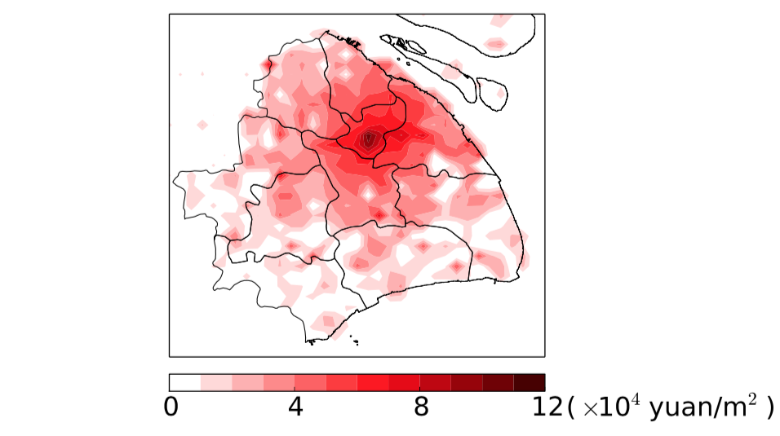
The (Dis)integretion of Migrants
Q3: What kinds of people tend to be active at more expensive area? Leaving migrants or staying migrants?
(a) Housing price distribution in Shanghai
Notes:
Economic theory suggests that individual migration depends on housing prices in different areas. To further study this, we collect housing price in Shanghai. We can know from the figure that the housing price in Shanghai spreads a wide range. We examine some features related to this factor, so the last question is: What kinds of people tend to be active at more expensive area?

Slide 16
Leaving migrants tend to stay in most expensive area
Q3: What kinds of people tend to be active at more expensive area? Leaving migrants or staying migrants?
(a) Housing price distribution in Shanghai
(b) Avg. housing price of users’ active areas.
Notes:
Surprisingly, we find that locals tend to be active in the least expensive areas, while leaving migrants stay in the most expensive places. One explanation is that a new migrant may leave Shanghai early because she fails to find a place with a reasonable renting price.

Slide 17
The (Dis)integretion of Migrants
Feature sets:
Ego network properties
Call behavior
Geographical patterns
Housing price information
Notes:
We also examine some other features, and split them into 4 feature sets: ego network properties, call behavior, geographical patterns and housing price information. If you are interested in these features, you can refer to our paper.

Slide 18
Classification Tasks
New Migrants (35K) vs. Locals (1.7M)
Leaving Migrants (1.4K) vs. Staying Migrants(34K)
leaving migrant?
new migrant?
Mobile networks，user v
staying migrant?
local?
Task 1
Task 2
Notes:
Given the constructed mobile networks and a certain user, our first task is to predict, our second task
Having established the dynamic patterns of single features, we explore to what extent locals, staying migrants, and leaving mi- grants are separable based on our proposed features. As these three groups of people have very different population sizes, we set up two prediction tasks. We rst propose a binary classi cation task to predict if an individual is a local or a new migrant, and then work on distinguishing leaving migrants from staying migrants

Slide 19
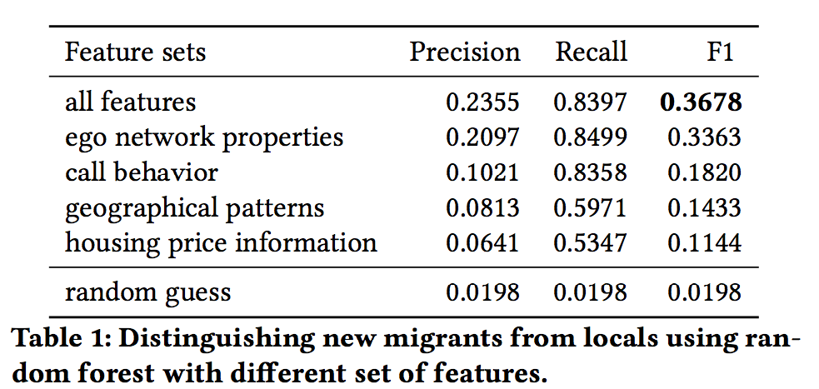
New Migrants from Locals
New Migrants(35K) vs. Locals(1.7M)
Classifier: random forest
5-fold cross-validation
Notes:
Our first binary classification task is to distinguish new migrants from locals. We conduct 5-fold cross-validation and use the minority class,the new migrants, as the target class.
This table demonstrates the results of random forest in this task. Our method is able to outperform the random baseline signi cantly with an F1 of 0.36

Slide 20
New Migrants from Locals
New Migrants(35K) vs. Locals(1.7M)
Classifier: random forest
5-fold cross-validation
Notes:
We further compare the effectiveness of different feature sets, we training a classiffer with a single feature set. The result shows that using every singe feature set outperforms random guessing. Ego network properties performs the best, followed by call behavior pattern.

Slide 21
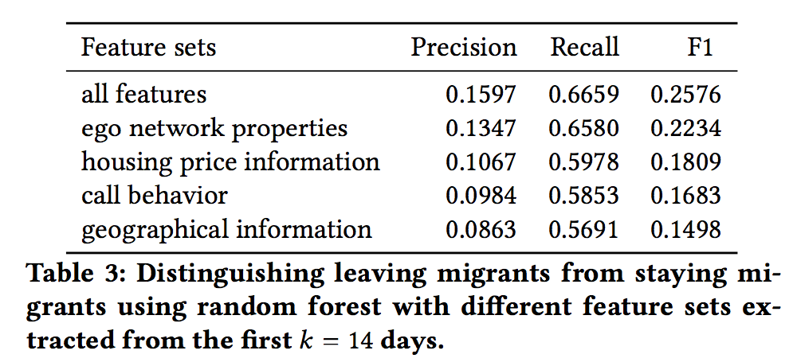
Churn prediction problem
Leaving Migrants(1.4K) vs. Staying Migrants(34K)
Classifier: random forest
5-fold cross-validation
Notes:
The second one is our churn prediction task, we use the same setting to distinguish leaving migrants from staying migrants. Again, ego network properties perform the best. Surprisingly, we find housing price features achieve a better F1- score than geographical patterns, which suggests that knowing meta information such as housing price of a person’s active areas is more useful than simply knowing the active areas for predicting migrants’ early departure.

Slide 22
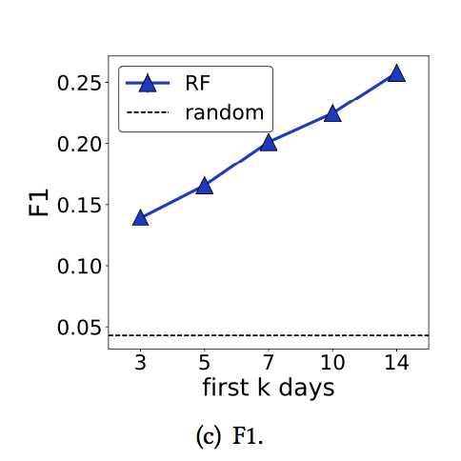
Churn prediction problem
Early detection of leaving migrant
Is it possible to detect leaving migrants sooner than two weeks?
If so, we may be able to provide integration service.
We extract features based on one’s information from the first k days.
Notes:
天数越多，准确性提高 一句话概括
We also find that by using features from more days , the classifier can better predict one’s decision to leave or stay.

Slide 23
Churn prediction problem
Why does the performance improve?
We disentangle the improvement due to feature quality or classifier quality
k-day features
t-day features
train
test
classifier
Predict leaving migrant
Notes:
To understand why the performance improves as we observe new migrants for longer, we propose a novel set of experiments. We attempt to disentangle the improvement due to feature quality or classi er quality by replacing the features with future information when applying the classi er trained from only a small number of days. Specifically, we first train a classifier with data in the first k days, and then use features extracted from the first t days to predict if the user will leave the city within the 3rd week after she arrives in Shanghai. We vary different k and t to see how they influence the performance.

Slide 24
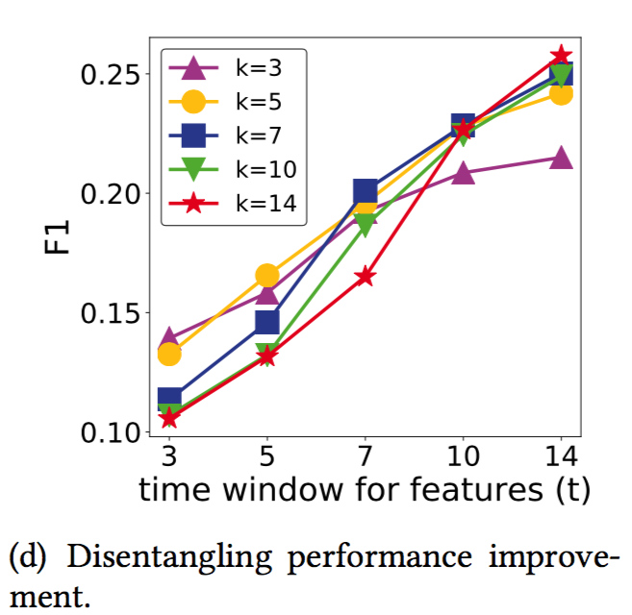
With the first 5 days’ data, the classifier performs as well as those trained using 14 days
Why does the performance improve?
We disentangle the improvement due to feature quality or classifier quality
k-day features
t-day features
train
test
classifier
Predict leaving migrant
Notes:
Surprisingly, we see that classi ers trained with only the first 5 days’ data perform as well as those trained using 14 days when test- ing with features extracted from the rst 10 or 14 days). This result indicates that the classi er can be well trained using data from a small number of days and the performance improvement is mainly due to improved feature quality. In other words, as new migrants stay longer, we have more reliable information regarding how she behaves, but even with less reliable information from the rst 5 days, we can already know how di erent features relate to leaving migrants.

Slide 25

Summary
We study the problem of early departure of new migrants.
Leaving migrants develop less diverse connections and their active areas also have higher housing prices than that of staying migrants..
Classification performance improves over time, mainly because the features become more robust.
Thank you! Q&A
QR code for housing price data:
Notes:
Finally let me summarize our work.
We study an important problem : early departure of new migrants in cities.
We find Leaving migrants tend to neither develop diverse connections or move around the city. Their active areas also have higher housing prices than that of staying migrants.
By investigating the integration process of new migrants, we find that migrants are indeed approaching locals in most characteristics despite the short time span.
In prediction task, we find that When using the same features, the classifier trained from only the first few days is already as good as the one using full data.
Lastly, We hope that our study can encourage more researchers to examine this important problem.

Slide 26
Appendix: Telecommunication in China
Obtaining a local number is the first integration step for a new migrant
Long-distance call cost
It is uncommon for a temporary visitor to obtain a local number
obtaining a phone number is nontrivial and requires personal identification
We can identify people who just obtained a local number but were not from Shanghai originally.
Personal identification allows us to extract the birthplace of a person.
Notes:
Before introducing our dataset and experi- mental setup, letme highlight several facts about telecommunication in China. First, obtaining a local number is the rst integration step for a new migrant because of long-distance call costs, and we are able to di erentiate whether a telephone number is a local number in Shanghai or from other regions. Second, since obtaining a phone number is nontrivial and requires personal identi cation, it is uncommon for a temporary visitor to obtain a local number. Personal identi cation allows us to extract the birthplace of a per- son. Therefore, we can identify people who just obtained a local number but were not from Shanghai originall

Slide 27
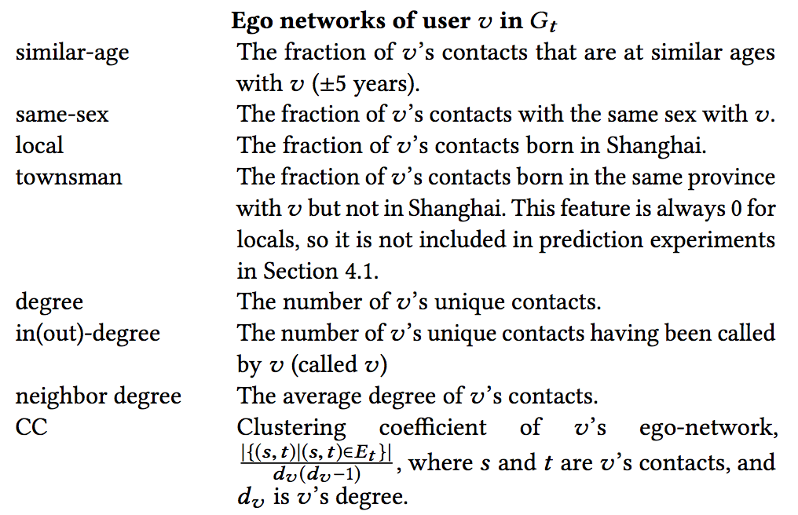
Appendix: Feature Sets

Slide 28
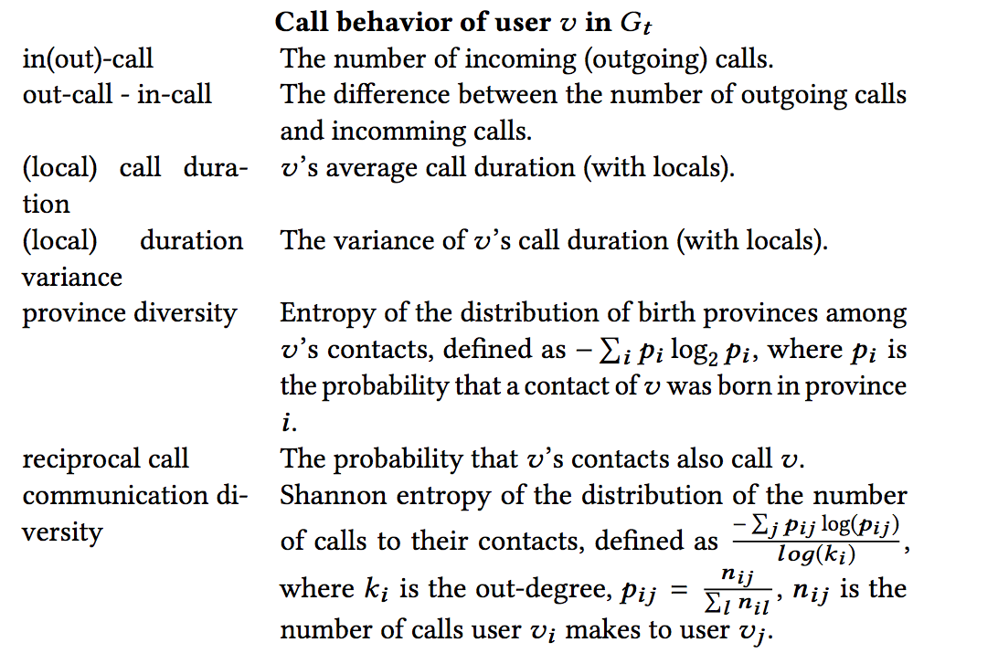
Appendix: Feature Sets

Slide 29
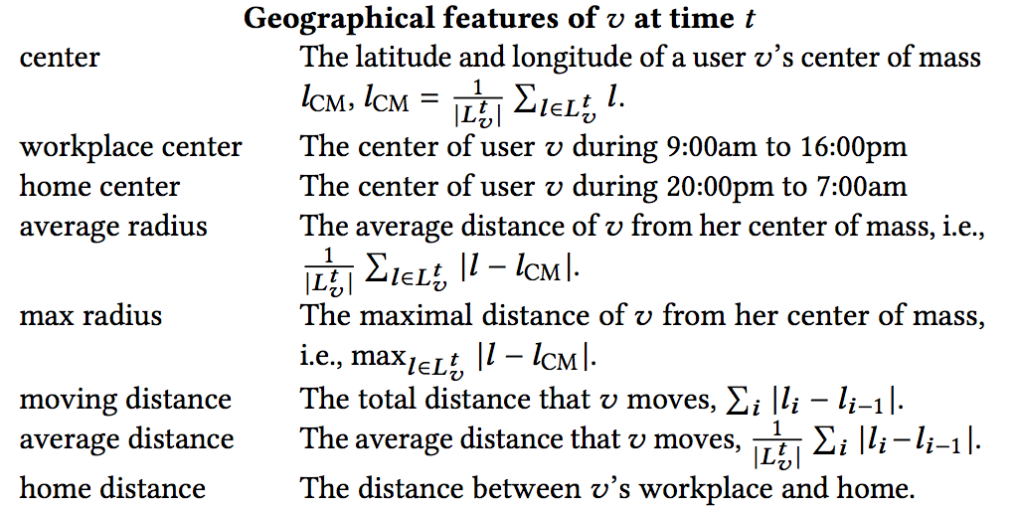
Appendix: Feature Sets

Slide 30
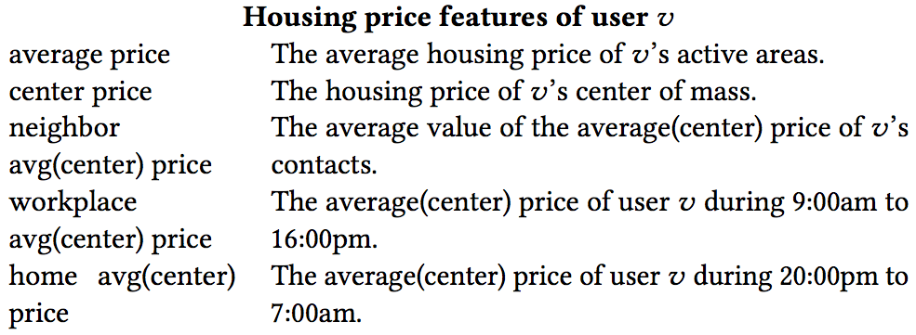
Appendix: Feature Sets

