Slide 1
fuse.ai | Open Sessions (1/5)
Unsupervised Learning
Suraj Regmi Data Scientist, The World Bank Researcher, AID

Slide 2
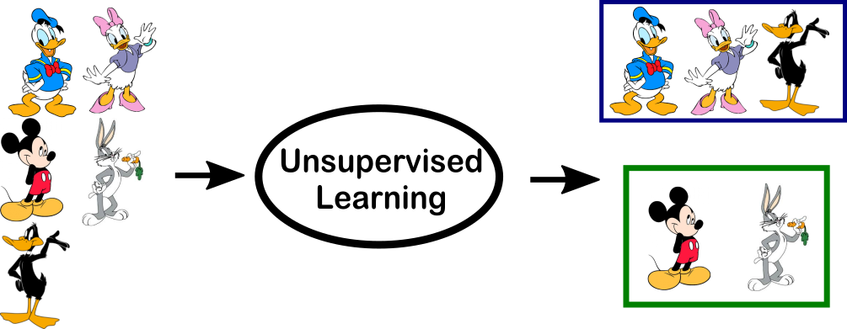
Unsupervised Learning

Slide 3
Principal Component Analysis
Gets principal components of the data
Helps for reduction of dimension of the data
Visualization Aid

Slide 4
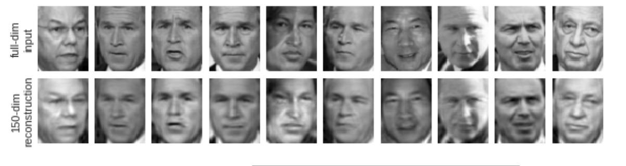
PCA in Facial Recognition

Slide 5
PCA
Mathematics
Notebook

Slide 6
Clustering
Separating the data into groups (clusters) on the basis of similar characteristics
Customer Segmentation

Slide 7
K-Means Clustering
Select k centroids.
Assign data points to nearest centroid.
New Centroid Value = Mean value generated cluster.
Reassign data points to new centroid.
Repeat until data points stay in the same cluster.

Slide 8
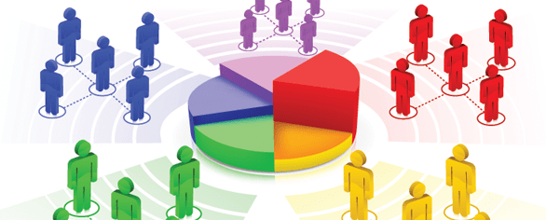
Market Segmentation
Grouping of customers on the basis of their features
Matching of Customer Needs

Slide 9
K-Means
Mathematics
Notebook

Slide 10
Reach me at:
sregmi@worldbank.org
regmi125@gmail.com

