Slide 1

TakeTheFloor
See who held the floor, who got cut off, and whose ideas got credited to someone else — then coach the next sentence.
Shermaine Yap Shi Min · Asia Pacific University (APU), Malaysia
305 EmpowHER Edition October 2026 · Analytics Competition · Built with Gemma
Notes:
Hi, I'm Shermaine. TakeTheFloor makes the invisible dynamics of a meeting visible — airtime, interruptions and idea credit — and then gives each person private, practical leadership coaching. I'm competing in the Analytics path.

Slide 2


Leadership is won or lost in meetings
Uneven airtime
Who gets cut off
Credit goes missing
In mixed groups, women's share of speaking time often falls below their share of seats unless group rules change.
Experimental work found people interrupted women more often than men.
Someone repeats your idea and gets the credit. White House staffers fought back with “amplification”.
Karpowitz, Mendelberg & Shaker, APSR 2012
Hancock & Rubin, JLSP 2015
Washington Post, 2016
Notes:
Three well-documented patterns decide who looks like a leader. Uneven airtime, interruptions that land more on women, and ideas that lose their author. None of these show up in meeting notes. TakeTheFloor measures all three.

Slide 3
The moment TakeTheFloor catches
01:29
Aisha
“What if we launch a student tier at half the price of the pro plan, verified with a student email…”
Mark cuts her off: “Let's not overcomplicate it.”
03:29
Mark
“What if we did a discounted tier for students, verified with a student email, priced at half the pro plan?”
Same idea, two minutes later.
03:40
Daniel
“Great idea, Mark.” … “Let's go with Mark's pricing plan.”
Credit goes to the wrong person.
Synthetic demo meeting — all people are fictional.
Notes:
Here's the pattern in one demo meeting. Aisha proposes a student tier and gets cut off. Two minutes later Mark pitches the same idea almost word for word, and Daniel says 'Great idea, Mark — let's go with Mark's pricing plan.' TakeTheFloor flags this automatically with the exact quotes and timestamps.

Slide 4




From transcript to coaching in seconds
1 Drop in a transcript
2 Transparent detectors
3 Gemma judges context
4 Private coaching
Zoom/Teams/Meet .vtt, Otter, or plain “Name: text”.
Airtime, cut-offs & overlaps, Hedge Index, idea-credit tracking — every flag shows the quotes.
Tells interruptions from “mm-hmm” and “yes, and…”, titles ideas, writes the recap.
Strengths, next moves, word-for-word scripts and rewrites of your own hedged sentences.
Notes:
The flow is simple. Upload a transcript. Deterministic detectors find candidates and every flag carries its evidence. Gemma then adds judgement — it separates real interruptions from backchannels and supportive overlap, names each idea and writes the recap. Finally every person gets private coaching built from their own words.

Slide 5
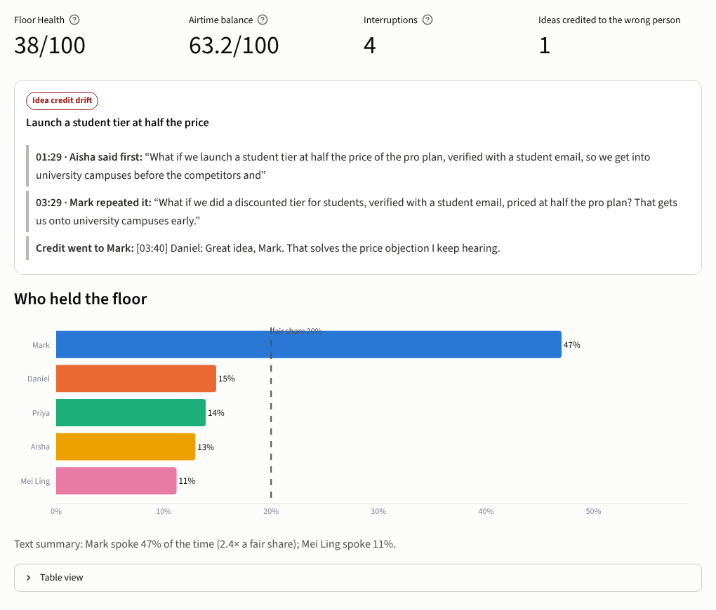
Live demo: the dashboard
38/100
Floor Health for the product-launch meeting (healthy stand-up scores 86)
47%
of airtime held by one person — 2.3× a fair share
4
real interruptions — the “mm-hmm” and the “yes, and…” are not counted
Notes:
Switch to the live app now. Show: Overview metrics and the credit-drift card; Floor timeline with interruption markers; Interruptions tab showing a backchannel kept separate; Idea credit; Leadership coach for Aisha; Accessible recap; then toggle the dyslexia-friendly font and high contrast.

Slide 6
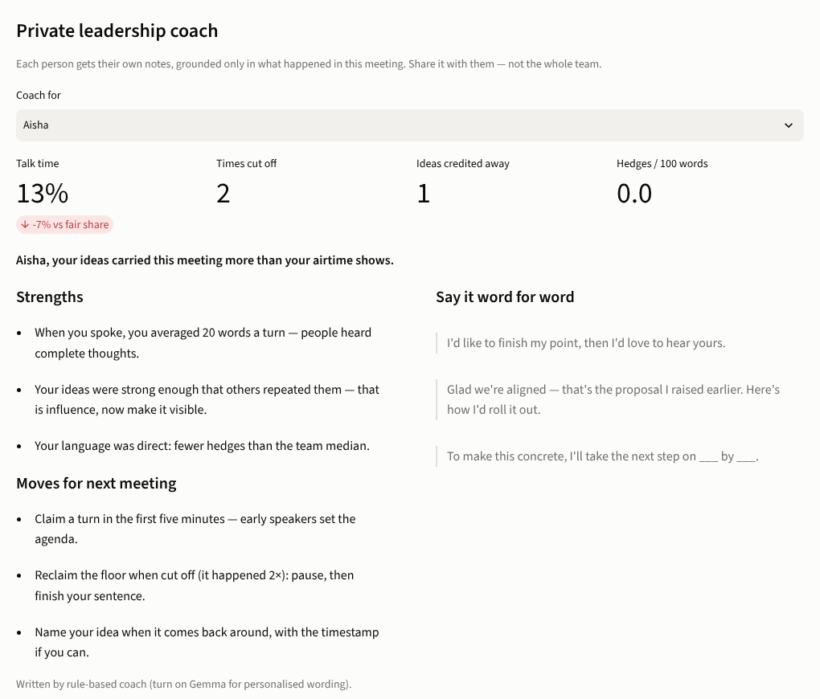
Coaching that turns data into leadership
Private by design
Each person gets their own notes — never a public ranking.
Grounded in evidence
Every strength and move cites what happened in this meeting.
Words you can use tomorrow
“I'd like to finish my point, then I'd love to hear yours.”
Facilitator tips too
Round-robins, a “let them land” norm, naming idea owners in notes.
Notes:
Data alone doesn't change behaviour, so the coach turns it into moves. Notes are private to each person, grounded in this meeting, and include word-for-word scripts. Facilitators get structural fixes, because the goal is to change the meeting, not blame individuals.

Slide 7
Validated against labelled meetings
5 / 5
4 / 4
planted interruptions found
idea-credit events found
0
0.20–0.70
false alarms, incl. the healthy control
stable similarity range (sensitivity sweep)
Honest scope: three synthetic, hand-labelled meetings test that the detectors behave as designed — not real-world accuracy. Full method, sensitivity analysis and limitations are in the Kaggle notebook.
Notes:
This is the analytics core. I wrote three meetings with hand labels, including a healthy control. The detectors find every planted interruption and credit event with zero false alarms, and the healthy stand-up scores highest. A sensitivity sweep shows results are stable across a wide threshold range. I'm explicit that this proves the method behaves as designed, not real-world accuracy — that's the next step.

Slide 8




Accessible by design, not by checkbox
Plain-language recap
Readable everywhere
Decisions, owners and open questions for Deaf/HoH, neurodivergent and second-language teammates.
Atkinson Hyperlegible font, larger text and high-contrast modes.
Never colour-alone
Safe to share
Colour-blind-safe palette, names on every chart, text summaries and table views.
One-click anonymised names; captions tab writes every event out in words.
Notes:
The EmpowHER theme is accessibility and leadership development. Accessibility here is a feature: a plain-language recap for people who couldn't follow the meeting live, readable font and contrast modes, charts that never rely on colour, and anonymised sharing.

Slide 9




Responsible by default, ready to grow
Ethics & privacy
What's next
Rules-only or local Gemma (Ollama): transcripts stay on-device
Validate on the AMI Meeting Corpus and real team meetings
Describes one meeting, never grades a person
Live mode: nudge the facilitator during the call
Overlap norms differ by culture — every flag shows evidence
“Amplify” button: credit a colleague's idea in one tap
Notes:
Two commitments: privacy and fairness. You can run it fully offline or with a local Gemma. It describes a meeting, not a person, and always shows evidence. Next I want to validate on the AMI corpus, add a live facilitator nudge, and an Amplify button to credit colleagues in one tap.

Slide 10
Make the invisible visible
TakeTheFloor helps every voice get heard — and get the credit.
Code & README: github.com/ShermaineYap/305-EmpowHER-Edition-October-2026
Analysis: notebooks/takethefloor_meeting_equity.ipynb (Kaggle)
AI used: Gemma (in-app analysis); Claude (coding assistant) — cited in README
Notes:
Thank you. Everything is open source on GitHub with the Kaggle notebook. Happy to take questions.

