Slide 1
DS - EDA Project - Top Runners By Shani & Keren

Slide 2
Kaggle Dataset of 1000 Top Ranked Runners in the world Olympic distances till 2017:
100m,200m,400m,800m,1500m,5000m,10000m,Half Marathon, Marathon
1000 first ranked for each event and gender.
The dataset consists of 10 columns and 18244 rows
Arrange data:
No deletion of rows (only 8 Naan in 1 column)
Added 6 helper columns
To enrich the data merged with 3thrd party csv file of Continents to display distribution by regions

Slide 3
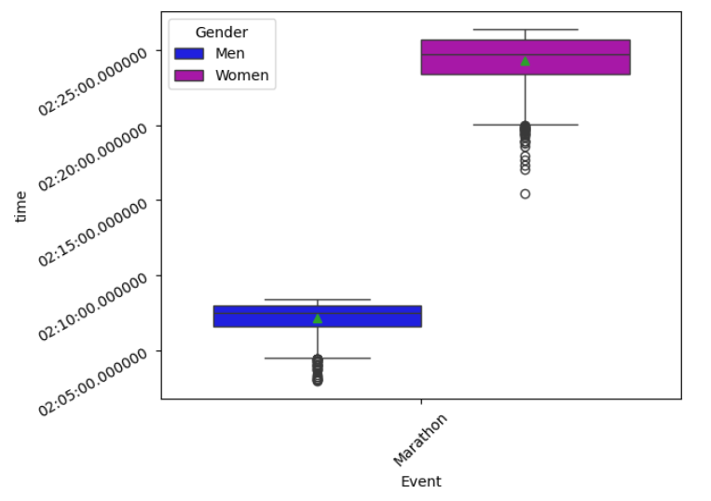
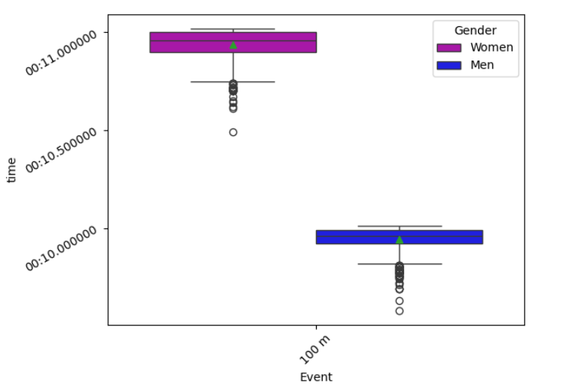
What did we discover?
Men are faster than women. Obviously…

Slide 4
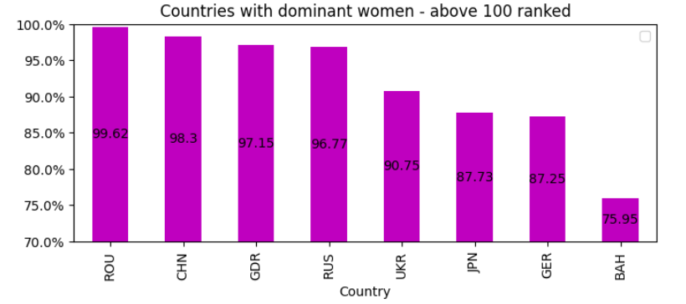
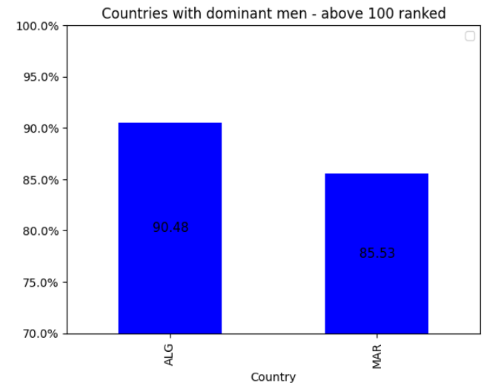
Men & Women Countries Difference:

Slide 5
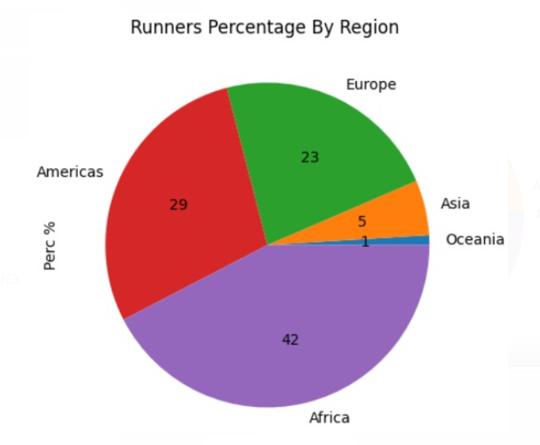
The African Story
Starts with checking which region in the world has the most ranked runners:

Slide 6
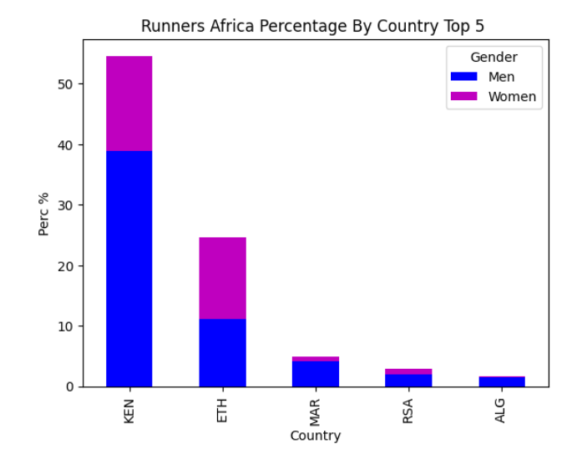
Drilling down to countries:
Almost 80% of the Runners are from Kenya and Ethiopia, most of them are Men

Slide 7
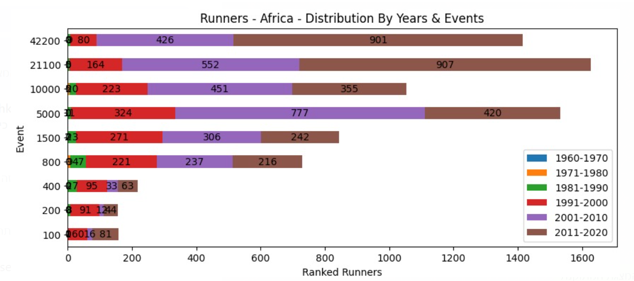
In the last 17 years (1990-2017) African runners loving to take most of the Long runs (Marathon, Half Marathon) ranks:

Slide 8
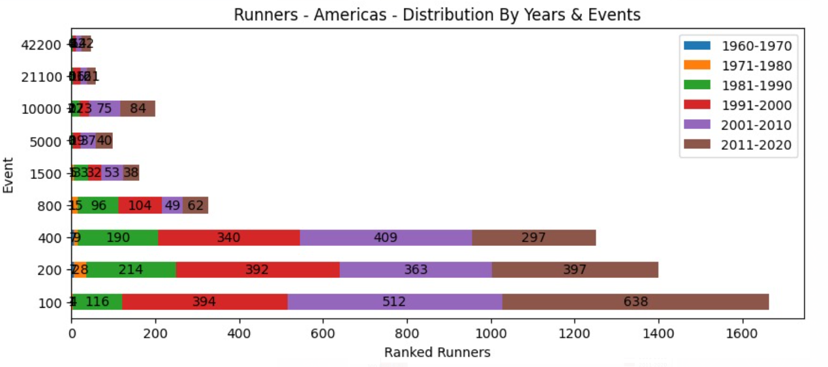
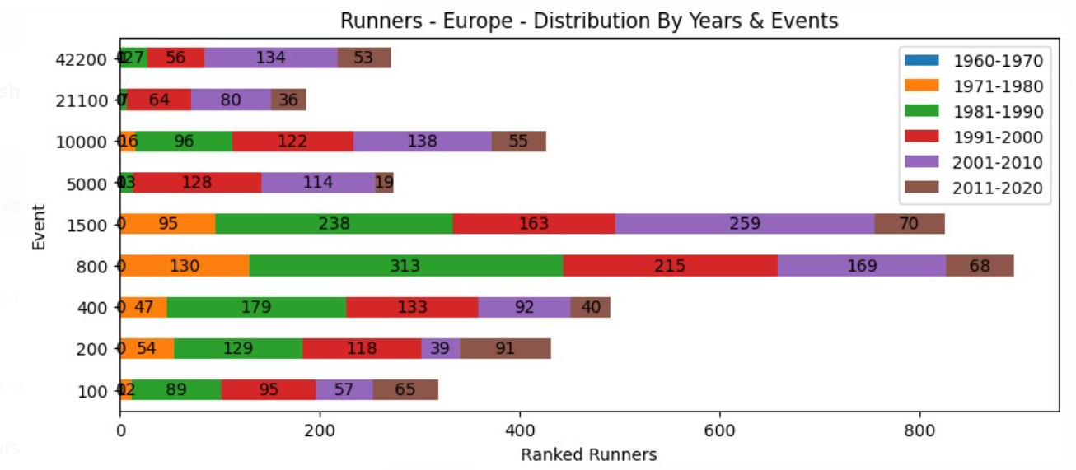
So who loves to take short run ranks?
So who loves to take Medium length runs?

Slide 9
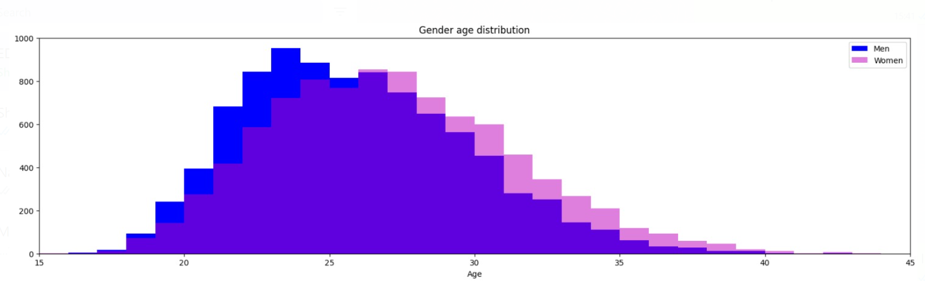
Ages Distribution Men & Women

Slide 10
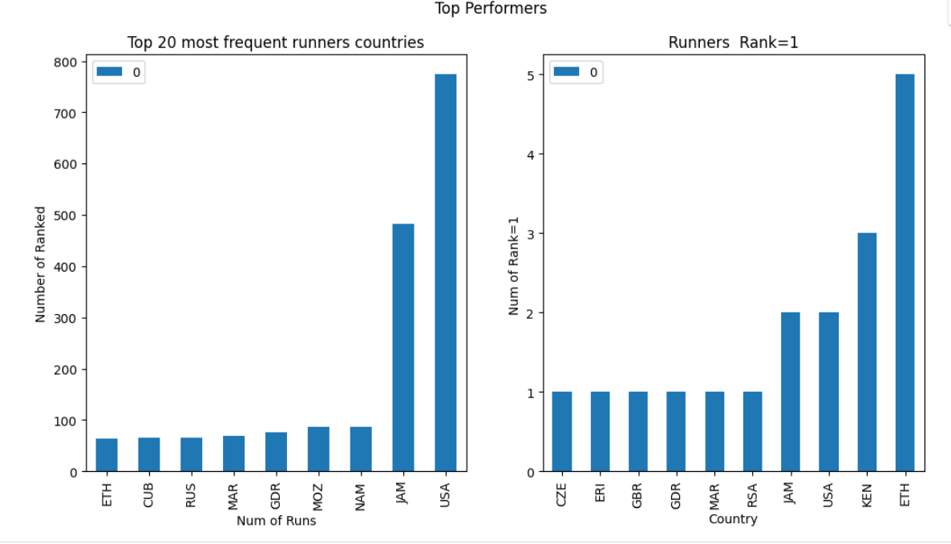
Top Countries Performers: - E

