Slide 1
Hotel Revenue
By: SheroD Brooks

Slide 2
Agenda
Introduction
Data Sources
Documentation of cleaning and manipulation
Summary of data analysis
Key Visualizations and Findings
Recommendations

Slide 3
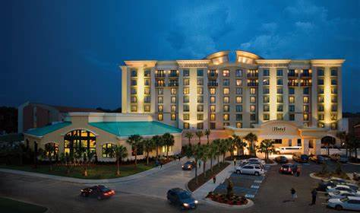
Introduction
Looked at two hotels' data from different years
The goal is to analyze and visualize data between the two hotels to update the stakeholders.
Used different applications to get data driven insights to give valuable business information.

Slide 4
Introduction cont.
Business Tasks
Is our hotel revenue growing by year
Should the hotel increase parking lot size
Trends in the data
Problem Statement
How can trends found in the data set be used to increase revenue and inform us on impactful decisions that need to be made.

Slide 5
Data Source
Downloaded the Excel dataset from a website called absent data. Where to Find Data? – AbsentData
This data is from a public trusted site
The Excel spreadsheet has information such as hotel name, arrival dates, meals, location, parking and much more. The Excel file also has multiple pages which separate the data by year.

Slide 6
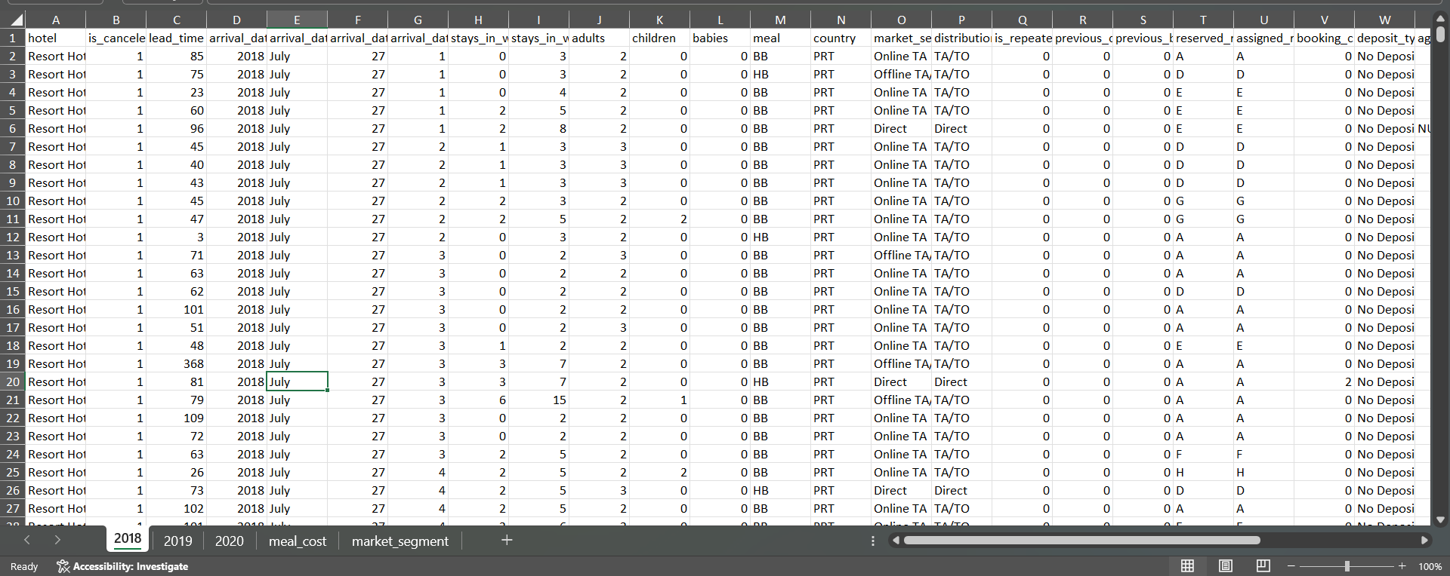
Data Source

Slide 7
Documentation of cleaning and manipulation
The Excel file was read into SQL server and there the data cleaning was completed.
During the cleaning process I used different functions to get the desired outcome. I also commented on the queries to keep track of the progress that was made.

Slide 8
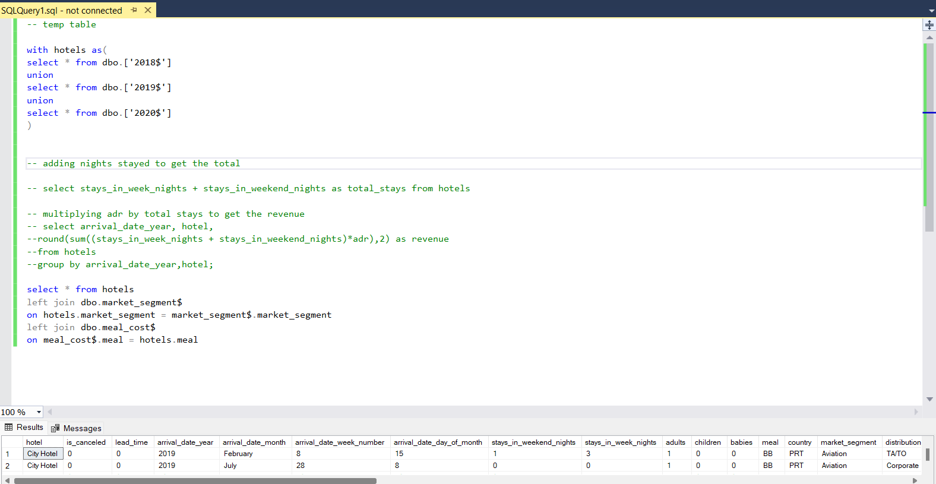
Documentation of cleaning and manipulation

Slide 9
Summary of data analysis
The functions that were used include temp tables and joins.
We used these functions to combine all the hotel years together and join market segment and meal cost to the temp table hotels.
The focus in SQL was getting everything combined due to the data being separated into distinct pages on Excel. Combining the data helped in the visualization portion of the project.

Slide 10
Key Visualizations and Findings
The key findings from this project is that the revenue of both is steadily increasing.
The resort hotel had the highest peak of 25 million in 8/29/2019, and the city hotel has outearned the resort hotel most of 2020 but currently the resort hotel is the higher earner.
Key numbers to know:
Total Revenue: 10.23 million
Average ADR: 104.47
Average Discount: 25.81%

Slide 11
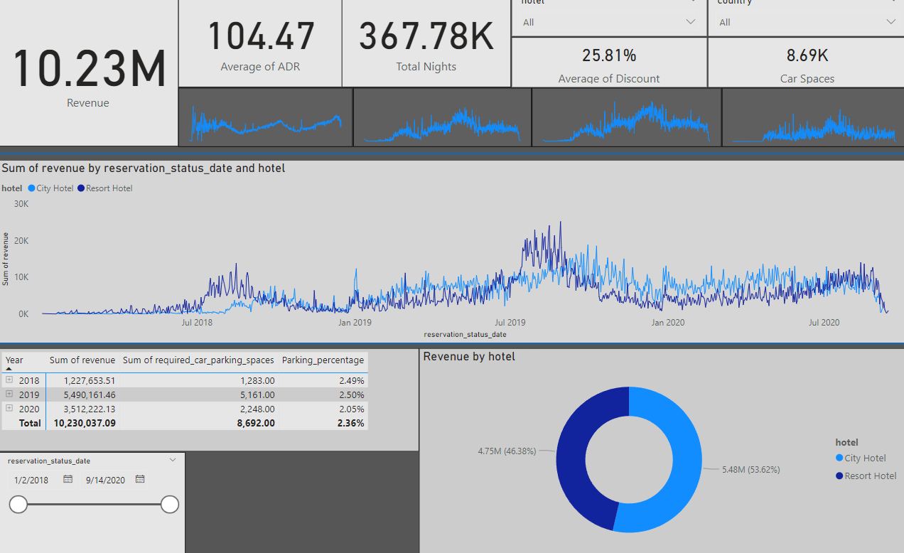
Key Visualizations and Findings

Slide 12
Recommendations
Is our hotel revenue growing by year?
Yes, Year by year our revenue is increasing for both hotels.
Should the hotel increase parking lot size?
No, There is not an immediate need to increase parking due to the parking percentage not increasing considerably.
Trends in the data
Marketing during the months June-August and on New Years can help revenue growth because that is the period were revenue is exploding.
Marketing our discount percentage can help with revenue growth as well.

Slide 13
THANK YOU
Sherod Brooks
567-328-0587
sherodbrooks20@gmail.com

