Slide 1
RedXParking
Presented by
Kushan
Suditha
Harindu

Slide 2
Content

Slide 3
RedXParking
A smart parking system which is based on parking availability in Australia as a solution to almost every person behind the wheel.
The smart parking system is integrated with hardware and software.
The System is available as a web application for users.

Slide 4
Things used in the project :Hardware
Sensors - PIR Sensor will be used to retrieve the data from the streets to check whether a vehicle is parked in the bay or not.
Arduino Uno – Data is collected from the connected sensors are sent to Raspberry Pi via serial port.
Raspberry Pi – Data is extracted to a SD card.

Slide 5
Things used in the project: Software & Programming languages
Programming language
Json – it is used to exchange the collected data from server to website.
Software
Arduino IDE – Implementation for PIR Sensor to work is compiled in the Sketch and uploaded to the board.
AtmelStudio – Program the AtMega328p without Arduino interface

Slide 6
How it is implemented
Sensors are used to collect data from the parking bays
Collected data is sent via Arduino Uno to Raspberry Pi.
Data is saved on a SD Card

Slide 7
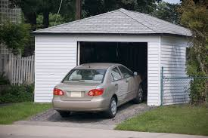
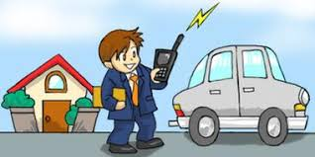
Outcome of the system
Before
After
RedXParking
Will there be parking bays ?

Slide 8
Conclusion

