Slide 1
VPC

Slide 2
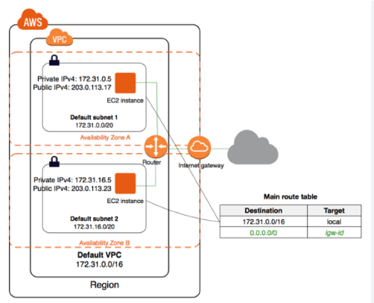

Slide 3
VPC[virtual private cloud]
•It lets you define your own network in aws. You can use vpc to create your own network and use aws resources like EC2 in that network.
•You have the complete control of that network like giving the ip address range you want, block suspicious ip (or) ip add range, configuring route tables, create subnets, igw.
•The first 3 and last ipaddress are not available. Because, it is used for router, dns, broadcast and network address.
•You can create public and private facing subnets. Public-subnets for web servers to access the internet, private-subnets for databases which you don’t want internet access.

Slide 4
•You can have multiple layers of security like security groups and Acl’s to control inbound and outbound traffic.
•If you launch an instance in public-subnet, you can access internet directly by attaching IGW. If you launch instance in private-subnet, you can access internet through NAT. so that your private ip won’t show to public.
•Route table is nothing but a set of rules, called routes which determines which determines where the network traffic is directed.
•Each subnet in your VPC must be associated with the route table. The table controls routing for the subnet.
•When you launch an instance in a new vpc, public dns name won’t come for that instance. Because, dns hostnames is disabled by default in newly created VPC.

Slide 5
Create VPC:
To Create a VPC:
> Go to VPC.
> Select your vpc’s option.
> Click Create VPC.
> Type a name to vpc.
> CIDR block (192.160.2.0/23).
> Click Creat

Slide 6
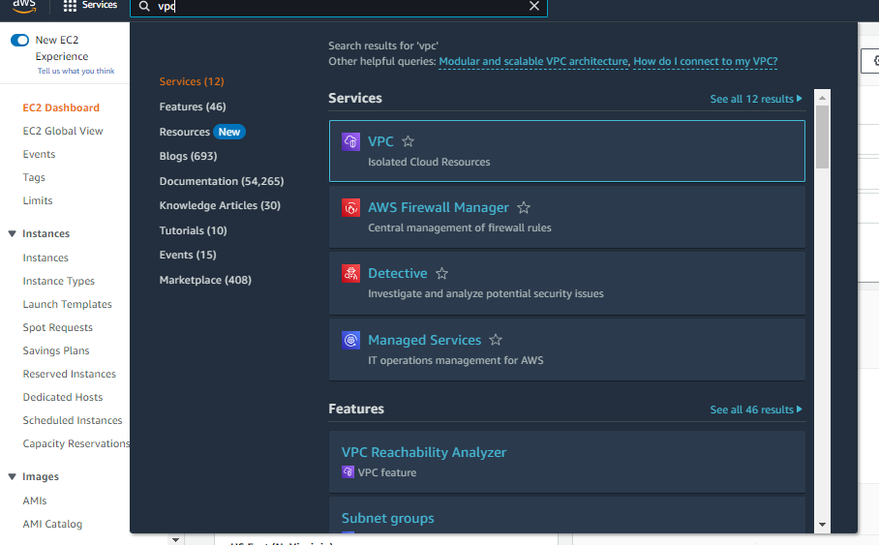

Slide 7
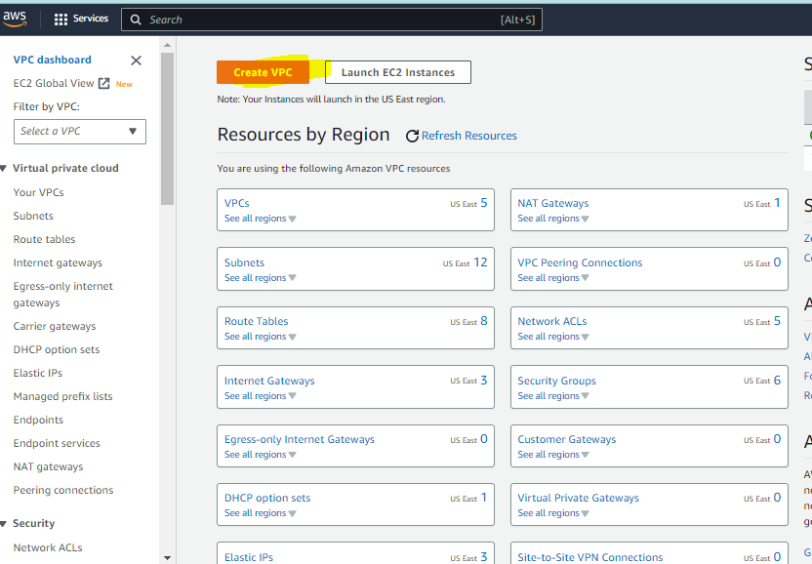

Slide 8
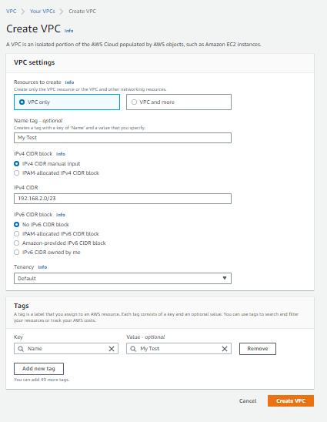

Slide 9
Create Subnets:
Create two subnets, public and private. Public will have internet access and private have NAT instance to access to internet.
•Create a public subnet with CIDR 192.168.10.0/24.
Go to VPC.
Click on Subnet.
Click create subnet.
Type a name(public).
Select your vpc.
Select AZ.
CIDR block (192.168.2.0/28).
Click Create.

Slide 10
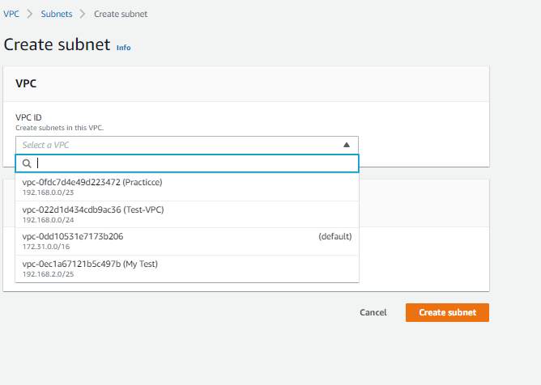

Slide 11
Create Private subnet:
Create a private subnet with CIDR 192.168.2.16/28.
Click subnet.
Click create subnet.
Type a name (private).
Select your vpc.
Select AZ.
CIDR block (192.168.20.0/24).
Click Create.

Slide 12
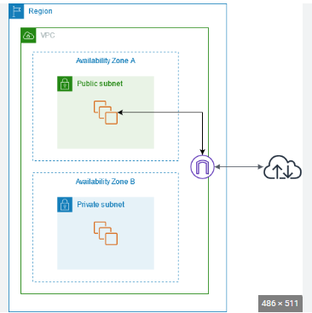
Internet Gate Way
•Now we have two subnets, if you launch any instance in these two subnets, you won’t able to access internet. Because, internet gateway is not attached to these subnets. To access internet, you have to attach an IGW to the subnet.

Slide 13
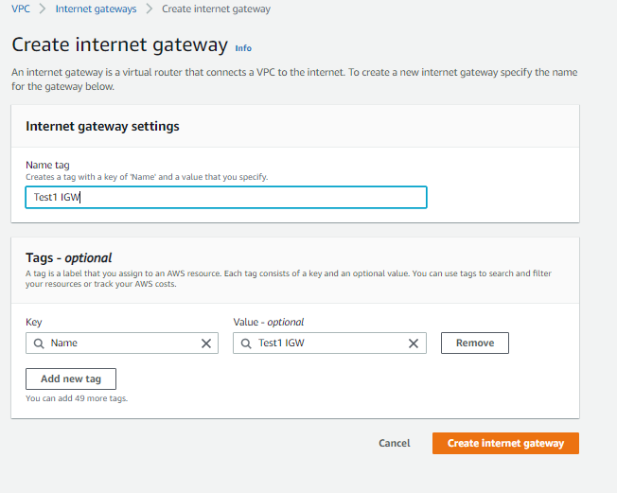
•To create an IGW:
Go to internet gateway.
Click create gateway.
Select your vpc.
Click create.

Slide 14
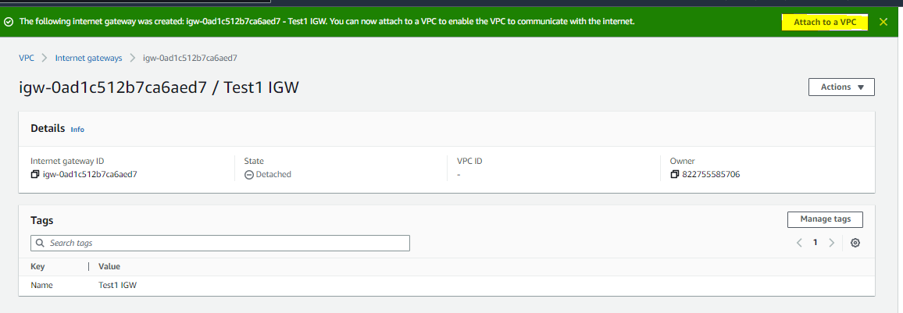
•Now we created a IGW and attached it to VPC.
•Now, you have to associate a subnet to route table and add a rule in that route table with IGW.

Slide 15
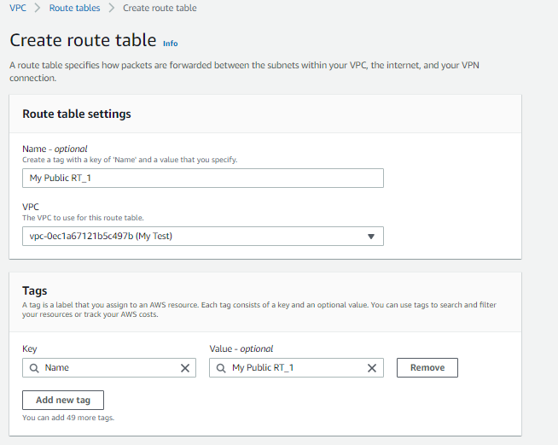
•To Create a route table,
Go to Route table.
Click Create route table.
Select your VPC.
Click Create.

Slide 16
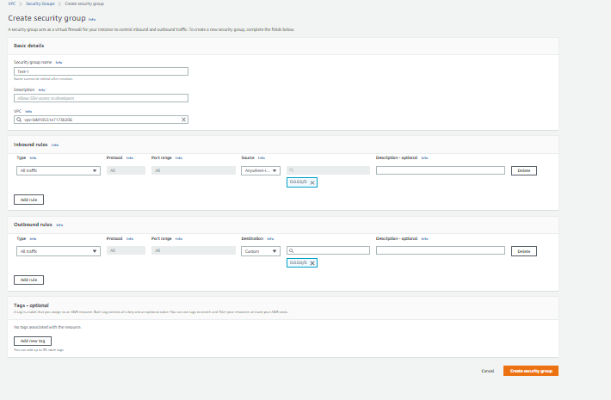
Security Groups:
SECURITY GROUPS
•Security groups are like firewall for your instances to control the inbound and outbound traffic. Security acts at instance level.
•You have to select security groups while creating ec2. If you didn’t selected any security group, vpc automatically selects default one.
•For each security group, you add rules to control inbound and outbound traffic. Like protocol, port, ip etc.
•To create a security group,
Go to Security groups
Click create a security group
Type a name to security group.
Select your vpc and choose Create.
•On Inbound rules tab,
Click edit, select rules you want (ssh, http, https).
Enter source as 0.0.0.0/0 (or) any ipaddress and Click Save

Slide 17


Slide 18


