Slide 1
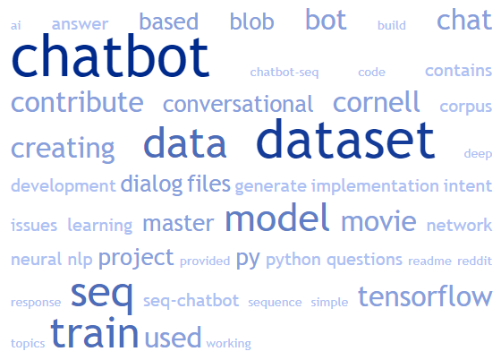
Finetuning Chatbot on a Single Node SPR
finetuning a chatbot using Intel Extension for Transformers

Slide 2

INTRODUCTION
PREPARING THE ENVIRONMENT
1. Installation of Intel Extension for Transformers:
!pip install intel-extension-for-transformers
2. Cloning the repository:
!git clone https://github.com/intel/intel-extension-for- transformers.git
3. Install requirements:
%cd ./intel-extension-for- transformers/intel_extension_for_transformers/neural_chat/
!pip install -r requirements.txt
%cd ../../../

Slide 3
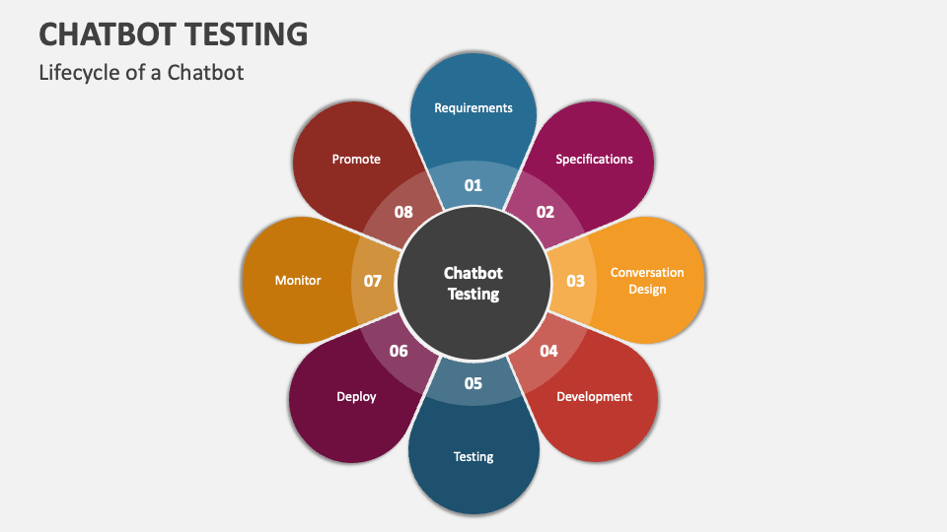
PreparING the Dataset
Selecting a dataset based on the task:
1. Text Generation: Alpaca dataset from Stanford University.
The Alpaca dataset includes 52,000 instruction-following examples generated by OpenAI's text-davinci-003 model. It is used for training models to handle a wide range of text generation tasks by learning from diverse instructions.
2. Summarization: CNN/DailyMail Dataset
The CNN/DailyMail dataset contains over 300,000 news articles paired with summaries. It's ideal for training models on text summarization, helping them learn to condense lengthy articles into concise summaries.
3. Code Generation: Evol-CodeAlpaca-v1 Dataset
The Evol-CodeAlpaca-v1 dataset includes pairs of natural language descriptions and code snippets. It trains models to translate human instructions into executable code, enhancing their code generation capabilities.

Slide 4
Finetune for Text Generation
Using the LoRA approach to finetune the model:
Importing necessary libraries: Imported the essential libraries needed for fine-tuning, including those for model configurations, data handling, and training settings.
from transformers import TrainingArguments
from intel_extension_for_transformers.neural_chat.config import ModelArguments, DataArguments, FinetuningArguments, TextGenerationFinetuningConfig
from intel_extension_for_transformers.neural_chat.chatbot import finetune_model
Defining model, data, and training arguments: Setting up the model, data, and training parameters. This includes specifying the model to be fine-tuned, the dataset to use, and the training configurations like batch size and number of epochs.

Slide 5
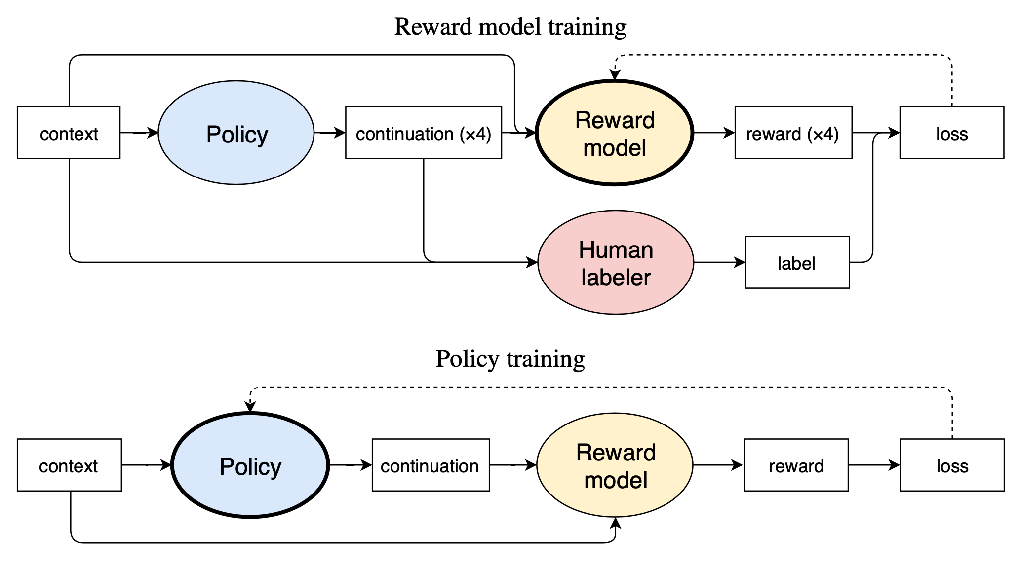
Finetune for Text Generation
Configuring finetuning settings: Configuring the specific settings for the LoRA fine-tuning process. This includes setting up the finetuning configuration to integrate the model, data, and training arguments.
Calling finetune_model function: Invoking the finetune_model function with the configured settings to start the fine-tuning process. This step applies the LoRA approach to adapt the model to the new task.
finetune_model(finetune_cfg)

Slide 6

Finetune CONCLUSION and Code Generation
Summarization:
1. Defining model, data, and training arguments.
2. Configuring finetuning settings.
3. Calling finetune_model function.
Code Generation:
1. Defining model, data, and training arguments.
2. Configuring finetuning settings.
3. Calling the finetune_model function.

