Slide 1
COLX585
What’s behind the MASK?
— A Chinese Idiom Cloze Test
Using Fine-tuning and Prompt Engineering
Group Zootopia
Jessie, Gordon, Sherry, Dave, Grace

Slide 2
MOTIVATION
1
Semantic analysis can be challenging for Chinese language corpus:
- Ambiguity
- Polysemy
- Contextual information
- Near-synonyms
- ...
Most transformer-based models are trained on English corpus.
We are linguistic students, let’s try bilingual tasks.
Notes:
We designed three kinds of prompt to feed into all the models for prompt engineering.

Slide 3

Chinese idioms
Also known as “Chengyu”. Succinctly paraphrasing or summarizing the original text.
A type of Chinese expression, most of which consist of four characters.
English:
one corner of an ice mountain
Chinese:
冰 山 一 角
ice mountain one corner
Meaning：
Only a small portion of a larger issue or problem is visible, while the majority of the issue or problem remains hidden or unknown.

Slide 4
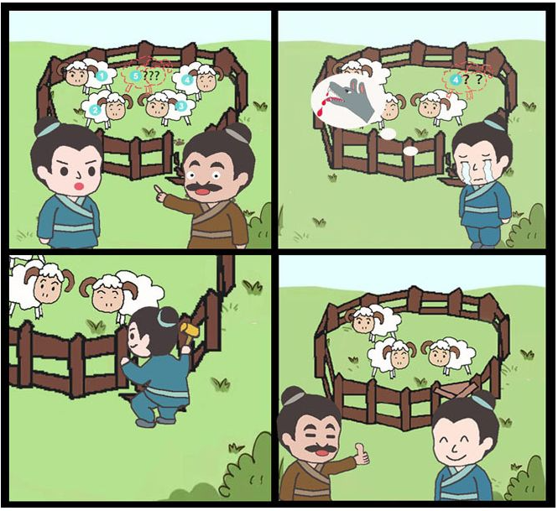
Chinese idioms
Also known as “Chengyu”. Succinctly paraphrasing or summarizing the original text.
A type of Chinese expression, most of which consist of four characters.
English:
To mend the fence after sheep are lost
Chinese:
亡 羊 补 牢
escape sheep mend fence
Meaning：
Never be late to make up
Note: An example of metaphor in idiom.

Slide 5
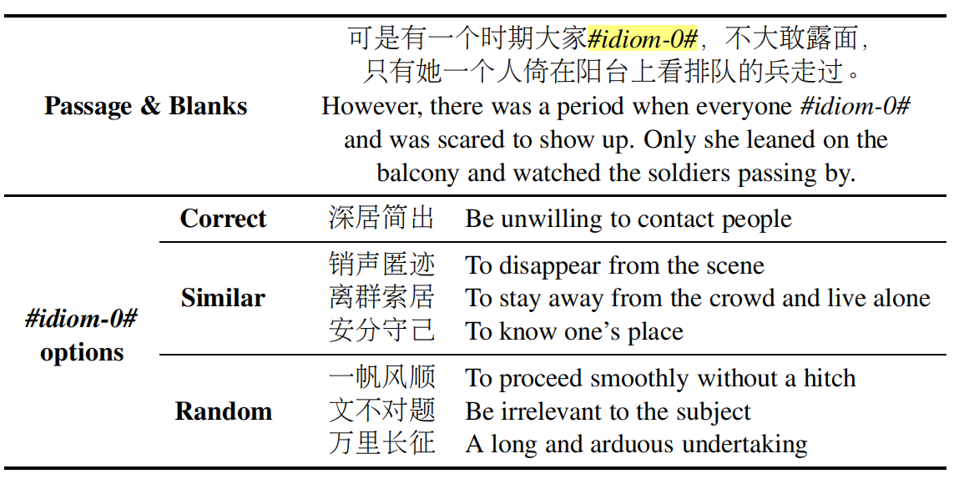
Computational linguistics, get the job done!
Dataset
ChID, a Chinese cloze test dataset.
Contains 581K passages and 729K blanks, and covers multiple domains.
We use:
train set: 15K
dev set: 2K
test set: 2K
{"groundTruth": ["不寒而栗"],
"candidates": [["瞠目结舌", "不寒而栗", "骇人听闻", "大功告成", "望而生畏", "时不我待"]],
"content": 个人信息一旦被公之于众，生活随之将被严重骚扰，这对当事人造成的心理压力可想而知，而因隐私泄露所引发的潜在危险也令人#idiom#。",
"realCount": 1}
Notes:
Hi everyone, we are group zootopia. In this course, we did a billingual project using Bert, GPT2, T5 to predict suitable Chinese idioms

Slide 6
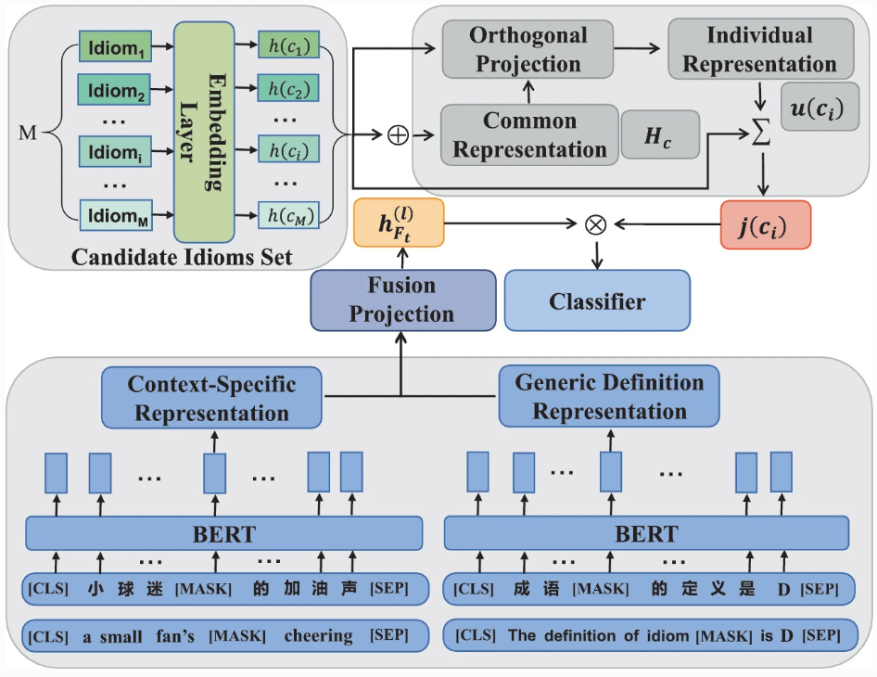
Computational linguistics, get the job done!
Previous work
Chujie et al. (2020) evaluated three state-of-art cloze test models on ChID corpus, and observed that existing model performance is still much worse than human performance.
Ying et al. (2023) experiment results on ChID shows that their model out performs state-of-art models. The accuracy on dataset Test reaches 95.7%, and the accuracy on dataset Sim, which has more synonyms or near-synonyms idioms, is significantly improved to 97.9%.

Slide 7
MODELS
2
Fine-tune
&
Prompt Engineering
Prompt Engineering
Fine-tune
BERT
T5
T5-small
GPT2
ChatGPT
3
2
4
1
5
Notes:
We were lucky to have 5 team members. So, we almost choose most of llm we could compare five model to check how it work in this task.

Slide 8
BertTokenizer
epoches = 5
BERT
T5
T5-small
GPT2
ChatGPT
3
2
4
1
5

Slide 9
AutoTokenizer
epoches = 5
BERT
T5
T5-small
GPT2
ChatGPT
3
2
4
1
5

Slide 10
BertTokenizer
epoches = 5
BERT
T5
T5-small
GPT2
ChatGPT
3
2
4
1
5

Slide 11
BertTokenizer
epoches = 5
BERT
T5
T5-small
GPT2
ChatGPT
3
2
4
1
5

Slide 12
Just API
Prompt
BERT
T5
T5-small
GPT2
ChatGPT
3
2
4
1
5

Slide 13
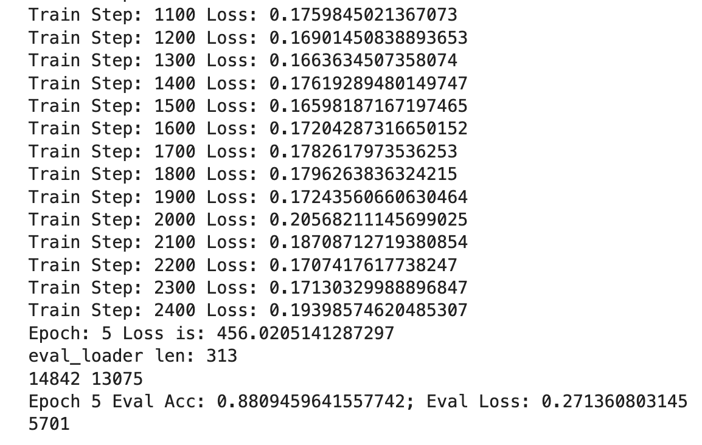
3
EXPERIMENTS
Fine-tuning
Notes:
For all the models appropriate for fine-tuning that Gordon just mentioned, we have fine-tuned each model and evaluated them based on evaluation accuracy and loss.

Slide 14
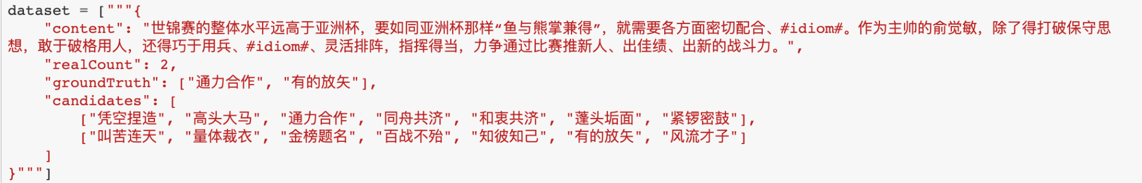
3
EXPERIMENTS
Prompt Engineering
Notes:
We have processed the dataset to replace the mask in the content with the candidates. When feeding the data into the models, we asked them to either rank the most relevant idiom among the candidates or choose the possible idioms to place in the sentence. We also tried various other prompts to see which one works best for the model.

Slide 15
RESULTS
4
 |  | BERT | T5 | T5-small | GPT2 | ChatGPT
Fine-tuning | f1-score | 0.545 | 0.454 | 0.41 | 0.644 | –
 | Accuracy | 0.552 | 0.536 | 0.40 | 0.717 | –
Prompt Engineering | f1-score | – | 0.084 | 0 | 0.172 | 0.242
 | Accuracy | – | 0.148 | 0 | 0.198 | 0.246
Notes:
Model performance is compared through F1-score and accuracy. We found that GPT-2 works best after fine-tuning, while T5-small performs the worst.
On the other hand, in prompt engineering, due to the differences in tokenizers among all models, the prompts we feed into the models also differ. The table here shows the highest results we have obtained from the models using all types of prompts we have tried. Since the models were directly sourced from Hugging Face and haven't been fine-tuned, all of them perform poorly. Here, we found that ChatGPT is the best model for prompt engineering, and, surprisingly, we discovered that T5-small doesn't work for prompt engineering at all without fine-tuning.

Slide 16
5
CONCLUSION
Prompt engineering → fine-tuning
vs.
fine-tuning → prompt engineering
Notes:
We tried to do the prompt engineering before fine-tuning, but we realized this approach makes no sense, as the models perform quite poorly, with F1-scores close to zero. Therefore, the experimental process we tried involved fine-tuning the models before testing different prompts on them.

Slide 17
6
FUTURE WORK
When we changed the data scale from 15,000 to 200,000…
 |  | BERT | T5 | T5-small | GPT2 | ChatGPT
Fine-tuning | f1-score | 0.545 | 0.454 | 0.41 | 0.644 | –
 | Accuracy | 0.552 | 0.536 | 0.40 | 0.717 | –
Prompt Engineering | f1-score | – | 0.084 | 0 | 0.172 | 0.242
 | Accuracy | – | 0.148 | 0 | 0.198 | 0.246
Notes:
The training set we used consists of 15 thousand samples, and we tested our model on 2 thousand validation and test sets. Out of curiosity, we tried T5-small on 50 thousand data points and observed a significant improvement in performance.

Slide 18
6
FUTURE WORK
When we changed the data scale from 15,000 to 200,000…
 |  | BERT | T5 | T5-small | GPT2 | ChatGPT
Fine-tuning | f1-score | 0.545 | 0.454 | 0.70 | 0.644 | –
 | Accuracy | 0.552 | 0.536 | 0.70 | 0.717 | –
Prompt Engineering | f1-score | – | 0.084 | 0 | 0.172 | 0.242
 | Accuracy | – | 0.148 | 0 | 0.198 | 0.246
Notes:
The training set we used consists of 15 thousand samples, and we tested our model on 2 thousand validation and test sets. Out of curiosity, we tried T5-small on 50 thousand data points and observed a significant improvement in performance.

Slide 19
6
FUTURE WORK
Fine-Tune
Prompt Engineering
Discuss the scale of dataset and align the dataset and re-train, for the purpose of comparison
Compare the performance across different models
Figure out the most appropriate on each of the model
Figure out the way to compare given different prompts
Notes:
Therefore, if we had more time, we would also try running all the models on a larger dataset and see how much their performance could be developed.
Additionally, as we tried different prompts on the models, we are still determining which prompt is most appropriate for each model. We could try more prompts if we had enough time.

Slide 20
The End
Notes:
And that's all we have for today. Thank you, and feel free to ask any questions you have!

