Slide 1


Data Mining Project
Health Insurance Coverage
and Hypertension Risk Analysis
Muhui Wang, Sherry Wang

Slide 2

01
Problem Statement
02
Dataset Description &Preprocessing
03
Exploratory Data Analysis (EDA)
Content
04
Association Rules
05
Classification
06
Clustering
07
Conclusion & Future Work

Slide 3
Insurance Disparities
Problem
Statement
Hypertension Burden

Slide 4
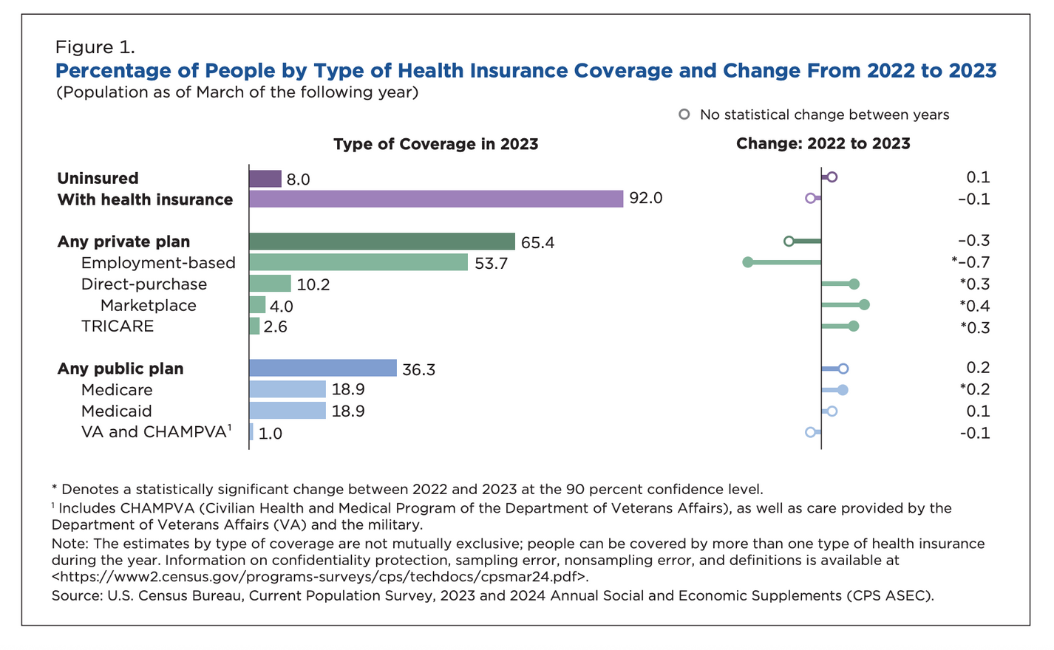
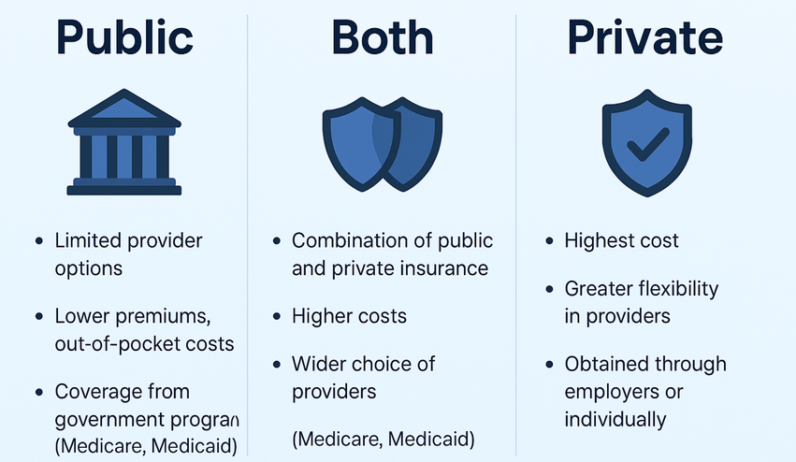
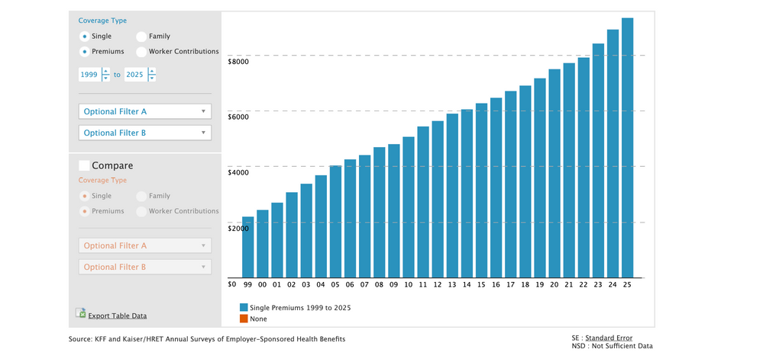
Insurance disparities
92%
Insurance Coverage
But Insurance Inequities Persistt
Insurance Coverage ≠ Equal Access

Slide 5
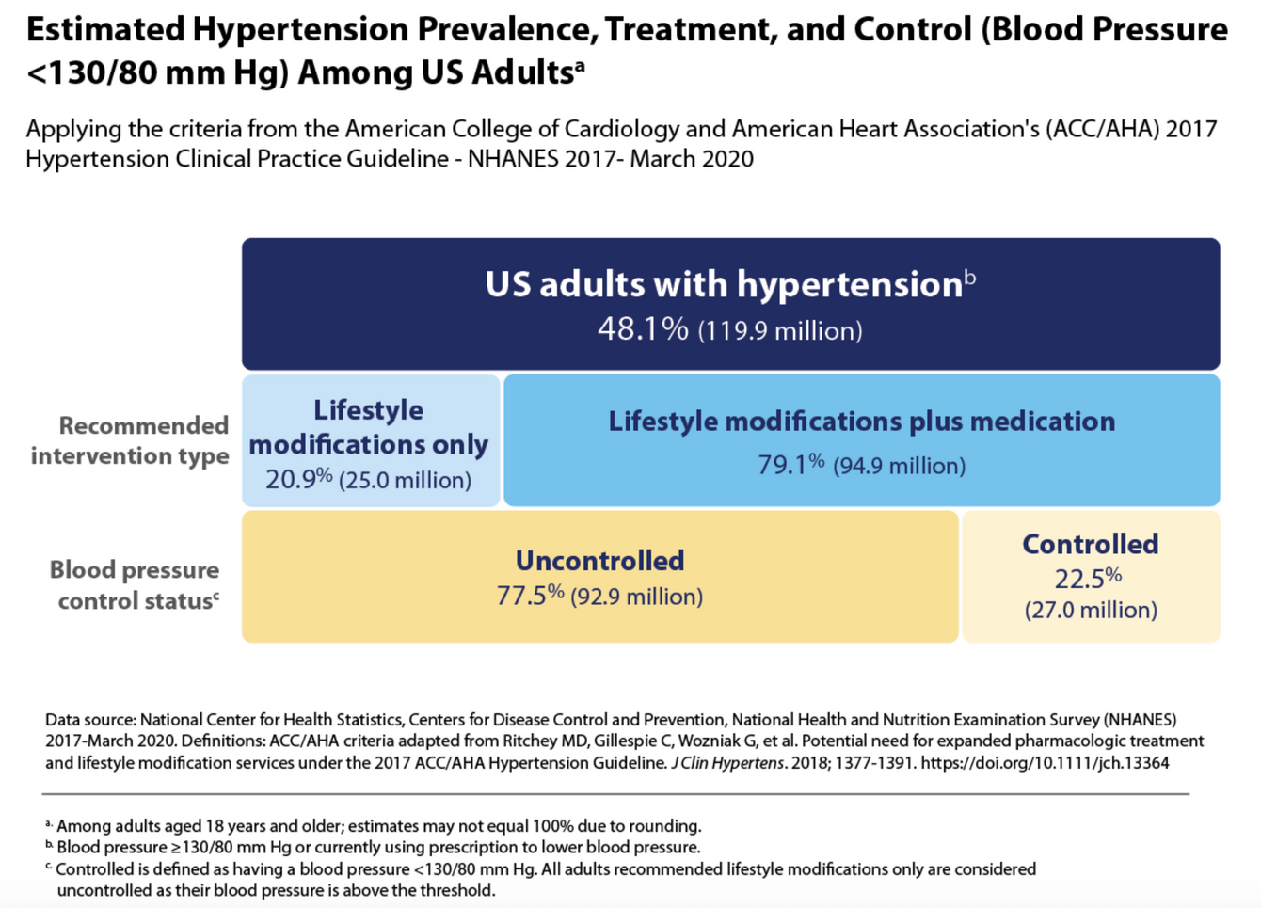
Hypertension Burden
48.1%
Hypertension Prevalence
Only 25% manage to control
[1] https://www.cdc.gov/high-blood-pressure/data-research/facts-stats/index.html

Slide 6
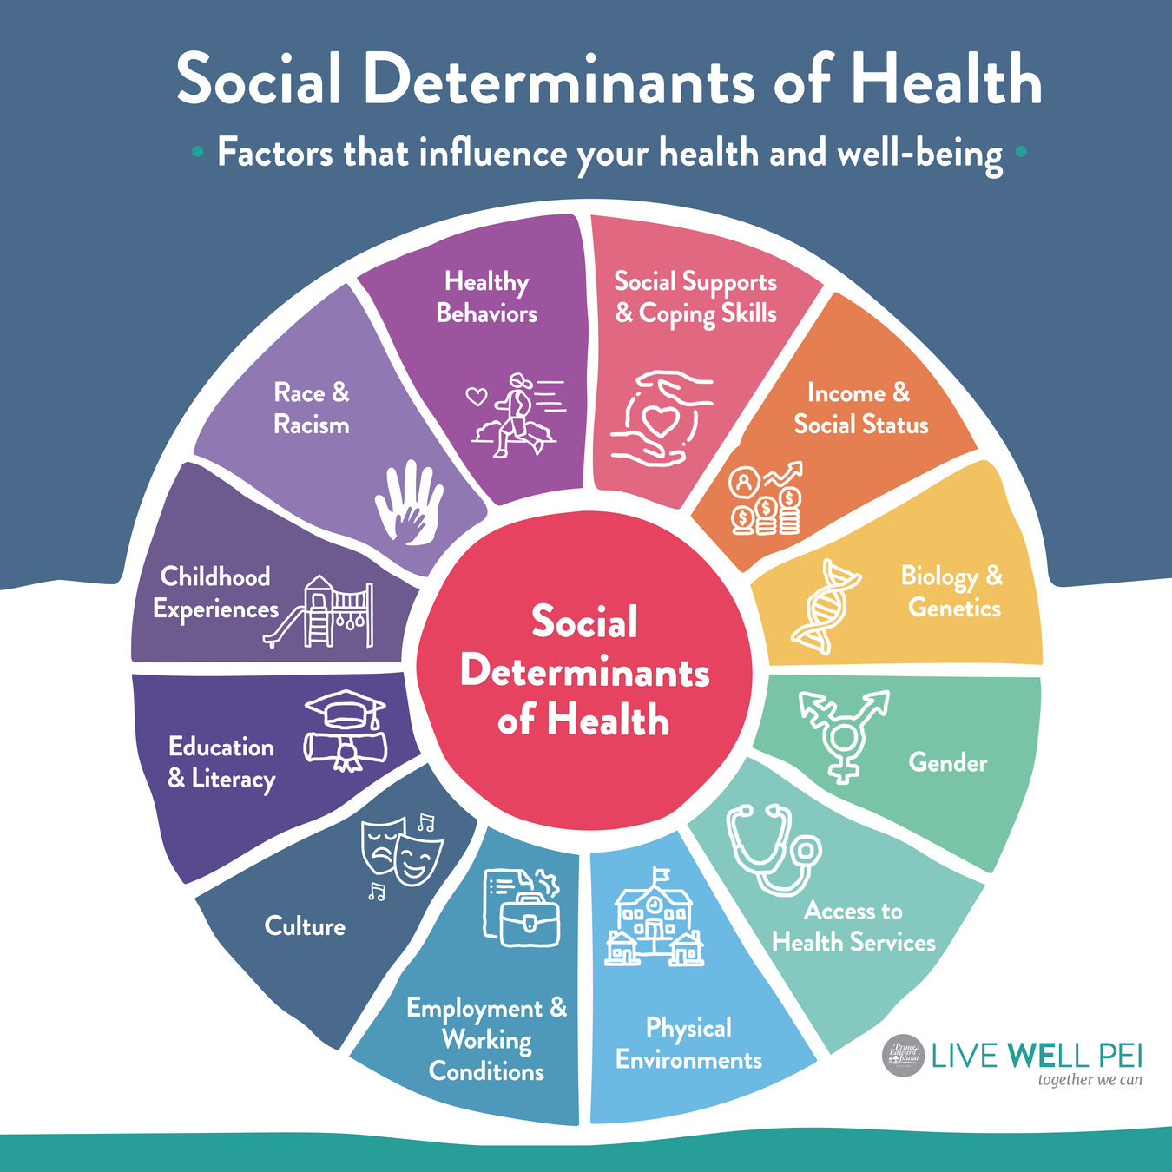
What Factors Shape Insurance Choice and Hypertension Risk？
Identify
Key Patterns Behind Insurance Types
Predict Hypertension Risk
Detect vulnerable population subgroups

Slide 7



Project Workflow
Focus Two Key Determinants:
Drivers of Insurance Type & Hypertension Risk
Phase 1
Phase 2
Phase 3
Data Collection & Preprocessing
Exploratory Analysis to Identify Potential Determinants
Association Rule Mining for Preliminary Factor Discovery with Apriori
Phase 4
Phase 5
Classification for Prediction:
Decision Tree(Baseline Model)
Random Forest
XGBoost
Clustering to Characterize Vulnerable Subpopulations with K-Prototypes

Slide 8

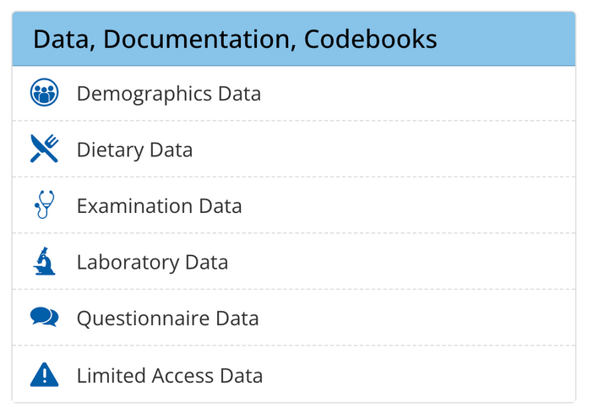
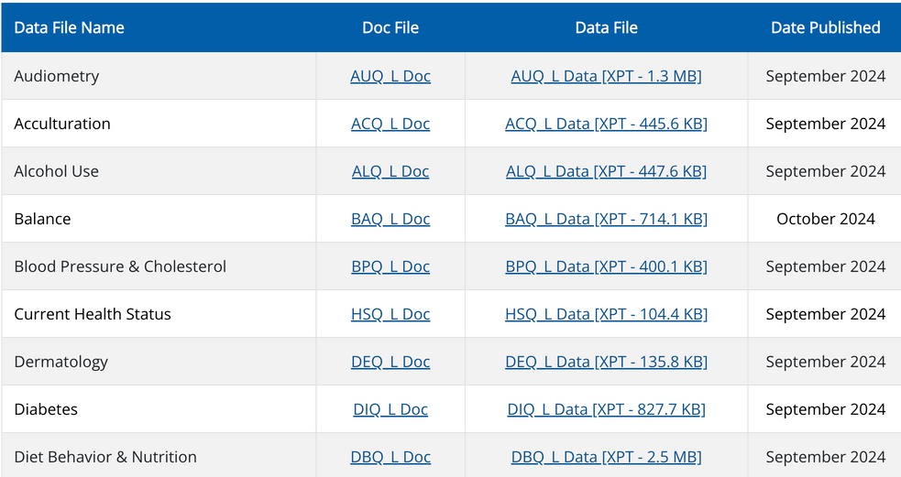
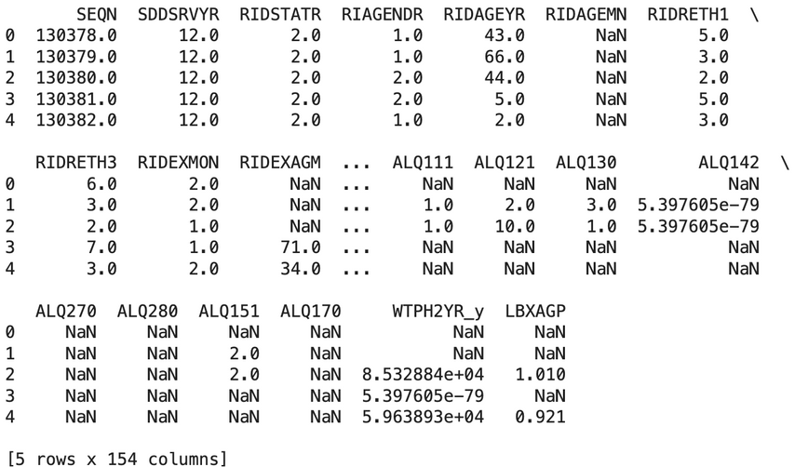
Dataset Description
NHANES August 2021-August 2023
11,933 observations x 154 variables
– Demographics Data (DEMO: age, gender, race, education, income-to-poverty ratio)
– Examination Data (BMX, BPXO: physical measurements such as BMI, sbp, dbp)
– Laboratory Data (AGP, GLU: clinical indicators (e.g., a1c, glucose))
– Questionnaire Data (DIQ, HIQ, ect.: self-reported lifestyle behaviors, health conditions, insurance coverage (e.g., smoking, physical activity, sleep hours, diabetes, insurance type))
Select 17 individual NHANES survey component files & Merge by a unique sequence number (SEQN)
https://wwwn.cdc.gov/nchs/nhanes/continuousnhanes/default.aspx

Slide 9

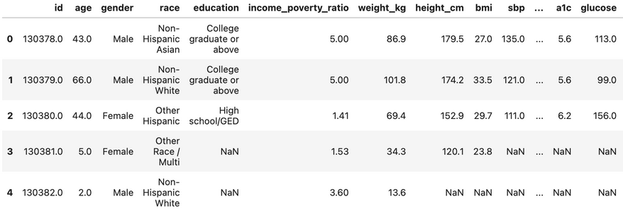
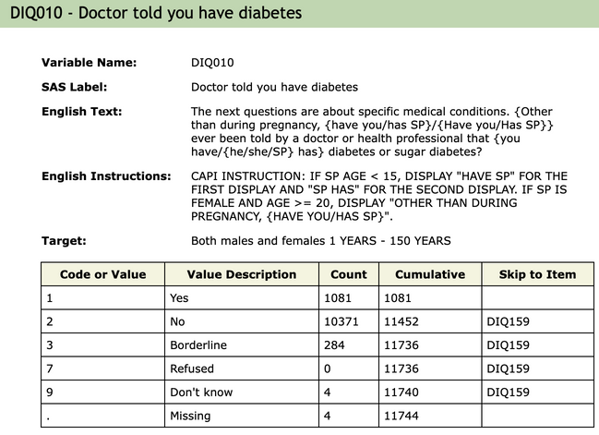
Dataset Preprocessing
– Demographics: age, gender, education, income poverty ratio
– Health indicators: sbp, dbp, bmi, diabetes self report
– Lifestyle:smoking current, smoking ever, physical activity freq, sleep hours
– Insurance status: insurance type
11,933 observations x 154 variables
Variable renaming and distinct value decode based on the Codebook
11,933 observations x 21 variables

Slide 10

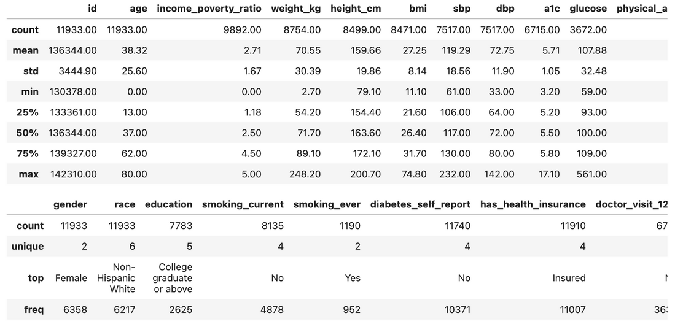
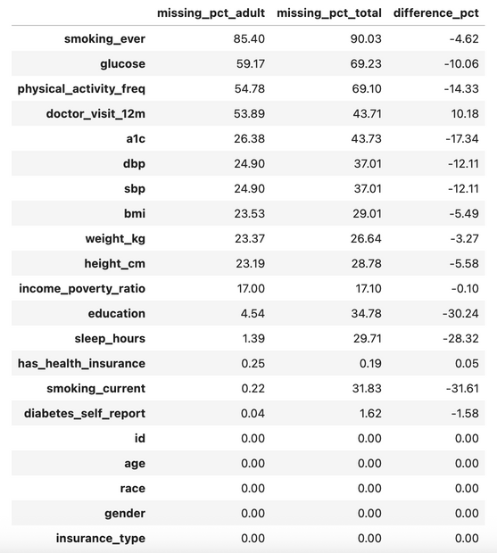
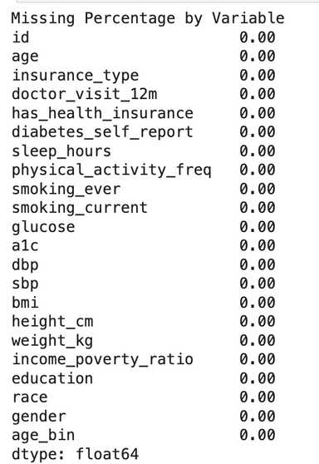
Data Preprocessing
Data Summary for Outlier Check
Missing Value Check
Handle the Missing Values and Ouliers
Categorical Na → "Unknown"
Numeric Na / Outlier → median imputation by_age × gender group → age group → global median

Slide 11
Exploratory Data Analysis (EDA)
Demographics
Health Indicators (BMI, SBP, DBP)
Lifestyle Factors
Insurance Status + BP Differences Across Insurance Types

Slide 12
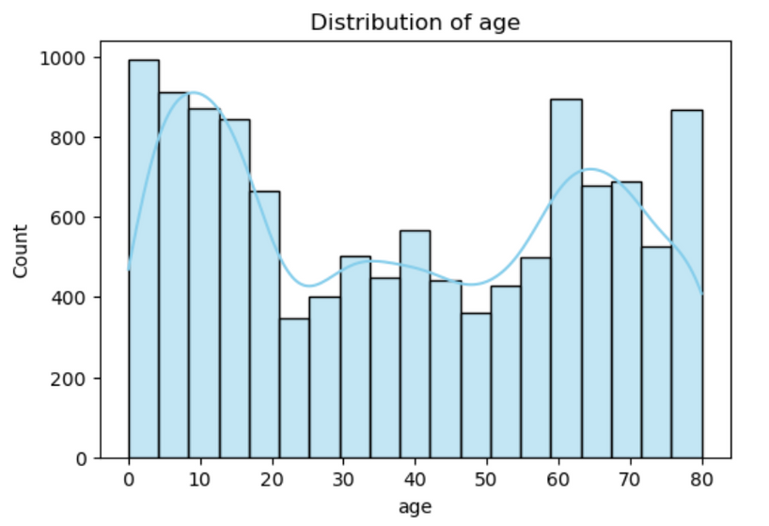
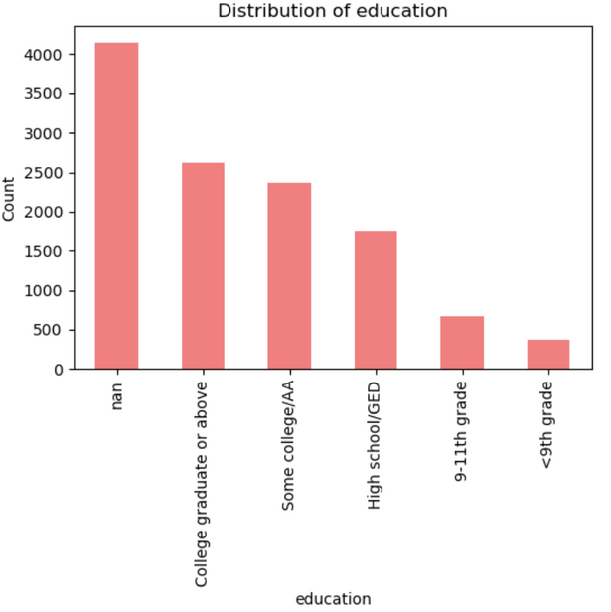
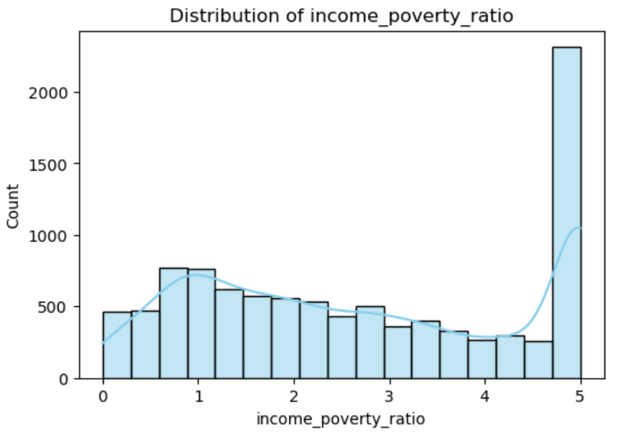
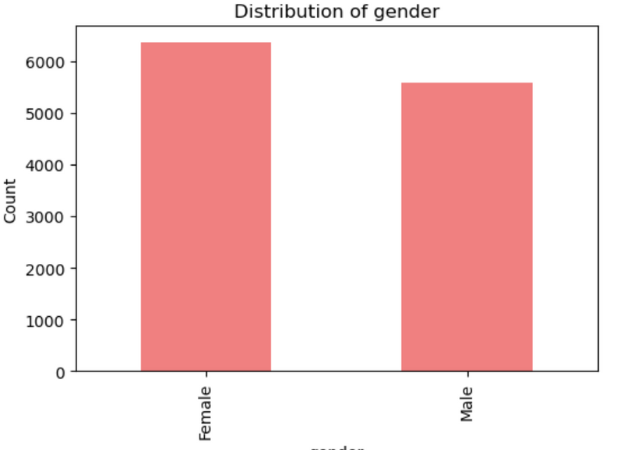
Exploratory Data Analysis (EDA)
Demographics

Slide 13
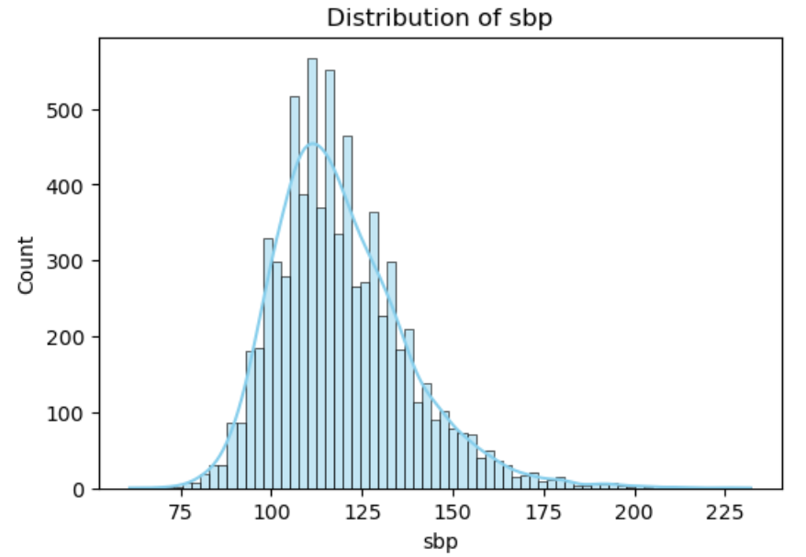
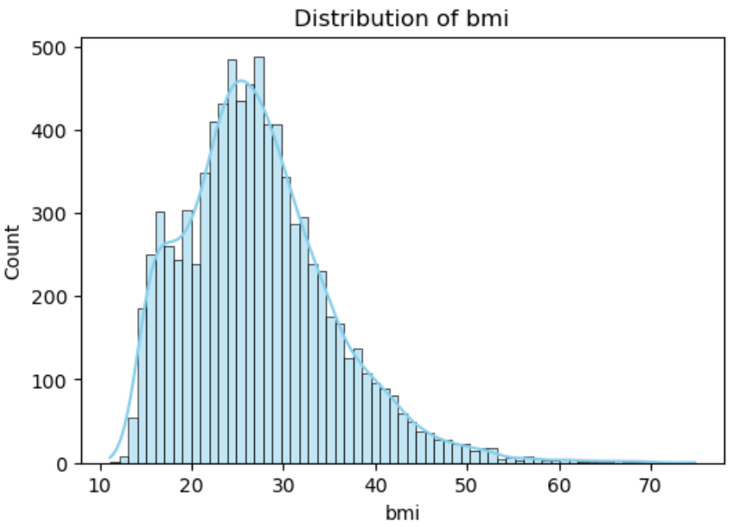
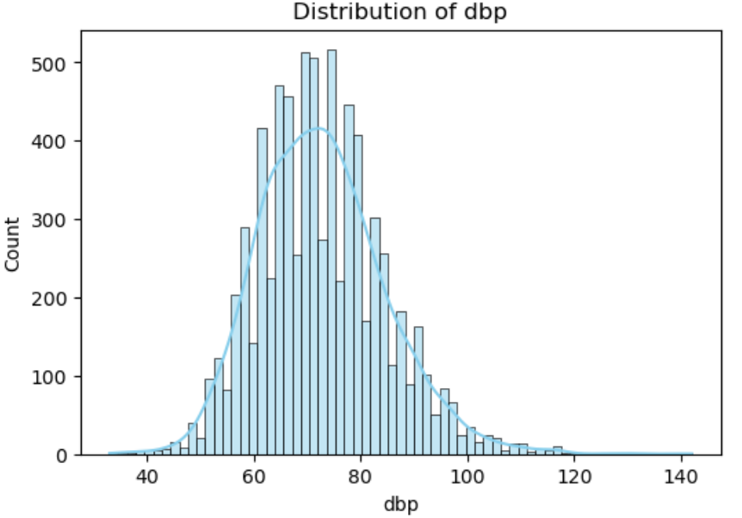
Exploratory Data Analysis (EDA)
Health
Indicators

Slide 14
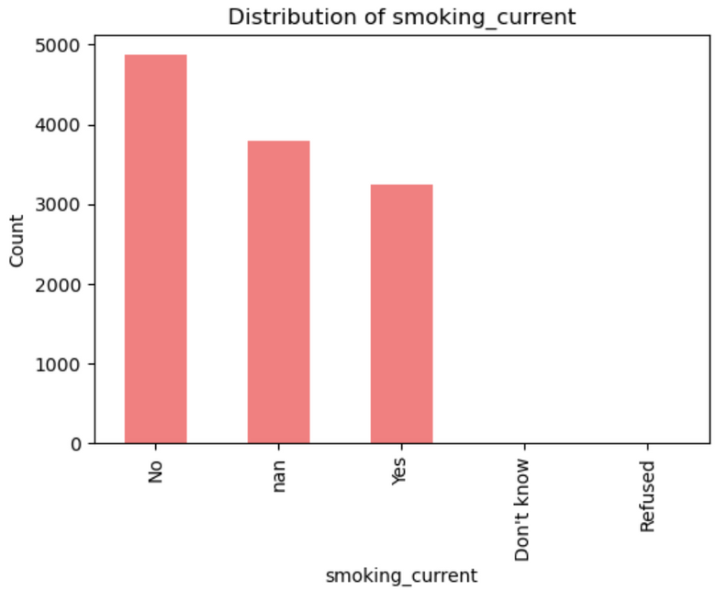
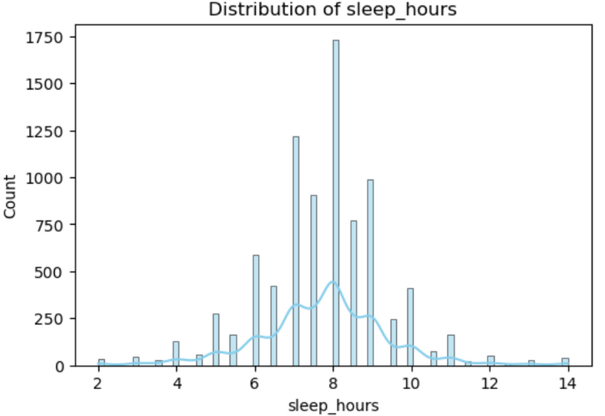
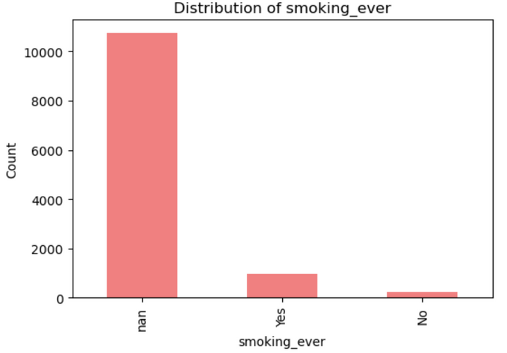
Exploratory Data Analysis (EDA)
Lifestyle

Slide 15
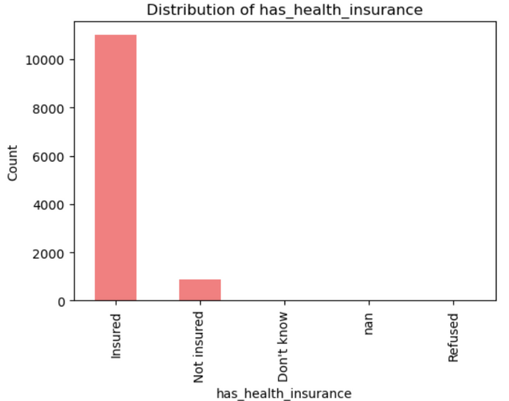
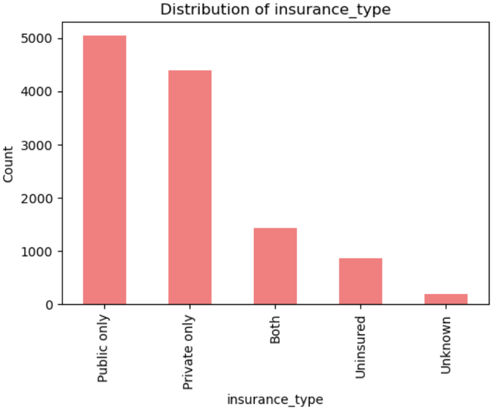
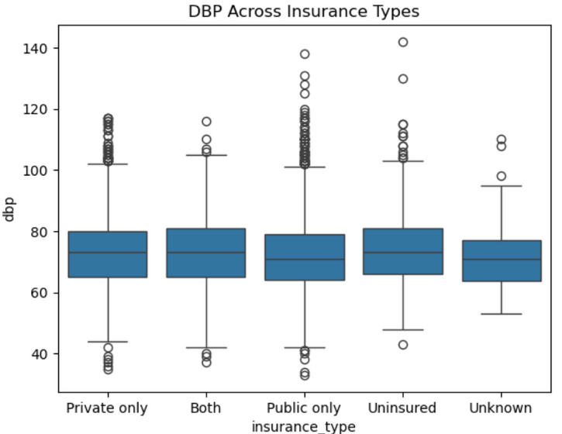
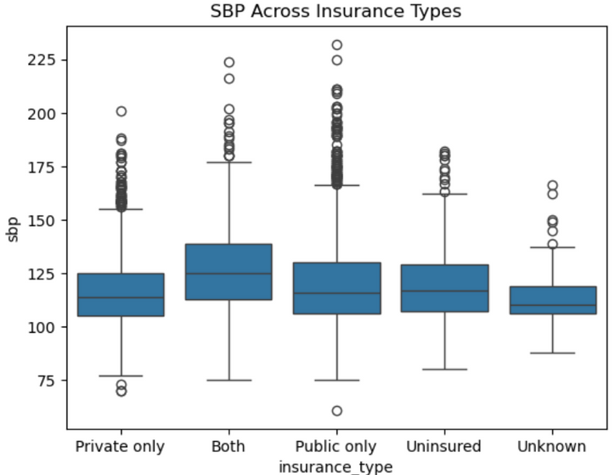
Exploratory Data Analysis (EDA)
Insurance Status
Blood Pressure Differences Across Insurance Types

Slide 16
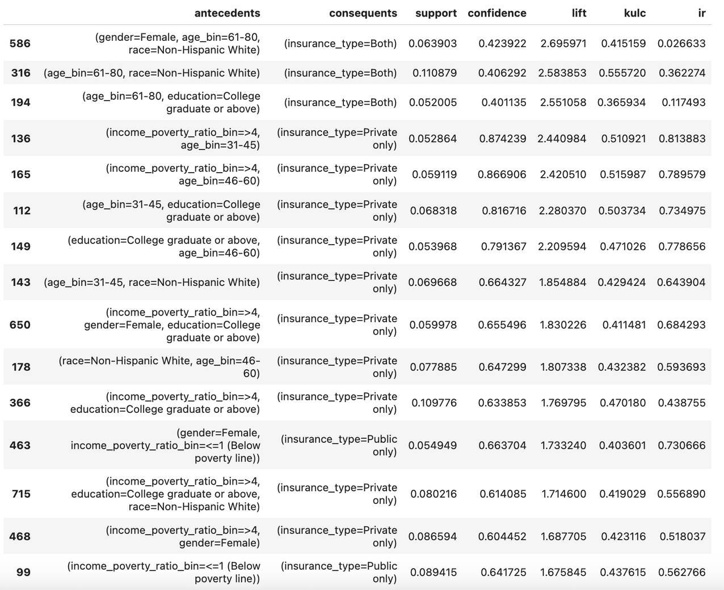
Association Rule Discovery: Apriori
Socio-economic → Insurance Type
1. Rules leading to “Both” (dual coverage):
Older adults such as 'age 61–80' who combine Medicare eligibility with private supplemental plans
2. Rules leading to “Private only” :
Middle-aged adults with high-income or college-education
3. Rules leading to “Public only”:
Low-income population

Slide 17
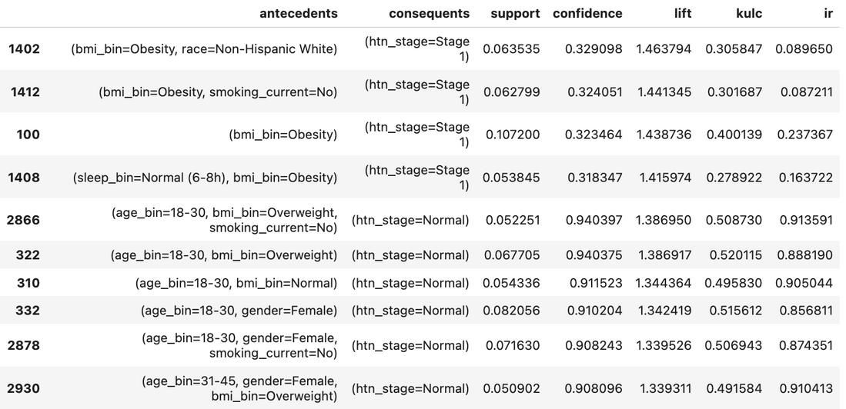
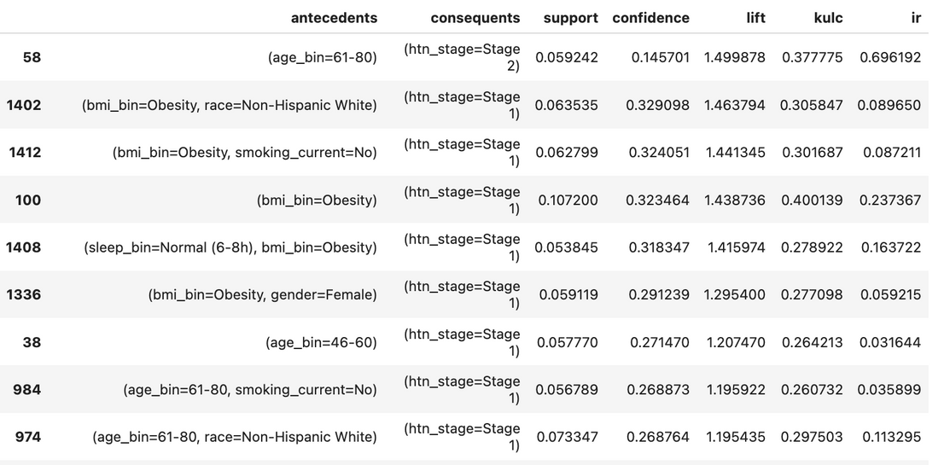
Association Rule Discovery: Apriori
Multi-Domain Determinant → Hypertension
1. Risk-increasing patterns
Obesity is one of the earliest detectable risk markers. This suggests that early weight-management interventions could substantially delay or prevent the transition from Normal BP to Stage 1.
2. Age-driven patterns
Age is one of the strongest protective buffer . Young age protects, obesity pushes individuals into Stage 1, and aging ultimately drives progression to Stage 2.

Slide 18
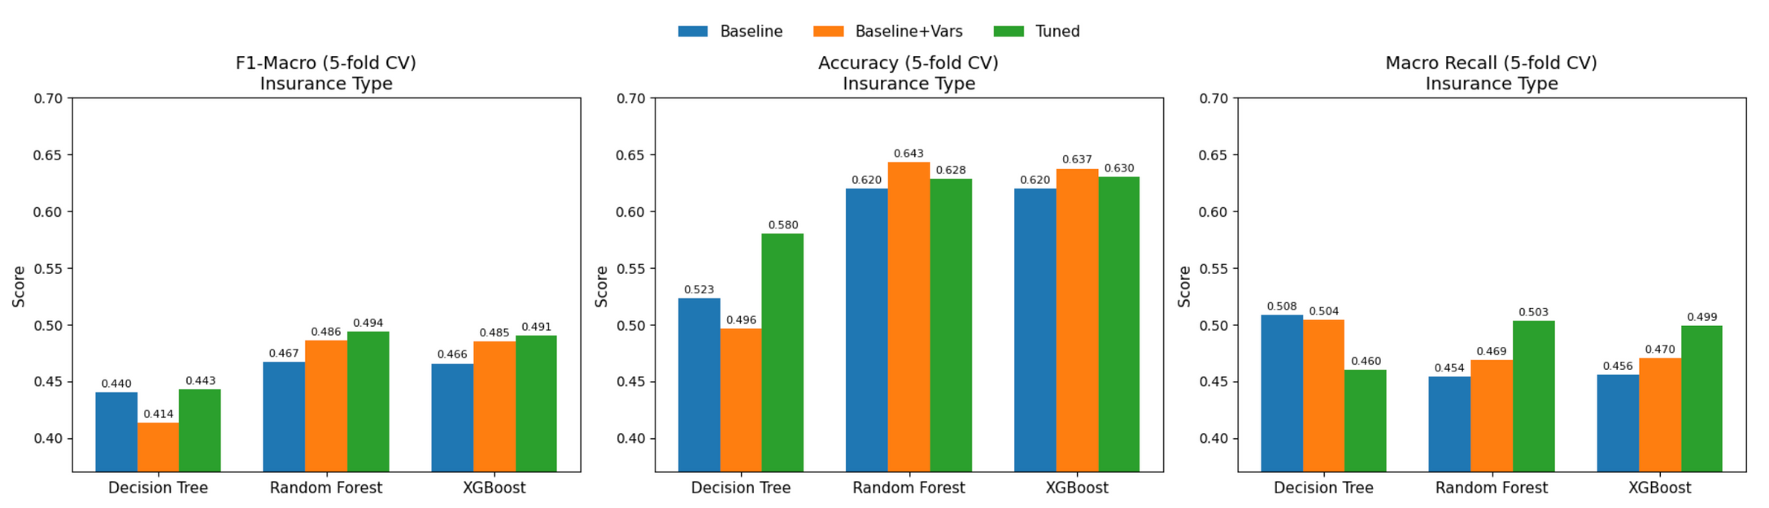
Classification for Insurance Type
Model Comparison
Decision Tree, 👍Random Forest, XGBoost
Optimzation Steps:
Feature Expansion: marital_status, household_size, is_employed
Stratified Cross Valiation
Oversampling to address class imbalance
Hyperparameter Tuning: Macro-F1 optimization

Slide 19
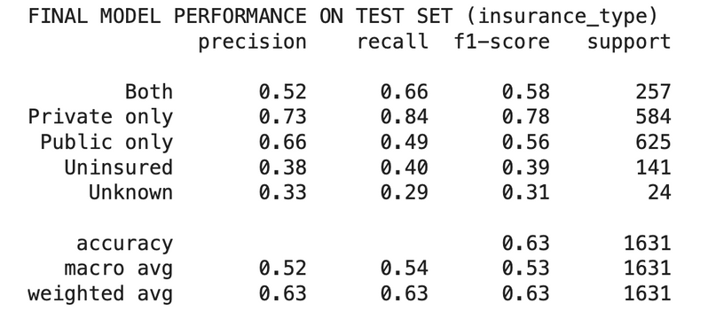
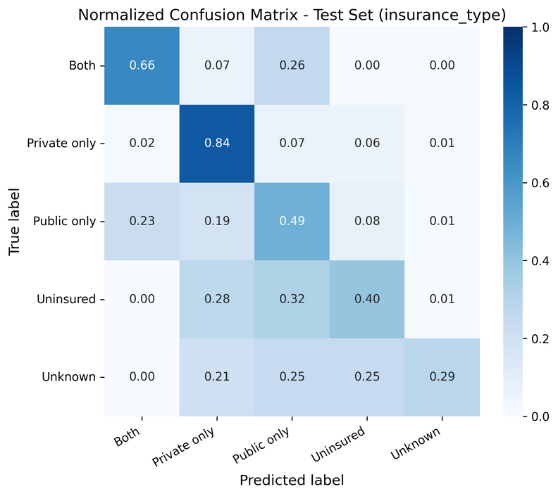
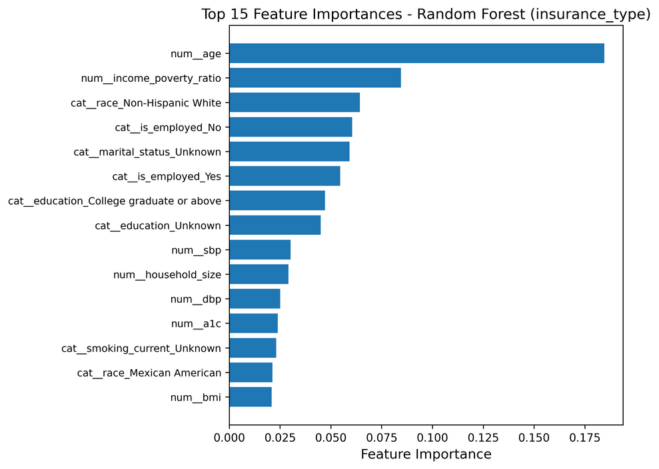
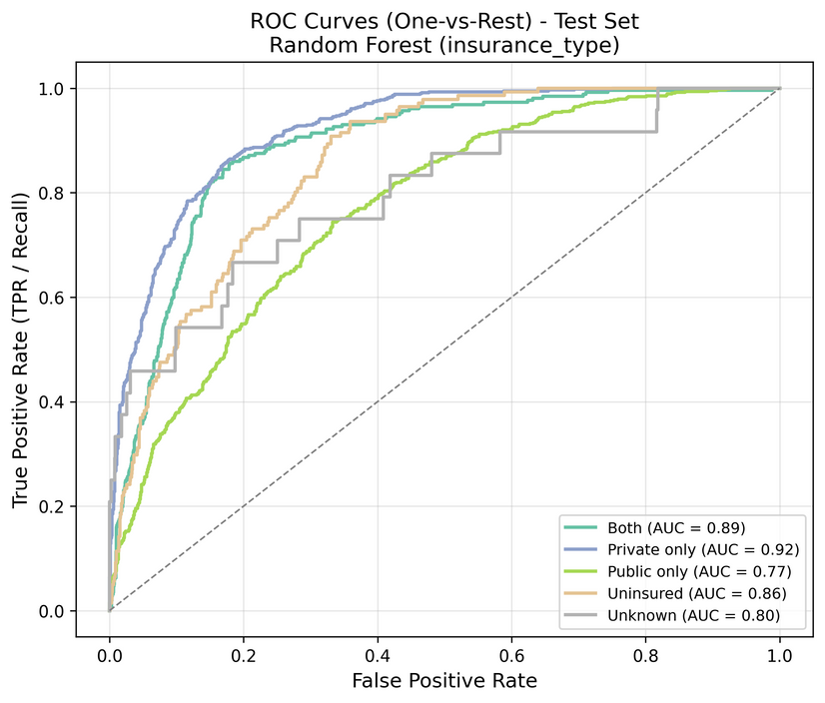
Classification for Insurance Type
Model Evaluation
Identifies the majority of Private-only (84%) and Both (66%) cases
Most confusion occurs between Public-only vs. Both and Uninsured vs. Public-only
Age and income–poverty ratio dominate prediction
Race, employment, and education collectively form the next tier
Clinical measures (BP, A1C) play a smaller role
Overall model performance is strong
AUC scores are high for Private-only (0.92) and Both (0.89)

Slide 20
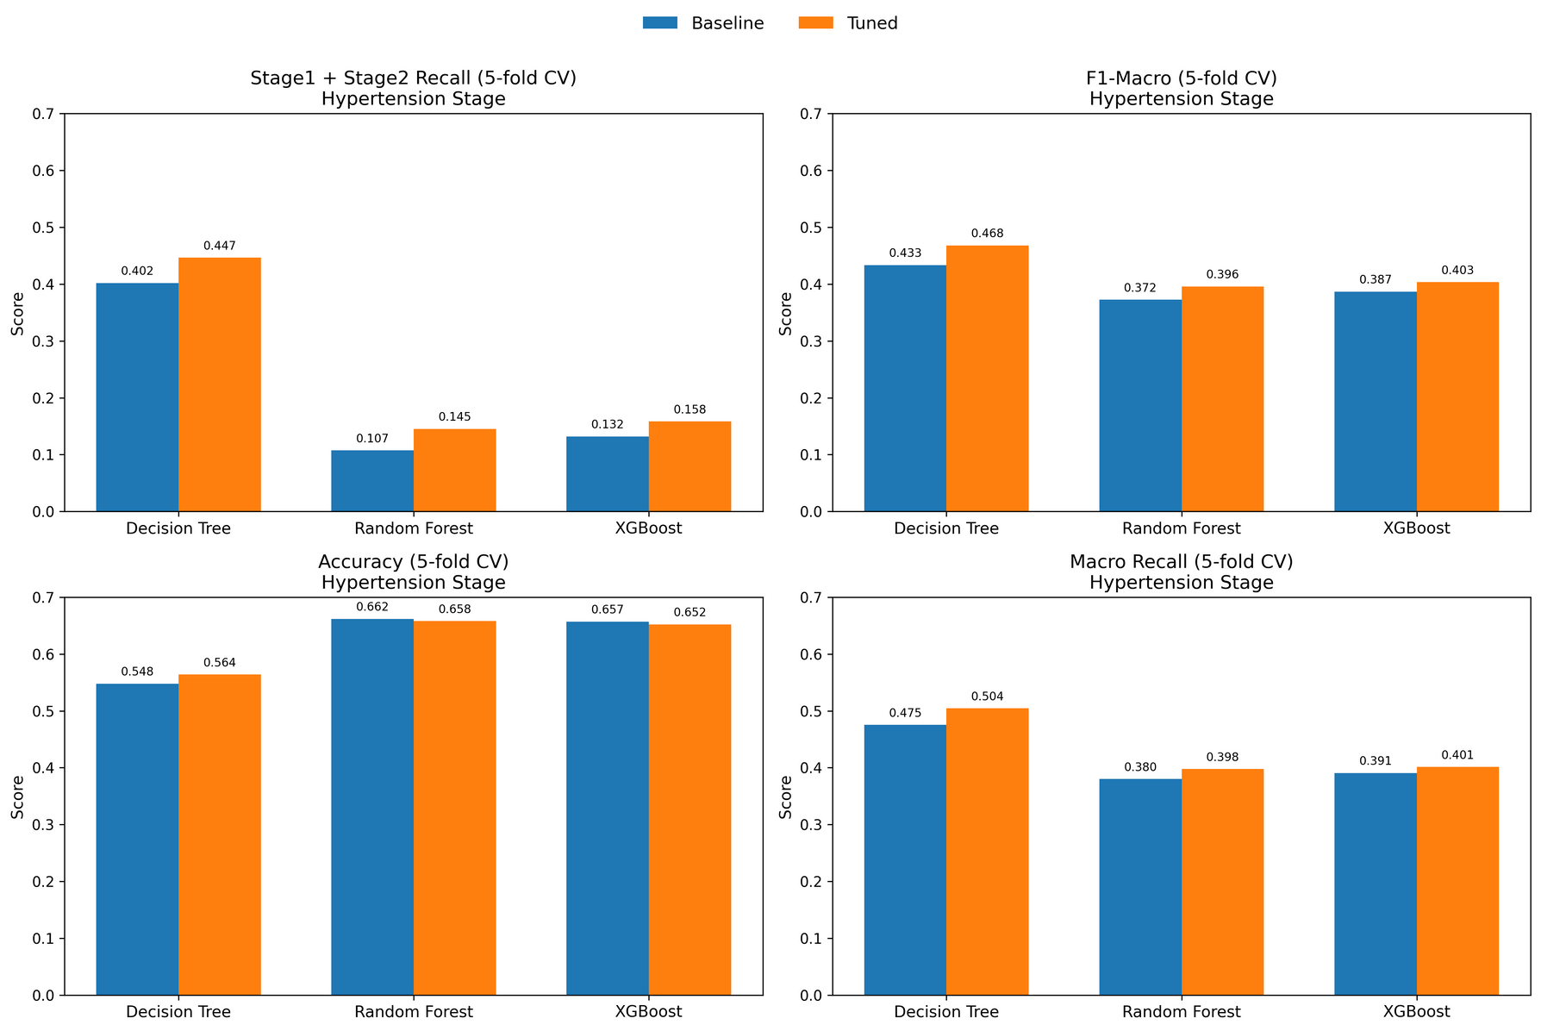
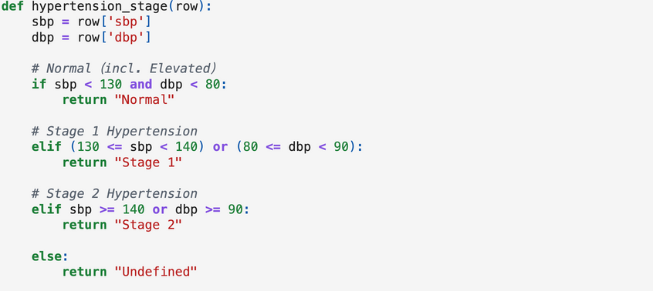
Classification for Hypertension Risk Prediction
Model Comparison
👍Decision Tree, Random Forest, XGBoost
Define hypertension Classification Labels:
Optimzation Steps:
Stratified Cross Valiation
Oversampling to address class imbalance
Hyperparameter Tuning: Aveage Recall of Stage 1 + Stage 2 as the tailored tuning indicator.
Best Model: Decison Tree:
Clear threshold patterns: Well-defined cutoffs in variables, such as age, BMI.
Strong rule-based separability - Hypertension stage criteria

Slide 21
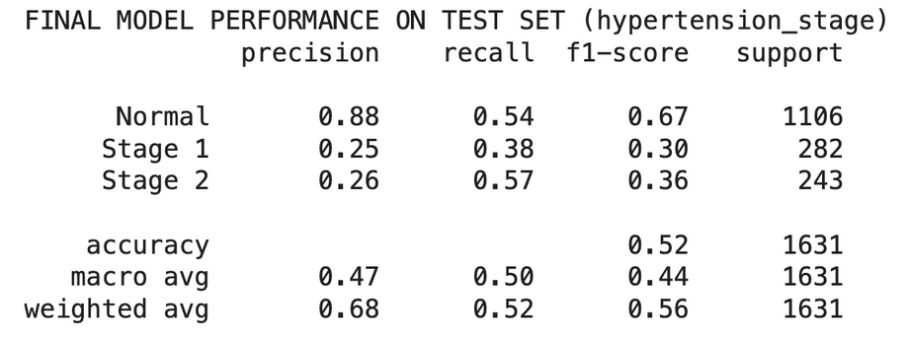
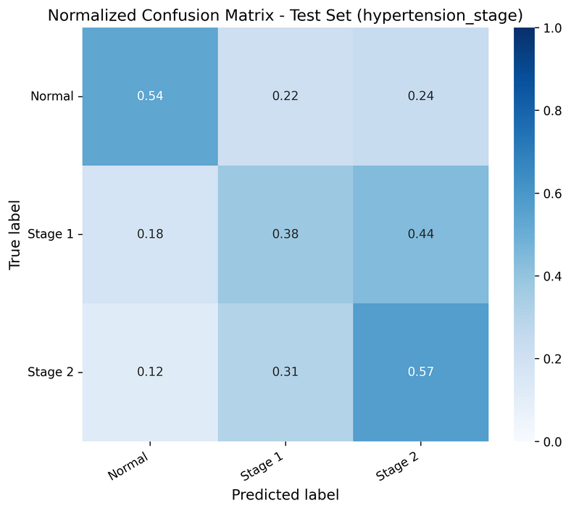
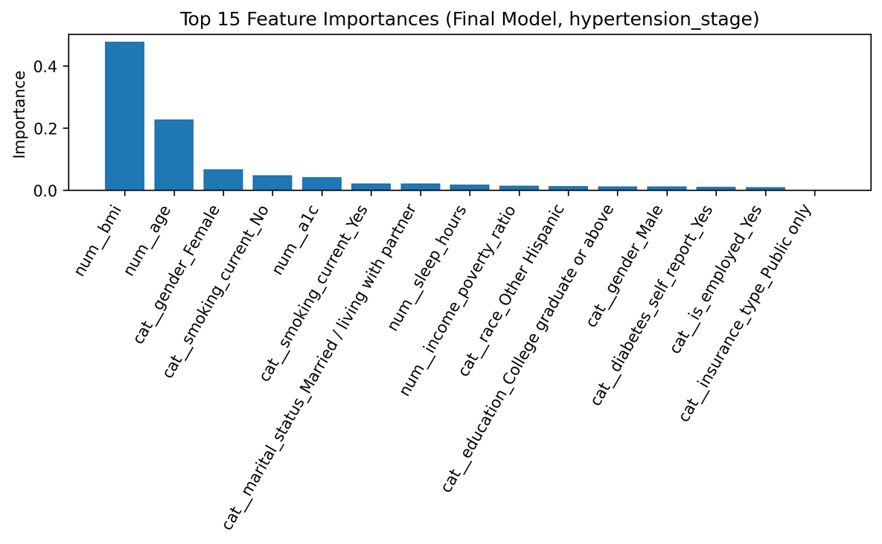
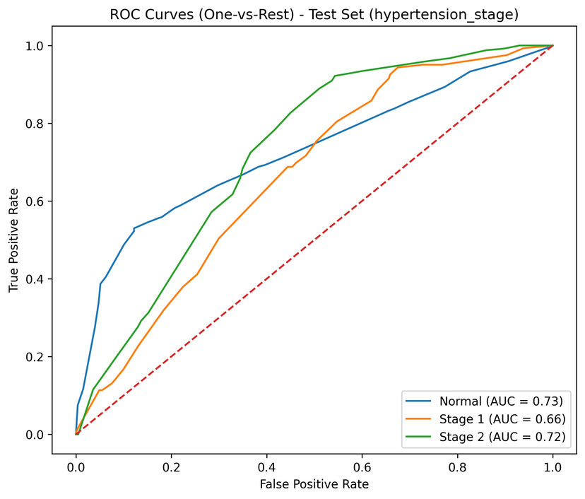
Classification for
Hypertension Risk Prediction
Model Evaluation
Identifies 54% of Normal cases
Stage 2 is recovered relatively well (57% recall), showing the model captures the more severe hypertension patterns aligned with clearer signals (older Age, higher BMI)
Stage 1 exhibits the most confusion
BMI and Age overwhelmingly dominate prediction
Behavioral factors are additional predictive signal
Socioeconomic variables play a secondary role vs direct physiological indicators.
Insurance type contributes minimally
Normal and Stage 2 are more distinguishable.
Stage 1 has a lower AUC reflecting real-world difficulty: mild hypertension is the hardest to clinically identify

Slide 22
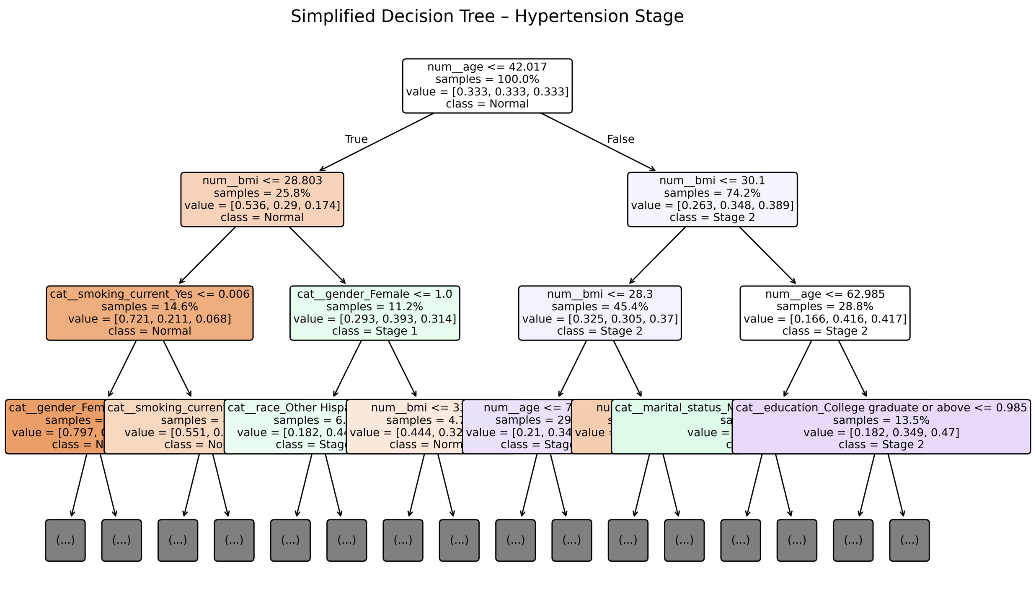

Slide 23
Clustering
Why?
Go beyond prediction → Understand population subgroups
Identify high-risk hypertensive groups + uninsured groups
K-Prototypes
Mixed data : numeric + categorical
K-Prototypes (Euclidean + matching dissimilarity)
What Method?
How Many Clusters?
k = 4
Elbow method
Clinical interpretability (HTN severity)
Balanced cluster size

Slide 24
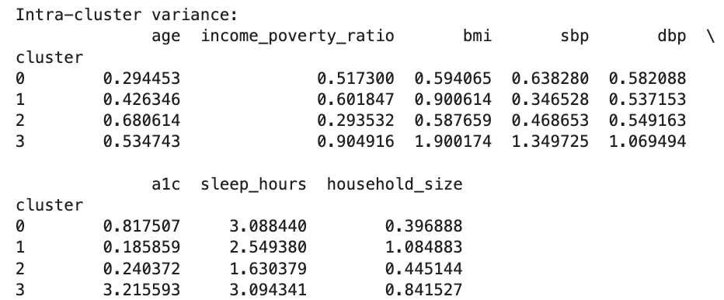
Cluster Evaluation
Expectedly low due to mixed-type high-dimensional data,but still indicates weak but valid separation among clusters.
Cluster 1: lowest variance
young, low-risk,behaviorally homogeneous group
Cluster 3: highest variance
older population,broad range of hypertension severity
Clusters 0 and 2: moderate variance
mixed SES and mixed insurance groups

Slide 25
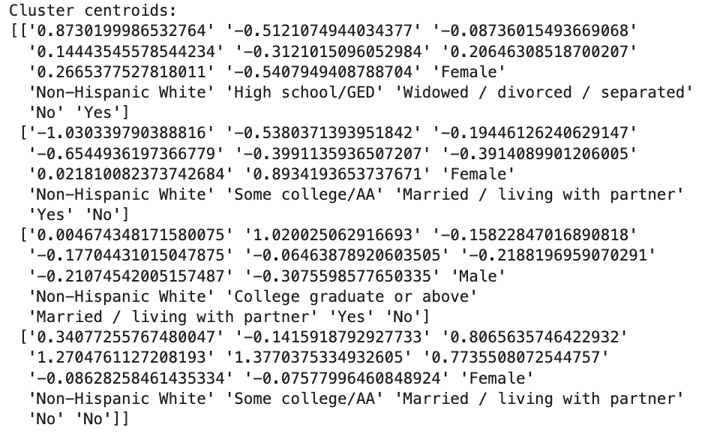
Cluster Evaluation
Centroids clearly differentiate SES, lifestyle, and hypertension gradients across the four clusters.

Slide 26
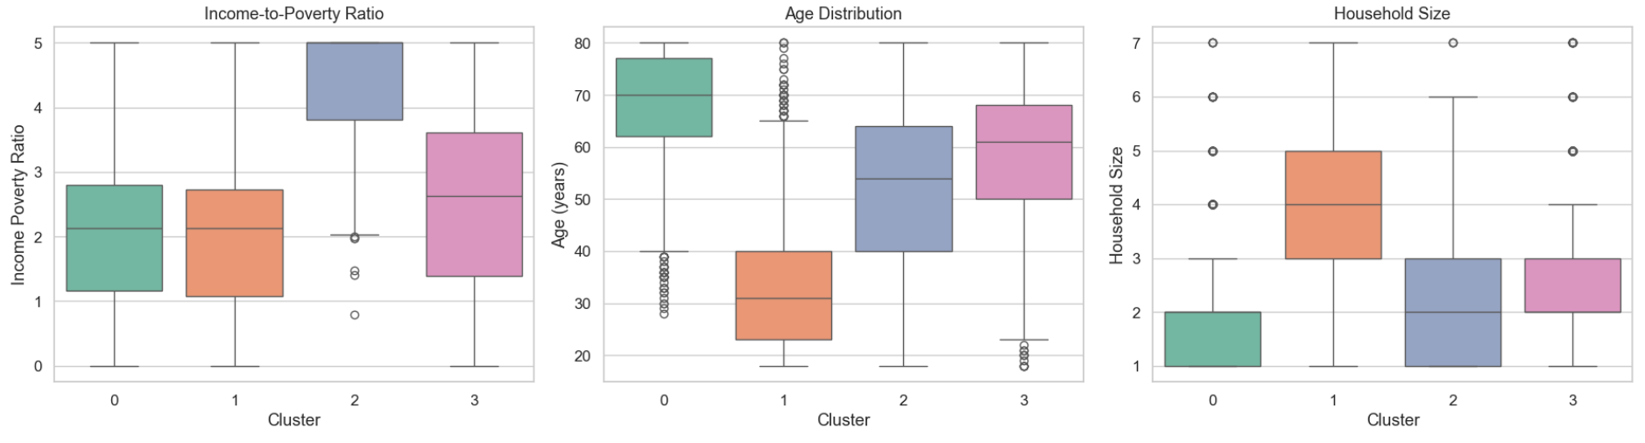
Cluster Profiles
Socioeconomic & Demographic Structure

Slide 27
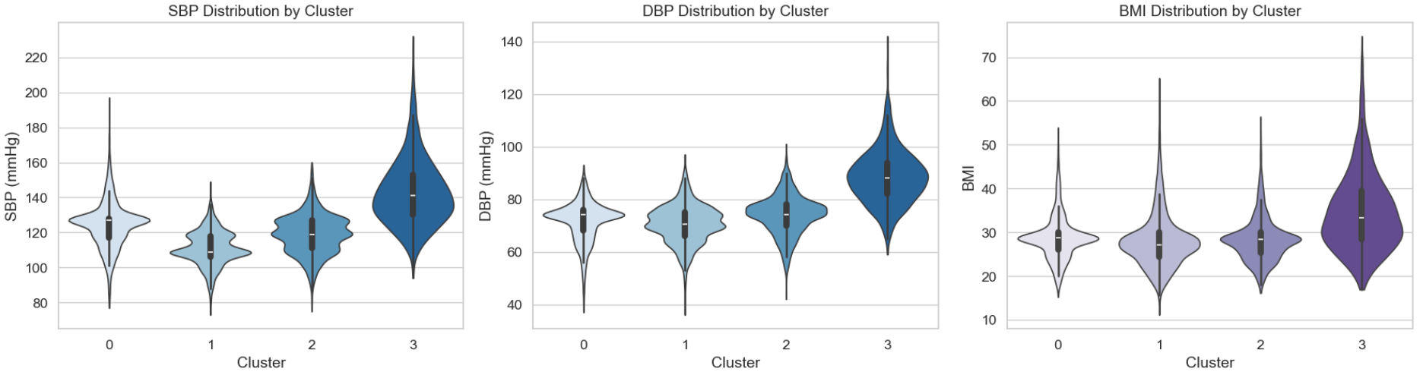
Cluster Profiles
Physiological Health Risk Profile

Slide 28
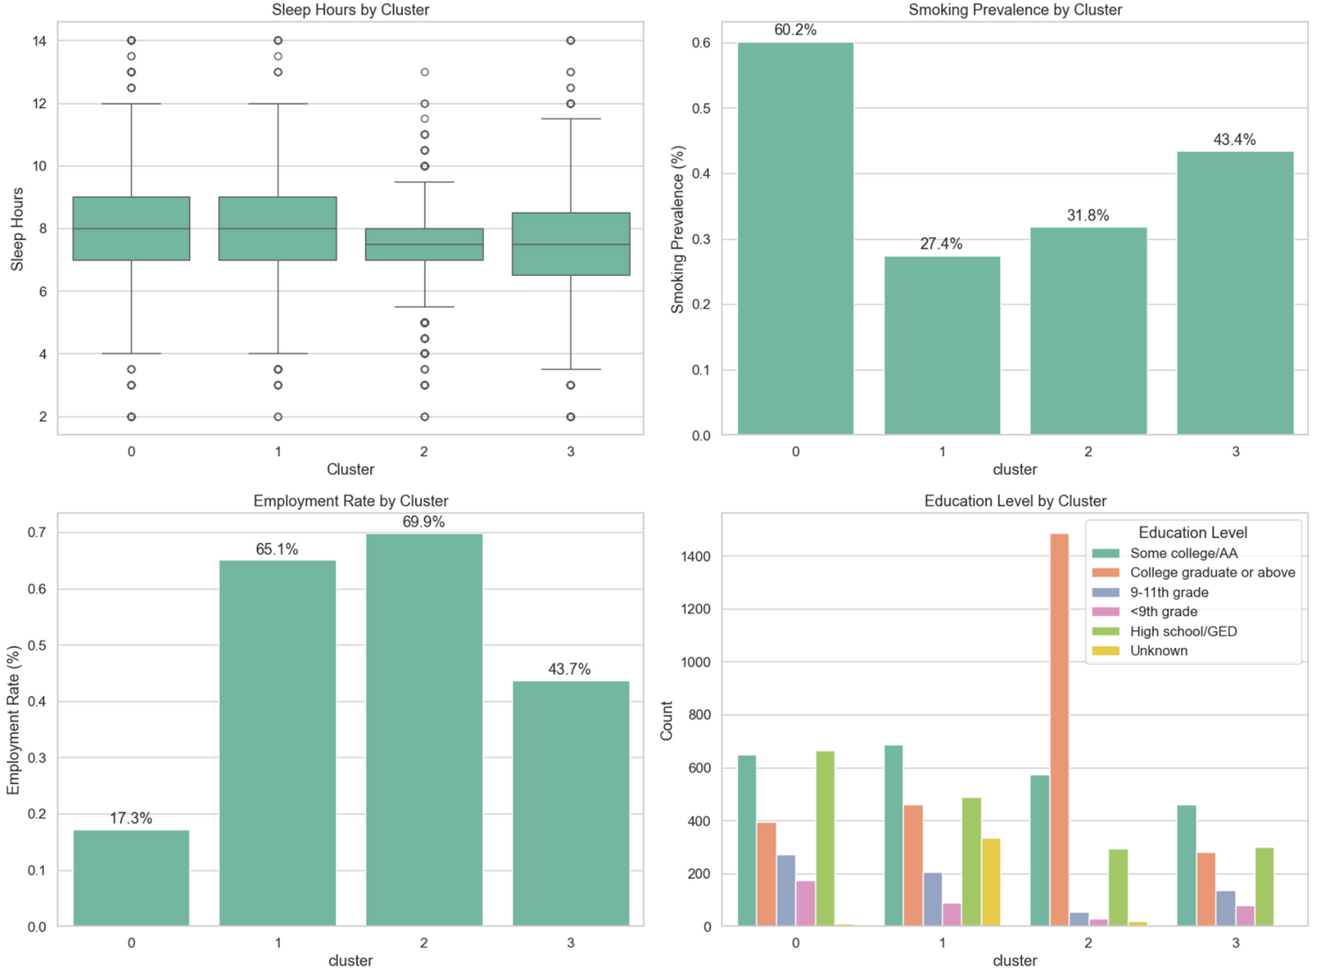
Cluster Profiles
Behavioral & Social Patterns

Slide 29
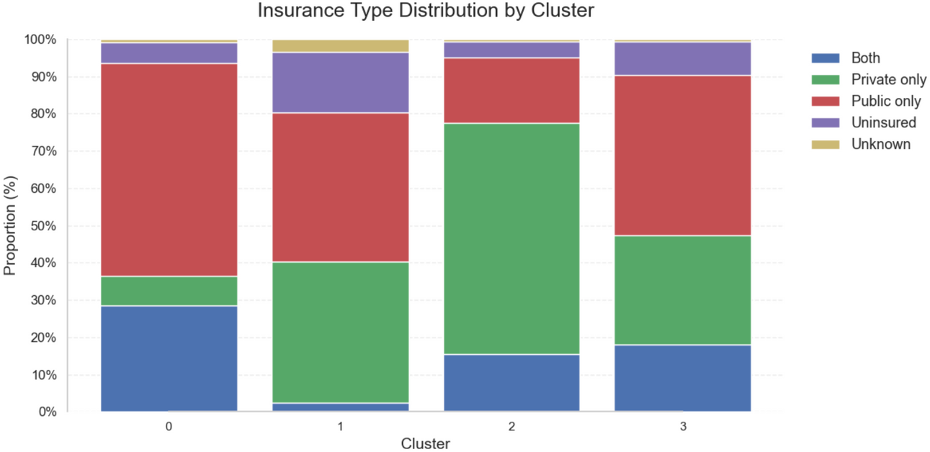
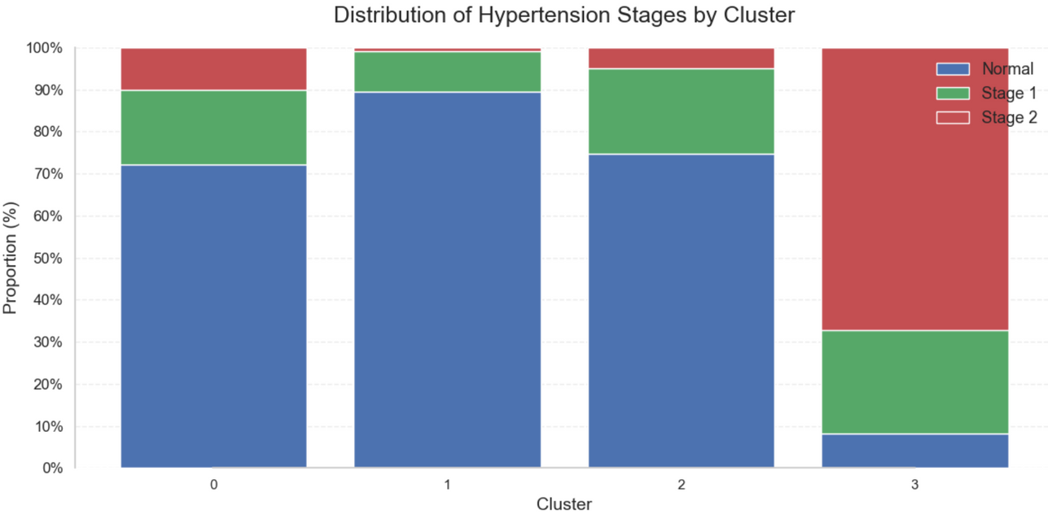
Cluster Profiles
Insurance Type & Hypertension Stage Distribution

Slide 30
Cluster Interpretation
Cluster 0 Low-Income Lifestyle-Risk Group
Cluster 1 — Young, Healthy, but Uninsured
Income-to-poverty ratio lowest → clear low-SES pattern
Age is oldest on average (≈ 65–80 yrs)
Smoking prevalence highest (≈ 60%)
Employment rate lowest (≈ 17%)
HTN distribution:
- Normal: 72%
- Stage 1: 18%
- Stage 2: 10%
- Insurance mainly public
- Youngest group (≈ 25–40 yrs)
- Highest proportion of Normal BP (≈ 89%)
- Lowest Stage 2 HTN (≈ 1%)
- Employment high (≈ 65%)
- Uninsured rate noticeably higher than other groups
- SES moderately low but stable
Cluster 2 — Well-Resourced, Protected, Low-Risk Group
Cluster 3 — Older, High-Risk Hypertension Group
- Highest income-to-poverty ratio → highest SES
- Education level highest
-Age (≈ 40-65 yrs)
- Employment highest (≈ 70%)
- Private insurance dominates
- HTN distribution:
- Normal: 75%
- Stage 1: 20%
- Stage 2: 5%
- Low BMI → lifestyle relatively healthy
- Age second-highest (≈ 50–70 yrs)
- Stage 2 hypertension extremely high (≈ 67%)
- BMI highest of all clusters
- Smoking high (≈ 43%)
- Insurance type mixed (public + private + uninsured)
- Employment moderate

Slide 31
Conclusion
Key Findings
Insurance Findings
Hypertension Findings
Cluster Findings
Cluster 0: Low-income, older, smokers
→ moderate HTN
Cluster 1: Young & healthy but uninsured
Cluster 2: High-SES, healthy lifestyle
→ mild HTN
Cluster 3: High BMI + unstable insurance
→ Severe HTN
Private insurance →
high-income, college-educated
Public insurance →
low-income, especially women
Dual: older adults on Medicare
Uninsured: most heterogeneous → hardest to predict
Stage 1 →
mainly predicted by BMI
Stage 2 →
strongest predictor = age
Young adults remain mostly normal BP even when overweight

Slide 32
Conclusion
Public Health Implications
1. Low-SES groups accumulate long-term risk
Higher smoking, BMI, older age → higher HTN stages
Implication: preventive care; lifestyle programs
2. Publicly insured older adults have unmet needs
Older age + elevated BP + poor lifestyle
Implication: strengthen follow-up; chronic care within public insurance
3. Young uninsured adults: healthy now, risky later
Highest uninsured rate
Implication: affordable insurance options, preventive outreach
4. Severe HTN + high BMI + unstable insurance
Fragmented care
Implication: integrated chronic care; insurance continuity

Slide 33
Conclusion
Limitations & Future Directions
Limitations
Future Work
NHANES is cross-sectional
Self-reported lifestyle data
High Laboratory Data Missingness
Link NHANES with cost data (e.g., MEPS)
Use dietary representation learning for richer features

Slide 34
Thank
You

