Slide 1
MERCURY RETROGRADE EFFECT ON CAPITAL MARKET
Sherry Zhao, Qintong He, Qixiang Jie, Yaxuan Jin

Slide 2
Catalog
Astrology origins
Mercury Retrograde and the Stock Market
Hypothesis
Models & Data & Methodology
Results
Conclusions

Slide 3
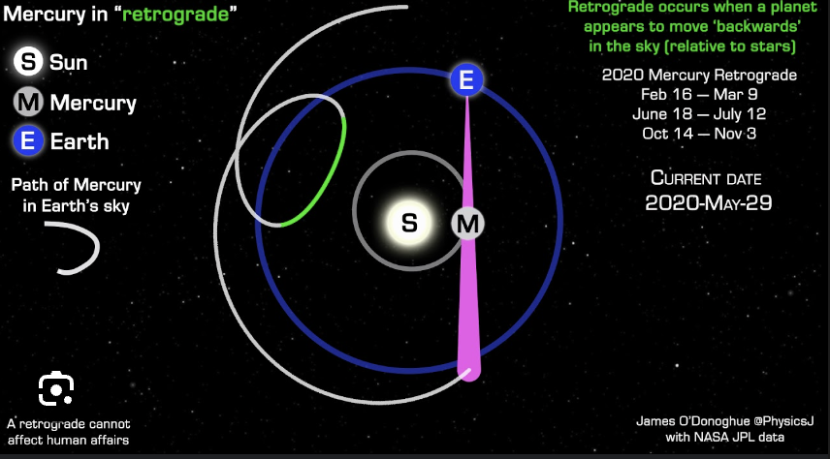
Mercury Retrograde
Astrology explanation
  An optical illusion
  All planets in the solar system move in the same direction around the sun, but because Mercury’s orbit is shorter than ours (88 days versus our 365), it “laps” the Earth a few times a year, and when it does so, it appears to reverse course
Behavioral influence
  Mercury rules communication, travel, technology, and thought processes, so when it goes retrograde, it's believed to disrupt these areas, creating confusion, delays, and misunderstandings

Slide 4
Origins of astrology
Early Origins: Astrology originated thousands of years ago across multiple cultures as a way to understand natural phenomena, time, and human life.
  Mesopotamia (around 3000 BCE): Among the first to systematically observe and record planetary movements. Believed celestial events impacted life on Earth, and by 1500 BCE, Babylonian astrologers developed horoscopes based on planetary positions.
  Ancient Egypt (after 332 BCE): Egyptian astrology was influenced by Babylonian concepts, introducing the zodiac divided into twelve constellations and associating celestial bodies with deities.
  Ancient Greece (2nd century BCE): Integrated Egyptian and Babylonian knowledge, formalizing astrology as a system. Ptolemy’s Tetrabiblos became a cornerstone of Western astrology.
.

Slide 5
The spread of astrology
After Alexander the Great conquered Asia, the Greeks were exposed to the cultures and cosmologies of Syria, Babylon, Persia, and Central Asia.
Islamic World
  In the 7th century, Alexandria was captured by the Arabs and the city of Baghdad was established as a center of learning, and a library and translation center was established in the city, which greatly facilitated the translation of Greek astrological texts into Arabic.
Medieval and Renaissance Europe
  By the end of the 10th century， Latin translations of Arabic works began to reach Spain, and in the 12th century, the spread of Arabic astrological works to Europe "gained great momentum.
Asia
  Cultural integration and globalization: Astrology originally originated in the West, but with the development of globalization, western astrology has become popular in Asia through movies, TV dramas, social media and other ways.

Slide 6
Mercury Retrograde
Source of Symbolism: The special symbolism of Mercury retrograde primarily comes from Western astrology, particularly the Greco-Roman tradition.
  Connection to Human Life: Greek and Roman cultures linked planetary movements to various aspects of life, believing that planets’ forward and retrograde states could influence events on Earth.
  Symbolism of Mercury Retrograde: During the Greco-Roman period, Mercury was associated with communication, travel, commerce, and thought. Mercury retrograde was believed to cause potential disruptions in these areas, like miscommunication or delays in travel and business.
The interpretation of Mercury retrograde continued to develop during the Middle Ages and became part of the Western astrological system, evolving into a popular modern astrological concept.

Slide 7
Mercury Retrograde in Modern Times
The astrological belief has been bonding with ancient Greek mythology. Hence, the name and roles of the planets come from Greek gods.
“Mercury Is in Retrograde. Don’t Be Alarmed.”
– Mar 16, 2019, The New York Times

Slide 8
Mercury Retrograde and the stock market
What do investors do during Mercury retrograde?
  Climb into a hole and stay there. Just kidding.
  Increased Volatility: Investors may misinterpret announcements from companies, news, or economic reports, leading to overact and increase
  Re-evaluation of Investments: Mercury retrograde is traditionally viewed as a time for reflection, which could encourage some investors to review their portfolios rather than take new risks
  Cautious Investment Strategies: some astrologers advise taking a cautious approach to investing during Mercury retrograde, favoring a more conservative investment style

Slide 9
Hypothesis
H1: The return volatility is significantly different during the Mercury Retrograde period
H2: The Mercury Retrograde has a significant influence on market return
H3: During the Mercury Retrograde period, there is a significant cumulated abnormal return either negative or positive

Slide 10
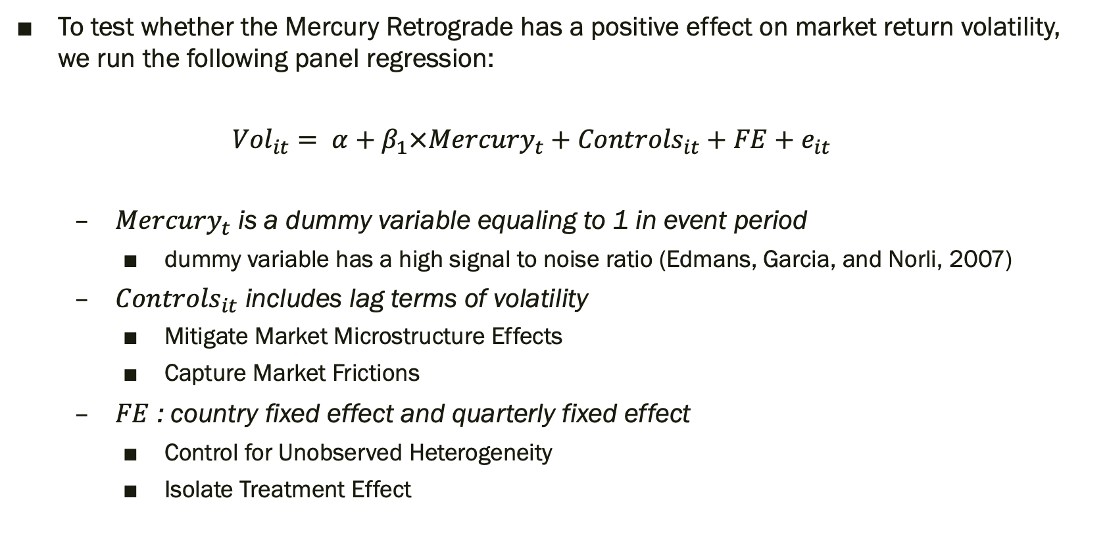
Model 1
To test whether the Mercury Retrograde has a positive effect on market return volatility, we run the following panel regression:
  $${Vol}_{it}= α+β_{1}×{Mercury}_{t}+{Controls}_{it}+FE+e_{it}$$
  ${Mercury}_{t}$ is a dummy variable equaling to 1 in event period
    dummy variable has a high signal to noise ratio (Edmans, Garcia, and Norli, 2007)
  ${Controls}_{it}$ includes lag terms of volatility
    Mitigate Market Microstructure Effects
    Capture Market Frictions
  $FE$ : country fixed effect and quarterly fixed effect
    Control for Unobserved Heterogeneity
    Isolate Treatment Effect

Slide 11
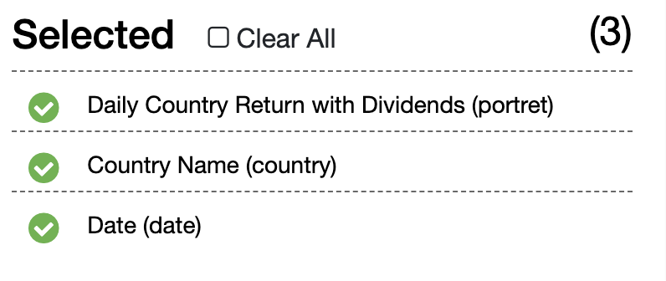
Data
Data source
  World Indices by WRDS – daily world indices
  Date range: from 2000-01-01 to 2023-12-31
  Daily country return with dividends
  Download all the available indices
  The Mercury Retrograde period
Data cleaning
  Classify into DM and EM (developed market and emerging market)
  Merge the data by date
  Drop the NA value
  Set time index
  Create dummy variable (equals 1 when in mercury retrograde period, otherwise 0)

Slide 12
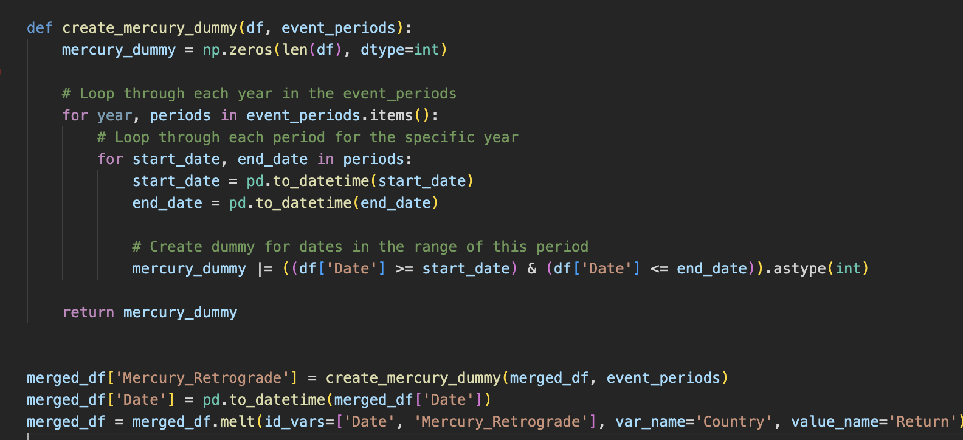
Data
Create a dummy variable

Slide 13
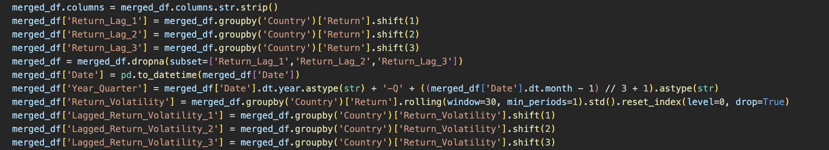
Data
Prepare for the regression
  Lag terms of return volatility
  Year-Quarter column

Slide 14
Data
Date | Mercury_Retrograde | Country | Return | Return_Lag_1 | Return_Lag_2 | Return_Lag_3 | Year_Quarter | Return_Volatility | Lagged_Return_Volatility_1 | Lagged_Return_Volatility_2 | Lagged_Return_Volatility_3
2000-01-12 00:00:00 | 0 | Sweden | 0.001584 | 0.006886839 | 0.029017234 | 0.014624913 | 2000-Q1 | 0.011860397 | 0.012450193 | 0.014508772 | 0.010341375
2000-01-13 00:00:00 | 0 | Sweden | 0.005911 | 0.001583818 | 0.006886839 | 0.029017234 | 2000-Q1 | 0.010766993 | 0.011860397 | 0.012450193 | 0.014508772
2000-01-14 00:00:00 | 0 | Sweden | 0.021253 | 0.005910626 | 0.001583818 | 0.006886839 | 2000-Q1 | 0.010759657 | 0.010766993 | 0.011860397 | 0.012450193
2000-01-17 00:00:00 | 0 | Sweden | 0.027039 | 0.021252625 | 0.005910626 | 0.001583818 | 2000-Q1 | 0.011406016 | 0.010759657 | 0.010766993 | 0.011860397
2000-01-18 00:00:00 | 0 | Sweden | -0.0229 | 0.027038992 | 0.021252625 | 0.005910626 | 2000-Q1 | 0.016104873 | 0.011406016 | 0.010759657 | 0.010766993
2000-01-19 00:00:00 | 0 | Sweden | 0.00203 | -0.022901597 | 0.027038992 | 0.021252625 | 2000-Q1 | 0.015355374 | 0.016104873 | 0.011406016 | 0.010759657
2000-01-20 00:00:00 | 0 | Sweden | 0.004718 | 0.002029981 | -0.022901597 | 0.027038992 | 2000-Q1 | 0.014613006 | 0.015355374 | 0.016104873 | 0.011406016
2000-01-21 00:00:00 | 0 | Sweden | 0.002554 | 0.004717719 | 0.002029981 | -0.022901597 | 2000-Q1 | 0.014027847 | 0.014613006 | 0.015355374 | 0.016104873
2000-01-24 00:00:00 | 0 | Sweden | 0.015842 | 0.002553833 | 0.004717719 | 0.002029981 | 2000-Q1 | 0.013617974 | 0.014027847 | 0.014613006 | 0.015355374
2000-01-25 00:00:00 | 0 | Sweden | -0.01285 | 0.015842412 | 0.002553833 | 0.004717719 | 2000-Q1 | 0.014258271 | 0.013617974 | 0.014027847 | 0.014613006
2000-01-26 00:00:00 | 0 | Sweden | 0.007549 | -0.01285324 | 0.015842412 | 0.002553833 | 2000-Q1 | 0.013740846 | 0.014258271 | 0.013617974 | 0.014027847
2000-01-27 00:00:00 | 0 | Sweden | -0.01325 | 0.007548856 | -0.01285324 | 0.015842412 | 2000-Q1 | 0.014197302 | 0.013740846 | 0.014258271 | 0.013617974
2000-01-28 00:00:00 | 0 | Sweden | 0.025783 | -0.013251976 | 0.007548856 | -0.01285324 | 2000-Q1 | 0.014590031 | 0.014197302 | 0.013740846 | 0.014258271
2000-01-31 00:00:00 | 0 | Sweden | -0.01836 | 0.025783356 | -0.013251976 | 0.007548856 | 2000-Q1 | 0.015347558 | 0.014590031 | 0.014197302 | 0.013740846
2000-02-01 00:00:00 | 0 | Sweden | 0.035826 | -0.018360654 | 0.025783356 | -0.013251976 | 2000-Q1 | 0.016466481 | 0.015347558 | 0.014590031 | 0.014197302
2000-02-02 00:00:00 | 0 | Sweden | 0.040901 | 0.035825998 | -0.018360654 | 0.025783356 | 2000-Q1 | 0.017728307 | 0.016466481 | 0.015347558 | 0.014590031
2000-02-03 00:00:00 | 0 | Sweden | 0.005966 | 0.040900799 | 0.035825998 | -0.018360654 | 2000-Q1 | 0.017289773 | 0.017728307 | 0.016466481 | 0.015347558
2000-02-04 00:00:00 | 0 | Sweden | 0.005266 | 0.00596555 | 0.040900799 | 0.035825998 | 2000-Q1 | 0.016887851 | 0.017289773 | 0.017728307 | 0.016466481
2000-02-07 00:00:00 | 0 | Sweden | 0.019513 | 0.005265871 | 0.00596555 | 0.040900799 | 2000-Q1 | 0.016660732 | 0.016887851 | 0.017289773 | 0.017728307
2000-02-08 00:00:00 | 0 | Sweden | 0.00404 | 0.019513092 | 0.005265871 | 0.00596555 | 2000-Q1 | 0.016324799 | 0.016660732 | 0.016887851 | 0.017289773
2000-02-09 00:00:00 | 0 | Sweden | 0.005658 | 0.004039532 | 0.019513092 | 0.005265871 | 2000-Q1 | 0.015992699 | 0.016324799 | 0.016660732 | 0.016887851
2000-02-10 00:00:00 | 0 | Sweden | 0.007259 | 0.005658051 | 0.004039532 | 0.019513092 | 2000-Q1 | 0.015671734 | 0.015992699 | 0.016324799 | 0.016660732
2000-02-11 00:00:00 | 0 | Sweden | 0.010411 | 0.007259269 | 0.005658051 | 0.004039532 | 2000-Q1 | 0.015371648 | 0.015671734 | 0.015992699 | 0.016324799
2000-02-14 00:00:00 | 0 | Sweden | -0.02112 | 0.010410508 | 0.007259269 | 0.005658051 | 2000-Q1 | 0.016096136 | 0.015371648 | 0.015671734 | 0.015992699
2000-02-15 00:00:00 | 0 | Sweden | -0.03176 | -0.02111946 | 0.010410508 | 0.007259269 | 2000-Q1 | 0.017409891 | 0.016096136 | 0.015371648 | 0.015671734
2000-02-16 00:00:00 | 0 | Sweden | 0.023121 | -0.031764167 | -0.02111946 | 0.010410508 | 2000-Q1 | 0.017384281 | 0.017409891 | 0.016096136 | 0.015371648

Slide 15
Results and conclusions
 | Coefficient of Mercury_t | T statistics | P value | Adjusted R^2 | No. Observations
DM | 9.86e-06 | 2.666 | 0.008 *** | 99.2% | 156050
EM | -1.301e-05 | -2.006 | 0.045 *** | 99.1% | 57888
DM
  During the Mercury Retrograde period, the volatility is significantly higher
  Developed markets often have higher liquidity and a greater number of participants who react to global news and sentiment shifts, potentially amplifying volatility
EM
  During the Mercury Retrograde period, the volatility is significantly lower
  Investor caution and decreased trading activity rather than heightened turmoil
  Bad mood and anxiety may affect investor decisions; anxious people may be more pessimistic regarding future returns, tend to take less risk (Guy Kaplanski 2008)

Slide 16
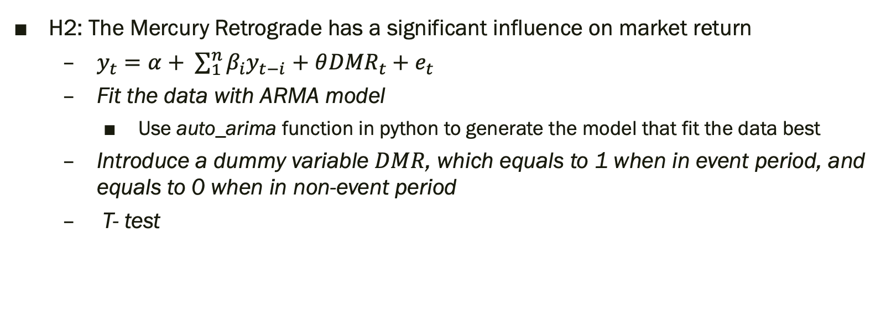
Model 2
H2: The Mercury Retrograde has a significant influence on market return
  $y_{t}=α+ \sum_{1}^{n}{β_{i}y_{t−i}}$ $+$ $θ{DMR}_{t}+e_{t}$
  Fit the data with ARMA model
    Use auto_arima function in python to generate the model that fit the data best
  Introduce a dummy variable $DMR$, which equals to 1 when in event period, and equals to 0 when in non-event period
  T- test

Slide 17
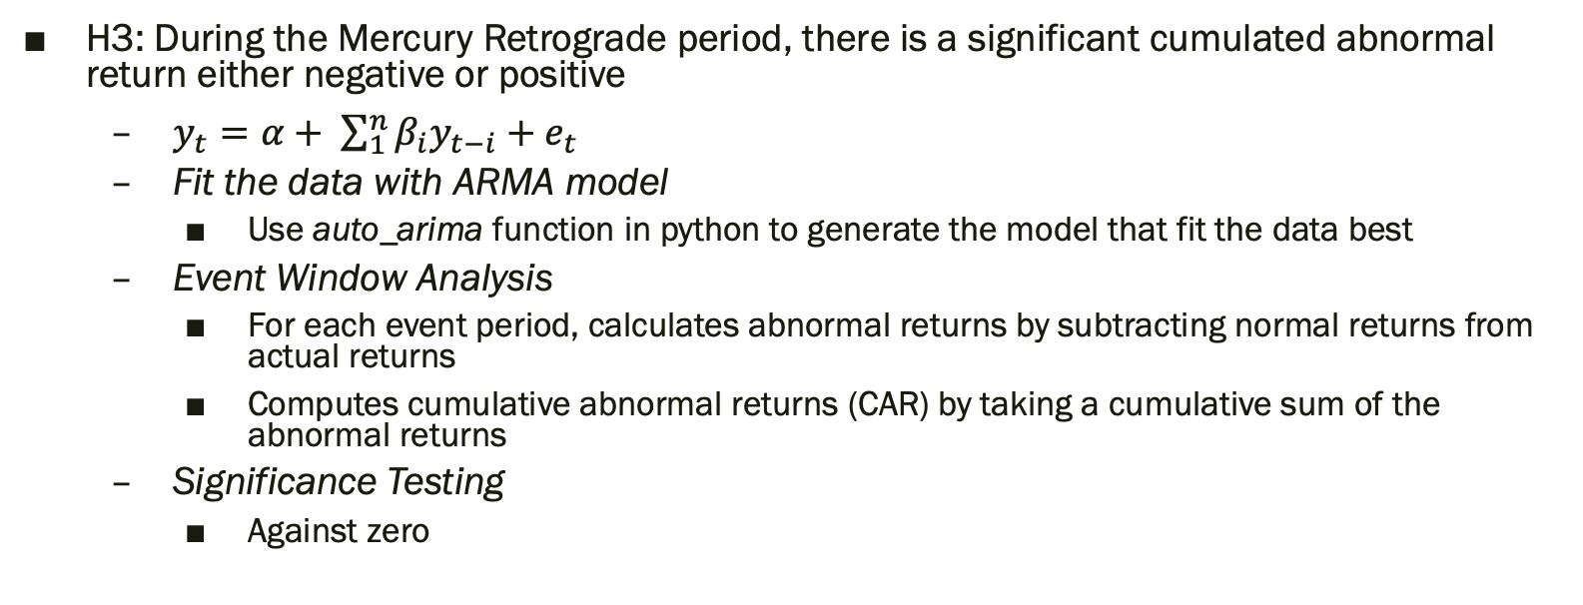
Model 3
H3: During the Mercury Retrograde period, there is a significant cumulated abnormal return either negative or positive
  $y_{t}=α+ \sum_{1}^{n}{β_{i}y_{t−i}}+e_{t}$
  Fit the data with ARMA model
    Use auto_arima function in python to generate the model that fit the data best
  Event Window Analysis
    For each event period, calculates abnormal returns by subtracting normal returns from actual returns
    Computes cumulative abnormal returns (CAR) by taking a cumulative sum of the abnormal returns
  Significance Testing
    Against zero

Slide 18
Results
Country | Percentage of periods that the influence is significant (level=10%) | Percentage of periods that the CAR is significant (level=5%)
US | 62.5% | 95.8%
Japan | 58.3% | 100%
France | 70.8% | 100%
Australia | 75% | 100%
China | 83.3% | 95.3%
India | 25% | 100%
Mexico | 54.2% | 100%

Slide 19
Conclusion
The Mercury Retrograde has significant impact on market volatility and returns
Self-Fulfilling Prophecies: Some market participants might believe in or be influenced by Mercury Retrograde, expecting volatility and thus contributing to increased market activity. In behavioral finance, beliefs—rational or not—can drive trading volume and volatility, particularly if a large number of traders act on similar expectations.
Cognitive Bias and Decision-Making: During periods when Mercury is retrograde, traders who believe in its effects might be prone to increased caution or hasty decisions, impacting market behavior. While this could theoretically add to volatility, this effect would likely be minimal and hard to separate from broader market influences.

