Slide 1
Click Fraud Detection In Online Advertisements

Slide 2
PROBLEM??
Dishonest publishers might generate clicks on advertisements on their websites using manual and/or automated techniques to increase their revenue.
Dishonest advertisers might also generate false clicks on their competitor's advertisements to drain their advertising budgets.

Slide 3
Dataset
PartnerID | Bank Account | Address | Status
8iaxj |  | 14vxbyt6sao00s | Fraud
8jljr |  |  | Ok
Table 1: Publisher sample in raw training data.
id | iplong | agent | Partner id | cid | cntr | timeat | category | referer
134178 | 364840 | GT-I9 | 8iaxj | 8fj2j | ru | 0:00:00 | ad | 26okyx5
134176 | 375696 | Samsun | 8jljr | 8geyk | in | 0:11:05 | es | 15vynjr
134178 | 693232 | SonyEri | 8jljr | 8gkkx | ke | 1:21:00 | es
134178 | 288420 | Nokia | 8jljr | 8gp95 | vn | 0:47:13 | es
134180 | 364840 | GT-I | 8iaxj | 8fj2m | ru | 5:30:00 | ad | 24w9x4
134183 | 78135 | Nokia | 8iaxj | 8fj2j | ru | 7:16:53 | ad | 4im48n
Table 2: Click sample in raw training data.

Slide 4
Feature Extraction
Attribute: iplong
MaxSameIpCount
NoOfUniqueIp
IpClickRatio
Ipvariance
Attribute: Time-At
No. of click per 1 minute
Average
Max
Variance
Skewness
No. of clicks per 1 hour
No. of clicks per 3hour

Slide 5
Top Features
Click Behaviour | High Risk Click Behaviour
Rank | Feature | Relative inf. | Rank | Feature | Relative inf.
1 | EntropyIplong | 5.97 | 2 | cntr_id_% | 5.49
3 | RefClickRatio | 4.79 | 9 | cntr_sg_% | 3.09
4 | IpClickRatio | 4.69 | 10 | cntr_othr_% | 2.72
5 | NoOfUniqueRef | 4.56 | 12 | cntr_us_% | 1.44
6 | MaxSameAgentCnt | 4.15 | 13 | cntr_th_% | 1.39
7 | IpVariance | 3.77 | 14 | cntr_uk_% | 1.34
8 | NoOfUniqueAgent | 3.75 | 15 | cntr_in_% | 1.26
11 | Skew5Min | 1.621 | 19 | cntr_ng_% | 0.95
16 | TotalClicks | 1.09 | 21 | cntr_tr_% | 0.94
17 | AvgClickPer1Min | 1.08 | 32 | cntr_ru_% | 0.66
Table 3: Top-10 features by type

Slide 6
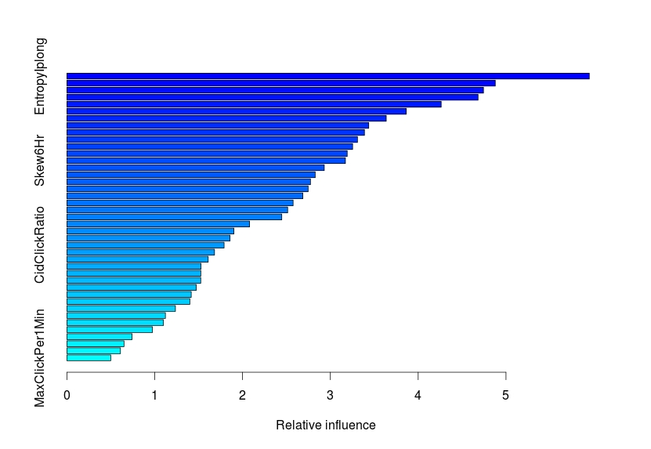
Relative Influence

Slide 7
Feature Selection
Chance of data overfitting.
Methods
Principal Component Analysis (PCA)
Common Spatial Patterns (CSP)
rapper subset evaluation
Not yet tested.

Slide 8
Single Algorithms
Precision | Recall | F-Measure | ROC
Algorithm | Ok | Fraud | Ok | Fraud | Ok | Fraud | Ok | Fraud
Logistic Regression | 0.976 | 0.316 | 0.991 | 0.141 | 0.984 | 0.195 | 0.936 | 0.906
Bayesian Net | 0.996 | 0.114 | 0.803 | 0.894 | 0.889 | 0.203 | 0.871 | 0.867
MLP | 0.975 | 0.588 | 0.998 | 0.118 | 0.986 | 0.196 | 0.825 | 0.825
J48 | 0.977 | 0.283 | 0.986 | 0.200 | 0.981 | 0.234 | 0.589 | 0.589

Slide 9
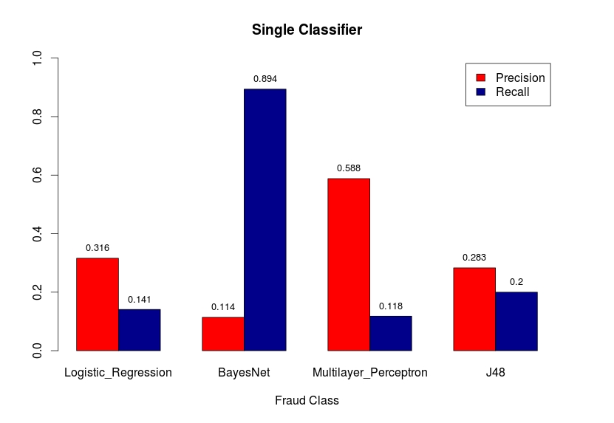
Precision-Recall

Slide 10
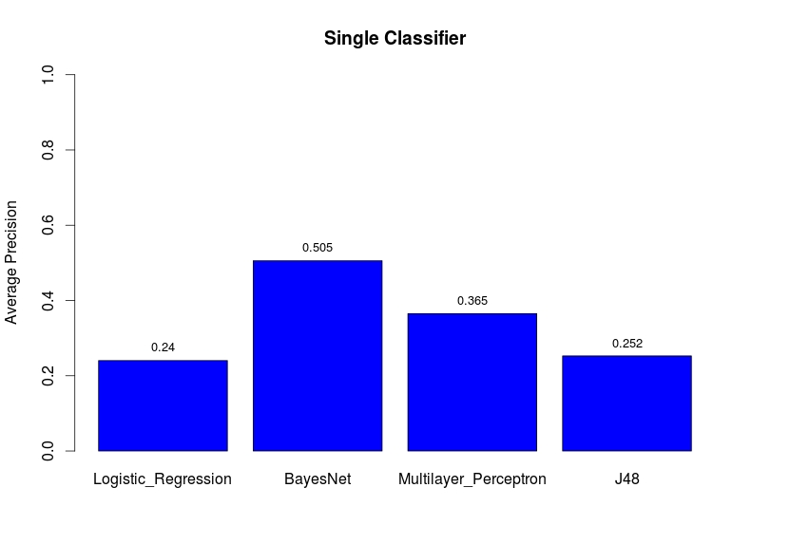
Average Precision

Slide 11
Ensemble Approach
Precision | Recall | F-Measure | ROC
Algorithm | Ok | Fraud | Ok | Fraud | Ok | Fraud | Ok | Fraud
Bagging J48 | 0.978 | 0.655 | 0.997 | 0.224 | 0.987 | 0.333 | 0.928 | 0.928
Bagging RF | 0.976 | 0.846 | 0.999 | 0.129 | 0.987 | 0.224 | 0.932 | 0.932
Bagging REPTRee | 0.976 | 0.765 | 0.999 | 0.153 | 0.987 | 0.255 | 0.934 | 0.934
Adaboost J48 | 0.978 | 0.476 | 0.993 | 0.235 | 0.986 | 0.315 | 0.846 | 0.871
Adaboost RF | 0.975 | 0.625 | 0.998 | 0.118 | 0.987 | 0.198 | 0.923 | 0.923
Adaboost REPTree | 0.979 | 0.457 | 0.992 | 0.247 | 0.985 | 0.321 | 0.910 | 0.910
Stacking NB<J48<MLP | 0.987 | 0.293 | 0.961 | 0.565 | 0.974 | 0.386 | 0.907 | 0.907
Stacking NB<BJ48<BRF | 0.991 | 0.365 | 0.966 | 0.682 | 0.978 | 0.475 | 0.931 | 0.931

Slide 12
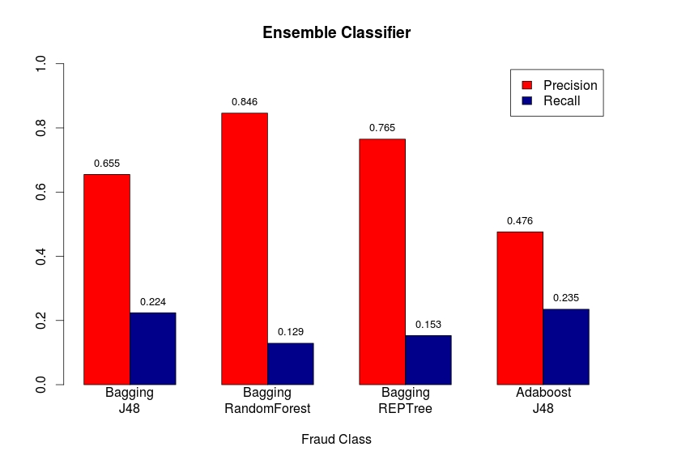
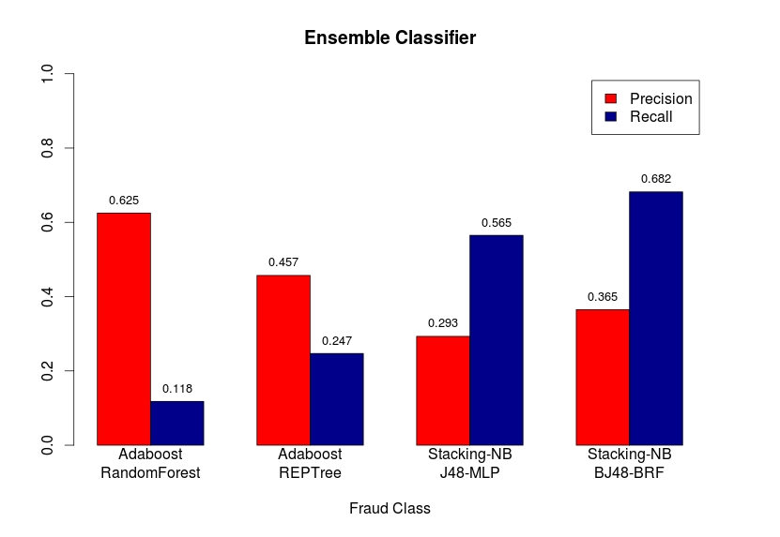
Precision-Recall

Slide 13
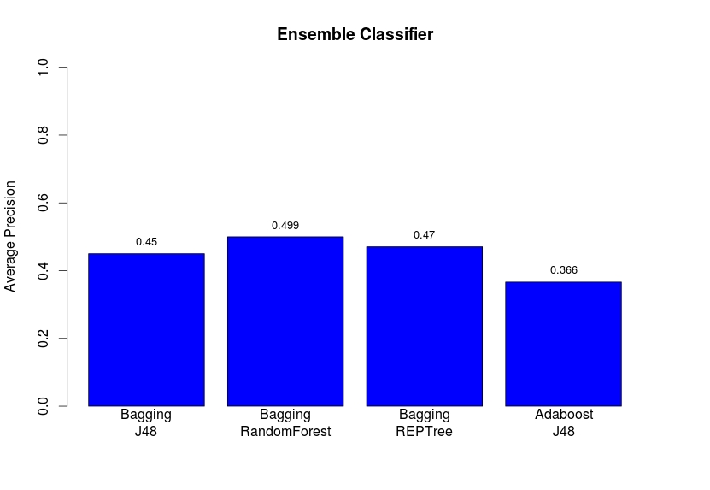
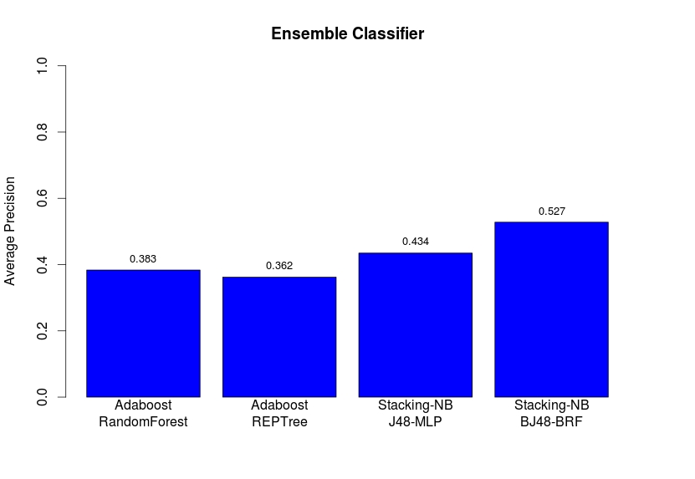
Average Precision

Slide 14
Sampling With Ensemble Learning
Precision | Recall | F-Measure | ROC
Algorithm | Ok | Fraud | Ok | Fraud | Ok | Fraud | Ok | Fraud
Cluster 15:85 | 0.988 | 0.458 | 0.981 | 0.576 | 0.984 | 0.510 | 0.928 | 0.928
Cluster 33:67 | 0.996 | 0.171 | 0.878 | 0.882 | 0.933 | 0.287 | 0.923 | 0.923
Cluster 50:50 | 0.998 | 0.125 | 0.812 | 0.941 | 0.895 | 0.220 | 0.916 | 0.916
Resampling | 0.988 | 0.462 | 0.981 | 0.565 | 0.984 | 0.508 | 0.925 | 0.925
SMOTE 100% | 0.990 | 0.371 | 0.968 | 0.659 | 0.979 | 0.475 | 0.924 | 0.924
SMOTE 500% | 0.984 | 0.444 | 0.985 | 0.424 | 0.984 | 0.434 | 0.908 | 0.908

Slide 15
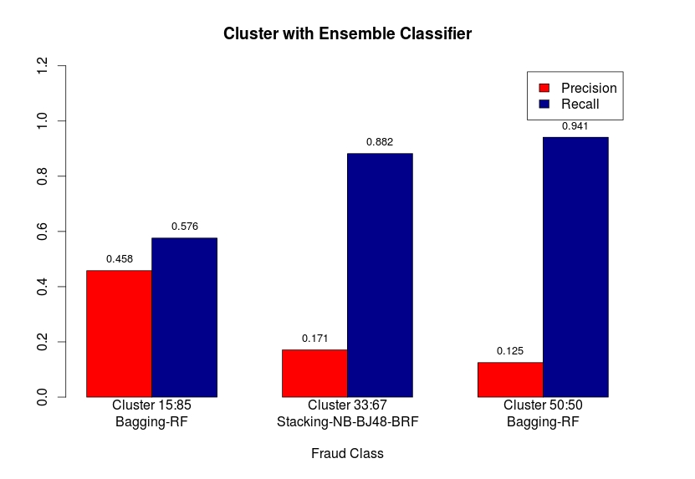
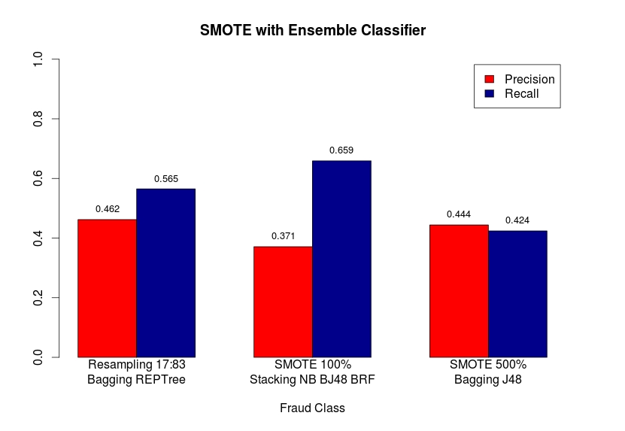
Precision-Recall

Slide 16
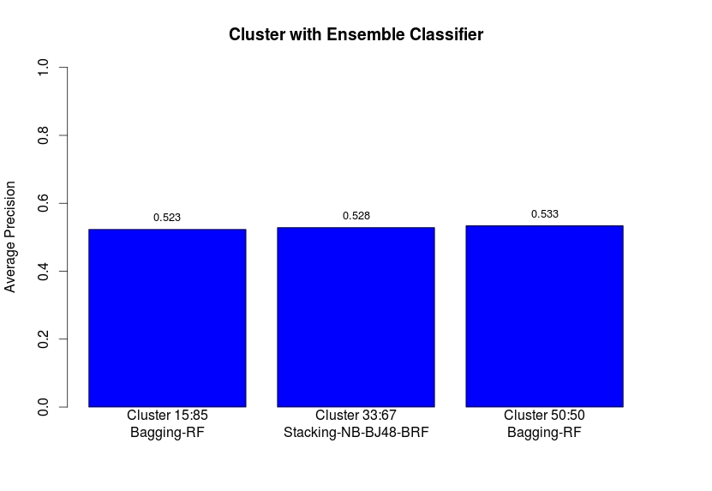
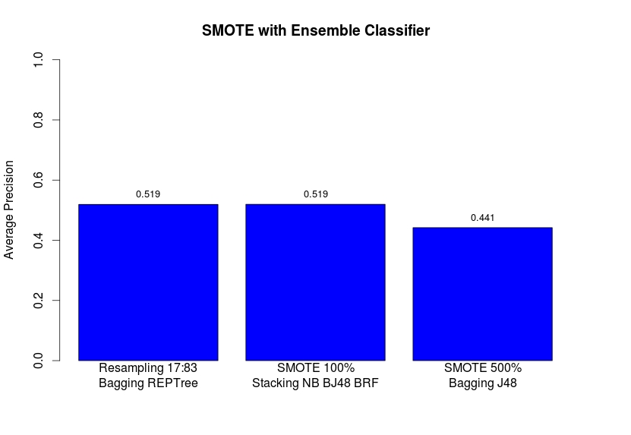
Average Precision

Slide 17
Whats Next
Cost Based Algorithms
Minority class is more important than majority class.
Missclassifying a Fraud instance as OK instance has 10 times higher cost than misclassifying a OK instance as a fraud instance.
Combining Multiple Algorithms
Simple averaging over the predicted confidence values for all models.
Majority voting.
Averaging on majority voting.

Slide 18
Whats Next
Category | Publisher Count | Fraud click (fraud %) | Night fraud click | Morning fraud click | Afternoon fraud click | Evening fraud click
adult | 10 | 47226 (37) | 15435 (12) | 6439 (5) | 11299 (9) | 14053 (11)
Mobile content | 23 | 41941 (33) | 13589 (11) | 9284 (7) | 9623 (8) | 9445 (7)
community | 12 | 16411 (13) | 7218 (6) | 3301 (3) | 2612 (2) | 3280 (3)
lifestyle | 14 | 14433 (11) | 2649 (2) | 3265 (3) | 3573 (3) | 4946 (4)
Search, portal | 4 | 3180 (3) | 682 (1) | 572 (0) | 689 (1) | 1568 (1)
Premium portal | 6 | 2926 (2) | 351 (0) | 608 (0) | 732 (1) | 904 (1)
Info. | 3 | 893 (1) | 49 (0) | 284 (0) | 428 (0) | 132(0)
Total | 72 | 127010 | 39973 (31) | 23753 (19) | 28956(23) | 34328 (27)

