Slide 1
COMP 3211 Software Engineering
Zheng Hongyi 13104036D
Chen Yunkun 13103214D
Li Dawei 13103693D

Slide 2
Outline
Job Allocation
Methodology
Debuggers
Performance
Conclusion

Slide 3
Job Allocation

Slide 4
Job Allocation
ZHENG Hongyi(13104036d)
Implement Crosstab debugger and get coverage data
CHEN Yunkun(13103214d)
Find proper test program, add bugs
LI Dawei(13103693d)
Implement Tarantula debugger and analyze the performance of debuggers

Slide 5
Methodology

Slide 6
Test Programs
We use two programs for testing
4-element naïve sorting program
Input: 4 integer numbers
Output: a sequence of these 4 numbers with descending order
Example: [4,2,3,5] => [5,4,3,2]
Simple encrypt-decrypt program
Input: strings
Output: a string after being encrypted and decrypted, which is the same as the original string
Example: “I love software engineering” => “o sgct lgyzvqkt tfuofttkofu” => ” I love software engineering”

Slide 7
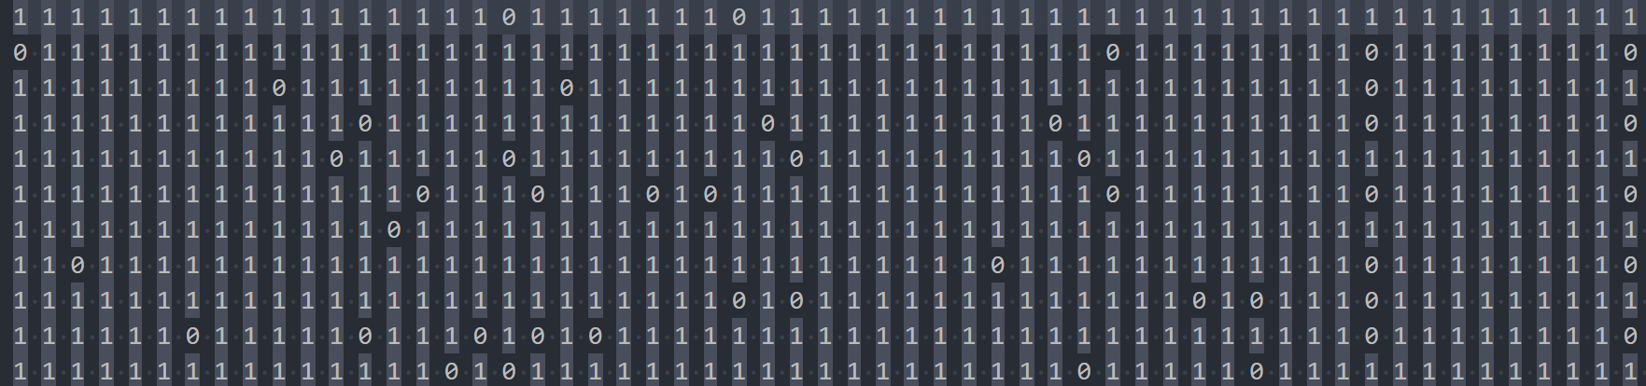
Coverage Information
We execute testing programs then use Coverage.py Python package to get coverage information
Transform raw output into table described in papers. Sample table:
Feed them into faulit localization programs.

Slide 8
Solution of Oracle Problem
It is easy to determine whether the two programs give a correct result.
For the sorting program, we check whether the numbers are shown in descending order
For the encrypt-decrypt program, we check whether the string after being encrypted and decrypted is the same as the original one

Slide 9
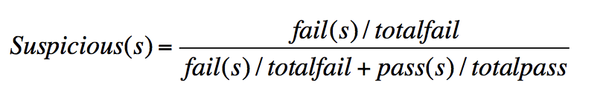
Tarantula Automatic Fault-Localization Technique
Insight
Entities in a program that are primarily executed by failed
test cases are more likely to be faulty than those that are
primarily executed by passed test cases
Solution
Ranking based on suspiciousness
fail(s) = num(failed test cases that executed statement s) totalfail = num(total failed cases)
pass(s) = num(passed test cases that executed statement s) totalpass = num(passed cases)

Slide 10
Tarantula Implementation
Our implementation mainly followed the instruction of the paper
However, it is possible that the number of cases passed or failed is 0.
Thus we ensure that if the number of fail cases is 0, the suspicious(s) is 0, if the number of passed cases is 0, the suspicious(s) is 1.

Slide 11
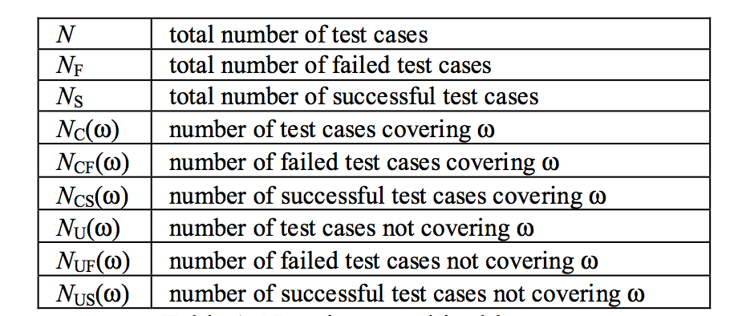
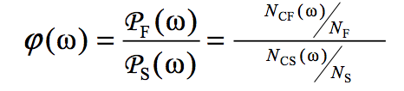
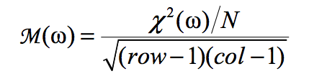
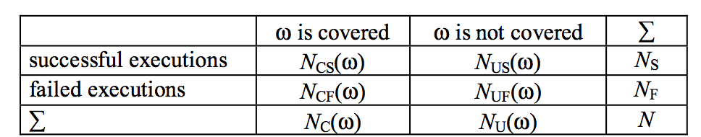
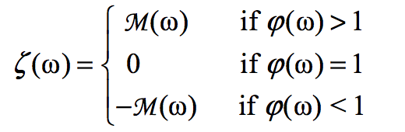
Crosstab-based Statistical Method
Insight same as Tarantula, Entities in a program that are primarily executed by failed test cases are more likely to be faulty
Solution

Slide 12
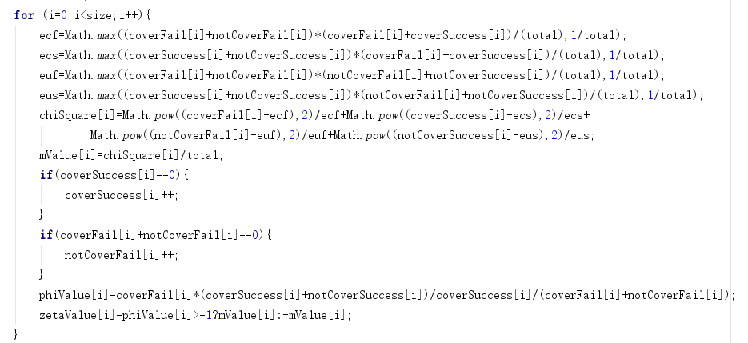
Crosstab Implementation
Our implementation mainly followed the instruction of the paper
However, it is possible that the number of cases passed or failed is 0.
Thus we make some changes to handle “divided by 0” problem
If 0 will be used to divide a
number, replace this 0 by 1

Slide 13
Test Cases
10 bugs for each program.
500 test cases for each bug in encrypt program
625 test cases for each bug in sorting program

Slide 14
Performance of Debuggers

Slide 15
Our Implementation
 | Tarantula | CrossTab
0-2.5% | 8 | 11
2.5-5% | 4 | 2
5-20% | 1 | 6
20-40% | 1 | 1
40-65% | 5 | 0
65-100% | 1 | 0
Tarantula | CrossTab
0.03261 | 0.03261
0.01087 | 0.01087
0.15217 | 0.15217
0.03261 | 0.01087
0.01087 | 0.01087
0.03261 | 0.01087
0.02174 | 0.02174
0.01087 | 0.01087
0.03261 | 0.01087
0.02174 | 0.03261
Tarantula | CrossTab
0.0078125 | 0.0078125
0.65625 | 0.0234375
0.015625 | 0.0078125
0.0078125 | 0.0078125
0.6171875 | 0.09375
0.609375 | 0.1328125
0.6171875 | 0.1484375
0.6015625 | 0.1640625
0.6015625 | 0.171875
0.3515625 | 0.28125
Percentage of lines needed to be examined before finding the bug.

Slide 16
Tarantula and CrossTab Compare

Slide 17
Conclusion

Slide 18
Conclusion
CrossTab has a better performance in effectiveness compared with Tarantula. It is relatively reliable and able to find bugs in high rank (top 5 %) statements.

