Slide 1


COMP4433
Group Project
Group G01
ZHENG Hongyi 13104036D
HAN Yunpeng 13103831D
CHEN Yunkun 13103214D
WANG Qifan 14109533D
JIANG Yifan 15103709D

Slide 2


Outline
01
Objectives
02
Data preprocessing & feature engineering​
03
Data analysis (model building)
04
Training & evaluation
05
Discussion & conclusion

Slide 3



Objectives

Slide 4
Objectives
objectives
Problems
Possible Sources

Slide 5
Problems
Using the given data to train a model that can predict whether a applicant is qualify for apply for a credit card given the attribute.

Slide 6
Possible Sources
Credit card application form​
Behavior of qualify and unqualify credit card owner

Slide 7
Data analysis
All data are convert to meaningless symbol, however don't affect our KDD process
First 16th variables are the credit application attribute.
The last attribute indicate whether a application is approved or not, it's the output value.

Slide 8
Data preprocessing &
feature engineering​

Slide 9
Since the given data set is not well formed for data mining, we do some preprocessing for the data set.
Data preprocessing & feature engineering
Handle missing values
Create dummy variables
Create more features ​
Normalization

Slide 10
Handle missing values
There’re only a few missing values, which can be estimated and filled​
Random forest regressor is used​
Random forest regressor: using known values to generate many small decision trees to predict missing values coordinately, each tree has a small weight on the final decision​

Slide 11
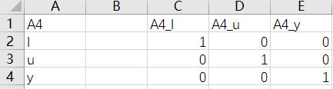
Create dummy variables
Some attributes are categorical and need to be processed so that computer can deal with it.​
Example: attribute A4 with values{l, u, y} => three attributes: A4_l, A4_u, A4_y​
Set these attributes to one-hot attributes​
One-hot attributes: using n attributes to represent an n-possible-value categorical attribute.​​

Slide 12
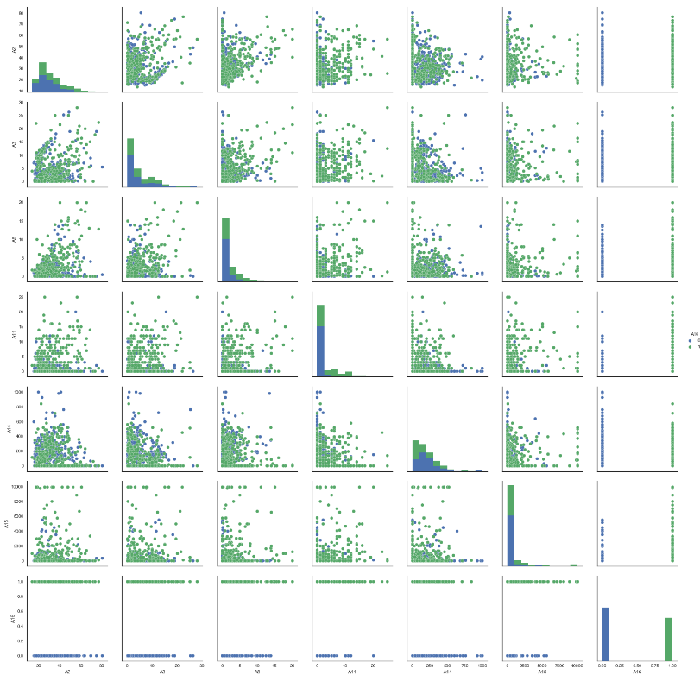
Create more features
Using graphs to observe the relationship between attributes
The result differs when some attributes’ value is beyond a particular threshold
More features are created based on the observation.
eg. A8_big, A11_big

Slide 13
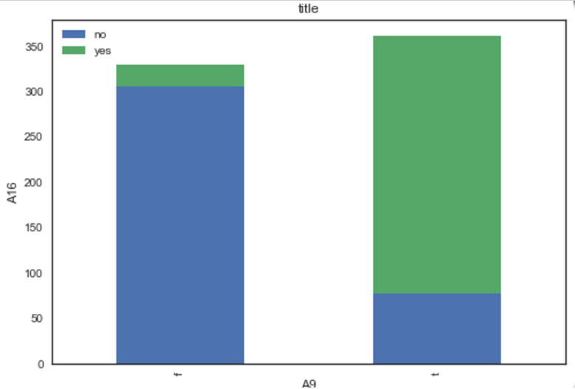
Normalization
Scaling the data to unit variance

Slide 14
Data Analysis (Model)

Slide 15
Data Analysis (Model)
model
Overview
Key Point

Slide 16
An ensemble (stacking) classification model
Overview
SVM(Stacking)
Individual Prediction 1
Individual Prediction 2
Individual Prediction 3
Individual Prediction 4
Final Prediction
Random Forest
SVM1
SVM2
Logistic Regression Classifier
Naïve Bayes
Individual Prediction 5
Preprocessed Data

Slide 17
Key Points
Ensemble Learning
Ensemble learning is the process by which multiple models are strategically generated and combined to solve a particular computational intelligence problem
Stacking
Stacking is one of the ensemble learning method, which trains a separate model for prediction, basing on the output of previous models.

Slide 18
Training & evaluation

Slide 19
Training
GridSearchCV
Random Forest
SVM
Linear Regression
Ensemble SVM

Slide 20
GridSearchCV
A efficient function from sklearn, a Python machine learning package.
Exhaustive search over specified parameter values for an estimator.
Estimator, param_grid, cv(cross validation) as function input.
Estimator, param_grid, cv(cross validation) as function input.

Slide 21
Random Forest
parameter | n_estimators | max_features | min_samples_leaf | max_depth | oob_score
meaning | The number of trees in the forest | The number of features to consider when looking for the best split | The minimum number of samples required to split an internal node | The maximum depth of the tree | Whether to use out-of-bag samples to estimate the generalization accuracy
optional range | Range(30, 70) | “sqrt” “log2” None | Range(10,100) | Range(1,10) | [True, False]
Optimal parameter | 42 | log2 | 71 | 2 | True
Other parameters are set as default.

Slide 22
SVM
parameter | C | kernel | tol
meaning | Penalty parameter C of the error term. | Specifies the kernel type to be used in the algorithm | Tolerance for stopping criterion
optional range | 10^i(i from -5 to 5) | ‘linear’, ‘poly’, ‘rbf’, ‘sigmoid’ | 10^-i (i from 1 to 7)
Optimal parameter | 0.1 | linear | 0.0001
Other parameters are set as default.

Slide 23
Linear Regression
parameter | fit_intercept | normalize | copy_X
meaning | whether to calculate the intercept for this model | If True, the regressors X will be normalized before regression. | If True, X will be copied
optional range | True, False | True, False | True, False
Optimal parameter | True | False | True
Other parameters are set as default.

Slide 24
Ensemble SVM
parameter | C | kernel | gamma | degree
meaning | Penalty parameter C of the error term. | Specifies the kernel type to be used in the algorithm | Kernel coefficient for ‘rbf’, ‘poly’ and ‘sigmoid’ | Degree of the polynomial kernel function
optional range | 10^i(i from -10 to 10) | ‘linear’, ‘poly’, ‘rbf’, ‘sigmoid’ | 10^i (i from -5 to 5) | Range(1,10)
Optimal parameter | 5 | poly | 100 | 2
Other parameters are set as default.

Slide 25
Evaluation
We achieved 88% average accuracy in 6-fold validation

Slide 26
Discussion & Conclusion

Slide 27
Discussion
Traditional machine learning algorithms work well when attribute number is small.
Ensemble method, especially stacking, improve the model performance significantly.
More data is the most vital issue for further improve the performance.
Further feature selection and feature generation could be done, if the natural of features are known

Slide 28
Conclusion
We trained a classification model, which can predict whether a credit card application will be approved or not, basing on the information of the applicant. The model achieved 88% accuracy basing on the available data in hand.

Slide 29
Contribution of each Team member
WANG Qifan – Data preprocessing
JIANG Yifan - Data preprocessing & feature engineering
CHEN Yunkun – Feature engineering
ZHENG Hongyi – Model building
HAN Yunpeng - Training

Slide 30
Checklist
Identifying problem
Identifying Sources
Data analysis
Handling missing values
Creating dummy variables
Normalization
Designing model
Training model
Validation and evaluation
Providing result

