Slide 1
A TEAM Flu Vaccinating Analysis
Members: yulin hou, yuexin ma, xin shen, qi li

Slide 2

Are you looking for a comprehensive tool to help you stay on top of the flu vaccination situation in the US?
Are you looking for a one-stop shop for all your flu vaccination needs?
Do you want to plan ahead and schedule your flu shot at a convenient time?
Look no further than our new R Shiny app!

Slide 3

Dataset Introduction
The Vaccines.gov Dataset
Provider Information
providers‘ names, addresses, phone numbers, zip codes, and locations, insurance_accepted, walkins_accepted, etc
Vaccine Information
vaccine information including vaccine names, in stock or not, supply levels, etc
The Vaccines.gov Dataset
powered by VaccineFinder
Provider Information
Vaccine Information
Link:
https://data.cdc.gov/Flu-Vaccinations/Vaccines-gov-Flu-vaccinating-provider-locations/bugr-bbfr

Slide 4
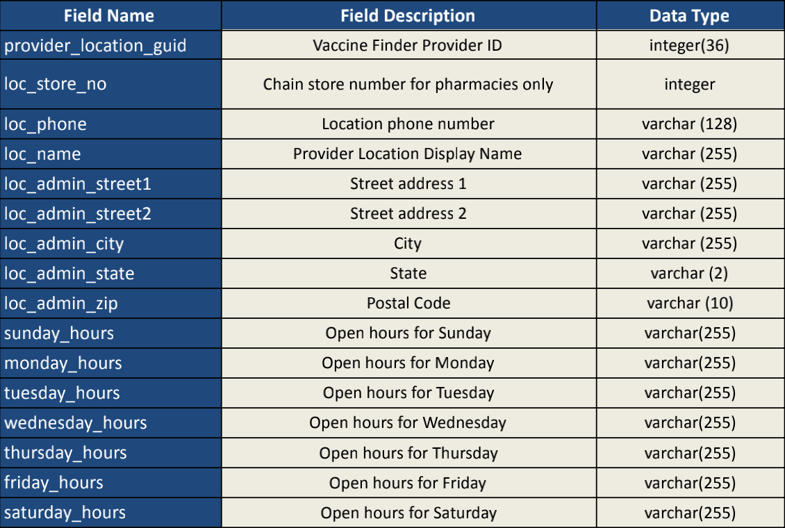
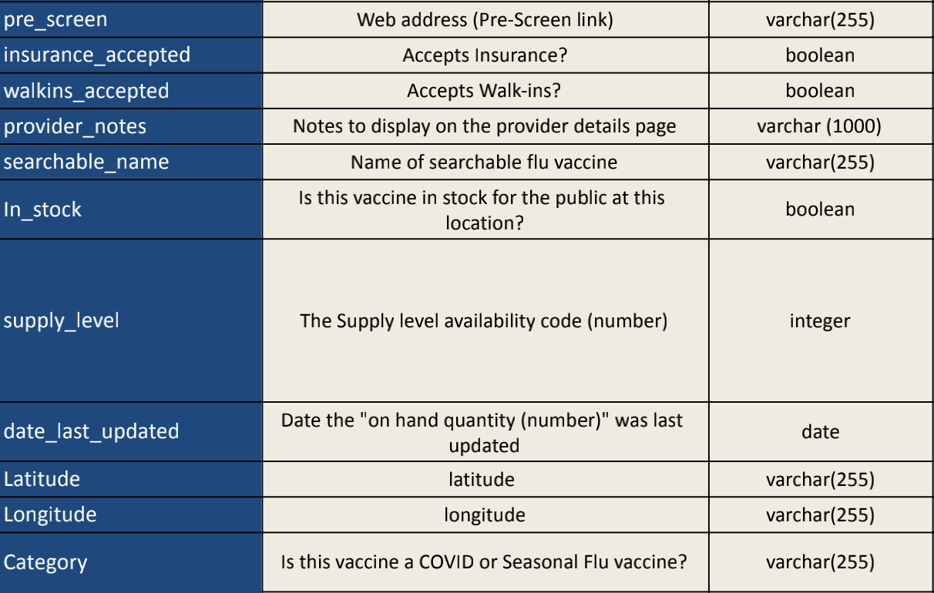
Dataset Introduction

Slide 5
Data Pipeline
Data Extraction
Data Transformation
Data Cleaning
Vaccine.gov
Shiny App

Slide 6
Shiny App Introduction
Geospatial
Analysis
Recommendation
System
Stock
Management
System

Slide 7
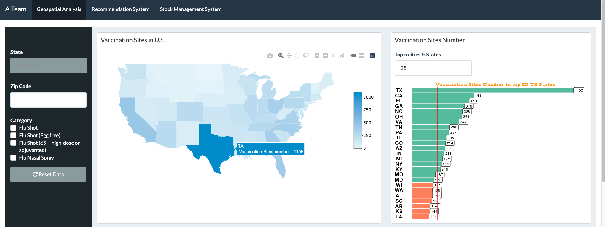
Input: State, City, Zip Code, Flu Category, bars num
Interactive Map: Vaccination Sites Distribution in US
Geospatial Analysis
Interactive Bar Chart: Vaccination Site Number in top n States
Input Widgets
Interactive Map
Interactive Table
Interactive Bar Chart
Interactive Pie Chart

Slide 8
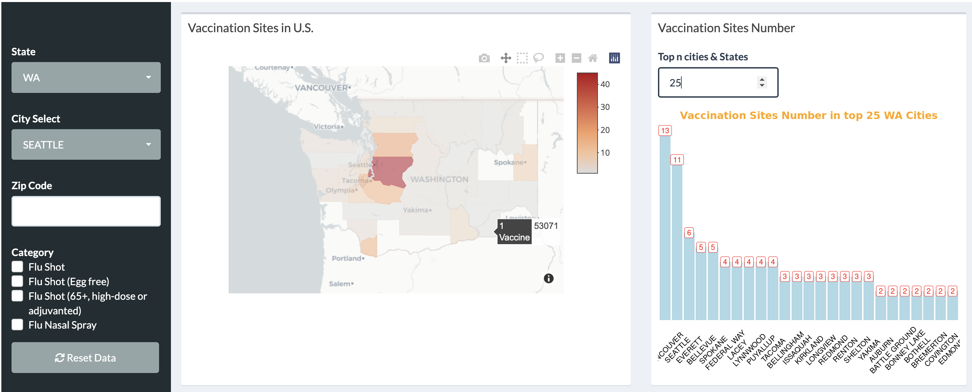
Input: State, City, Zip Code, Flu Category
Interactive Map: Vaccination Site County distribution in selected State
Geospatial Analysis
Interactive Bar: Vaccination Site Number in top n cities of selected state
Input Widgets
Interactive Map
Interactive Table
Interactive Bar Chart
Interactive Pie Chart

Slide 9
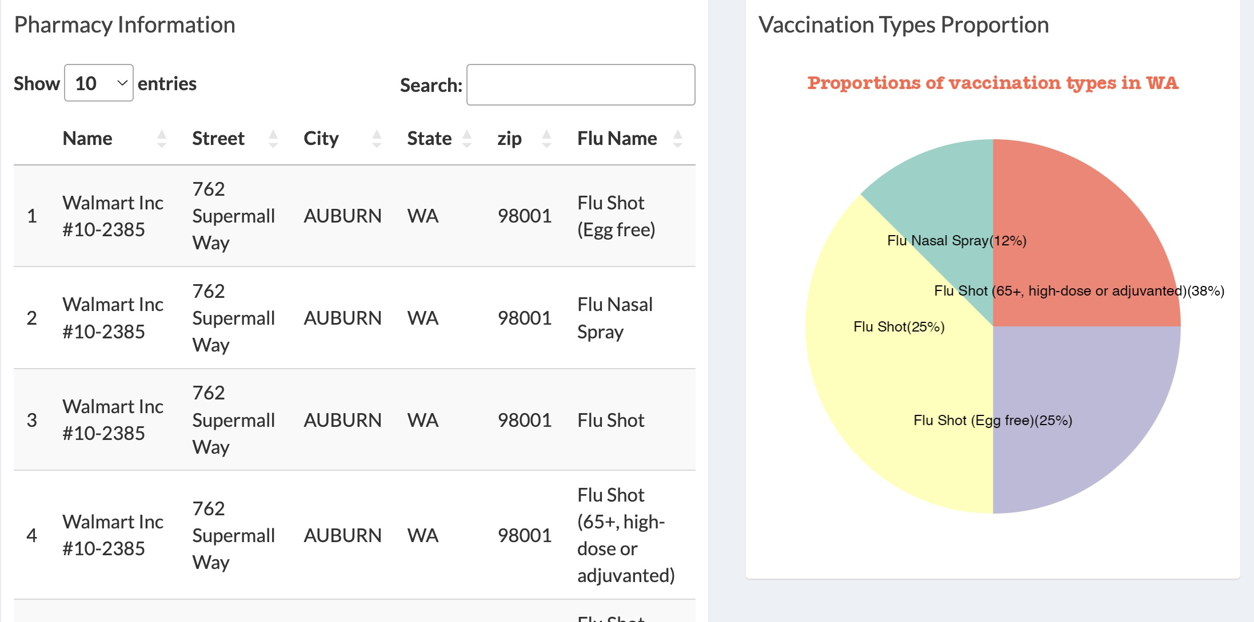
Input: State, City, Zip Code, Flu Category
Interactive Table: Pharmacy information in selected state /city/zip code/flu category
Geospatial Analysis
Pie Chart: Proportions of Vaccination Types in selected state
Input Widgets
Interactive Map
Interactive Table
Interactive Bar Chart
Interactive Pie Chart

Slide 10
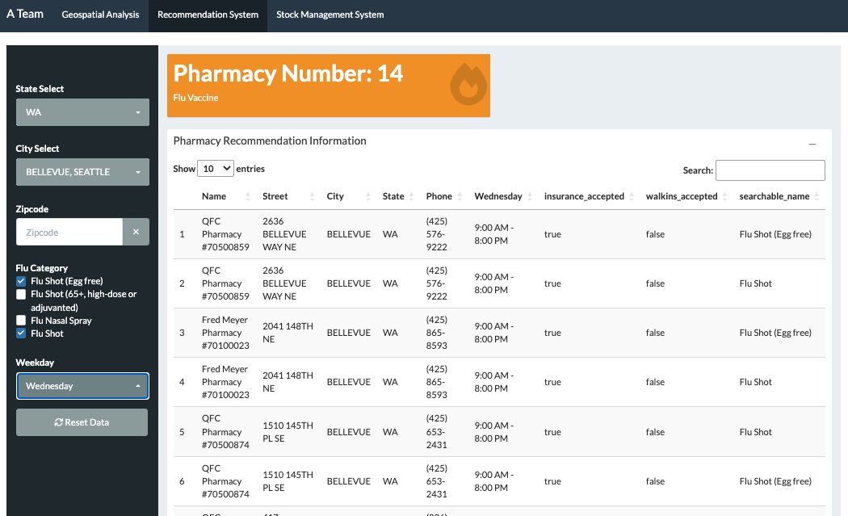
Input: State, City, Zip code, Flu Category, Weekday
Interactive Table: Pharmacy Recommendation Information
Recommendation
System
KPI Card: the Number of Available Pharmacies
Input Widgets
Interactive Table
KPI Card

Slide 11
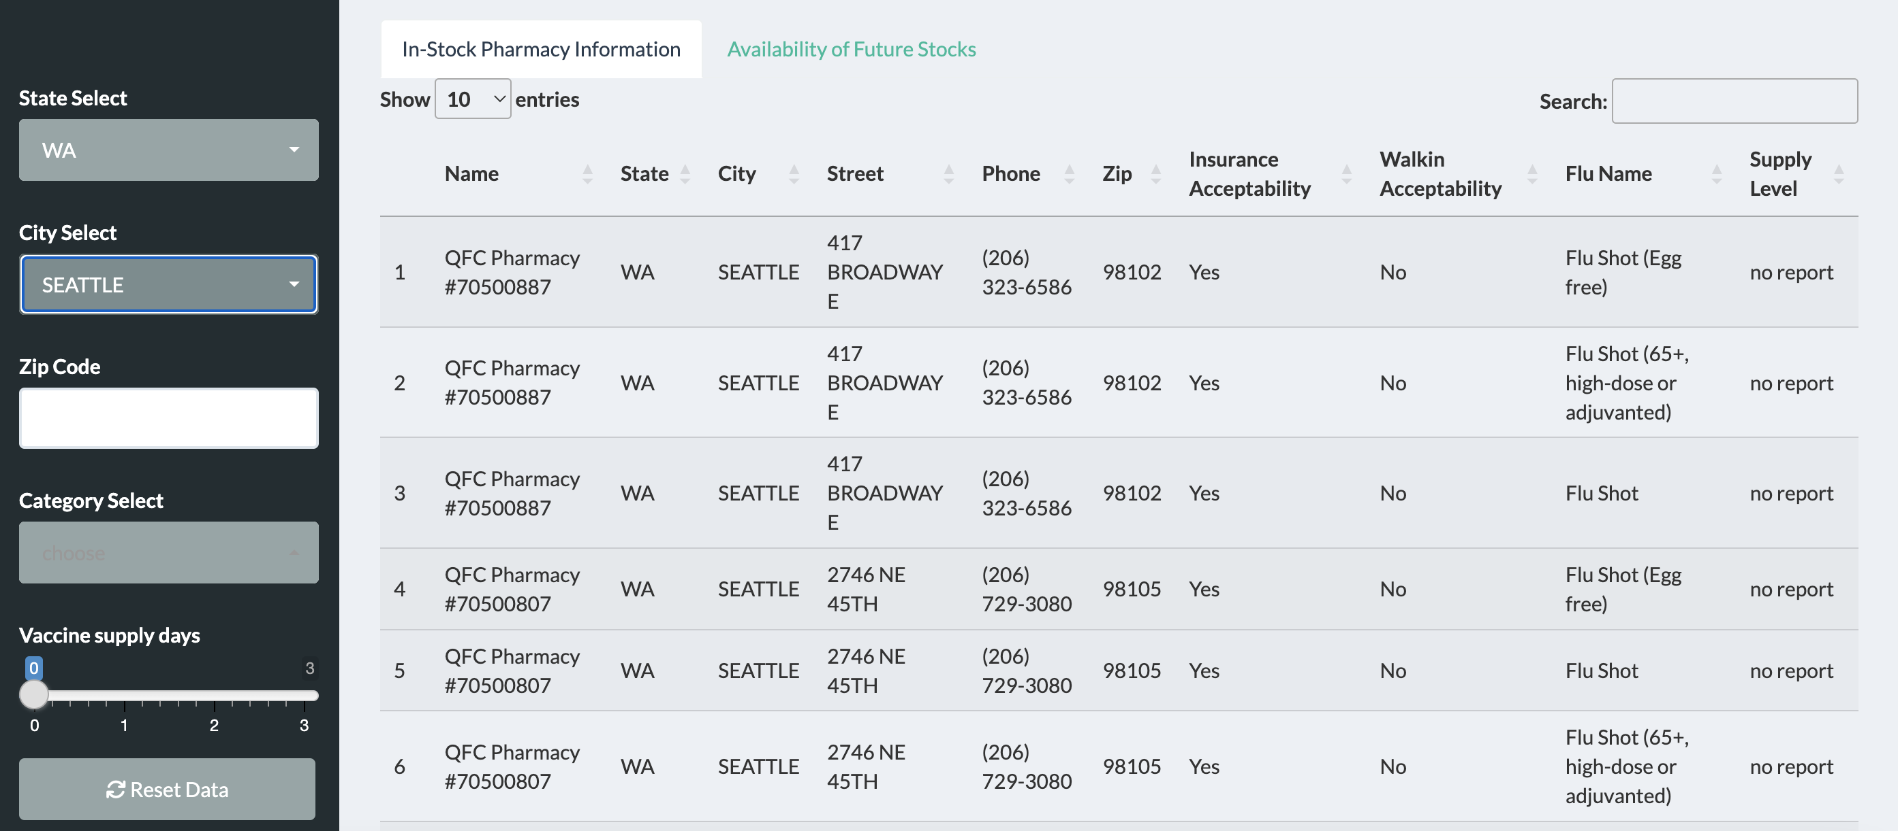
Stock Management System
Input: State, City, Zip Code, Flu Category, Supply days
Interactive Table: Stock Management Information
Interactive Bar Chart: Vaccination distribution in selected region according to supply level
Input Widgets
Interactive Table
Interactive Bar Chart

Slide 12
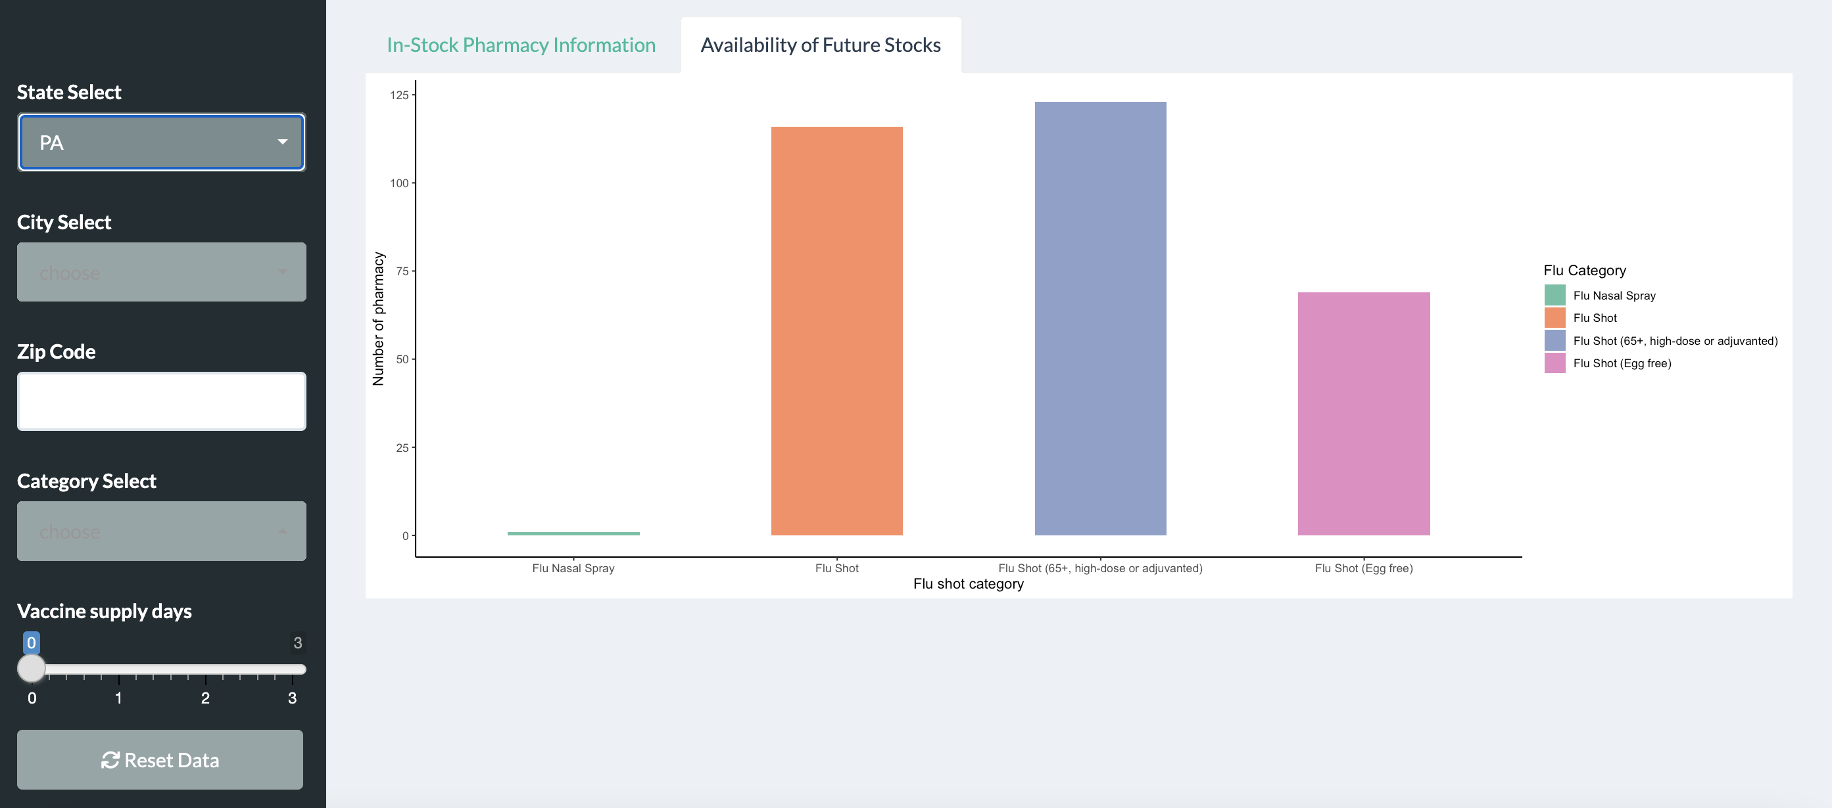
Stock Management System
Input: State, City, Zip Code, Flu Category, Supply days
Interactive Table: Stock Management Information
Interactive Bar Chart: Vaccination distribution in selected region according to supply level
Input Widgets
Interactive Table
Interactive Bar Chart

Slide 13
Don‘t forget to get vaccinated in a timely manner for your own and others health.
Let’s try our system!!!

