Slide 1
1
Order
Process Mapping &
Improvement Analysis
Customer request submitted
2
Warehouse
Pick, pack, and dispatch
E-commerce order fulfillment and delivery process
3
Courier
SLA-based fulfillment
A professional deck that maps the current workflow, diagnoses handoff risks, and proposes a practical improvement roadmap.
4
Customer
Delivery confirmation + feedback

Slide 2
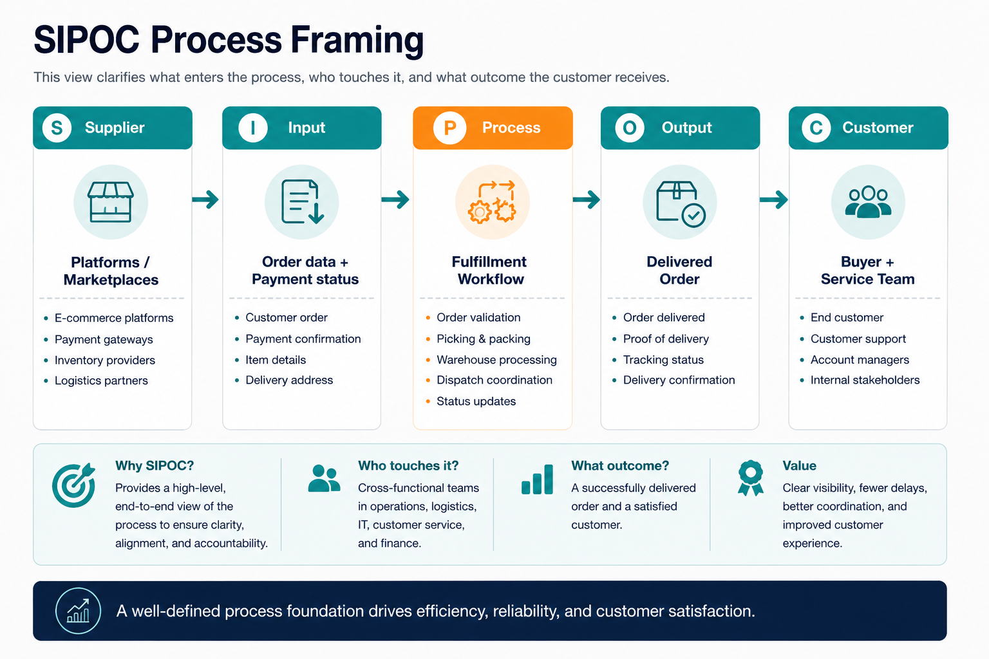
SCOPE
Objective and Process Scope
The deck focuses the assignment on one operational process and frames it using a simple SIPOC view.
Objective
Map a common operational workflow, identify inefficiencies, and design a practical improvement plan for better workflow efficiency.
Selected process: e-commerce order fulfillment and delivery
Start point: customer order placement
End point: delivery confirmation and feedback review
In scope
Validation, warehouse queue, picking, packing, courier handoff, dispatch, delivery attempt, feedback and KPI review.
Out of scope
Marketing, supplier negotiations, product design and finance reconciliation are excluded to keep the map focused.
E-Commerce Fulfillment Process Improvement
02

Slide 3
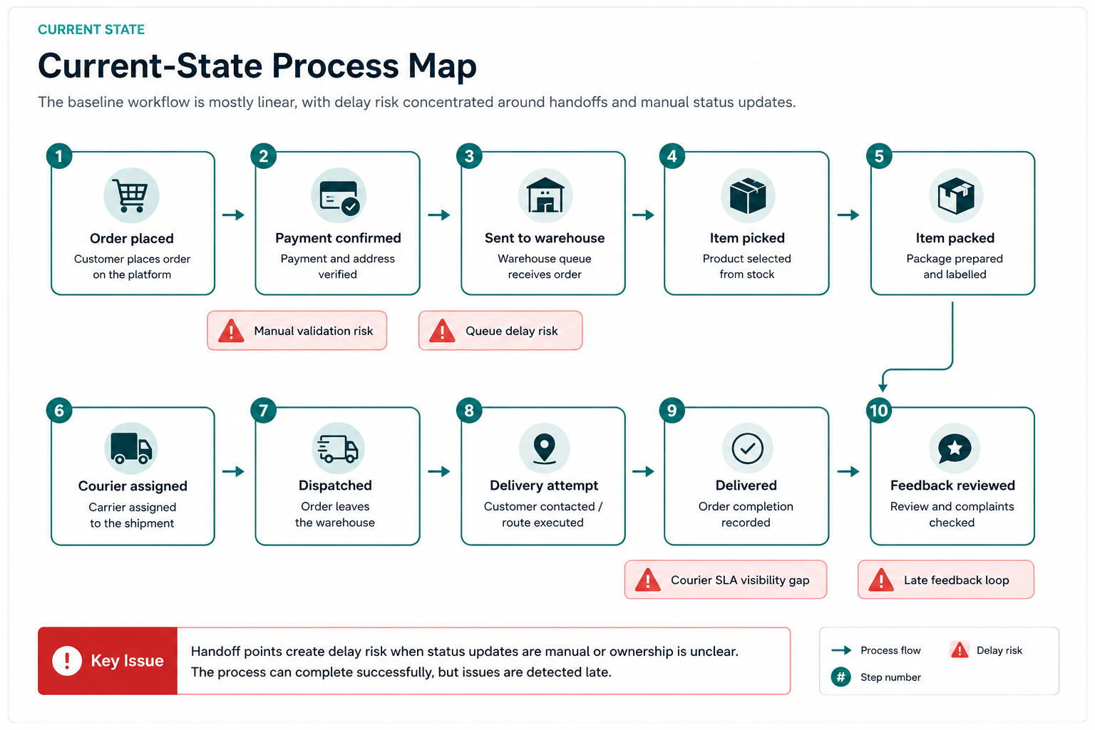
CURRENT STATE
Current-State Process Map
The baseline workflow is mostly linear, with delay risk concentrated around handoffs and manual status updates.
E-Commerce Fulfillment Process Improvement
03

Slide 4
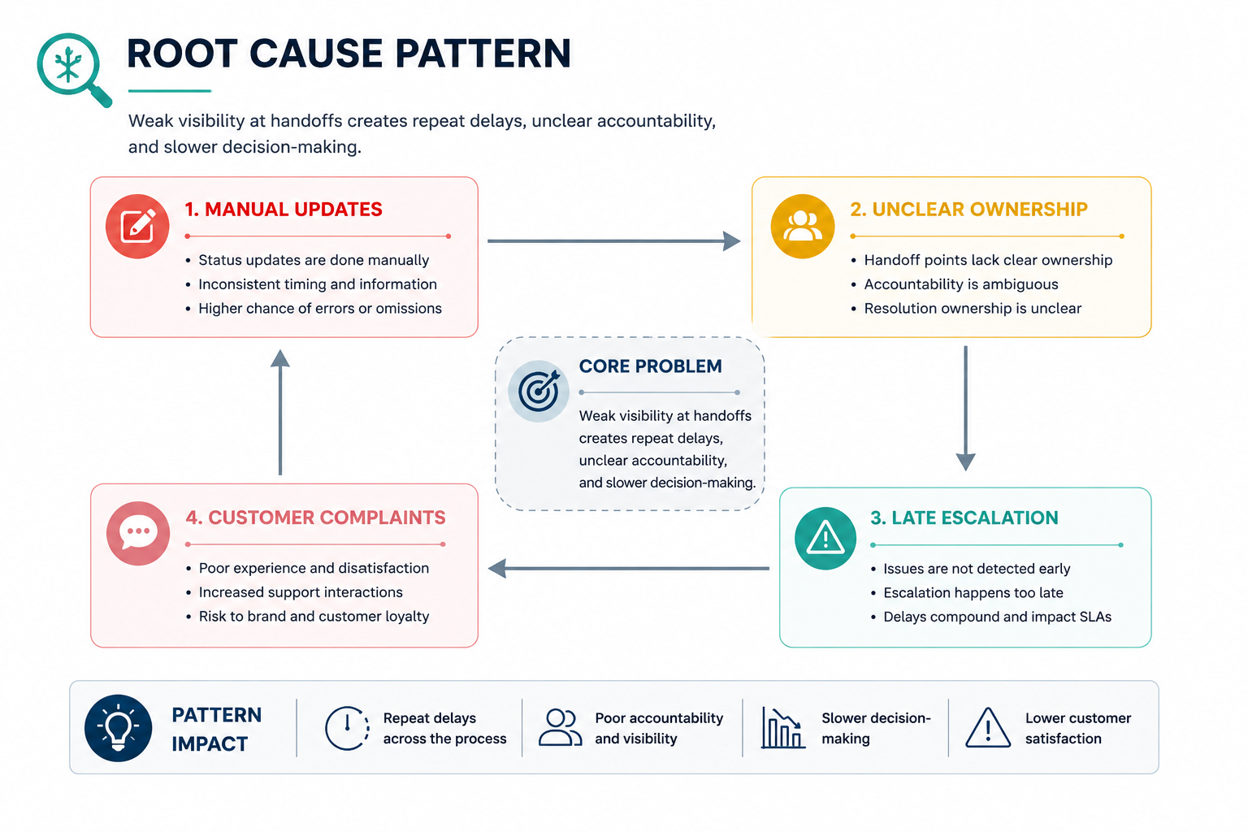
DIAGNOSIS
Bottlenecks and Inefficiencies
Most delays are caused by handoffs, visibility gaps, and delayed escalation rather than by a single step.
1
Manual validation
Incomplete details can hold orders before warehouse release.
2
Warehouse queueing
No priority rules can push urgent orders behind low-risk orders.
3
Pick and pack errors
Manual checks create rework and missed dispatch windows.
4
Courier handoff gap
Carrier performance is not visible enough by area or SLA.
5
Late feedback loop
Review data is checked after the issue has already happened.
Operational theme
The process needs early warning indicators and clear ownership so teams can prevent delays instead of only reacting to them.
E-Commerce Fulfillment Process Improvement
04

Slide 5
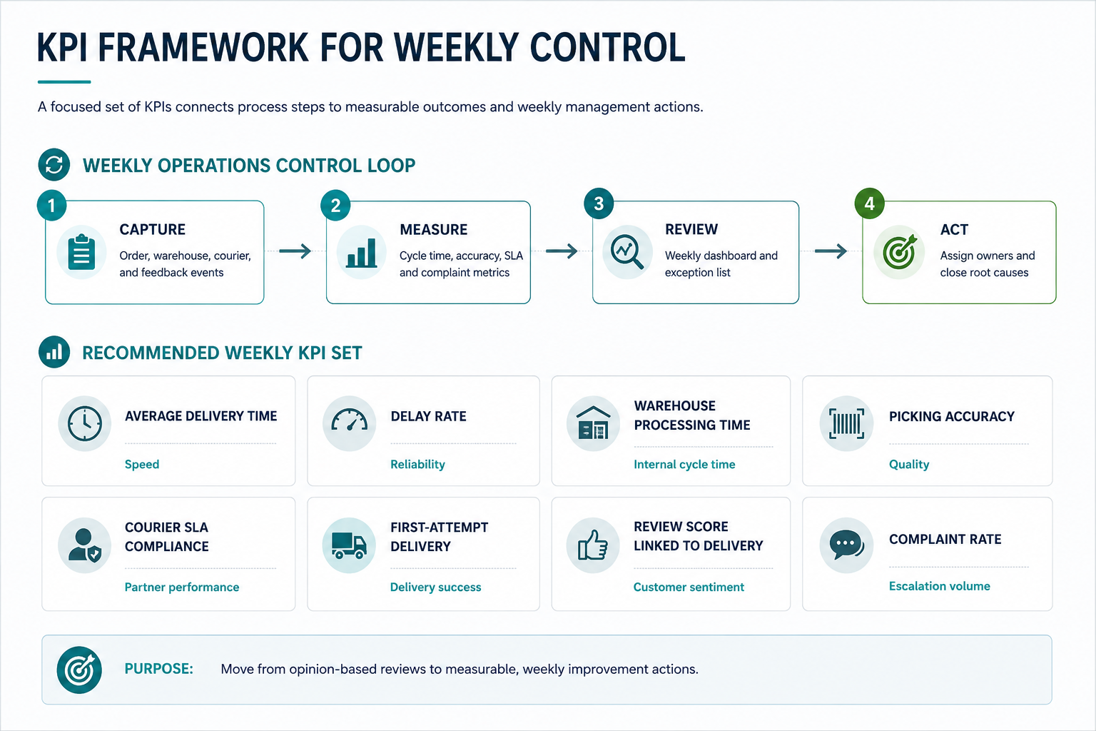
MEASUREMENT
KPI Framework for Weekly Control
A focused set of KPIs connects process steps to measurable outcomes and weekly management actions.
E-Commerce Fulfillment Process Improvement
05

Slide 6
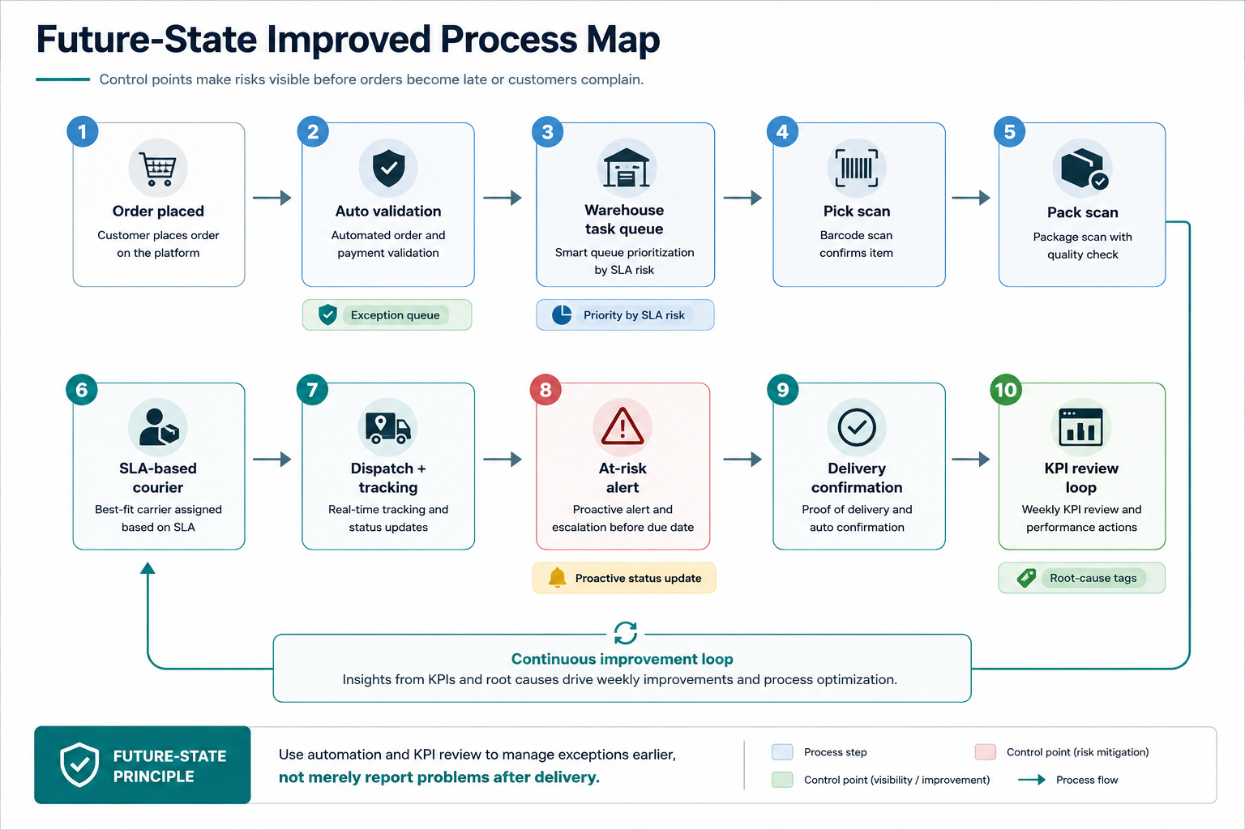
FUTURE STATE
Future-State Improved Process Map
Control points make risks visible before orders become late or customers complain.
E-Commerce Fulfillment Process Improvement
06

Slide 7
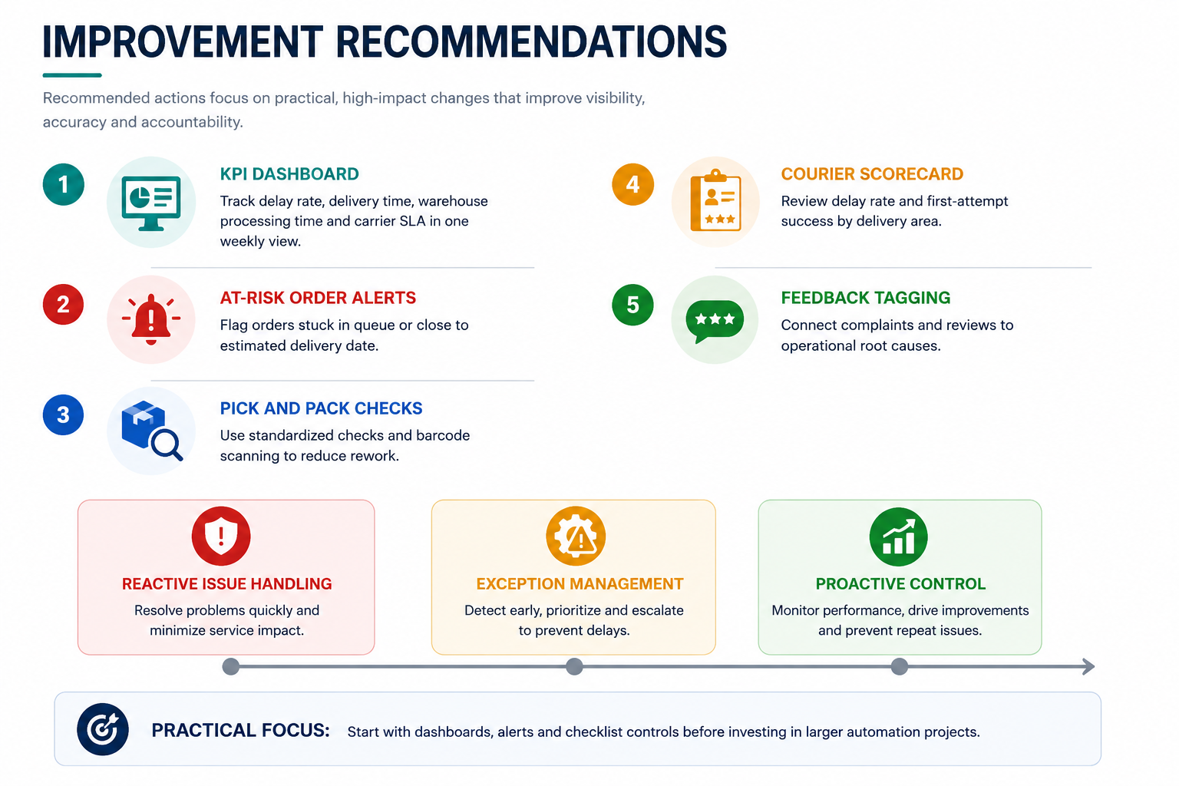
RECOMMENDATIONS
Improvement Recommendations
Recommended actions focus on practical, high-impact changes that improve visibility, accuracy and accountability.
E-Commerce Fulfillment Process Improvement
07

Slide 8
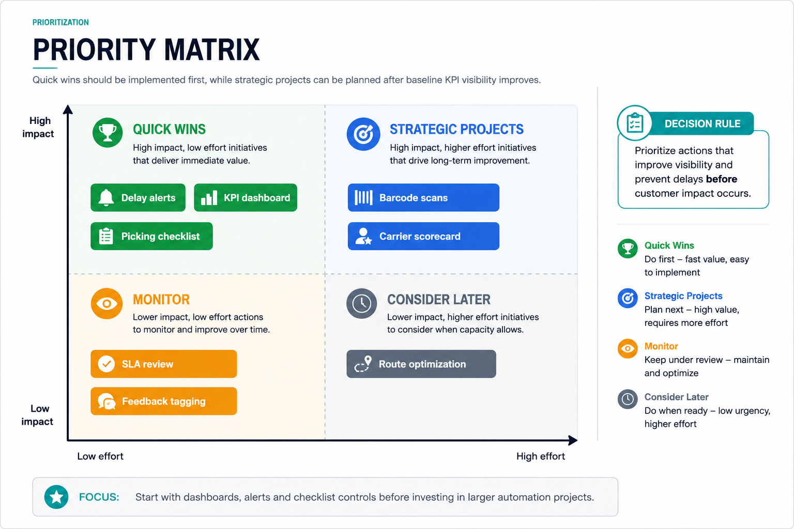
PRIORITIZATION
Priority Matrix
Quick wins should be implemented first, while strategic projects can be planned after baseline KPI visibility improves.
E-Commerce Fulfillment Process Improvement
08

Slide 9
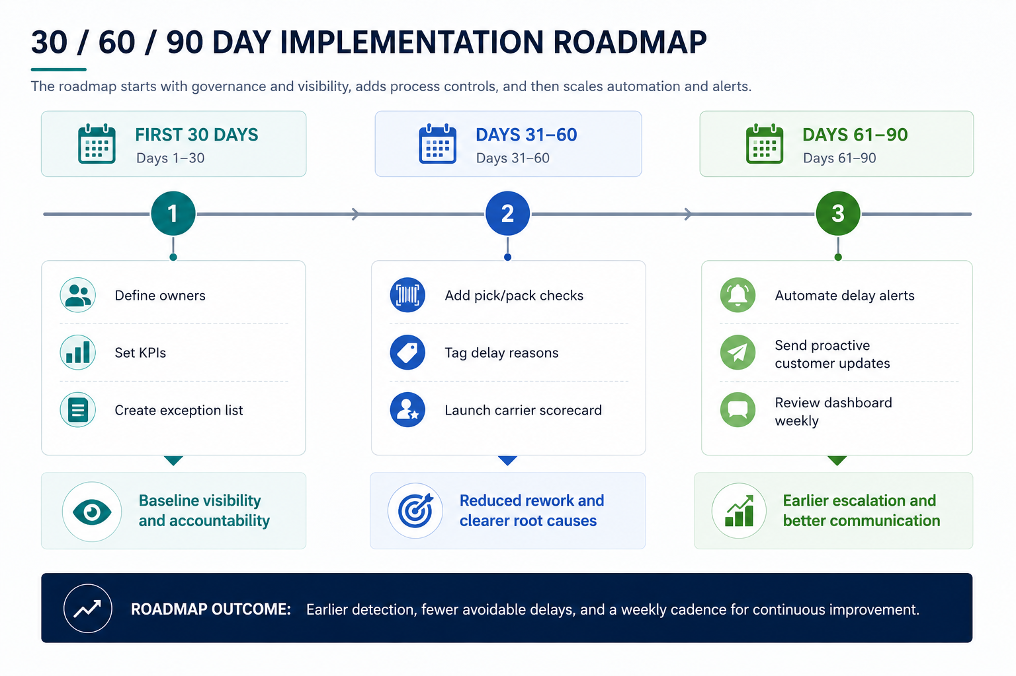
ROADMAP
30 / 60 / 90 Day Implementation Roadmap
The roadmap starts with governance and visibility, adds process controls, and then scales automation and alerts.
Roadmap outcome: earlier detection, fewer avoidable delays, and a weekly cadence for continuous improvement.
E-Commerce Fulfillment Process Improvement
09

Slide 10
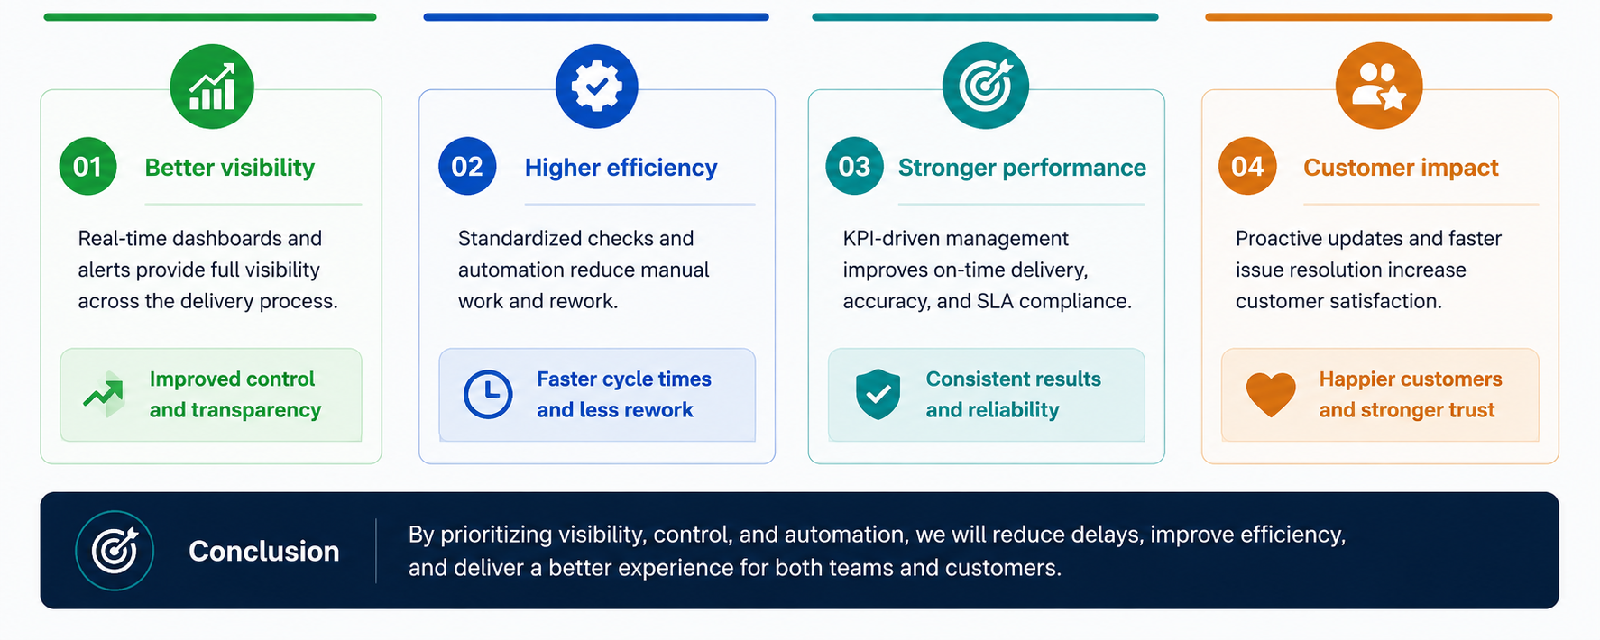
CONCLUSION
Expected Impact and Conclusion
Expected improvements should be validated with actual baseline data after implementation.
Thank you
E-Commerce Fulfillment Process Improvement
10

