Slide 1
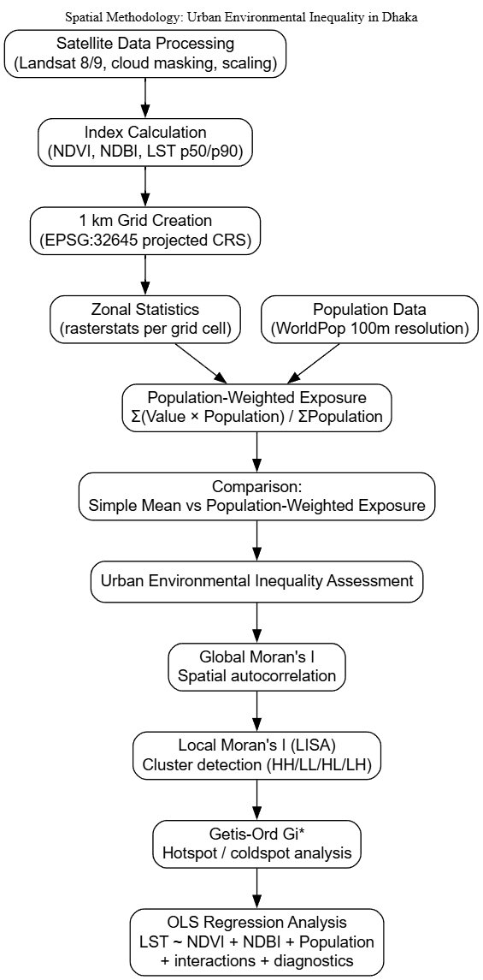
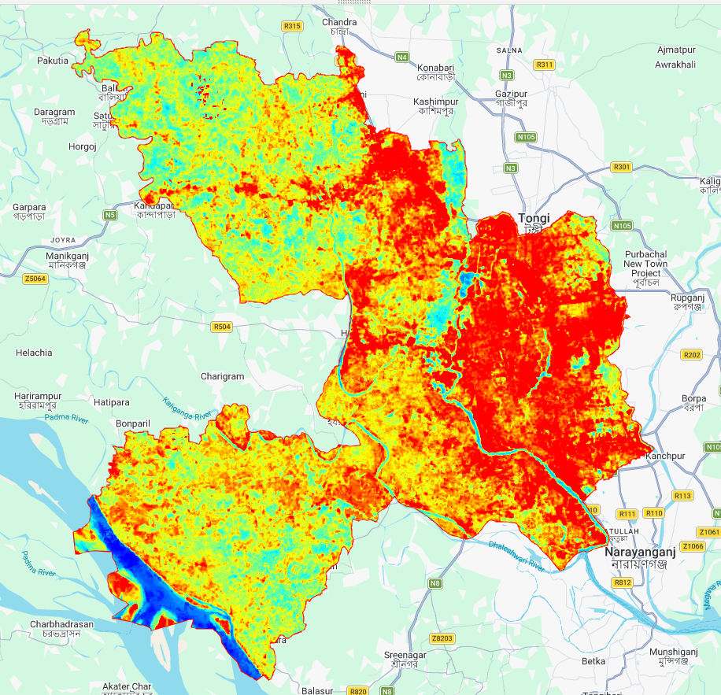
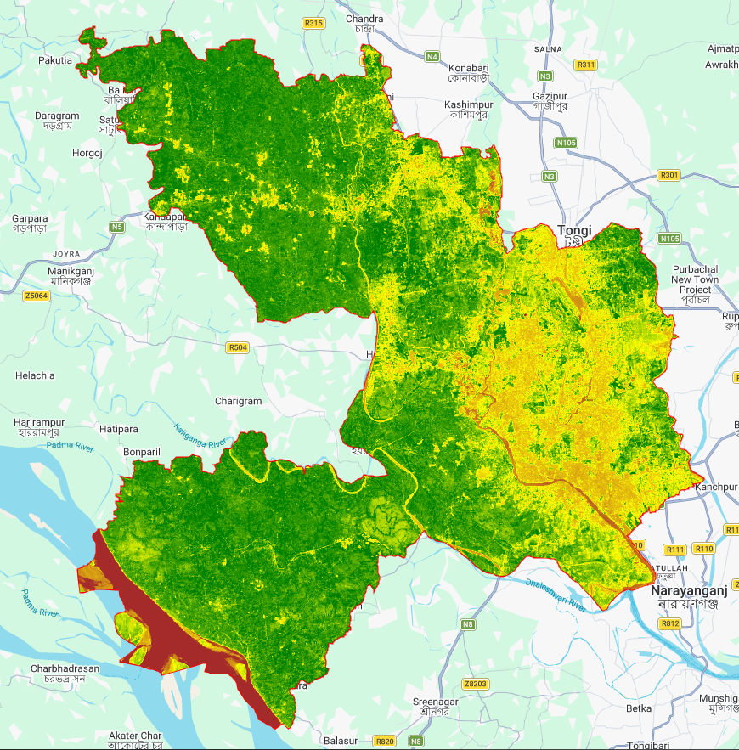
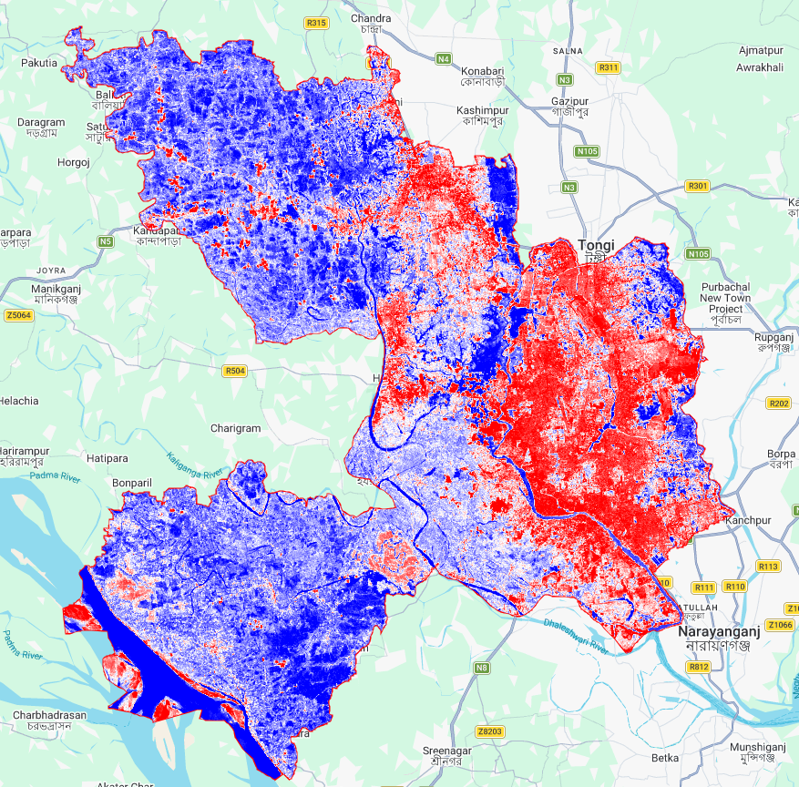
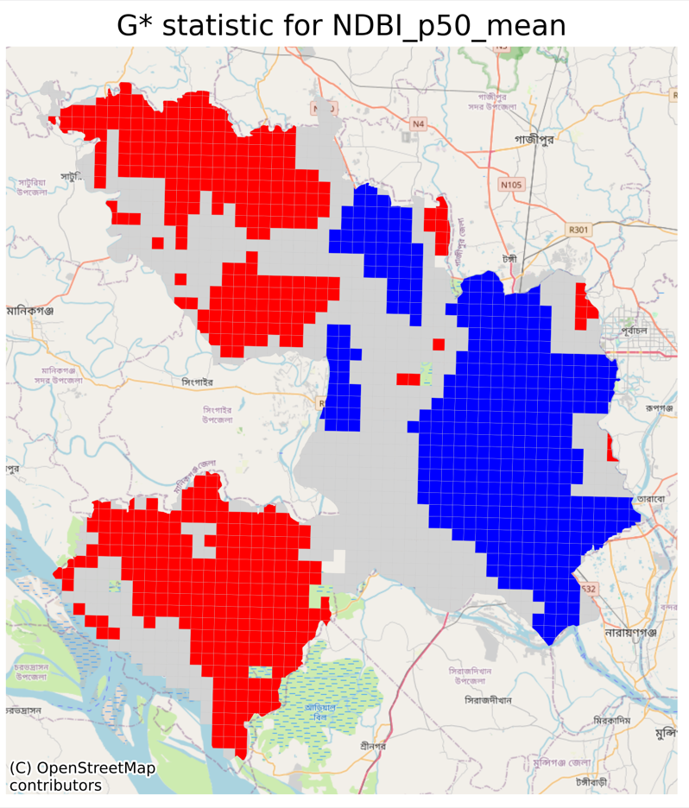
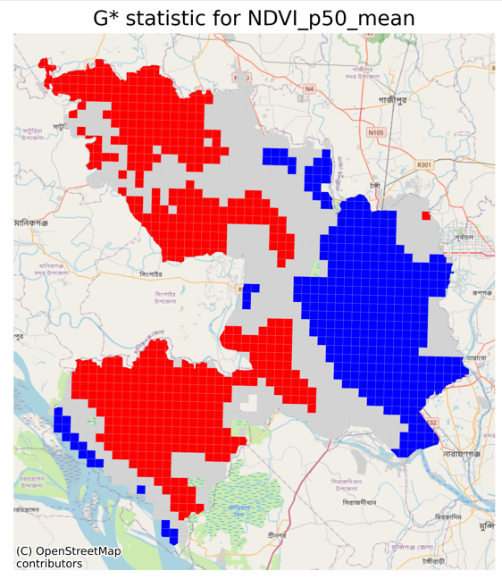
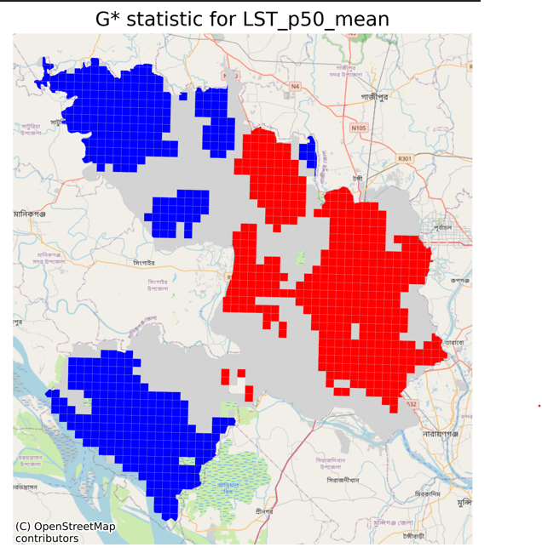
Spatial Inequality in Urban Green Space and Heat Exposure: Evidence from Dhaka, Bangladesh
Shahr Bano Bokhari (MSDS25027)
Session: Spring 2025
Supervisor: Dr. Adnan Siddique
Course: Spatial Data Science
1. Introduction
4. Methodology
Dhaka is a rapidly growing megacity undergoing intense land-use change, driven by urban expansion and population growth. This transformation is reshaping local climate conditions and urban environmental quality, particularly through the loss of vegetation and increased surface sealing.
As a climate-vulnerable city, these changes raise concerns not only about environmental degradation, but also about how exposure to heat and green space varies across its population. This project examines urban environmental patterns in Dhaka using satellite-derived indicators and spatial analysis to quantify these changes and their distribution across space.
A spatial analysis framework is used to quantify urban environmental conditions and population exposure in Dhaka.
A 1 km grid (EPSG:32645) is created to standardize spatial units across the study area. Within each cell, zonal statistics are computed using rasterstats to extract NDVI, NDBI, and
LST (p50/p90) from satellite data.
Population exposure is then estimated using
a population-weighted mean.
Spatial patterns are assessed using Queen contiguity weights and Global Moran’s I to measure spatial autocorrelation.
Finally, a comparison is made between:
Simple spatial mean (equal-weight grid cells)
Population-weighted exposure (human-
centric exposure)
This framework highlights disparities between physical environmental conditions and
actual human exposure.
Fig. 2: Left: Google Earth snapshot of the observed area. The yellow line shows the approximate projection of the slant-range vector on ground. Right: An initial PSI solution obtained with IPTA. The dots mark the detected persistent scatterers. Their color represents the estimated deformation in mm/y. The red line shows the extent of an azimuth line whose tomographic inversion is presented in Fig. 5.
2. Problem Statement
Rapid urbanization in Dhaka has led to significant vegetation loss and the expansion of impervious surfaces, intensifying the Urban Heat Island (UHI) effect.
Are residents unequally exposed to heat and green space deficits?
Do more people live in hotter, less vegetated areas?
3. Data
5. Results & Discussion
Satellite Data: Landsat 8 & 9 (Collection 2, Level 2), 2023–2025, cloud-masked and processed for surface reflectance and temperature.
Derived Indices (Percentiles)
NDVI (vegetation/greenness)
NDBI (built-up/impervious surfaces)
LST (Land Surface Temperature)
Population: WorldPop 2024 (100m resolution)
Administrative Boundary: Dhaka District
Preprocessing Steps:
Cloud masking and scaling factor correction
Percentile composites (p10, p50, p90)
Creation of 1 km × 1 km regular grid (clipped to Dhaka)
Zonal statistics + population masking
Spatial analysis reveals strong clustering of heat, vegetation, and built-up intensity across Dhaka. Global Moran’s I confirmed significant spatial autocorrelation for LST, NDVI, and NDBI.
LISA and Getis-Ord Gi* identified a persistent LST hot spot in the dense central-eastern urban core, which coincides with NDVI cold spots and high population concentration. In contrast, the western and southwestern periphery forms a cooler, vegetation-rich zone.
Notably, NDBI hot spots do not fully overlap with LST hot spots, suggesting that extreme urban heat is influenced not only by built-up intensity, but also by dense settlement structure, limited airflow, and low canopy cover.
Population-weighted analysis shows that residents are disproportionately exposed to hotter and less vegetated environments, confirming significant environmental inequality in Dhaka.
Targeted greening, cool roofs, and neighborhood-scale heat mitigation strategies are recommended for the identified residential hot spot areas.
LST p50: Blue = cold (~24.7°C), cyan = cool, yellow = warm, red = hot (~33.6°C) (~33.6°C max).
NDVI p50: Brown = very low vegetation/bare soil (~-0.1), yellow = sparse/mixed, green = dense vegetation (~0.67)
NDBI p50: Blue = low built-up (vegetation/water), white = neutral/mixed (~-0.36), red = high built-up areas.
Acknowledgments: I would like to thank Dr. Adnan Siddique for his valuable supervision and guidance throughout this project.

