Slide 1
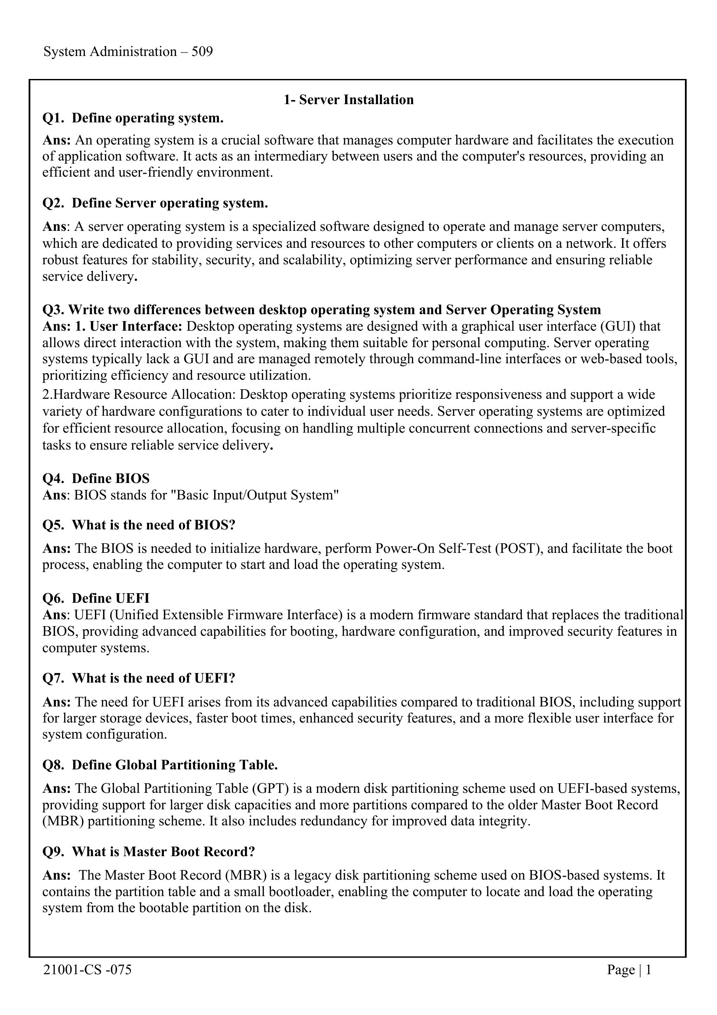

Slide 2
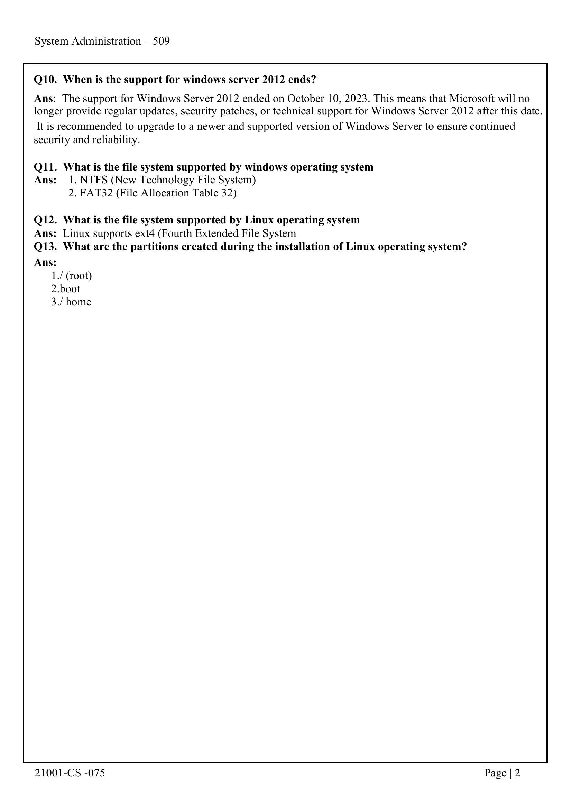
System Administration – 509

Slide 3
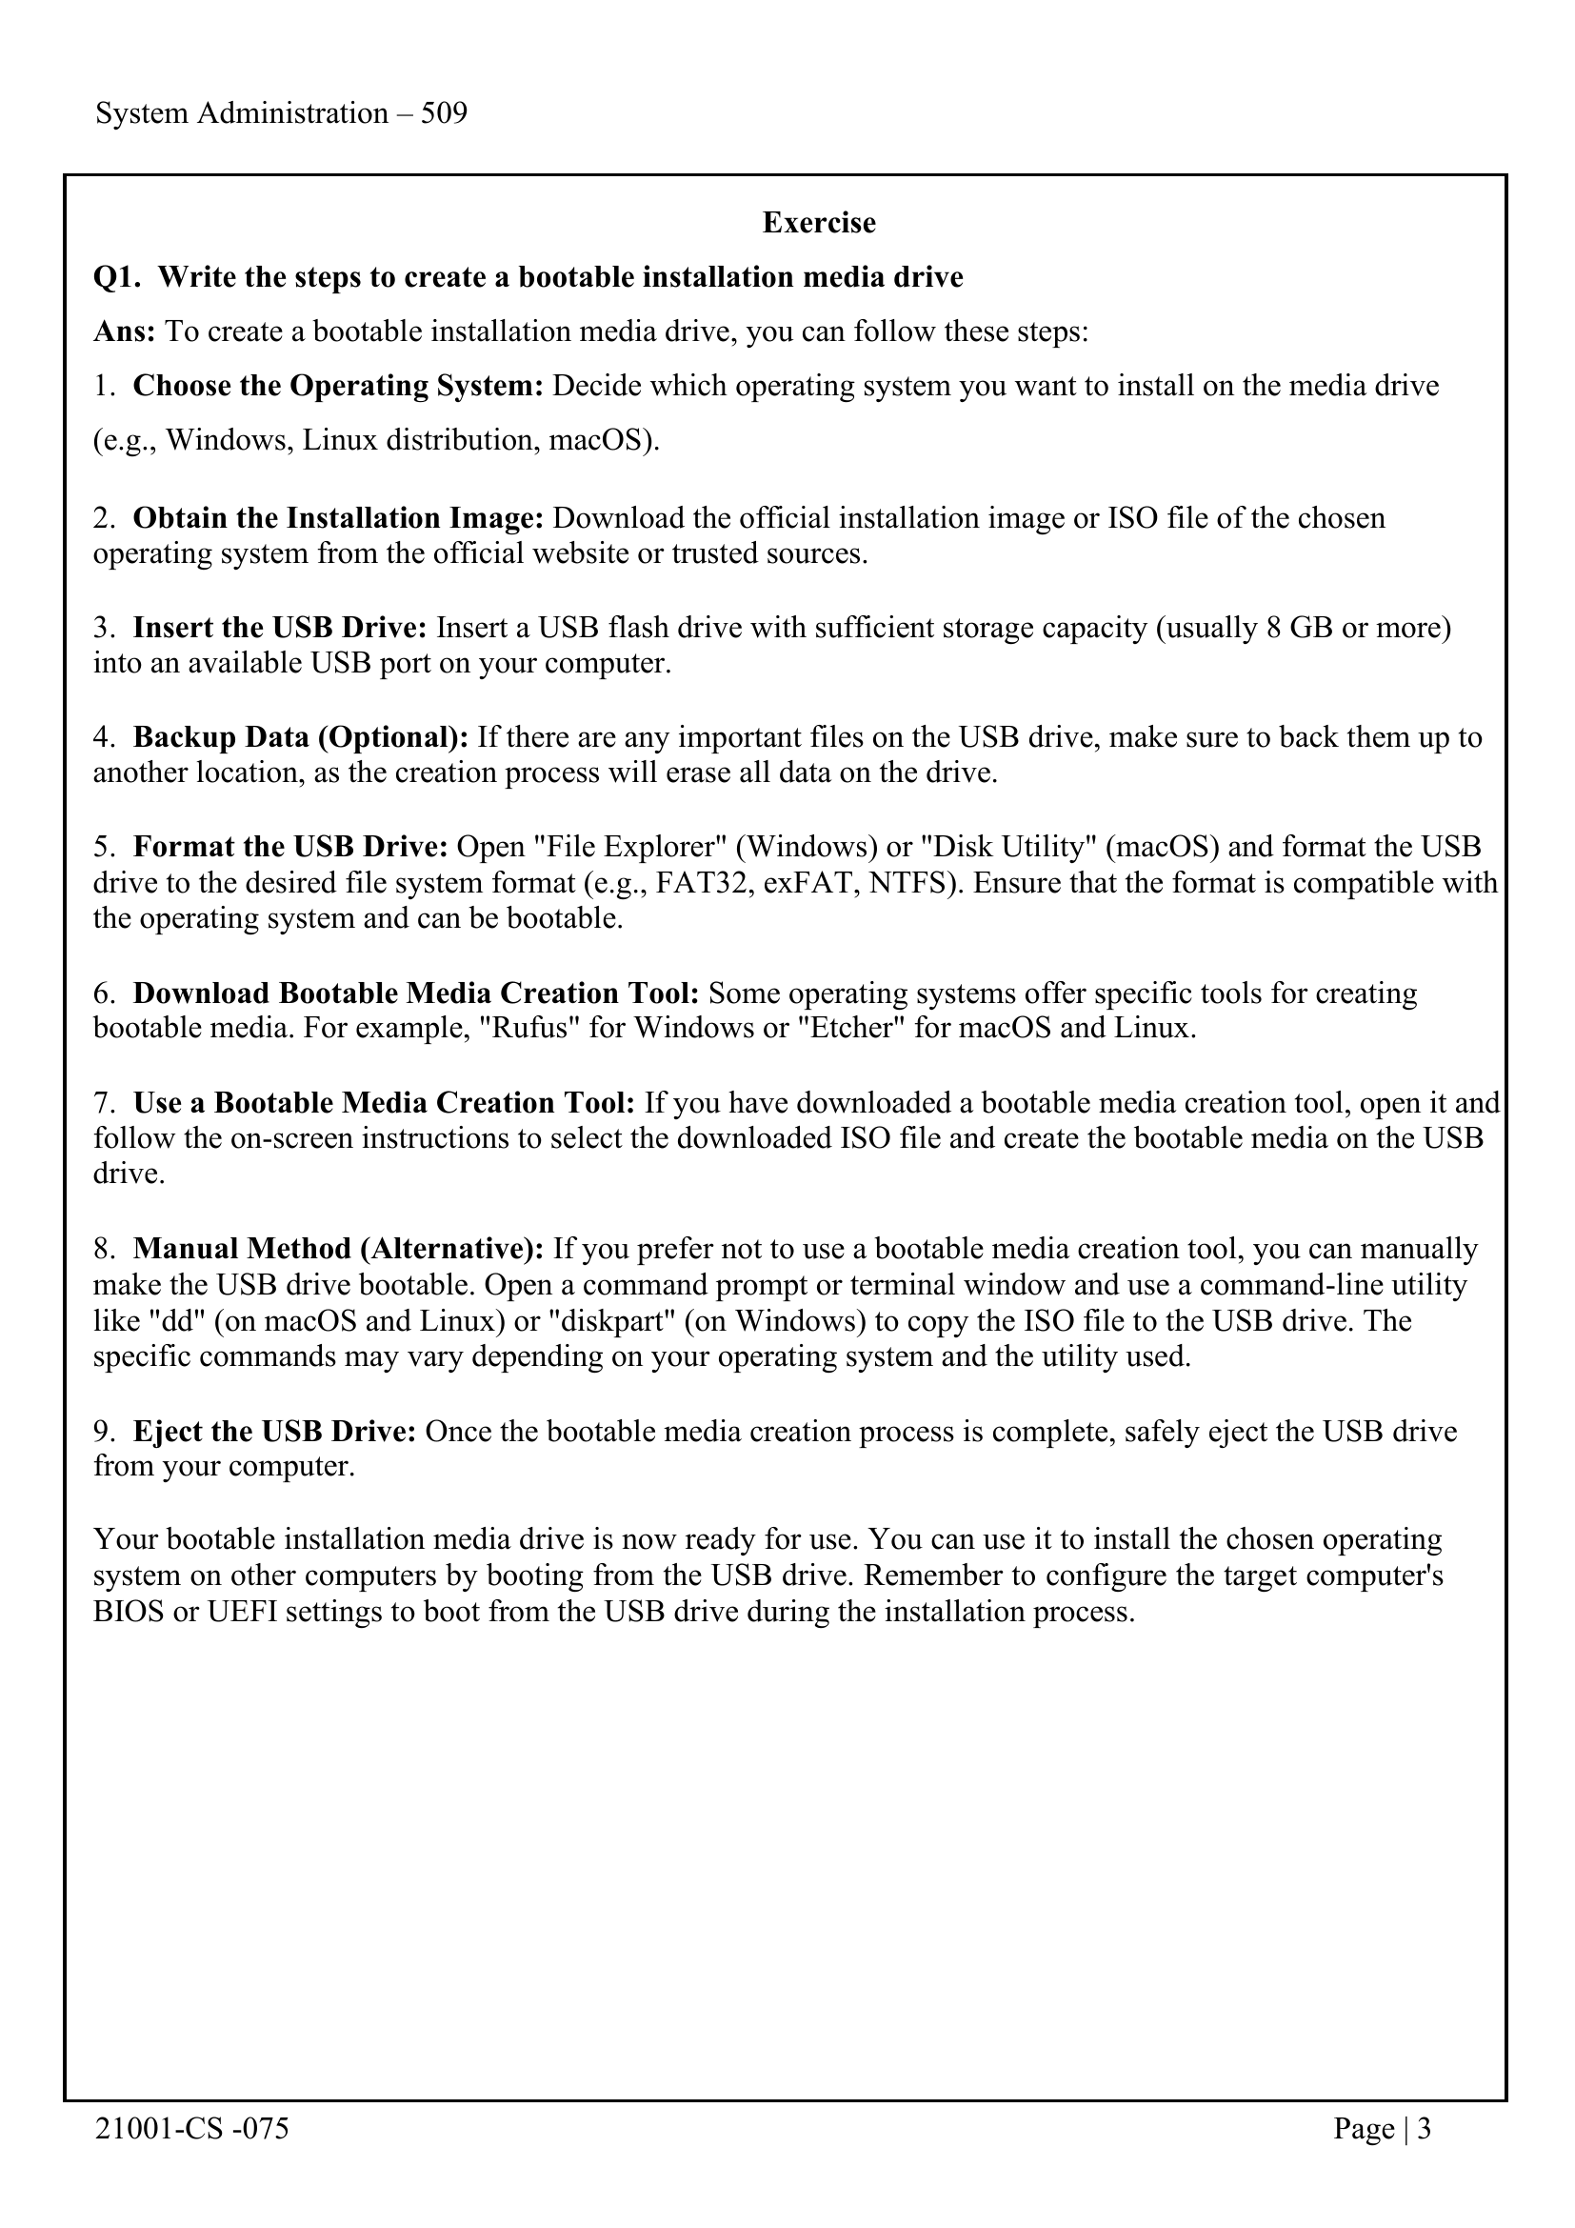
21001-CS -075 Page | 1

Slide 4
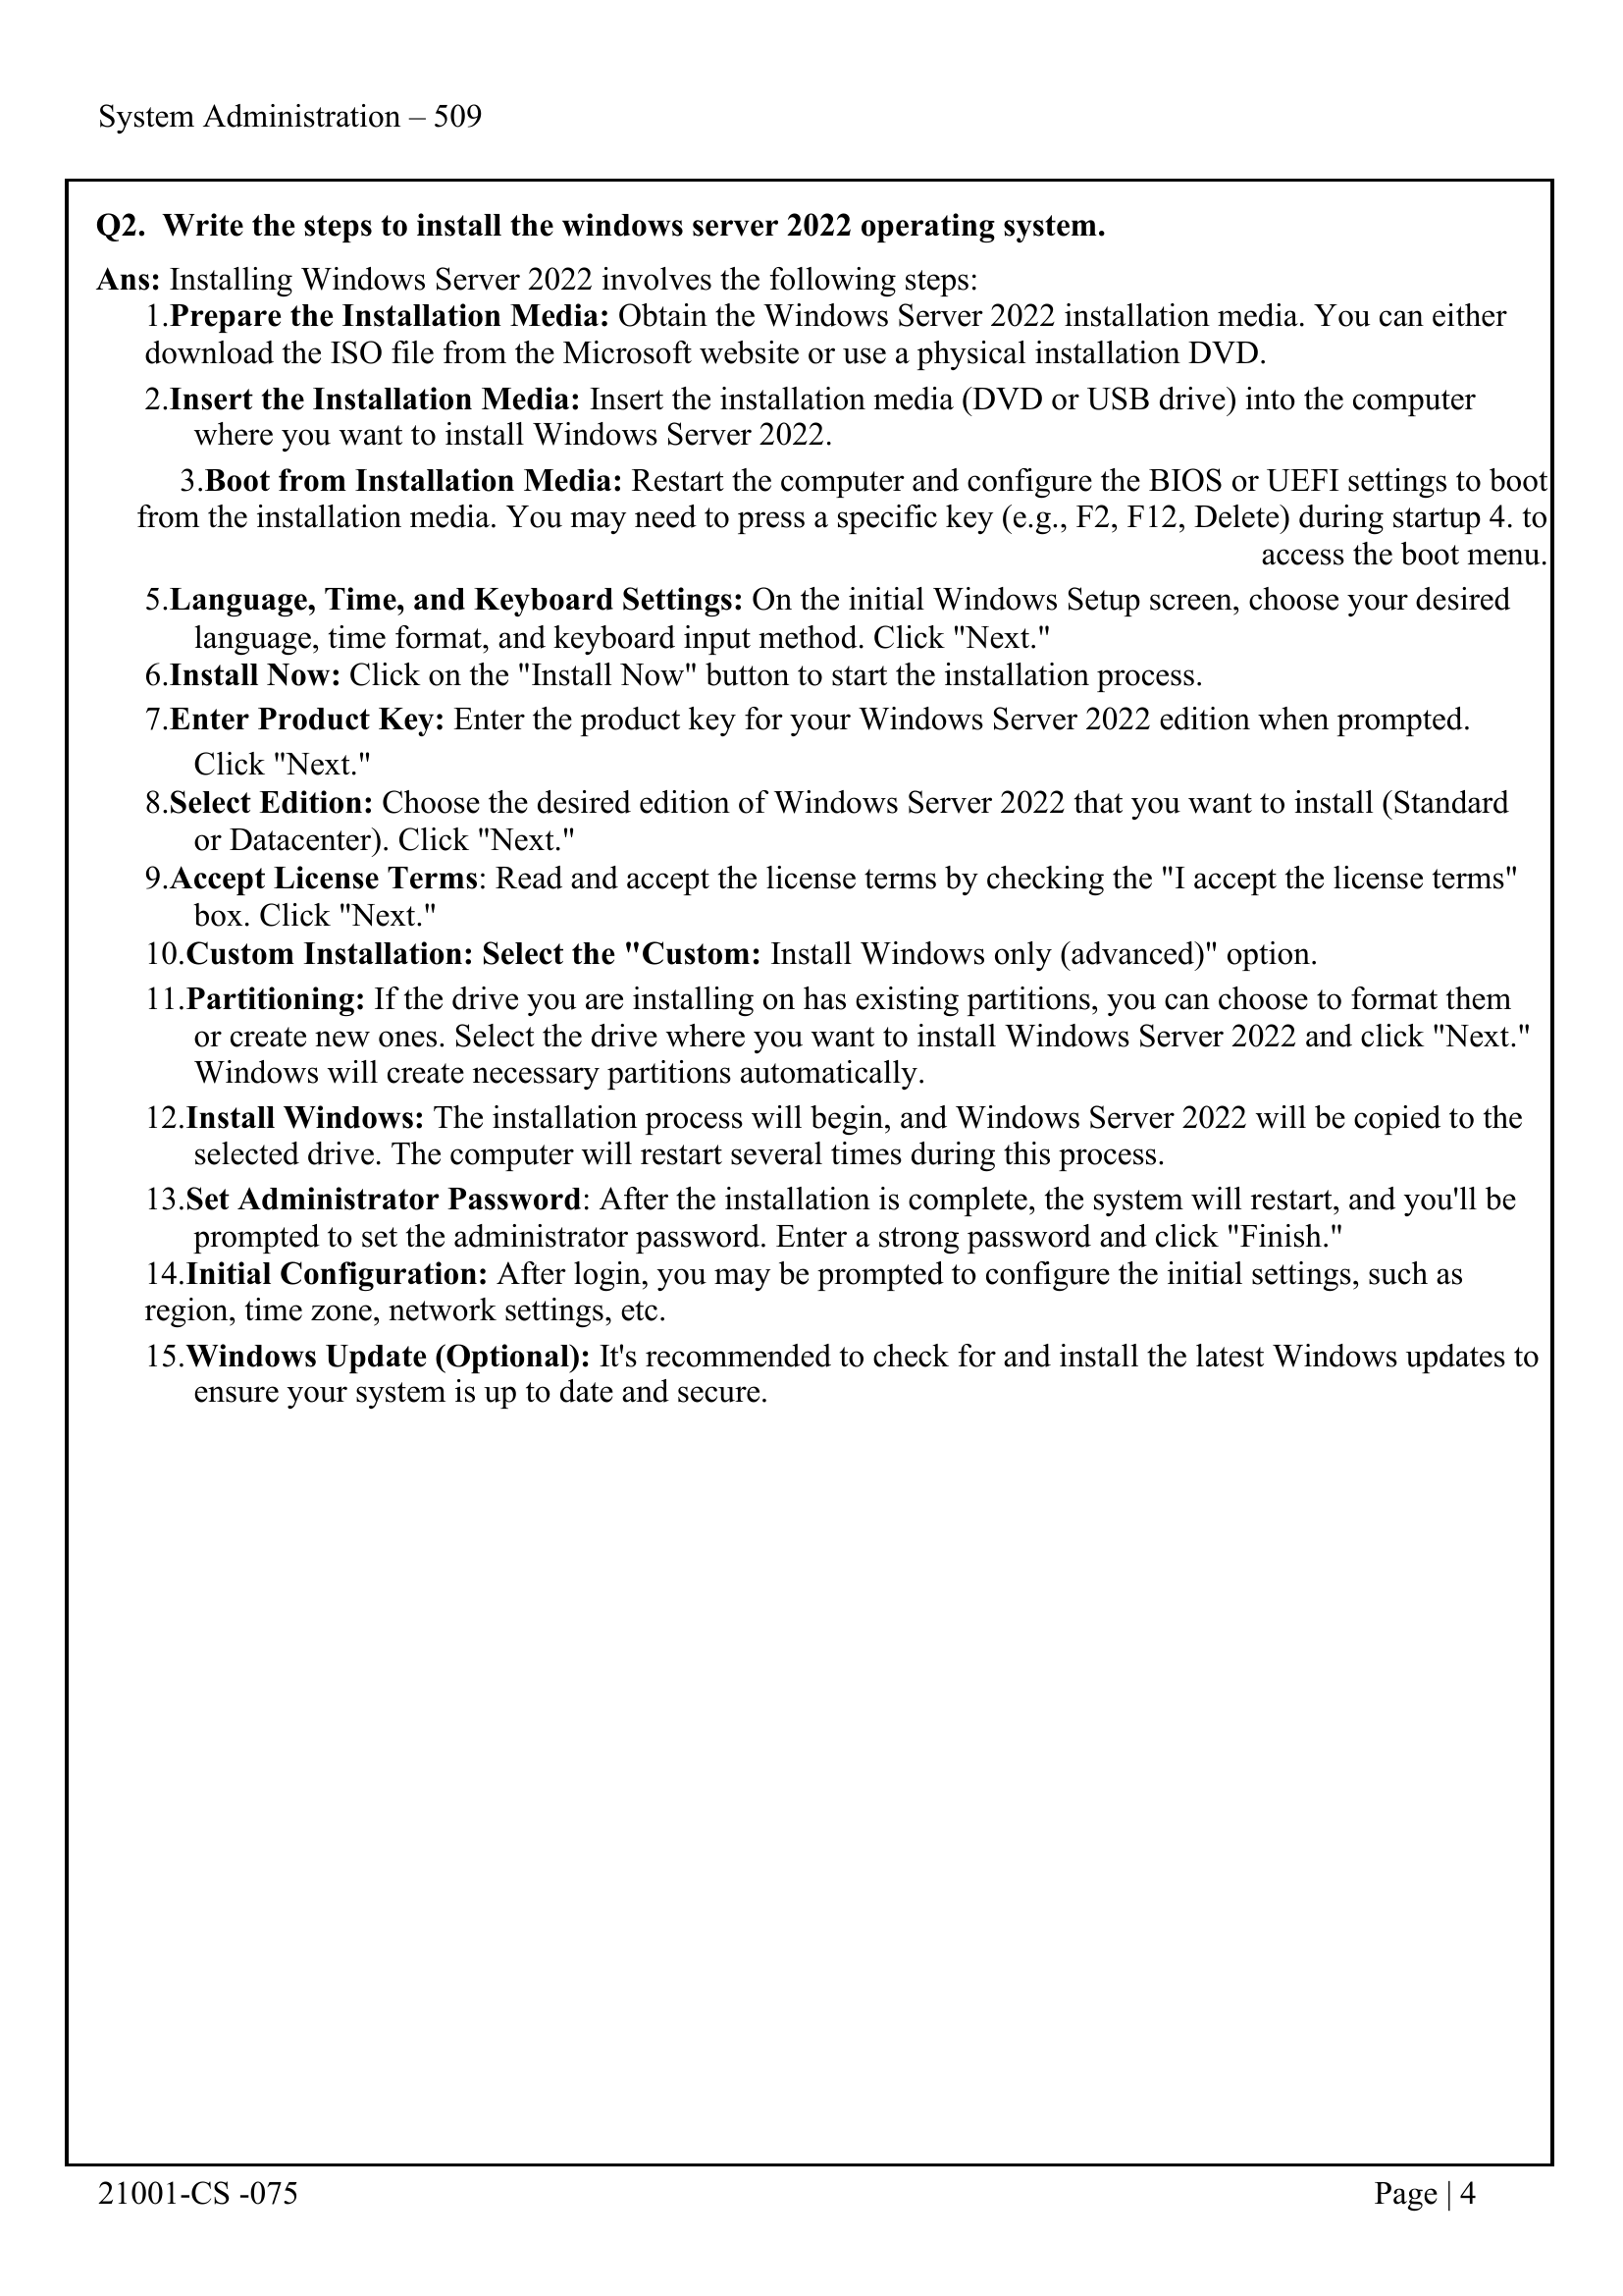

Slide 5
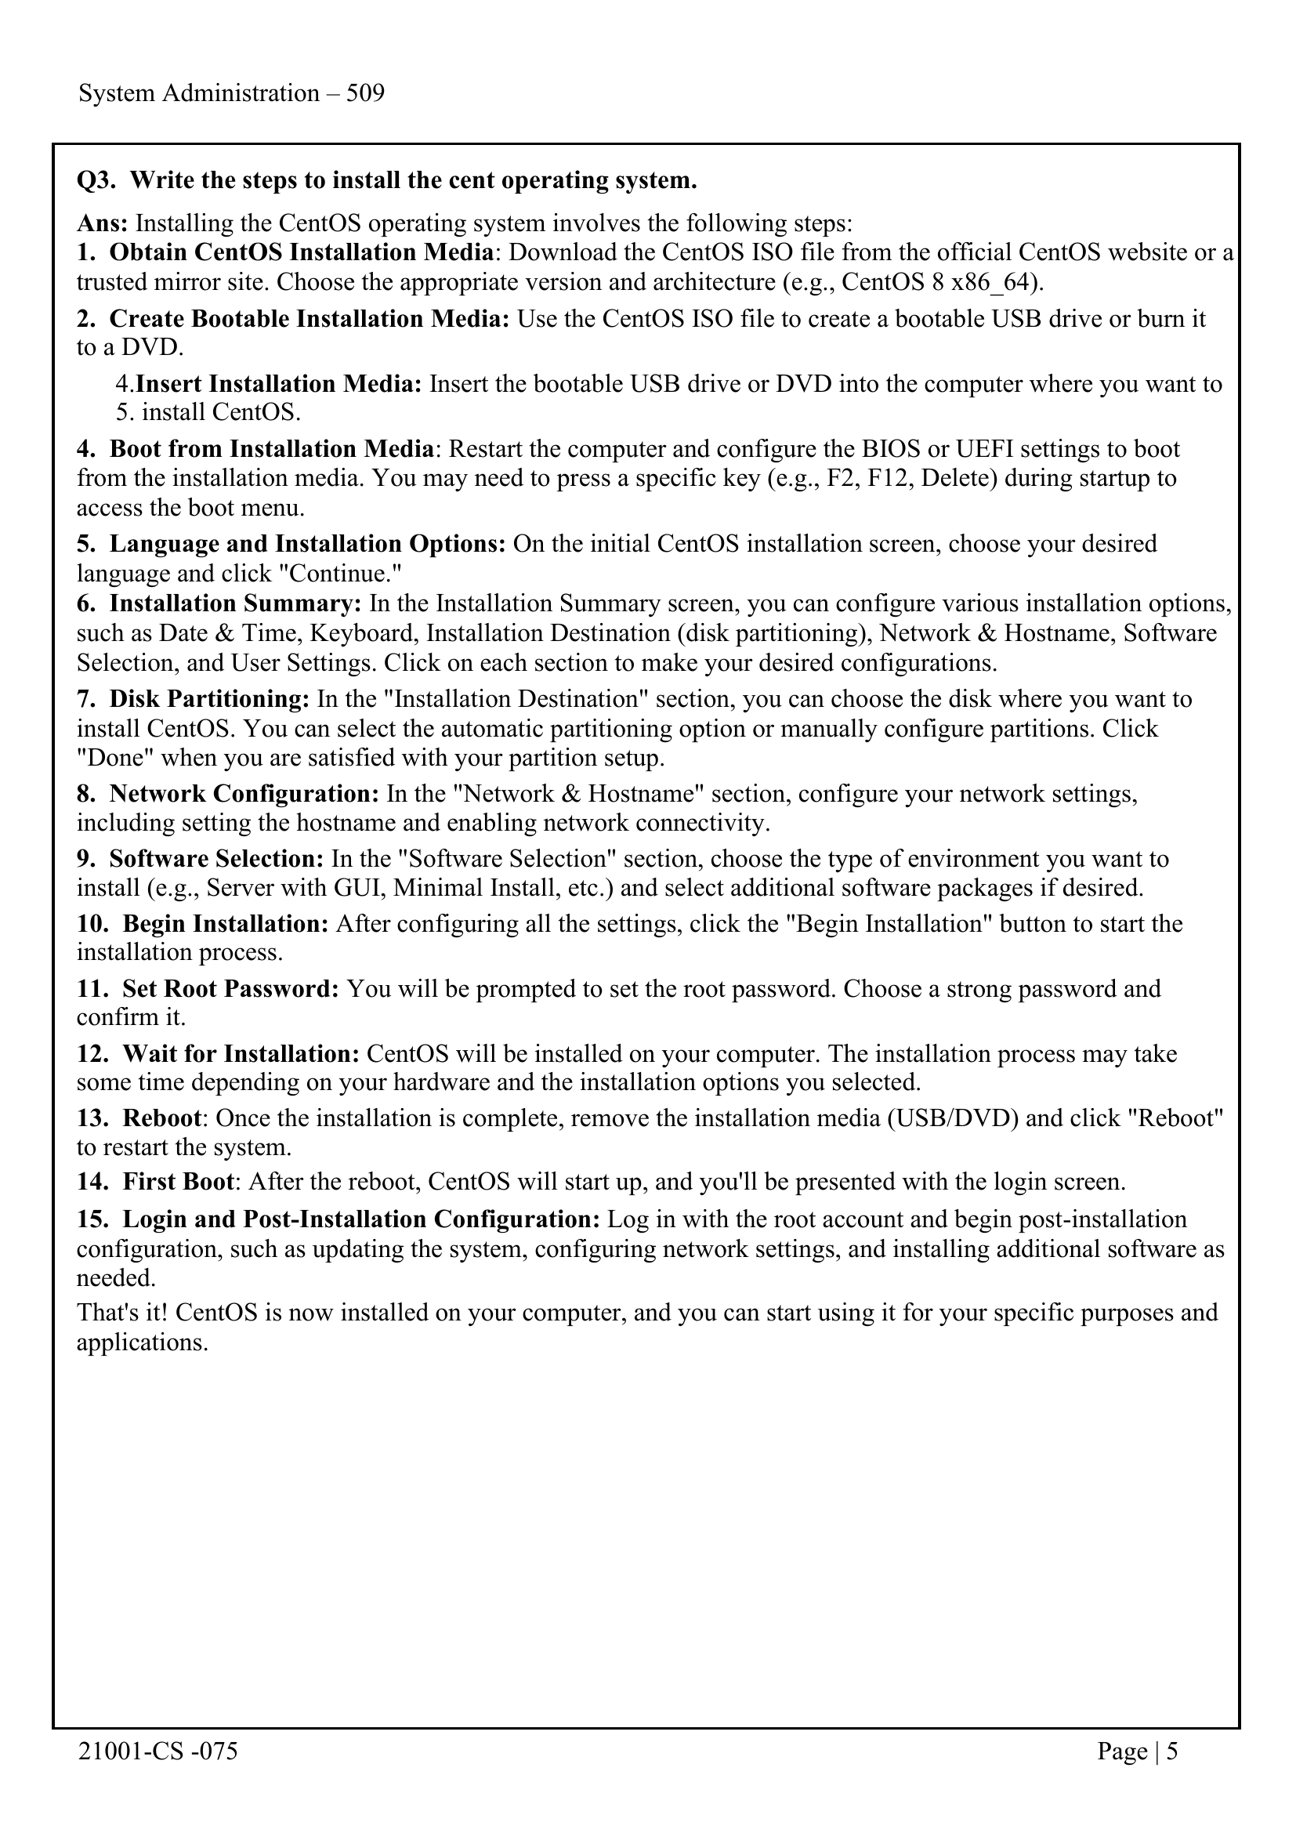

Slide 6
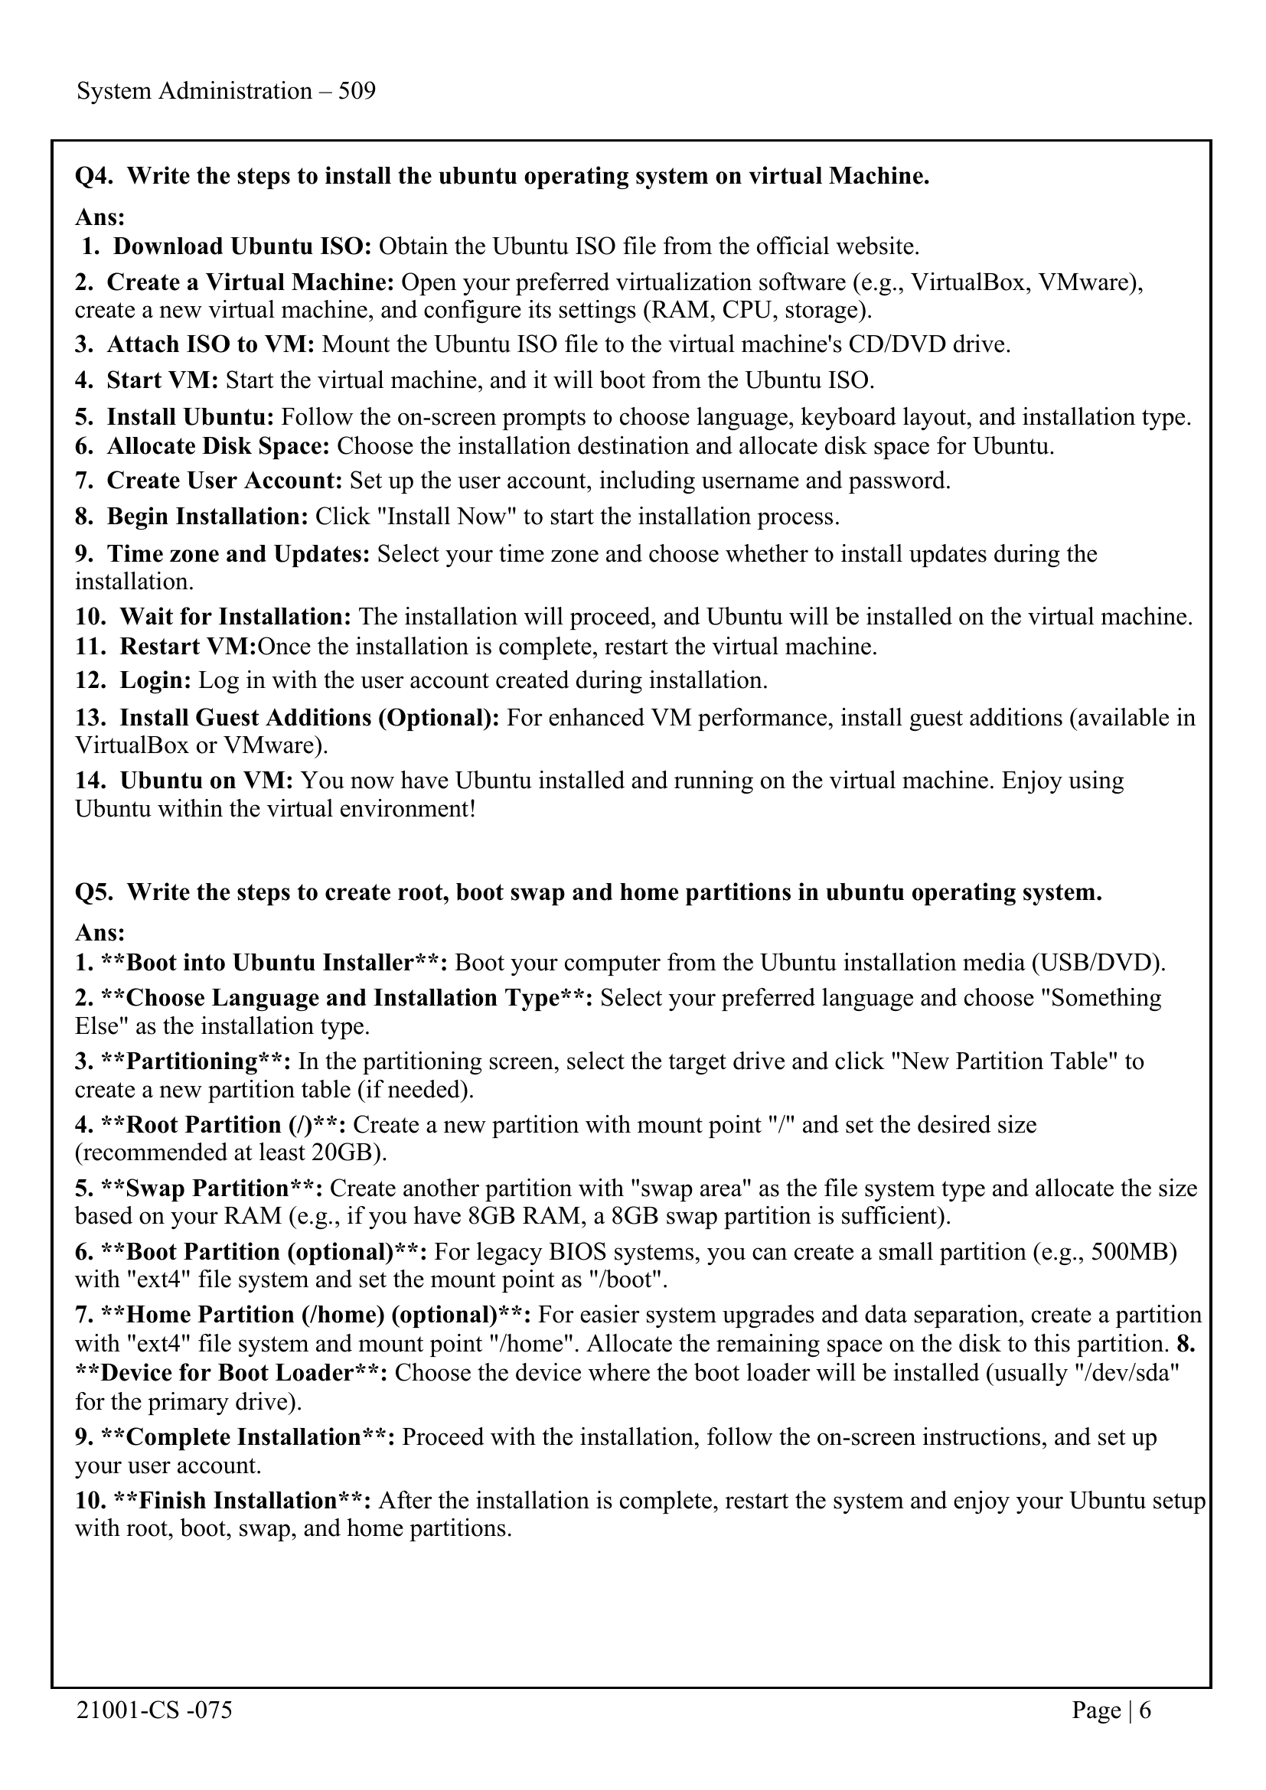
System Administration – 509

Slide 7
21001-CS -075 Page | 2

Slide 10
System Administration – 509

Slide 11
21001-CS -075 Page | 3

Slide 14
System Administration – 509

Slide 15
21001-CS -075 Page | 4

Slide 18
System Administration – 509

Slide 19
21001-CS -075 Page | 5

Slide 22
System Administration – 509

Slide 23
21001-CS -075 Page | 6

