Slide 1
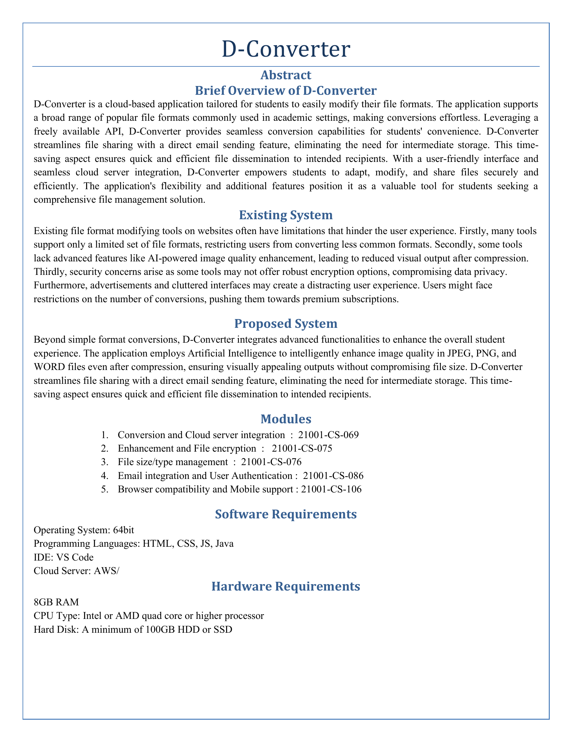
D-Converter

Slide 2
Abstract

Slide 3
Brief Overview of D-Converter

Slide 4
D-Converter is a cloud-based application tailored for students to easily modify their file formats. The application supports a broad range of popular file formats commonly used in academic settings, making conversions effortless. Leveraging a freely available API, D-Converter provides seamless conversion capabilities for students' convenience. D-Converter streamlines file sharing with a direct email sending feature, eliminating the need for intermediate storage. This time-saving aspect ensures quick and efficient file dissemination to intended recipients. With a user-friendly interface and seamless cloud server integration, D-Converter empowers students to adapt, modify, and share files securely and efficiently. The application's flexibility and additional features position it as a valuable tool for students seeking a comprehensive file management solution.

Slide 5
Existing System

Slide 6
Existing file format modifying tools on websites often have limitations that hinder the user experience. Firstly, many tools support only a limited set of file formats, restricting users from converting less common formats. Secondly, some tools lack advanced features like AI-powered image quality enhancement, leading to reduced visual output after compression. Thirdly, security concerns arise as some tools may not offer robust encryption options, compromising data privacy. Furthermore, advertisements and cluttered interfaces may create a distracting user experience. Users might face restrictions on the number of conversions, pushing them towards premium subscriptions.

Slide 7
Proposed System

Slide 8
Beyond simple format conversions, D-Converter integrates advanced functionalities to enhance the overall student experience. The application employs Artificial Intelligence to intelligently enhance image quality in JPEG, PNG, and WORD files even after compression, ensuring visually appealing outputs without compromising file size. D-Converter streamlines file sharing with a direct email sending feature, eliminating the need for intermediate storage. This time-saving aspect ensures quick and efficient file dissemination to intended recipients.

Slide 9
Modules

Slide 10
Conversion and Cloud server integration : 21001-CS-069

Slide 11
Enhancement and File encryption : 21001-CS-075

Slide 12
File size/type management : 21001-CS-076

Slide 13
Email integration and User Authentication : 21001-CS-086

Slide 14
Browser compatibility and Mobile support : 21001-CS-106

Slide 15
Software Requirements

Slide 16
Operating System: 64bit

Slide 17
Programming Languages: HTML, CSS, JS, Java

Slide 18
IDE: VS Code

Slide 19
Cloud Server: AWS/

Slide 20
Hardware Requirements

Slide 21
8GB RAM

Slide 22
CPU Type: Intel or AMD quad core or higher processor

Slide 23
Hard Disk: A minimum of 100GB HDD or SSD

