Slide 1
Probability and Distributions

Slide 2
Random variables
Bayes' Theorem
Means and Covariances
Sums and Transformations
Gaussian Distribution
Conjugacy and the Exponential Family

Slide 3
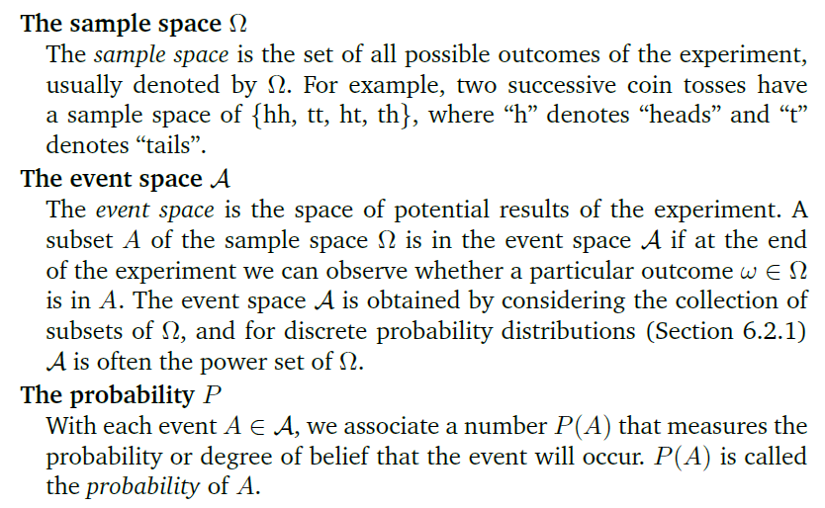
The probability space
Notes:
概率空间是概率论的基础。概率的严格定义基于这个概念。概率空间(Ω, F, P)是一个总测度为1的测度空间（即P(Ω)=1）

Slide 4



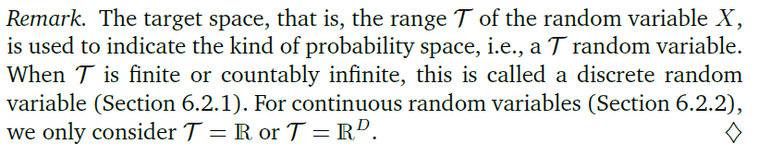
Random variable

Slide 5

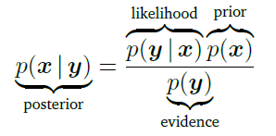

p(x) is the prior, which encapsulates our subjective prior knowledge of the unobserved (latent) variable x before observing any data.
The likelihood p(y|x) describes how x and y are related
The posterior p(x|y) is the quantity of interest in Bayesian statistics posterior because it expresses exactly what we are interested in, i.e., what we know about x after having observed y
marginal likelihood/evidence

Slide 6
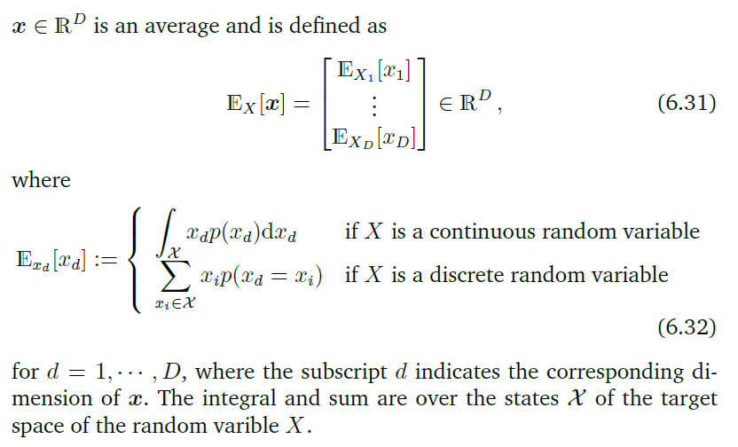
Means and Covariances

Slide 7
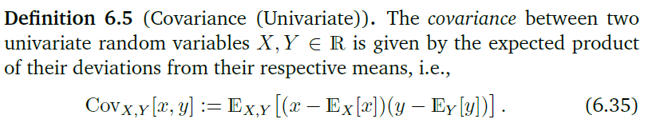
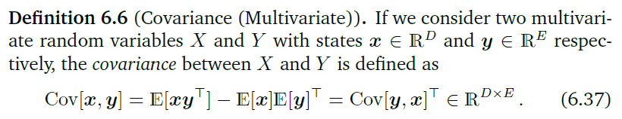

Slide 8
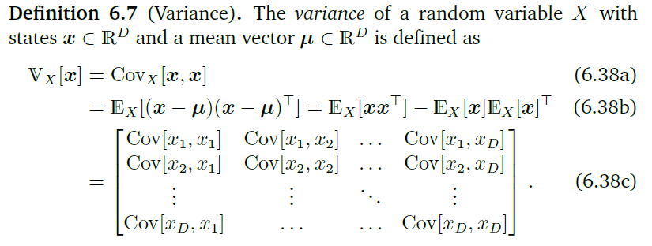

Slide 9
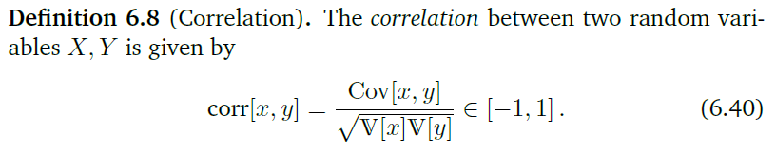
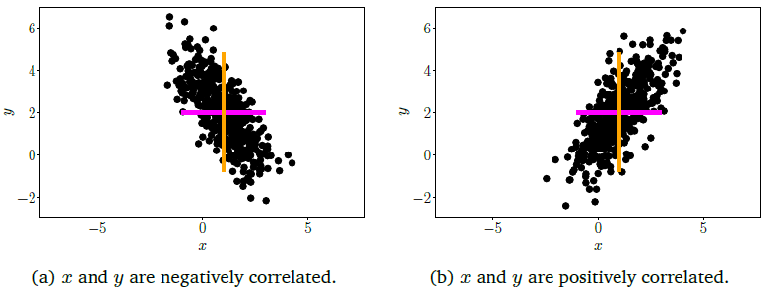
Notes:
When we want to compare the covariances between different pairs of
random variables, it turns out that the variance of each random variable
affects the value of the covariance. The normalized version of covariance
is called the correlation.

Slide 10
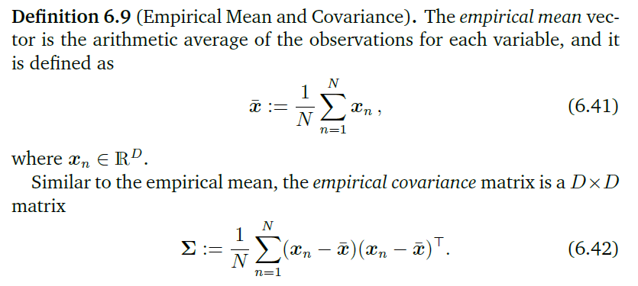
Empirical Means and Covariances

Slide 11
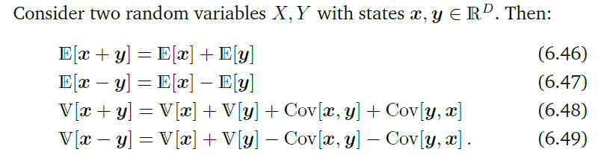


Sums and Transformations of Random Variables

Slide 12
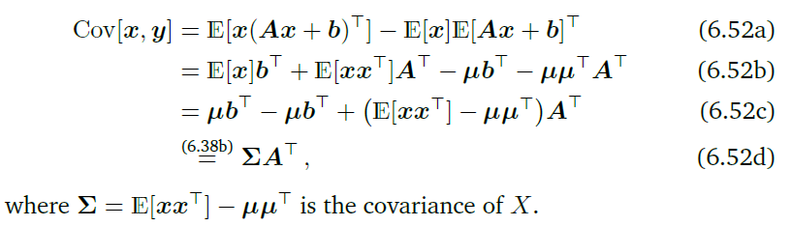

Slide 13

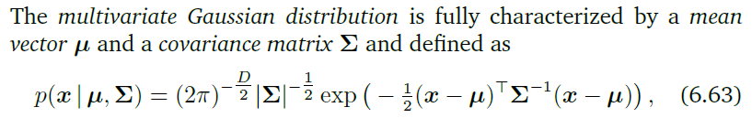
Gaussian Distribution
The Gaussian distribution arises naturally when we consider sums of independent and identically distributed random variables.
This is known as the central limit theorem.

Slide 14
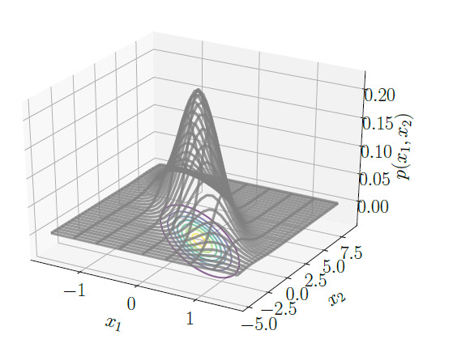

Slide 15
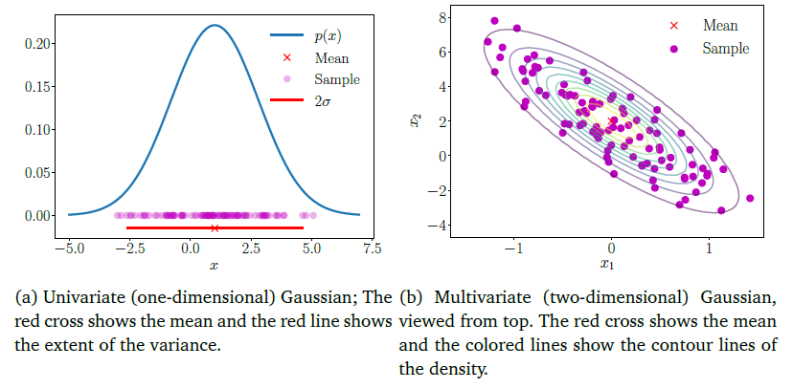

Slide 16

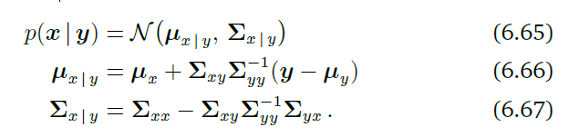
Marginals and Conditionals of Gaussians

Slide 17
Applications
The Kalman filter (Kalman, 1960), one of the most central algorithms for state estimation in signal processing, does nothing but computing Gaussian conditionals of joint distributions.
Gaussian processes which are a practical implementation of a distribution over functions. In a Gaussian process, we make assumptions of joint Gaussianity of random variables. By (Gaussian) conditioning on observed data, we can determine a posterior distribution over functions.
Latent linear Gaussian models which include probabilistic principal component analysis.

Slide 18

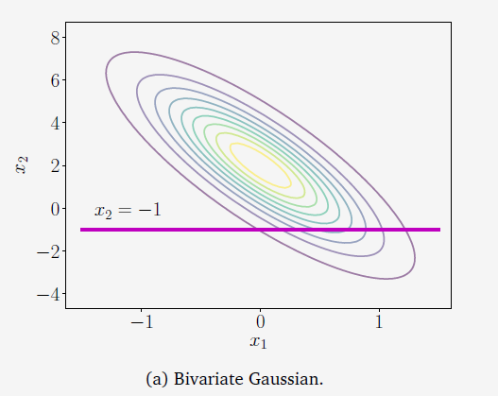

The marginal distribution

Slide 19
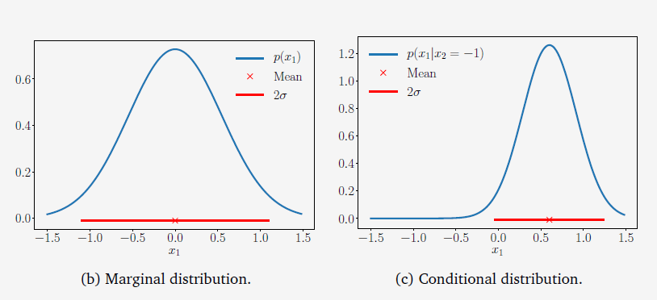
Notes:
2sigma 0.954，3sigma0.997

Slide 20

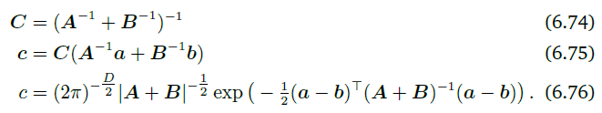
Product of Gaussian Densities
Bayes’ Theorem to compute the posterior, which results in a multiplication of the likelihood and the prior, that is, the multiplication of two Gaussian densities.

Slide 21

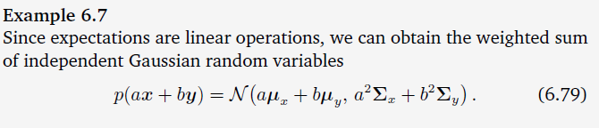
Sums and Linear Transformations

Slide 22
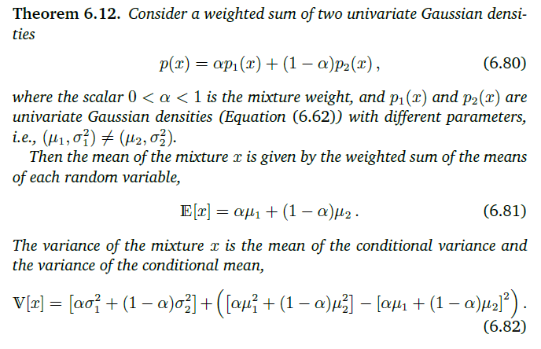

Slide 23
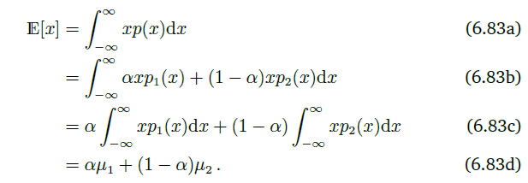
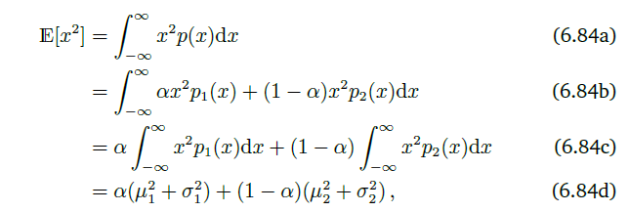

Slide 24
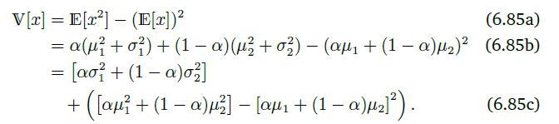




Slide 25
Sampling from Multivariate Gaussian Distributions
A source of pseudo-random numbers that provide a uniform sample in the
interval [0,1]
Use a non-linear transformation such as the
Box-Muller transform (Devroye, 1986) to obtain a sample from a univariate Gaussian
We collate a vector of these samples to obtain a
sample from a multivariate standard normal gaussion distribution

Slide 26
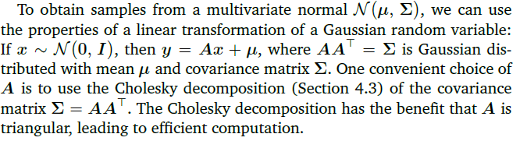
For a general multivariate Gaussian, that is, where the mean is non
zero and the covariance is not the identity matrix, we use the properties of linear transformations of a Gaussian random variable.

Slide 27
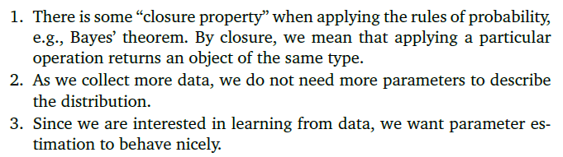
Conjugacy and the Exponential Family
Desired probability distributions in the machine learning context
Exponential family provides the right balance of generality while retaining favorable computation and inference properties.

Slide 28
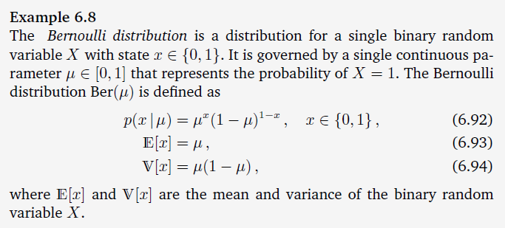
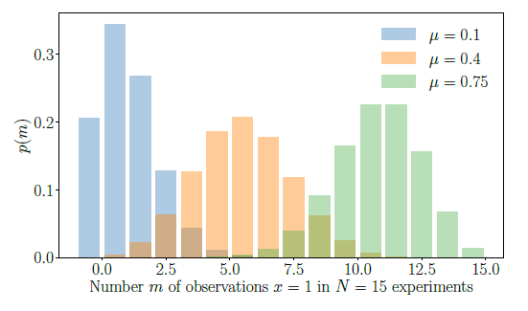

Slide 29
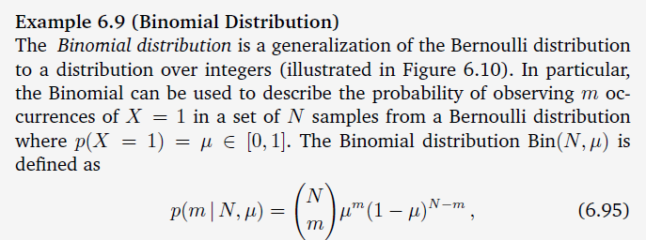
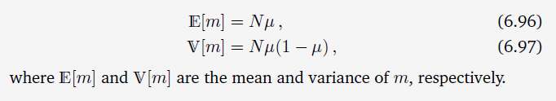

Slide 30
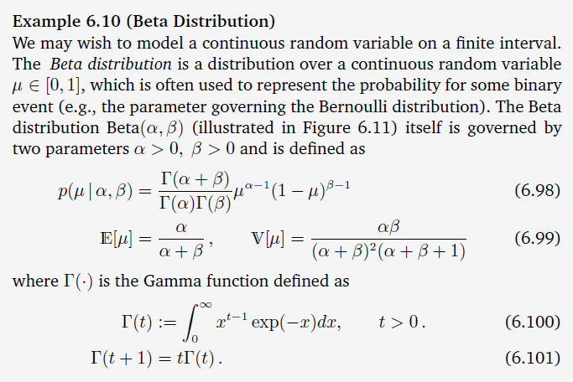

Slide 31
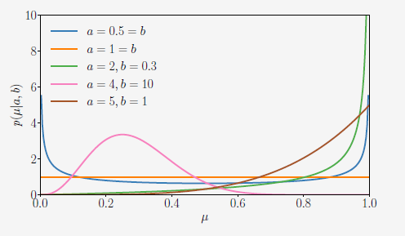
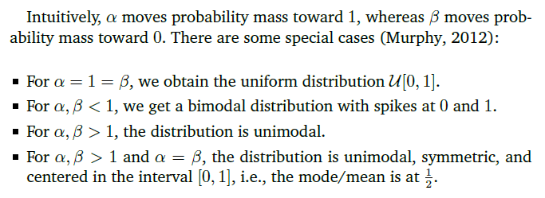

Slide 32
Conjugacy
According to Bayes’ theorem (6.23), the posterior is proportional to the
product of the prior and the likelihood.
The specification of the prior canbe tricky for two reasons:
The prior should encapsulate our knowledge about the problem before we see any data. This is often difficult to describe.
It is often not possible to compute the posterior distribution analytically.
However, there are some priors that are computationally convenient: conjugate priors.

Slide 33
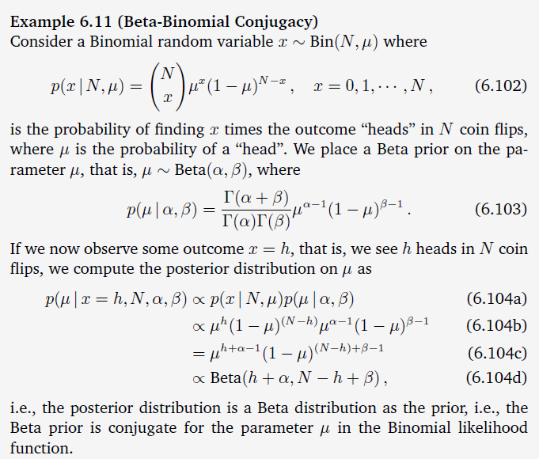

Slide 34
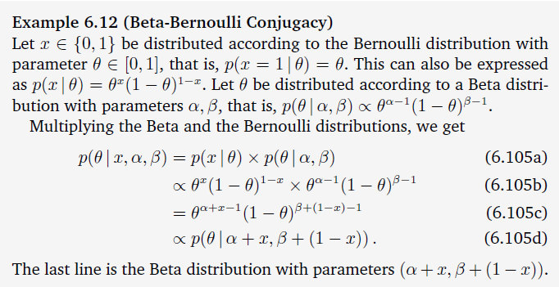

Slide 35
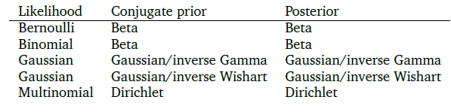
The reason why the Gaussian likelihood appears twice： distinguish the univariate from the multivariate case.

Slide 36
Exponential Family
There are three possible levels of abstraction we can have when considering distributions (of discrete or continuous random variables). At level one (the most concrete end of the spectrum), we have a particular named distribution with fixed parameters
The second level of abstraction, that is, we fix the parametric
form (the univariate Gaussian) and infer the parameters from data.
A third level of abstraction is to consider families of distributions, and in this book, we consider the exponential family. The univariate Gaussian is an example of a member of the exponential family. Many of the widely used statistical models, including all the prevously “named” models are members of the exponential family.

Slide 37
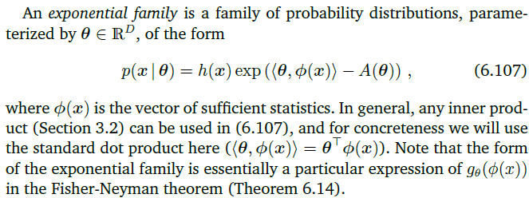

The parameters are called the natural parameters.

Slide 38
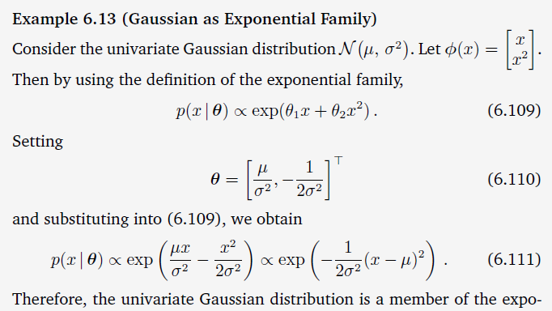


Slide 39
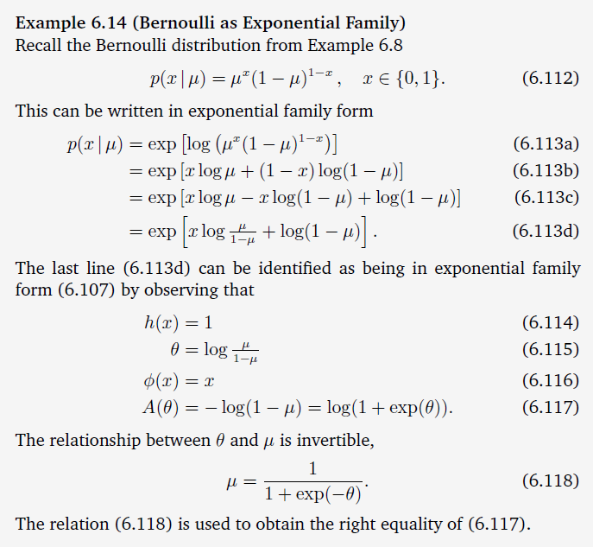

Slide 40

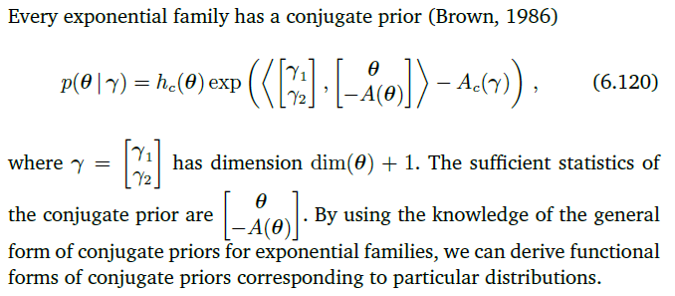

Slide 41
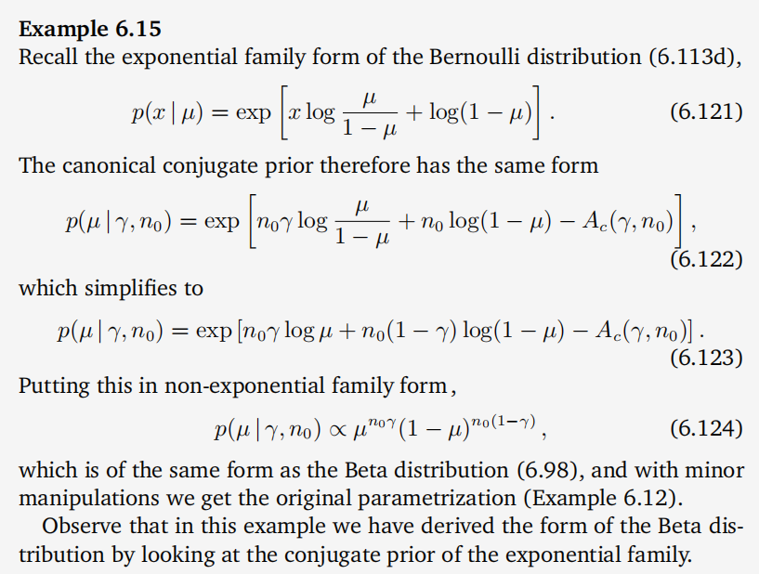

Slide 42
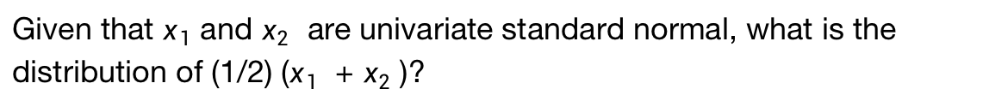
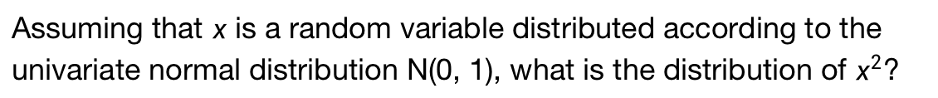
Change of Variables/Inverse Transform
Assuming that $x$ is a random variable distributed according to the univariate normal distribution N(0, 1), what is the distribution of $x^{2}$?
Given that $x_{1}$ and $x_{2}$ are univariate standard normal, what is the distribution of (1/2) ($x_{1}$ + $x_{2}$ )?
We will look at two approaches for obtaining distributions of transformations of random variables: a direct approach using the definition of a cumulative distribution function and a change-of variable approach that uses the chain rule of calculus

Slide 43
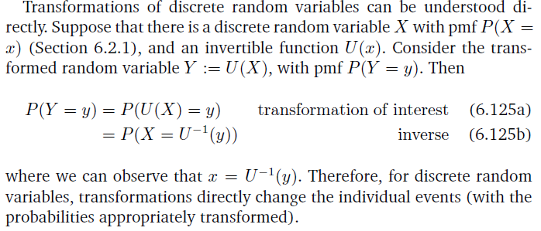
Distribution Function Technique

Slide 44
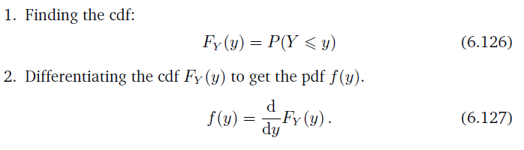
For a random variable X and a function U, we find the pdf of the random variable Y := U(X) by

Slide 45
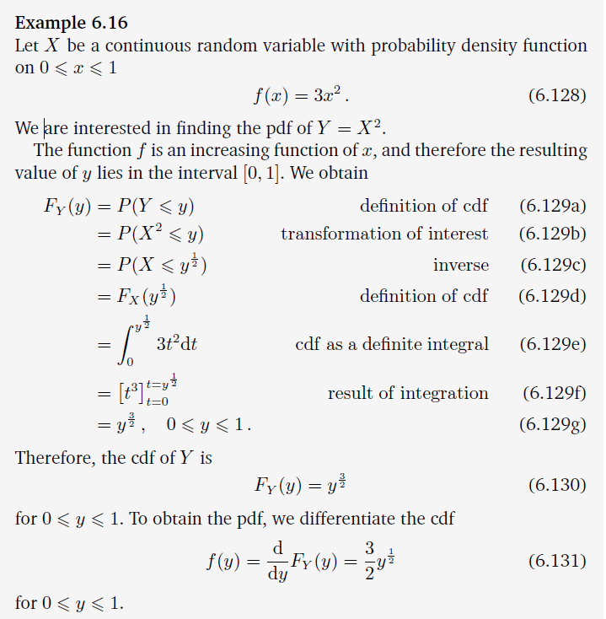

Slide 46
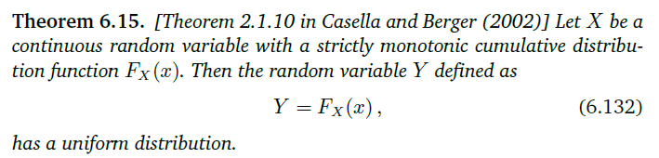
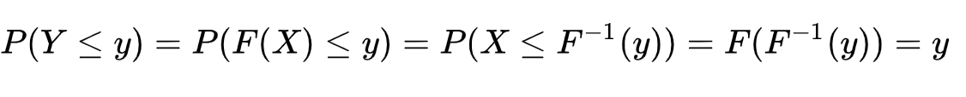

Probability integral transform

Slide 47
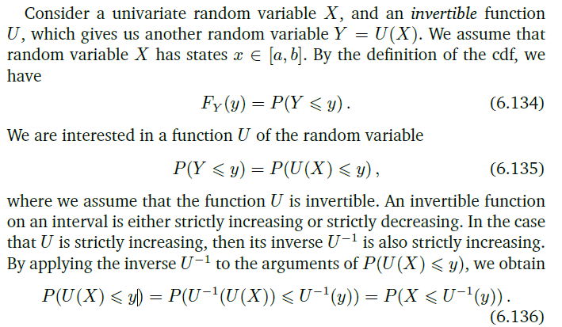
Change of Variables

Slide 48
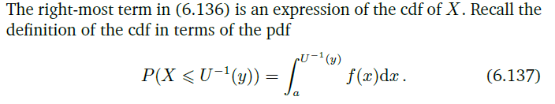



Slide 49



Slide 50


Slide 51






