Slide 1
Project Title: Travel Go Where? Idea: User generated travel forum Target to complete on: 8 Apr (Friday) - Backend 11 Apr (Monday) - Linking to Frontend + solving outstanding backend problems 12 Apr (Tuesday) - 13 Apr (Wednesday) - Stretch Goals (if time permits) 14 Apr (Thursday) - Presentation of project

Slide 2
Endpoints (for now)
:/ | main page
:/{singapore} | country page
:/{singapore}/{topic} | zooming into a particular post in a country's thread

Slide 3
General Flow (per country- for now)
Forum
Welcome Center
Thread 1
only superadmins can create
for rules & ETC
Thread 2
Popular Places to go
Thread 1
popular stuff talked about
Thread 2
General Discussions
Thread 1
every other thing
Thread 2

Slide 4
React Setup (for now)
Index
Login
NavBar
App
Credentials
Profile
ForumCtn
WelcomeCenter
NormalThread
StickyThread
Thread
Thread
Thread
Title
Content
etc
Title
Content
etc
Title
Content
etc

Slide 5

Landing Page
Login/ Register
Travel To Where?

Slide 6
Landing Page (on scroll)
Singapore
(demo example)
Placeholder Country 1
Placeholder Country 2

Slide 7
Clicking into Singapore
Search - Search for word that appears in title
Welcome Center
Rules
idk
Click for more
Popular Places to Go (Limit to 5 to show)
Sentosa
MBS
Click for more
General Discussions about {Singapore}
What to do at Airport
What to eat
Click for more

Slide 8
Clicking into a thread in SG - Sentosa
Create New Post
Post 1
Post 2
Post 3

Slide 9
Clicking into a thread in SG - Sentosa Post 1
Post 1 - original post
Reply
Post 1 - reply by someone
Reply
Post 1 - reply by someone else
Reply

Slide 10
Reply interface (at bottom of the page)
Post 1 - original post
Reply
Post 1 - reply by someone (who alr replied)
Reply
Post 1 - original post (replying to original post)
Post

Slide 11
Register Page/ Login Page
username: | (required), unique
password: | (required)
email:
Register
or
Login

Slide 12
Backend Setup
Authentication, sessions
Users Schema
Admin and users
Seed some data in
Topics/ Posts Schema
Title (post title)
Date
Content (content of the post)
Categories: [ Singapore, Sentosa ] (example)
Id

Slide 13
Base Functionality (MVP)
Create users
Log in and out
Create a new post into the forum
Reply to a post

Slide 14
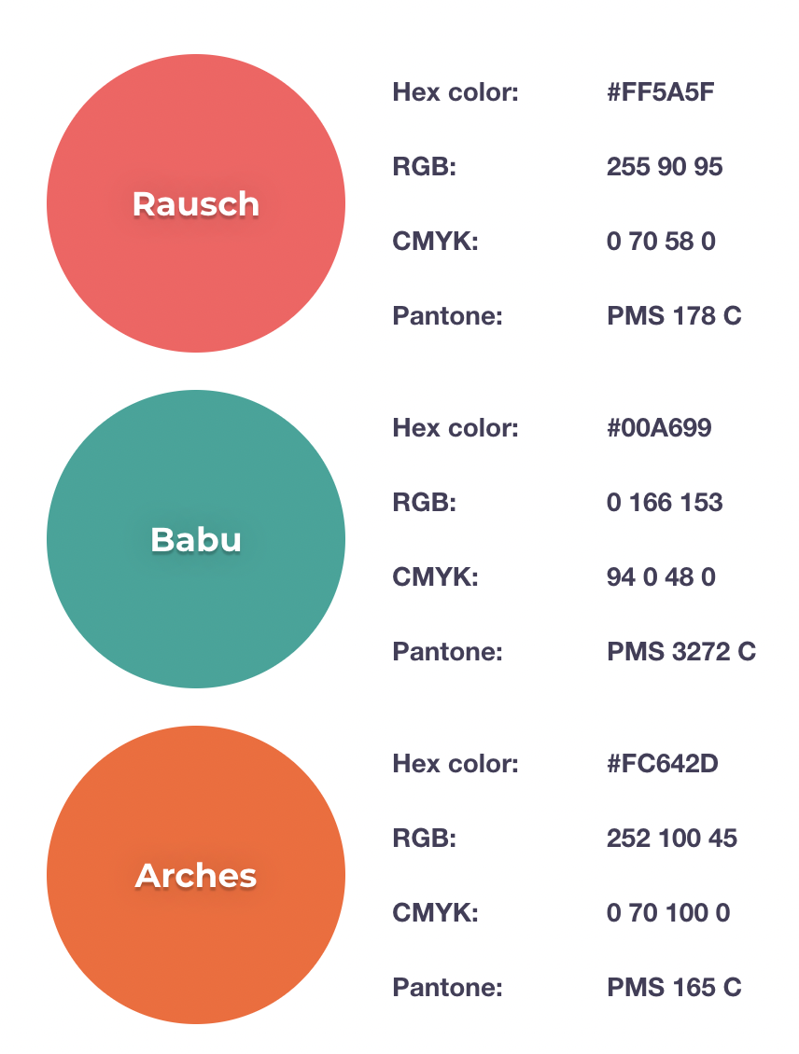
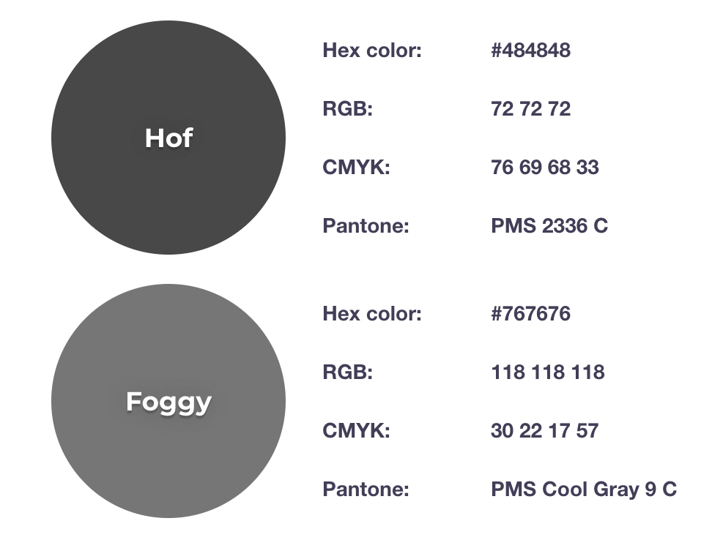
Colour Theme

Slide 15
Adding Thread Counts/ Message Counts
Search - Search for word that appears in title
Welcome Center
Rules
Thread Ct.
Msg Ct.
idk
Thread Ct.
Msg Ct.
Click for more
Popular Places to Go (Limit to 5 to show)
Sentosa
Thread Ct.
Msg Ct.
MBS
Thread Ct.
Msg Ct.
Click for more
General Discussions about {Singapore}
What to do at Airport
Thread Ct.
Msg Ct.
What to eat
Thread Ct.
Msg Ct.
Click for more

Slide 16
User Badges
Post 1 - original post
PFP
Reply
Post 1 - reply by someone (who alr replied)
Reply
Post 1 - original post (replying to original post)
Post

Slide 17
Travel Itinerary
Search - Search for word that appears in title
Welcome Center
Rules
idk
Click for more
Popular Places to Go (Limit to 5 to show)
Sentosa
MBS
Click for more
General Discussions about {Singapore}
What to do at Airport
What to eat
Click for more
Itinerary in {Singapore}
Sentosa
MBS
Click for more

Slide 18

Saving a post from other users
Post 1 - original post
Reply
Post 1 - reply by someone
Reply
Post 1 - reply by someone else
Reply

