Slide 1
Project: Travel Go Where? Idea: User generated travel forum

Slide 2
General Flow
Forum
Welcome Center
Thread 1
Thread 2
Landing Page
Popular Places to go
Thread 1
popular stuff talked about
Thread 2
General Discussions
Thread 1
every other thing
Thread 2

Slide 3
Base Functionality (MVP)
Create users
Log in and out
Create a new post into the forum

Slide 4
Backend Setup - Authentication & Schema
Authentication, sessions
Users Schema
Username
Password
Topics Schema
Title (post title)
Date
Content (content of the post)
Country
Categories: [ Singapore, Sentosa ] (example)
Author (ref to Users)

Slide 5
Backend Setup - Controllers/ Routers
Sessions Controller
Login
Logout
Topics Controller
Create new post
Read post
Update post
Delete post
Users Controller
Create new users

Slide 6
React Setup
Index
App
Login
Landing Page
WelcomeCenter
NormalThread
StickyThread
Thread
Thread
Thread
Title
Content
etc
Title
Content
etc
Title
Content
etc

Slide 7

Landing Page
Login/ Register
Travel To Where?
Notes:
search by country - done (full front end API or just add to DB with nice photos ~10 countries)

Slide 8
Landing Page
Singapore
(demo example)
Placeholder Country 1
Placeholder Country 2

Slide 9
Clicking into Singapore
Search - Search for word that appears in title
Welcome Center
Create New Post
Rules
idk
Click for more
Popular Places to Go
Sentosa
MBS
Click for more
General Discussions about {Singapore}
What to do at Airport
What to eat
Click for more

Slide 10
Clicking into a thread in SG - Sentosa
Post 1
aquarium
Post 2
Post 3

Slide 11
Clicking into a thread in SG - Sentosa Post 1 - Aquarium
Post 1 - original post
post title: is aquarium worth the price?
content: i think its expensive
Reply
Post 1 - reply by someone
Reply
Post 1 - reply by someone else
Reply

Slide 12
Reply interface (at bottom of the page)
Post 1 - original post
Reply
Post 1 - reply by someone (who alr replied)
Reply
Post 1 - original post (replying to original post)
Post

Slide 13
Register Page/ Login Page
username: | (required), unique
password: | (required)
email:
Register
or
Login

Slide 14
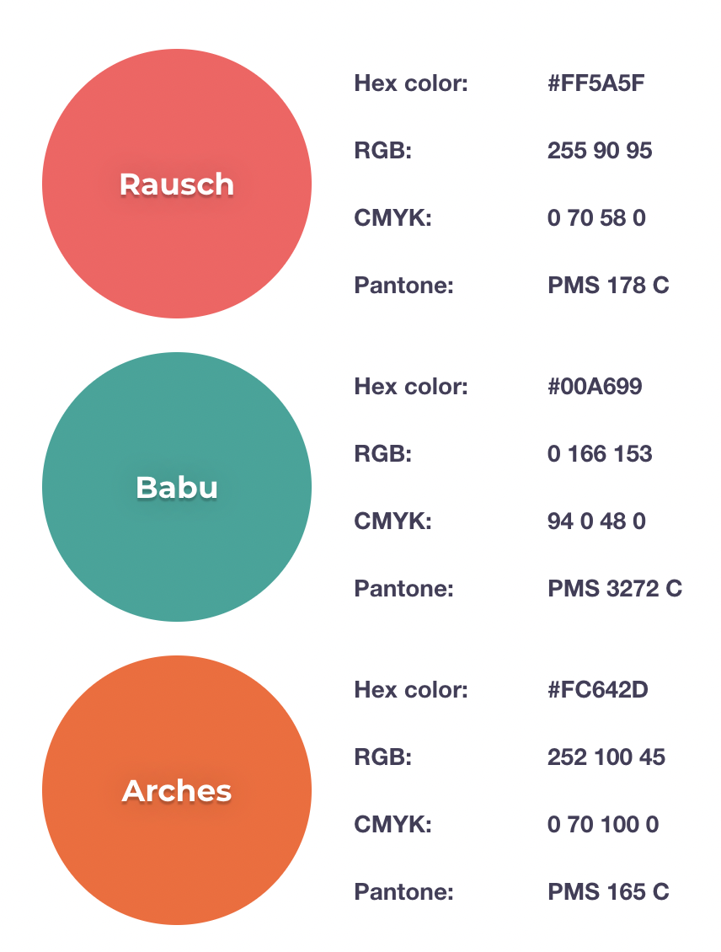
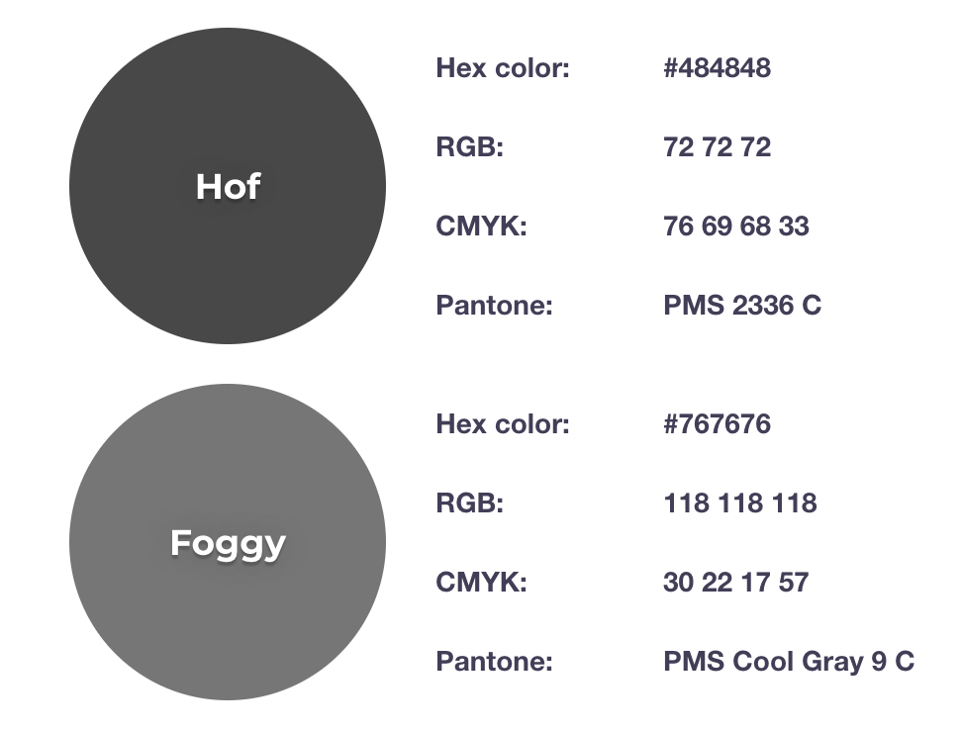
Colour Theme

