Slide 1


NextChapter
Last year, thousands of Singapore PMETs were made redundant.
Decades of skill.
No clear next step.
Meet Sarah
48 • Operations Manager • 16 years • Made redundant in May
Watch what happens in the next 90 seconds.
OpenArena • Track 05
Notes:
0:00–0:20 Last year, thousands of experienced Singapore professionals were retrenched. They have decades of skill — and no idea what to do with it. This is Sarah. 48, operations manager, 16 years, made redundant in May. Watch what happens in the next 90 seconds.

Slide 2
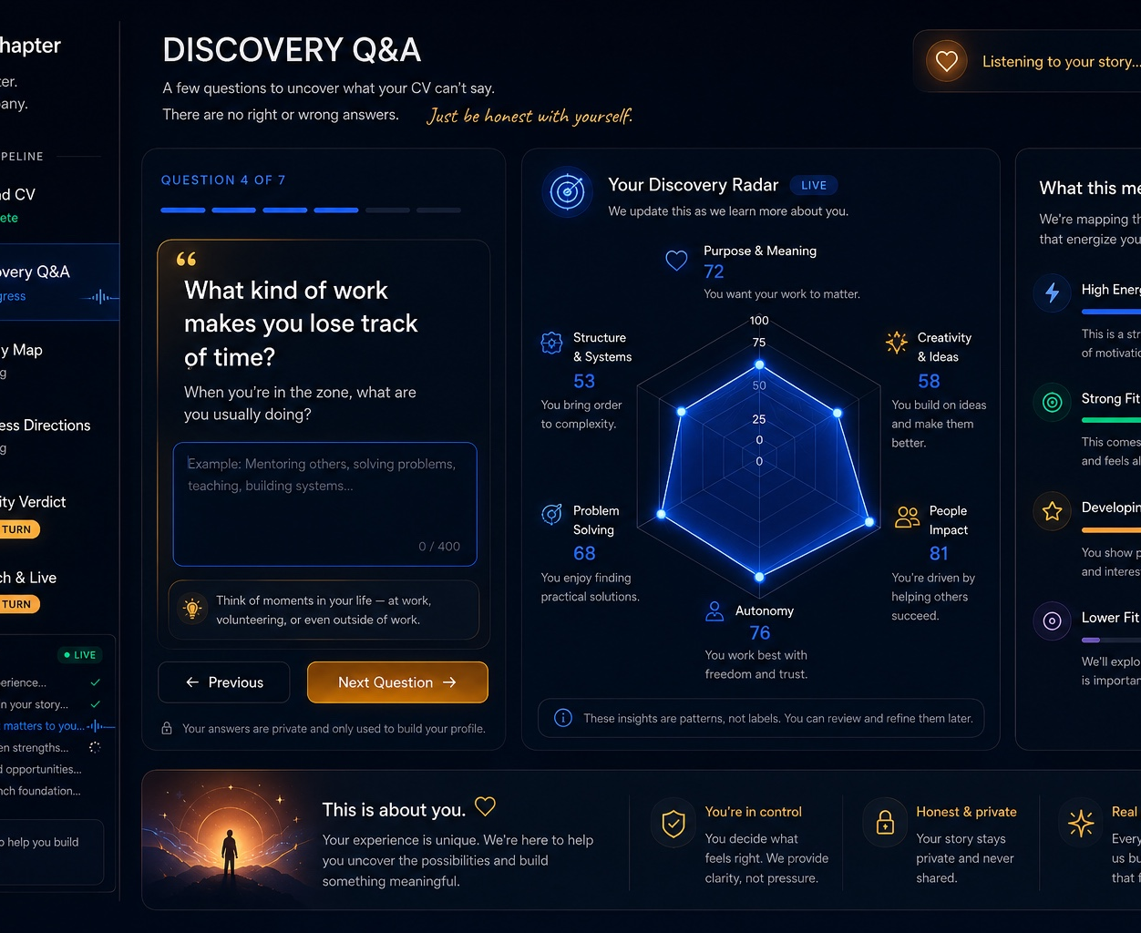
NextChapter
LIVE DEMO
Switch to the app. Show the pipeline: CV → discovery → energy map → directions → honest verdict → live site.
The human decides.
The agent tells the truth.
Demo beats slides here.
OpenArena • Track 05
Notes:
0:20–1:50 Sarah pastes her CV. NextChapter asks what her CV can’t say. Answer q1, paste the tart answer at q7. She bakes 40 tins of pineapple tarts every Chinese New Year, run like a production line. Her CV never mentions it. Energy map: it finds a hidden strength — she designs systems instinctively. Directions: it gives three scored directions. The agent recommends the safe consultancy. Sarah picks the one that fits her deeper. The human decides — that’s the design. Verdict: Then it does something rare: it’s honest. Amber. S$18–48k year one, here’s the actual math. It will tell you not to start. Finale: And it builds her company. Live website, deployed. That’s real — scan it.

Slide 3
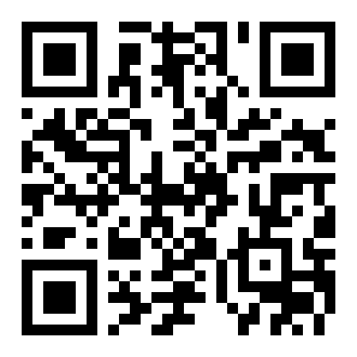
NextChapter
Get your own
Strength Map
Scan now — NextChapter will find your hidden strengths in the next two minutes.
You do not have to start a company today.
But you should know what you are worth.
nextchapter.ai
OpenArena • Track 05
Notes:
1:50–2:15 That’s one person. Here’s the room. Scan this — NextChapter will find your hidden strengths in the next two minutes. You don’t have to start a company today. But you should know what you’re worth.

Slide 4
NextChapter
Agentic.
Grounded.
Honest.
1
2
3
4
5
6
Upload CV
Discovery Q&A
Energy Map
Business Directions
Viability Verdict
Launch & Live
Six agents, chained
Career psychology
Honesty engine
Profiler, questioner, energy mapper, opportunity scorer, viability judge, launch builder.
Flow, self-determination theory, Holland-style fit signals — not generic prompts.
Amber/red verdicts with revenue arithmetic. It would rather lose you than lie to you.
OpenArena • Track 05
Notes:
2:15–2:35 Six agents, chained. Discovery grounded in real career psychology — flow, self-determination theory, Holland codes. And an honesty engine that would rather lose you than lie to you. Everyone builds hype. We built a partner that tells the truth.

Slide 5
NextChapter
Business model
1
Free Strength Map
2
S$49 Launch
3
B2B Channel
Shareable diagnosis card. Every share is acquisition.
Website + offer + pricing + first proposal.
Outplacement firms and e2i-style transition support pay per head.
One founder + agents = the next company.
Today it launches your company. Tomorrow it becomes the partner that remembers every decision and grows with you.
OpenArena • Track 05
Notes:
2:35–2:55 Free map, paid launch, and a B2B channel — outplacement firms and e2i pay per head to help people transition. Today it launches your company. Tomorrow it’s the partner that remembers every decision and grows with you.

Slide 6
NextChapter
We don’t build tools for one-person companies.
We build the companies.
Sheryl Deng • OpenArena / Track 05 • Built solo in two days with Claude Code
Notes:
2:55–3:00 We don’t build tools for one-person companies. We build the companies. I’m Sheryl — I built this solo, in two days, with Claude Code. NextChapter.

