Slide 1

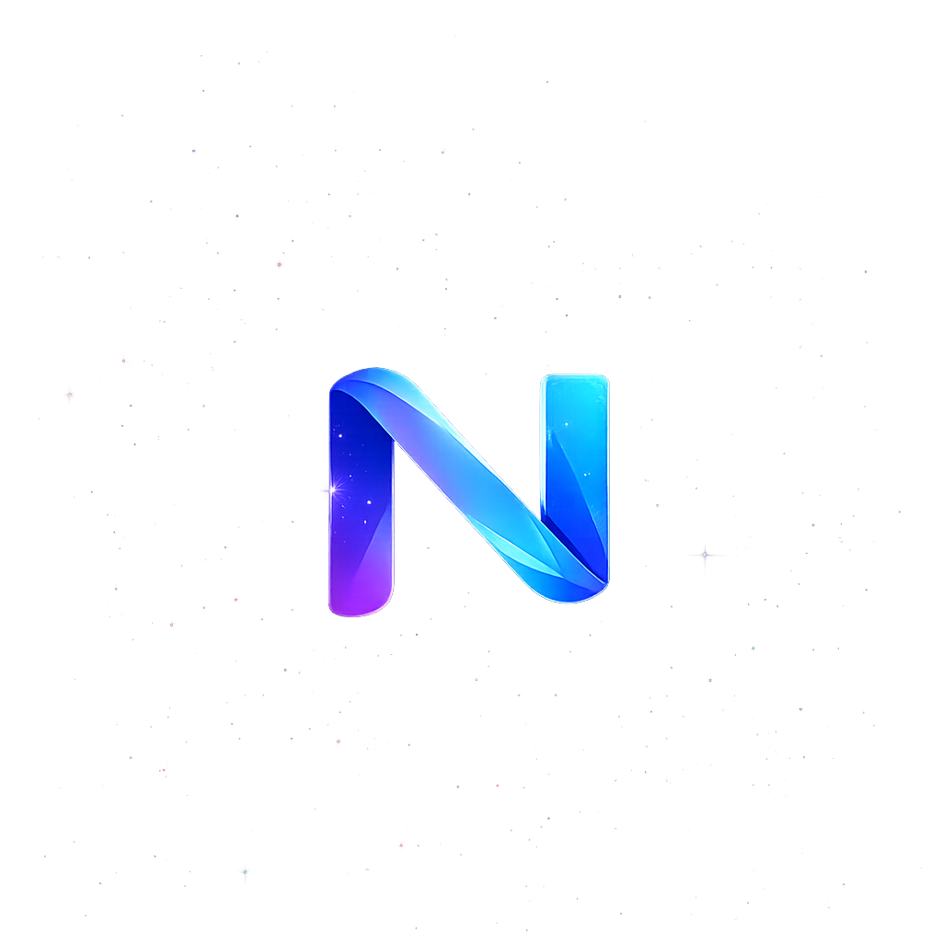
NextChapter
Everyone talks about
finding your next job.
What if you could build
your next chapter?
Discover the founder already hidden in your career.
Notes:
Opening. Say: Everyone talks about finding your next job. What if you could build your next chapter?

Slide 2

NextChapter
Meet Sarah
48 · Operations Manager · 16 years
MADE REDUNDANT IN MAY
Today, Sarah is
unemployed.
Her capability did not disappear.
The question is where it belongs next.
Notes:
Say: This is Sarah. 48, operations manager, 16 years. She was made redundant in May. Today, Sarah is unemployed. But her capability did not disappear.

Slide 3



NextChapter
Sarah is more than her CV.
The proof is in places a résumé never looks.
Before: operations leader
The person juniors ask for help
CNY pineapple tart factory
Built reliable operations for 16 years.
Turns messy processes into teachable systems.
40 tins, batched, timed, quality-checked.
None of this appears on her CV.
Notes:
Say: Her CV says operations manager. But Sarah also coaches juniors. And every CNY she bakes 40 tins of pineapple tarts like a production line. None of this appears on her CV.

Slide 4

NextChapter
What if AI could discover
the founder hidden
inside Sarah?
Not just what job she can apply for.
What company she could build.
SWITCH TO LIVE DEMO
Notes:
Say: What if AI could discover the founder hidden inside Sarah? Not just what job she can apply for — what company she could build. Switch to live demo.

Slide 5
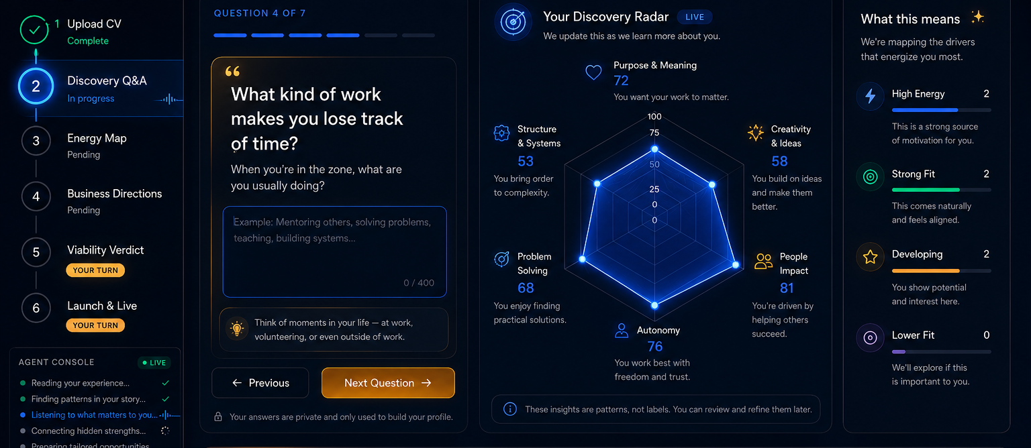
NextChapter
LIVE DEMO
CV → discovery → hidden strength → business directions → honest verdict → live website
Notes:
Live demo script: Sarah pastes her CV. NextChapter asks what her CV cannot say. Show pineapple tart answer. Energy Map reveals systems design intuition. Business directions: agent recommends safe consultancy; Sarah picks what fits deeper. The human decides. Verdict: amber, S$18–48k year one, actual math. Finale: live website and QR.

Slide 6
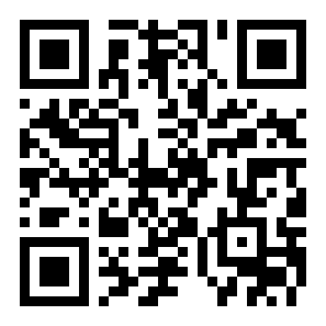
NextChapter
Get your own
Strength Map
Scan now. Two minutes.
You do not have to start a company today — but you should know what you are worth.
nextchapter.ai
DISCOVER YOURS →
Notes:
Say: That is one person. Here is the room. Scan this QR code and NextChapter will find your hidden strengths in the next two minutes. You do not have to start a company today — but you should know what you are worth.

Slide 7
NextChapter
Agentic. Grounded. Honest.
1
2
3
4
5
6
CV
Discovery
Strength Map
Directions
Verdict
Launch
Agentic
Grounded
Honest
Six agents work in sequence, from profile to launch.
Discovery uses flow, self-determination theory, career anchors and Holland codes.
The viability engine challenges weak ideas instead of flattering the user.
Notes:
Say: Underneath, six agents work in sequence. Discovery is grounded in career psychology. And the honesty engine would rather lose you than lie to you. Everyone builds hype. We built a partner that tells the truth.

Slide 8
NextChapter
Free insight.
Paid launch.
B2B transition.
Free Strength Map
S$49 Launch Kit
B2B Channel
A shareable insight card that brings users in.
Website, offer, pricing, intake form and first proposal.
Outplacement firms, employers and workforce-transition partners.
One founder + agents
= the next company.
Notes:
Say: The Strength Map is free. Users pay S$49 to build and launch their first business package. The larger channel is B2B — outplacement firms, employers and workforce-transition partners pay per head.

Slide 9
We do not build tools
for one-person companies.
We build the companies.
Sheryl Deng · OpenArena Track 05 · NextChapter
Notes:
Say: We do not build tools for one-person companies. We build the companies. I’m Sheryl — I built this solo in two days with Claude Code. NextChapter.

