Slide 1
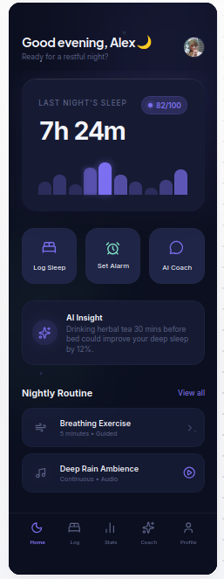
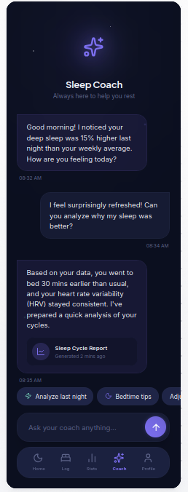
DreamMind
Home Dashboard
AI Coach
A smart sleep wellness app for better routines, clearer analytics, and personalized recovery guidance.
Sleep Logging
Smart Alarm
AI Coach
Real DreamMind screenshot
Final Exam Presentation

Slide 2
Introduction and Team
DreamMind is a mobile sleep wellness app designed for students and busy users who want better routines, clearer sleep insight, and calmer daily habits.
Xalilov Abdukarim
ID: 230544
Tohirov Hikmatillo
ID: 230272
Concept and presentation structure
Android implementation and architecture
Choriyev Mirjalol
ID: 230234
Bo'taboyev Sherzod
ID: 230804
UI/UX design and user flow
Testing review and future planning

Slide 3
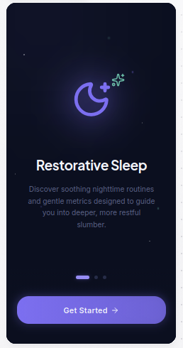
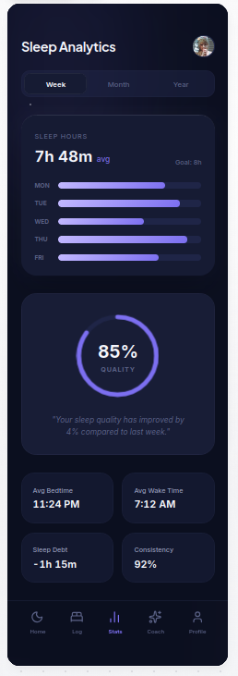
Problem, Motivation, and Target Users
Home Dashboard
Problem
Welcome
Analytics
Users often rely on separate apps for tracking, alarms, and advice, which weakens routine consistency.
Motivation
DreamMind unifies those tasks inside one calm interface that encourages regular use and easier interpretation.
Target users
Students, young professionals, and wellness-focused users who need sleep guidance without complexity.
First emotional entry into the app
Key sleep insights at a glance
Data becomes understandable trends

Slide 4
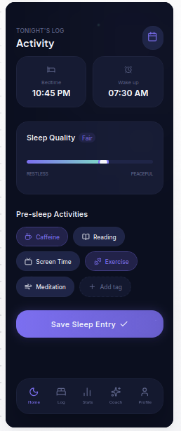
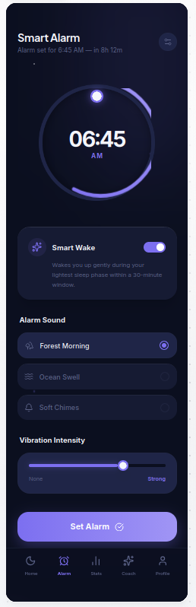
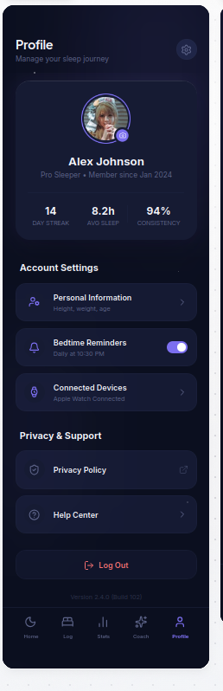
Application Goals and Core Functionalities
Dashboard
Sleep Log
Smart Alarm
Goal 1
Create one place for sleep onboarding, dashboard insight, and routine building.
Goal 2
Turn sleep behaviour into actionable information through logging, alarms, and analytics.
AI Coach
Analytics
Profile
Goal 3
Support engagement with coaching, personalized screens, and premium UI consistency.

Slide 5
Development Tools and Stack
The project uses a modern Android stack chosen for reactive UI, maintainable architecture, and API-based feature growth.
IDE and Language
UI Framework
State and Storage
Networking
Android Studio
Kotlin
Jetpack Compose
Material 3
Navigation Compose
ViewModel
StateFlow
DataStore Preferences
Retrofit
Gson
OkHttp
Workflow Tools
Project Reasoning
Git and GitHub for collaboration, version control, and final submission packaging.
This stack supports fast UI iteration, screen-level state handling, and easier separation between interface and data logic.
The stack also aligns well with the course focus on Kotlin mobile development and clean architectural thinking.

Slide 6
Architecture Overview
DreamMind follows an MVVM-oriented structure with clear layers for UI, state, repositories, navigation, and network or local services.
Compose UI
Screens render user interaction and visual state.
Home UI
Analytics UI
Coach UI
Feature ViewModels
StateFlow-based state and event handling per screen.
Repositories
Business logic connects screens to remote and fallback data.
Services
Retrofit API, DataStore tokens, and local alarm notifications.
Representative flow: User action -> ViewModel -> Repository -> API / Local service -> Updated UI state

Slide 7
UI/UX Design Highlights
The design language aims to feel calm, premium, and easy to navigate while keeping sleep metrics and actions visually clear.
Welcome
Dashboard
Analytics
Coach
Palette
Dark night palette with soft accent glow.
Hierarchy
Large cards highlight the most important metrics first.
Flow
Onboarding and core navigation stay simple and guided.
Consistency
Reusable card shapes and spacing unify the app.

Slide 8
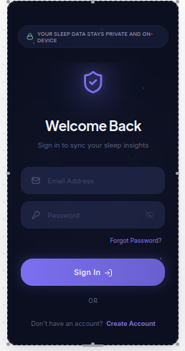
Main Screens and User Flow
The presentation demo follows a simple flow from entry to daily usage: authentication, dashboard, data capture, insights, and support.
Home
Sign In
Sleep Log
Alarm
Analytics
Returning user entry
Immediate overview and actions
Capture behaviour and quality
Plan the wake-up routine
Review trends and results
Presentation demo flow: Sign In -> Home -> Sleep Log -> Smart Alarm -> Analytics -> Coach -> Profile

Slide 9
Challenges and Solutions
The project required both design and engineering tradeoffs, especially when moving from polished mockups into a working Compose application.
UI consistency
State management
Challenge: keep the HTML-inspired premium look inside Compose.
Solution: reusable design-system cards, buttons, and shared color tokens.
Challenge: coordinate auth, onboarding, and feature states cleanly.
Solution: screen-specific ViewModels with StateFlow-based UI state.
Data reliability
Alarm realism
Challenge: support remote data without breaking demo stability.
Solution: repositories combine API calls with fallback demo content.
Challenge: make the alarm flow more than a static settings screen.
Solution: local scheduling plus notification receiver support.

Slide 10
Development Timeline
The project progressed through clear milestones from problem framing to design, implementation, integration, and presentation readiness.
1
2
3
4
5
Research
Design
Core Build
Integration
Polish
Defined the sleep problem, target audience, and app scope.
Created the DreamMind screen system and visual identity.
Implemented authentication, onboarding, and dashboard structure.
Added logging, alarm, analytics, coach, and profile flows.
Refined UI, prepared demo order, and finalized presentation assets.
This structure helps explain the project as a real development process, not only a collection of screens.

Slide 11
Future Work and Scalability
The current architecture leaves room for stronger production behaviour, deeper personalization, and broader device integration.
Backend growth
Offline support
Smarter guidance
Testing
Expand remote sync, stronger account flows, and richer analytics endpoints.
Add local persistence for history, caching, and better resilience without network.
Improve coaching recommendations with more personalized sleep patterns.
Increase automated coverage and validation depth.
Scalability direction
Possible extensions
The repository-based structure makes it easier to add new features without tightly coupling screens and data sources.
Wearable integration, sleep recommendations from device sensors, and richer session comparison views.
This slide directly answers the assignment requirement about planned enhancements and future scalability.

Slide 12
Conclusion and Live Demo Plan
Key message
Dashboard
Alarm
Analytics
Coach
DreamMind is more than a concept. It combines product thinking, design quality, and working mobile app structure.
Demo order
Sign In -> Home -> Sleep Log -> Smart Alarm -> Analytics -> Coach -> Profile
Closing note
The project demonstrates how one app can connect guidance, data, and calm user experience around sleep wellness.

Slide 13
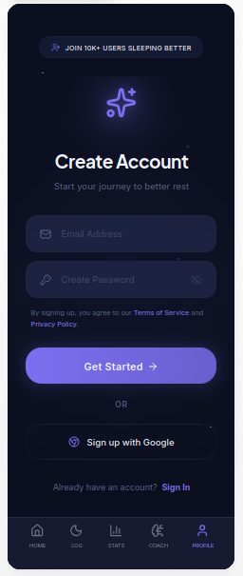
Screens Gallery
Real uploaded DreamMind screenshots used as backup visual proof during Q&A or when examiners ask to see more screens quickly.
Welcome
Sign Up
Sign In
Home
Activity
Alarm
Analytics
Coach
Profile

