Slide 1

Sprocket Central Pty Ltd
Data analytics approach

Slide 2
Agenda
Introduction
Data Exploration
Model Development
Interpretation

Slide 3
Introduction
Approach for New Customer Data Analysis:
■ Products sold state wise.
■ Products sold brand wise.
■ Brands sold per state.
■ Brands sold gender wise.
■ Brands sold job industry wise.
■ Brands sold according to product classes.

Slide 4
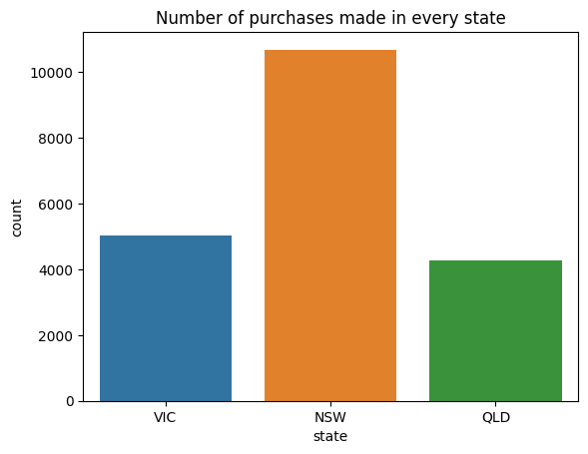
Data Exploration
Products purchased state wise.
► Data shows that New South Wales state has
high count in purchasing bikes.
► So the target audience are the people of
New South Wales.

Slide 5
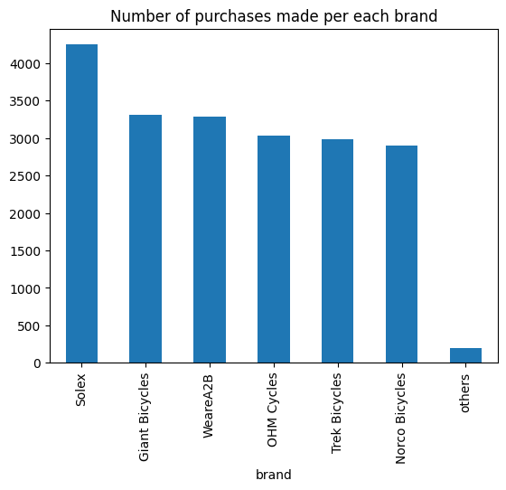
Data Exploration
Products purchased brand wise.
► From the given data the most sold brand is
Solex.
► The company has to produce more Solex branded bikes than other brands.

Slide 6
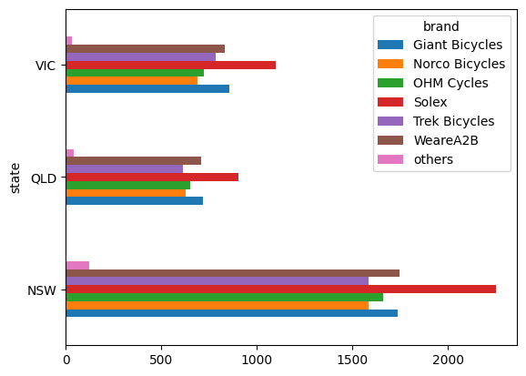
Data Exploration
Brands Sold per state.
► From the given data the bikes of brand Solex is highest selling brand in all states.
► After Solex the brands WeareA2B and Gaint
Bicycles are more selling brands.
► So the company should concentrate on the brands more in these states.

Slide 7
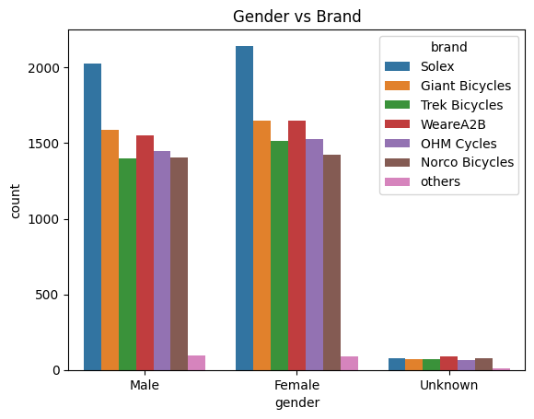
Data Exploration
Brands sold gender wise.
► From the given data females are buying more bikes than males.
► So the company should concentrate more on female customers and make modifications according to them.

Slide 8
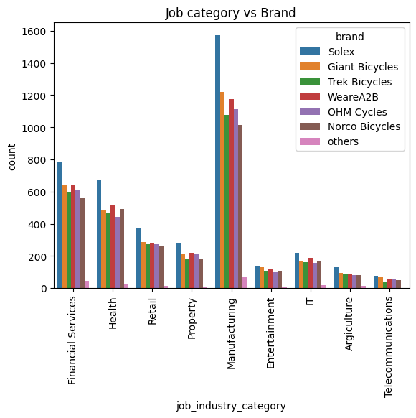
Data Exploration
Brands sold Job Industry Wise.
► From the given data the more bikes are sold in Manufacturing Industry.
► So the company should concentrate on Manufacturing Industry.
► The most sold brand in all Industries is Solex.
► So the company should target on manufacturing more Solex bikes and target customers in Manufacturing Industry.

Slide 9
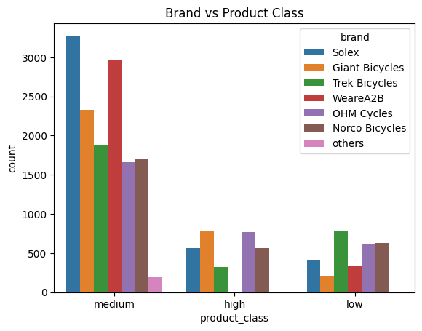
Data Exploration
Brands sold Product Class Wise.
► From the given data the more bikes are sold
from medium class.
► The more medium level bikes are manufactured by Solex and WeareA2B brands.
► Solex and WeareA2B are not producing high level and low level products.
► Since the sales are more from medium level.So the company should focus more on manufacturing medium level bikes so that normal people can also afford them.

Slide 10
Model Development
► The company should mainly target on producing medium level brands and targetting female customers,New South Wales state and people working in Manufacturing Industry.
► The company should mainly target on producing brands like Solex and WeareA2B medium level brands.

Slide 11
Thank You

