Slide 1
ILE-
Integrated Language Environment
Notes:
Hey everyone, Good morning and good evening to you all. I sincerely want to thank you all for taking time to attend this session and Programmers.io to provide me the opportunity to share my knowledge with you all today. I hope you will be able to learn something valuable from this session. I’ll try my best to simplify things wherever it is required.

Slide 2
Agenda
OPM
ILE
OPM vs ILE
ILE Program Model Design Order
Procedures
Modules
Bind by Copy vs Bind by Reference
Binder Language
Service Program
Binding Directory
Activation Group
Notes:
So, let’s hop on to our agenda for this session. I’ll be starting with VS Code introduction where we will be learning about the popular code editor’s history and basics. Then I will be walking you all through the Code for IBM I extension, it’s installation, setting up profiles, how to use the object browser to manage sources. I will also be show-casing few examples for that. Later in the session, I will be talking about predefined actions available with the extension. We can also define custom actions, so will be talking about how to manage them. Close to the session end, there will be short introduction about debugging your programs, running SQL and IFS browser. At the end of the session, I’ll be taking any questions you guys may have.

Slide 3
OPM
Legacy programming model for AS/400
Characteristics:
  Monolithic,
  Single-language focused
Limitations:
  No modularity,
  Difficult to maintain
  Limited code reusability across programs
Notes:
So, let’s hop on to our agenda for this session. I’ll be starting with VS Code introduction where we will be learning about the popular code editor’s history and basics. Then I will be walking you all through the Code for IBM I extension, it’s installation, setting up profiles, how to use the object browser to manage sources. I will also be show-casing few examples for that. Later in the session, I will be talking about predefined actions available with the extension. We can also define custom actions, so will be talking about how to manage them. Close to the session end, there will be short introduction about debugging your programs, running SQL and IFS browser. At the end of the session, I’ll be taking any questions you guys may have.

Slide 4
ILE
Modern IBM programming environment for IBM i
Introduced to replace OPM.
Supports multiple languages:
Characteristics:
  Modularity,
  Code Reusability
Notes:
So, first thing first, VS Code – a code editor or IDE that is open-source and has a very nice UI that a lot of developers like. Well, I personally did not ask every developer of their favourite code editor but there is a well-regarded consensus among the developer community. As any other IDE, VS Code support a ton of customizations, code completion, syntax highlighting, snippets, has a robust source control mechanism through git. It also supports various file types for your code and scripting, be it Java script or Python or any other language. Out of the box, VS Code does not support IBM I environment. But fret not, there is a solution available for that!

Slide 5
ILE vs OPM
OPM | ILE
Monolithic Programs | Modular Structure
Limited Languages | Multi-Language Support
Lower Performance | Better Performance
Notes:
Read and showcase

Slide 6
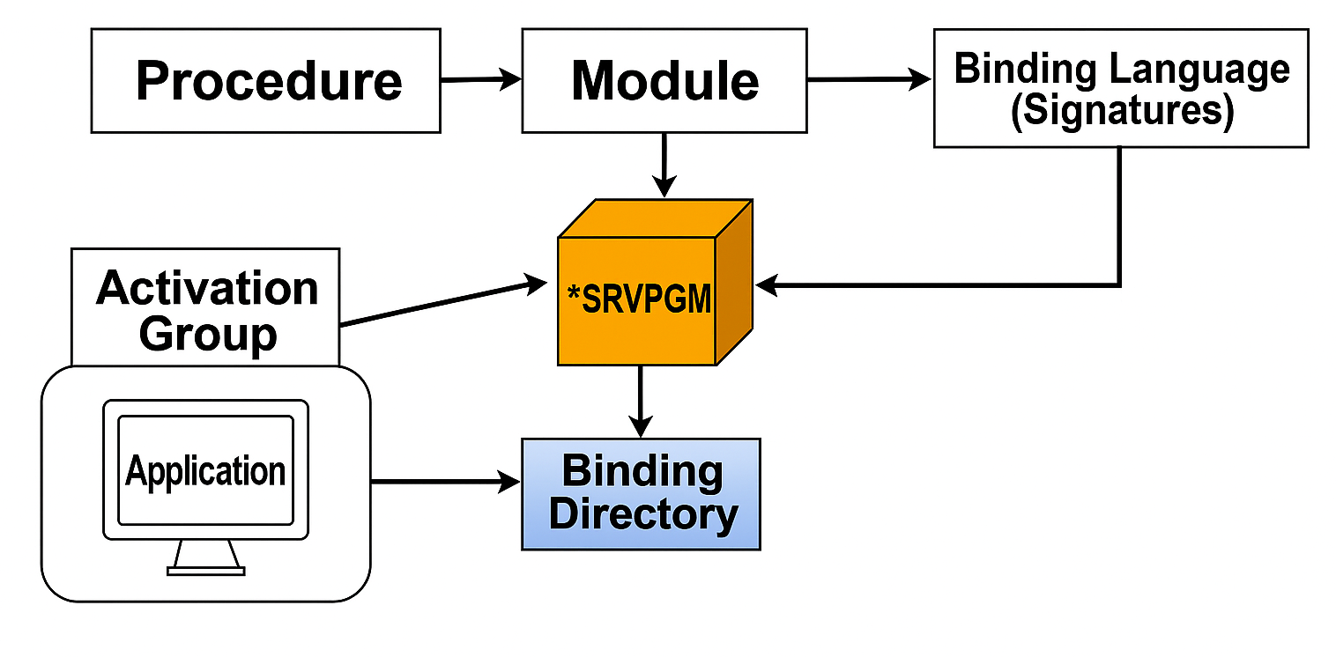
ILE Program Model Design Order

Slide 7
Procedure
In ILE, a procedure is a block of code that performs a specific task.
Main Procedures: Every RPGLE program has a main procedure that serves as the entry point of the program.
Sub-Procedure: These are additional procedures within the program.
Notes:
Read and showcase

Slide 8
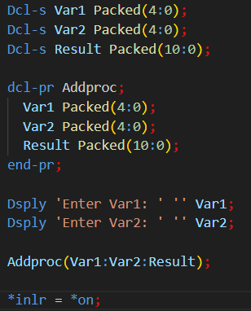
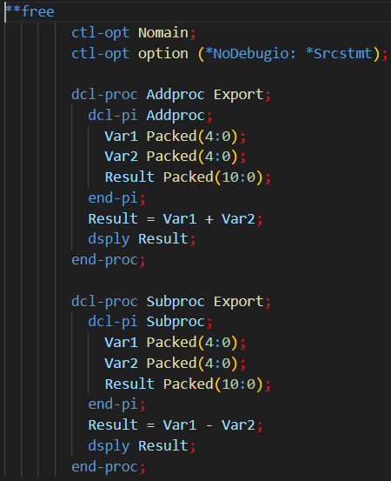
Contd.

Slide 9
Modules
Collection of procedures compiled together; not directly executable.
Compilation creates a MODULE object (e.g., RPGLE, CLLE).
Modules must be bound into a program or service program to execute or reuse.
Commands:
  CRTRPGMOD – Create RPG module
  CRTSQLRPGI – Create SQLRPGLE module
===> CRTRPGMOD MODULE(SHESHANKS1/SRV003) SRCFILE(SHESHANKS1/PRACTICE) SRCMBR(SRV003) REPLACE(*YES)
Notes:
Copying and downloading the code to your local system is a lot easier through VS code. You can view a lot more code in VS Code than SEU, so dry run is easier. You can even expand or collapse different code blocks to hide or show code. For fixed-format RPGLE, the extension provides the column assist feature to make maintaining old code easier.

Slide 10
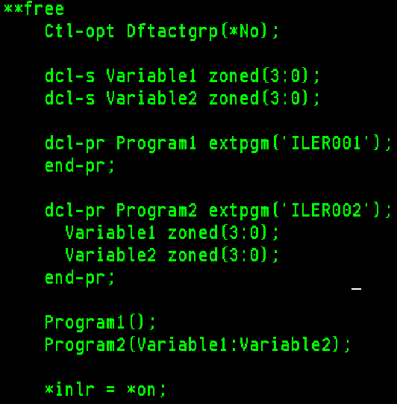
Bind by Copy vs Bind by Reference
Bind by Copy
  Copies module code into the program at compile time
  After CRTPGM, *MODULE objects can be deleted; program still works
Bind by Reference
  Links to another program at runtime using symbolic links
  Binding occurs when program is called using CALL
Notes:
So let’s hope on to VS code and install the full development pack. For the extension to work, your IBM I server must have a SSH server up and running.

Slide 11
Binder Language
A non-executable code used to define exports of procedures and data items for service programs.
Prevents signature violations.
Object Type: BND.
Procedures are written between start and end program expressions.
When new procedures are added, the previous set becomes old, and the new set is current.
Service programs must be updated with binder language.
Notes:
Read and showcase

Slide 12
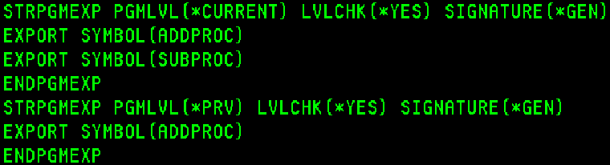
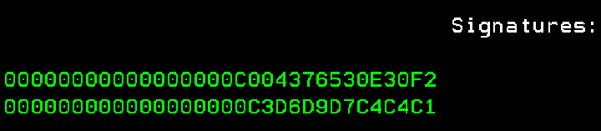
Contd.

Slide 13
Service Program
Collection of modules and procedures for reuse.
Commands : CRTSRVPGM ,DSPSRVPGM, UPDSRVPGM
A signature is assigned when created.
Signature changes when service program is updated.
Programs must be recompiled after update to avoid violation.
Signature violation occurs if export list changes.
Notes:
Before moving to source edit view, there are few considerations that we will have to keep in mind. Source dates when enabled does not play well with QCCSID 65535 and you can encounter issues while browsing source files.
When source dates are enabled, there are two modes available to us. Edit mode – When a line is changed the source date will be updated, you can not undo a change made. In diff mode, source comparison is performed between before and after image. You can undo/redo last change.

Slide 14
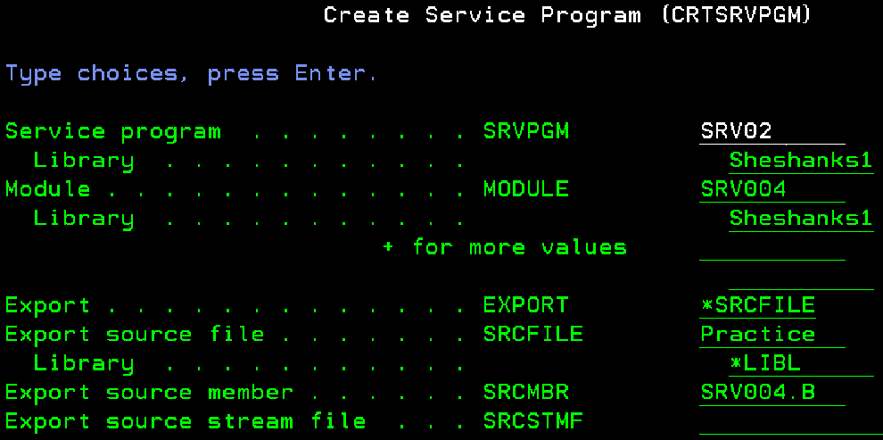
Contd.

Slide 15
Binding Directory
A collection of service programs and modules for easy binding without using CRTPGM.
Works with CRTBNDPRG.
CRTBNDDIR creates a binding directory.
ADDBNDDIRE adds entries; DSPBNDDIR displays it.
Binding is specified in H spec (CTL-OPT) or during compilation.
Notes:
Read and showcase

Slide 16
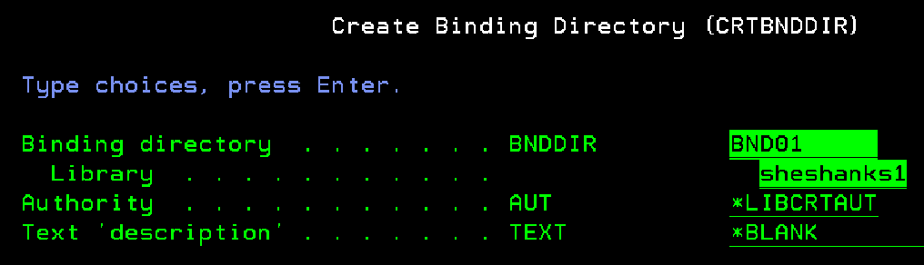
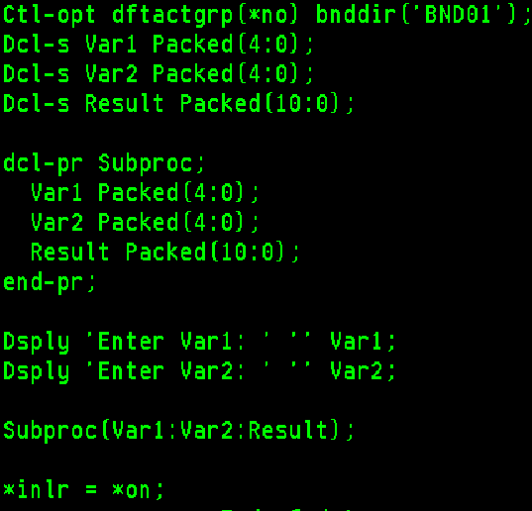
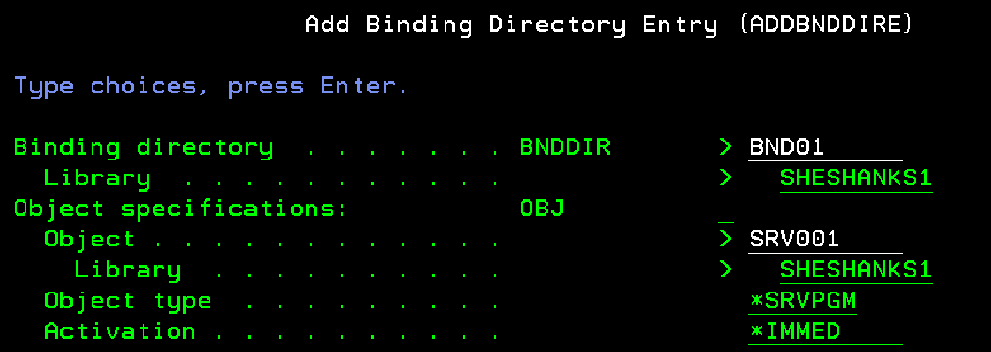
Contd.

Slide 17
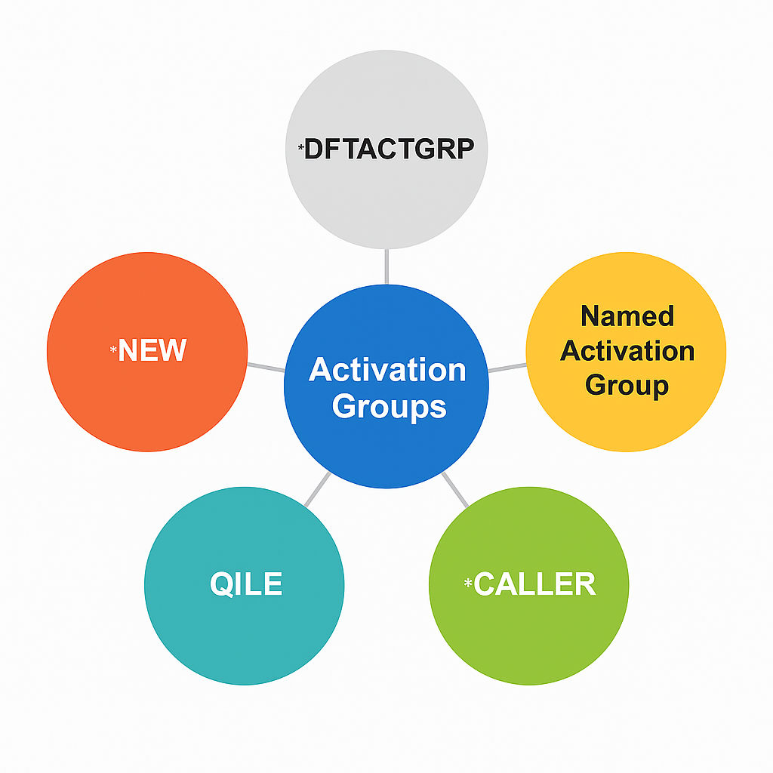
Activation Group
Activation Group is a memory area where programs run; manages resources (memory, files) and program interaction.
ILE Program executes within an activation group; all procedures share the same group.
Notes:
So let’s hope on to VS code and install the full development pack. For the extension to work, your IBM I server must have a SSH server up and running.

Slide 18


YOUR EXTENDED TEAM

