Slide 1
Crypto-philanthropy

Slide 2
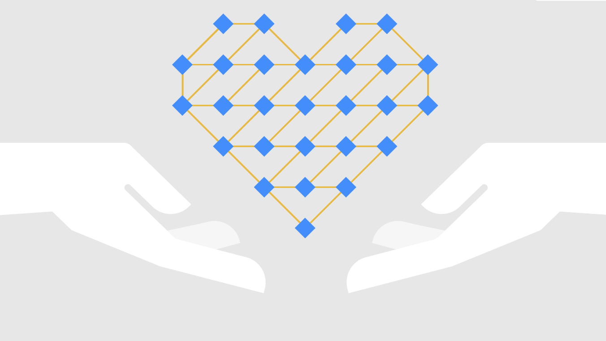
Team
Members:
Daivik Purani (2017A7PS0166H)
Dhruvil Shah (2017A7PS1566H)
Smit Sheth (2017A7PS1666H)
Vivek Soni (2017A7PS0173H)

Slide 3
The Charity
Transaction Problem
Charitable organizations often encounter barriers to success due to lack of transparency, accountability issues, and limits to the ways they can accept donations.

Slide 4
Crypto-philanthropy (or the use of blockchain technology to facilitate charitable contributions) offers an alternative solution, with decentralized and direct transactions that may help these organizations receive donations and raise funds more efficiently.
Solution

Slide 5
Implementation
createBlock(): for each donation made a block will be created containing the Donor ID, Receiver ID, Amount donated, Time of donation and a Unique token
verifyTransaction(): for the authentication of unique donation token (Zero knowledge proof)
mineBlock(): Verification of the confidentiality and integrity of the blockchain by using the hashes of preceding or succeeding blocks and it is validated by majority of miners
viewUser(): lists all the successful transaction against the user

Slide 6

Implementation
The program gives three choices upon running :
We will go through the options in the next slide.

Slide 7

Selecting First Option : Donate Money
The first option allows you to do the transaction.
CreateBlock() function is called to add this transaction to blockchain.
CreateBlock():
Details of donor is taken alongwith details organization and amount.
After this, we call ZeroKnowledge() to verify things without sharing underlying data.
If ZeroKnowledge returns true, we add this Block to array of
Blocks name BloackChain.

Slide 8
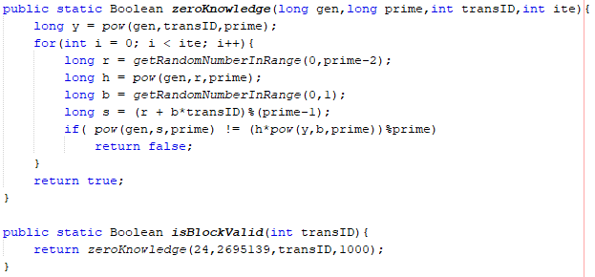
Zero Knowledge Proof :
We apply the Zero Knowledge process throug thousand interations with our attribute being TransactionID.
The Prime we used is 2695139.
The Process is as follow:

Slide 9
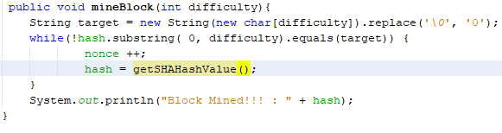
Mine Block():
The mine block function runs till the hash of the current block doesnot contain a prefix with number of zeroes equalling the difficulty value.
Everytime the loop runs, with incrementing nonce value of block , hash is recalculated.

Slide 10
VerifyTransaction:
This function verifies hash of all blocks stored and recalculated also, checks previoushash of this block with hash of the previous block.
It also checks whether the block is mined or not by checking its number of zeroes in its prefix equals to its difficulty value or not.

Slide 11
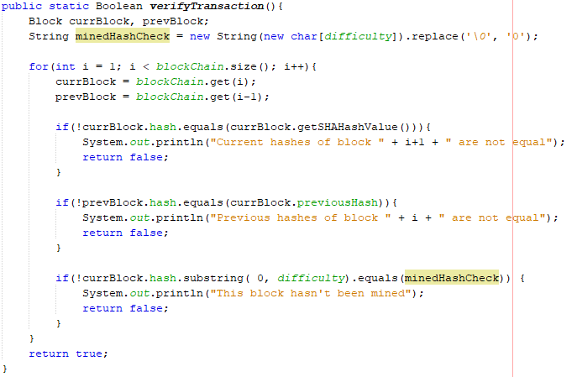

Slide 12
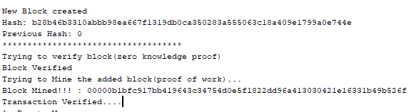
Output after Transaction is done.
As soon as the transaction is done from donor end, zeroknowledge is called to verify identity, after which the block is added to the BlockChain, Block is mined to set the hash with difficulty , and finally verify Transaction is called to confirm all blocks are mined and their hashes are also accurate.

Slide 13
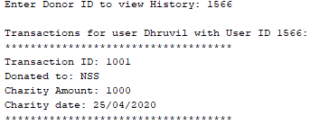
ViewUser()
If option 2 is selected to view users/donors past transaction history, viewUser method is called.
The method iterates the BlockChain and with all Blocks having donorid same as the input, it prints the details of the block.

Slide 14
Thank You

