Slide 1



ACHIEVE AGENDA
||Kriya Sheth||

Slide 2

Presented by:
Name: Kriya Sheth
Enrollment number:24002171310157
Roll number :223
Branch : CST
Class :C8

Slide 3
Framework
Introduction
Functionality
Features
Charts
Merits & Demerits
Future initiatives

Slide 4
Introduction
‘Achieve Agenda’ is a digital tool designed to help individuals and organization teams efficiently organize , track and complete Tasks.
It enables users to plan tasks , scheduled tasks , Assign tasks by organization and progress in structured manner.
Modern Features are like Task prioritization , recurring tasks and many more making them essential for Organization , companies , Freelancer , Students alike . Whether used for personal productivity or Work Management , a well- designed Task Management Systems enhances efficiency and ensures smooth execution of tasks.

Slide 5
Functionality
Achieve Agenda works on both Interfaces which are as User and as AG Pilot (Admin).Allowing Users to create , schedule , Organize , Track and monitor Individual Tasks .
>Key Functions include task creation , task dependencies , Updating tasks , Completion Tasks and many more functions:
Tasks Creation: Ability to input new tasks with detailed description .
Scheduling Tasks : Create New tasks according to Calendar .
Tasks Completion : The tasks which are completed.

Slide 6
Functionality
4. Prioritize Tasks :
Flagged Tasks/ Unflagged – Important Tasks that are highlighted with symbol.
Recurring Tasks – The tasks to perform Daily/Weekly/Monthly.
5. Tasks Updating:
The tasks names are updated with new tasks and Descriptions.
6.Categorizing Tasks:
To divide personal and work tasks.

Slide 7
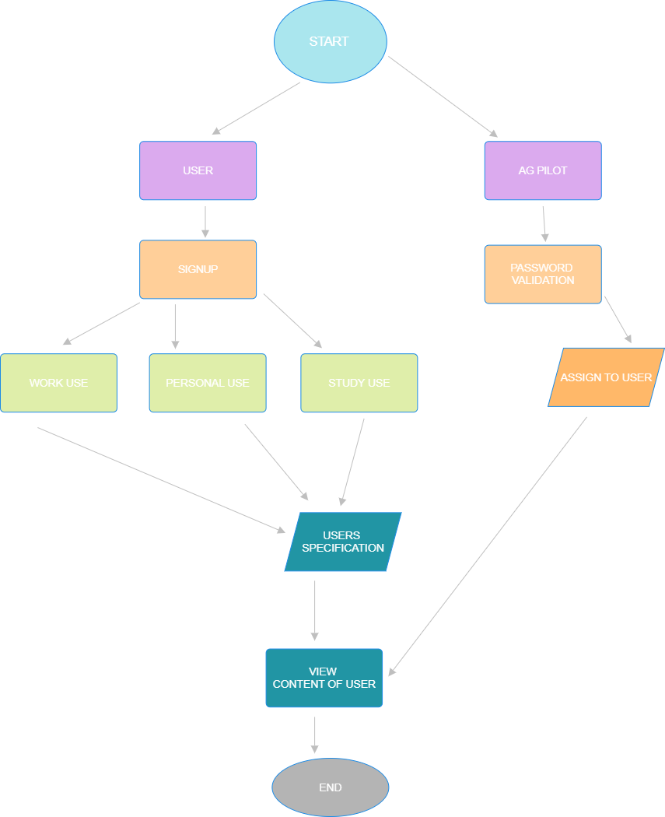
Flow Chart

Slide 8
Merits & Demerits
Merits
Demerits
1.
1.
Enhanced Collaboration
Dependency Issues
2.
Efficient Time Management
Need Power supply
2.
3.
Sharing Tasks with team members
Overwhelming Notifications
3.
4.
Saving Paper
4.
Limited Functionality

Slide 9
Future initiatives
Augmented Reality and Virtual Reality
Blockchain for Tasks Verification.
Personalized Tasks Assisting.
Mindfulness and Well-being Integration

Slide 10
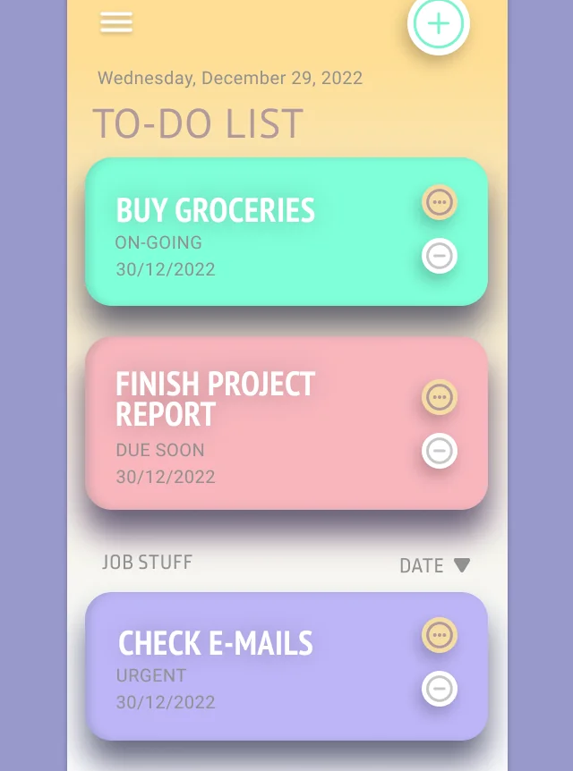
THANK YOU
||For your Attention||

