Slide 1






MEDISCAN
| | D2_Group1

Slide 2





Our Team
Kriya Sheth
Arya Shah
Megh Shah

Slide 3

Introduction
MediScan is a comprehensive, AI-powered healthcare assistant designed to bridge the gap between patients and healthcare providers. It serves as a unified platform for tracking personal health metrics, managing medications, booking doctor appointments, and maintaining family health records.

Slide 4
Technical Breakdown
  Backened - Python with flask framework
  Frontend - HTML5 , CSS3 ,JavaScript (ES6+) ,Bootstrap 5, Jinja2
  Database - SQLite
  Data Visualization & Analytics - Chart.js , Numpy ,Matplotlib
  Email Services - SMTP for secure access
  Security & Validation - Werkzeug

Slide 5
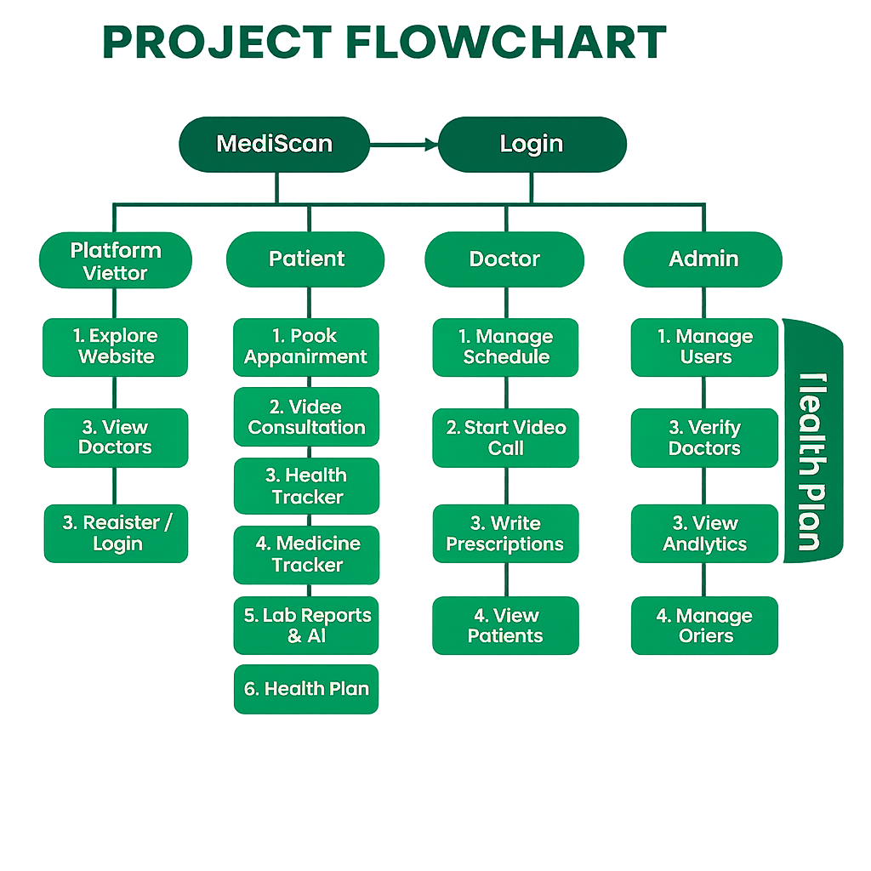
Care Plan

Slide 6


Why Choose Us?
PUBLIC ACCESS
AUTHENTICATED
  Landing Page (Home)
  About Us:
  Find Doctors:
  Medicine
  Authentication:
  Personal Dashboard
  Access to all services
  Add records in profile
  Avail Offers
  Consultation anytime

Slide 7
PUBLIC
PAGES

Slide 8
01
HOME
Presenting MediScan's
core services,
AI features,
and patient testimonials.
02
SERVICES
Integrated
suite for Medicine Tracking, Analysis, and Booking.
03
ABOUT
Introduces the platform's mission, vision, and real-time user statistics.
04
DASHBOARD
Central hub for tracking vitals, upcoming appointments, and quick actions.
05
PROFILE
Manages Records,
History,
lifestyle of patient

Slide 9
Patient Dashboard
1
Health Vitals Tracking
2
Real time Monitoring and give Analysis
3
Trend Analysis which helps to displays
6-month historical graphs
4

Slide 10
Patient Dashboard
1
Medical Assets & Rewards
2
Inventory and reports
Manage consulation payments and
engage user to claim offers and also
shows Active plan.
3
4

Slide 11
Patient Dashboard
1
Smart Quick Actions
2
Emergency mode to access quickly
One-Tap Utilities Direct shortcuts to
Top Up Wallet, Family Health
Tracker, and Download Prescriptions
3
4

Slide 12
Patient Dashboard
1
Token and Topical
2
Recent Appointment Access
Log of Booking and care tip
3
4

Slide 13
Doctor Dashboard
1
Appointment Schedule
2
"Today's Schedule" view provides a focused list of daily consults, allowing doctors to manage their time efficiently without clutter.
3
4

Slide 14
Doctor Dashboard
1
Patient Overview
2
Quick access to total patient counts and key demographics, helping doctors understand their patient base at a glance.
3
4

Slide 15
Doctor Dashboard
1
Consultation Tools
2
Dedicated workflow controls to "Start" video calls, take notes during sessions, and "Complete" appointments to trigger prescriptions/follow-ups.
3
4

Slide 16
Doctor Dashboard
1
Quick Actions & Settings
2
Simplified controls to update profile availability, manage account security, and export practice data
3
4

Slide 17
Admin Dashboard
1
System Statistics
2
Real-time analytics dashboard displaying critical metrics like Total Users, Active Doctors, Appointment Volume, and Platform Revenue.
3
4

Slide 18
Admin Dashboard
1
User Management
2
Comprehensive tools to onboard new doctors, verify credentials, and manage patient/doctor accounts to ensure platform integrity.
3
4

Slide 19
Admin Dashboard
1
Offer Management
2
Marketing toolkit to create, update, or delete promotional offers and discount codes to drive user engagement.
3
4

Slide 20
Admin Dashboard
1
Data Export & Logs
2
Advanced administrative features to export system-wide data for offline analysis and view detailed system logs for troubleshooting.
3
4

Slide 21

Rising Interests
PPG Technology that can be useful in may ways
Real-time ECG/SpO₂ via wearable during call
Insurance claims auto-filed

Slide 22

THANK
YOU

