Slide 1
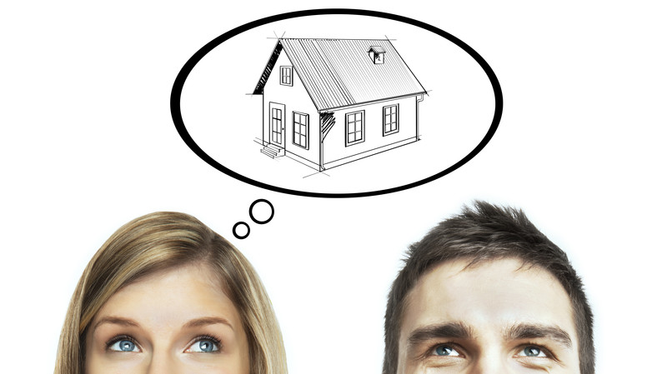
House
Management System!

Slide 2
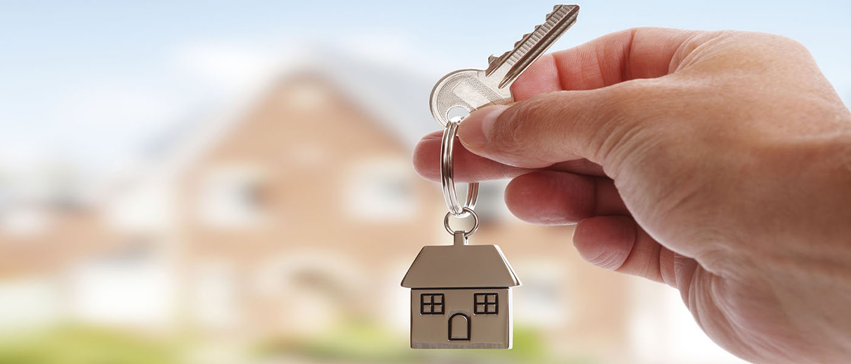
P r o b l e m s !
House rental is a time consuming process .
Finding right renters/House holder is also a challenge .
Some renters/House Holder may have a positive relationship others may not.
There are different renters/house holder who have different behavior that show different characteristics on people.
Notes:
To use this title animation slide with a new image simply 1) move the top semi-transparent shape to the side, 2) delete placeholder image, 3) click on the picture icon to add a new picture, 4) Move semi-transparent shape back to original position, 5) Update text on slide.

Slide 3
S o l u t I o n !
This system will save both our time & money.
We don’t’ have go outside and look for house here and there..
We can find them on our device from anywhere.
Also we can make sure that we have found right Tenant/House holder by checking there detail info.
It will be easy like snapping your finger!
Notes:
To use this title animation slide with a new image simply 1) move the top semi-transparent shape to the side, 2) delete placeholder image, 3) click on the picture icon to add a new picture, 4) Move semi-transparent shape back to original position, 5) Update text on slide.

Slide 4
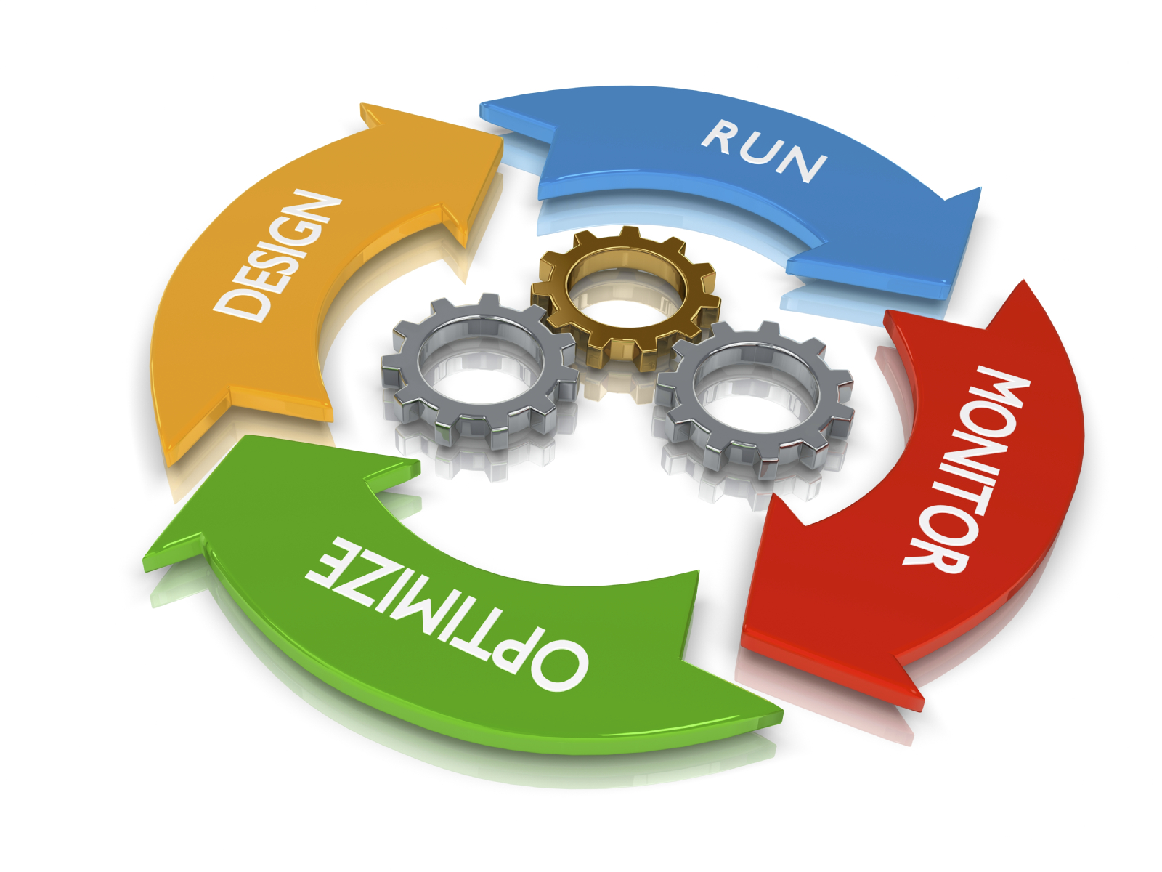
System progress !
We needs to research a lot to build the system.
We made a report where you can see the details of this project.
You can find Class Diagram, Sequence Diagram, Activity Diagram , Requirement's, Feasibility, Methodology, Fact & Techniques and many more things on the report.

Slide 5
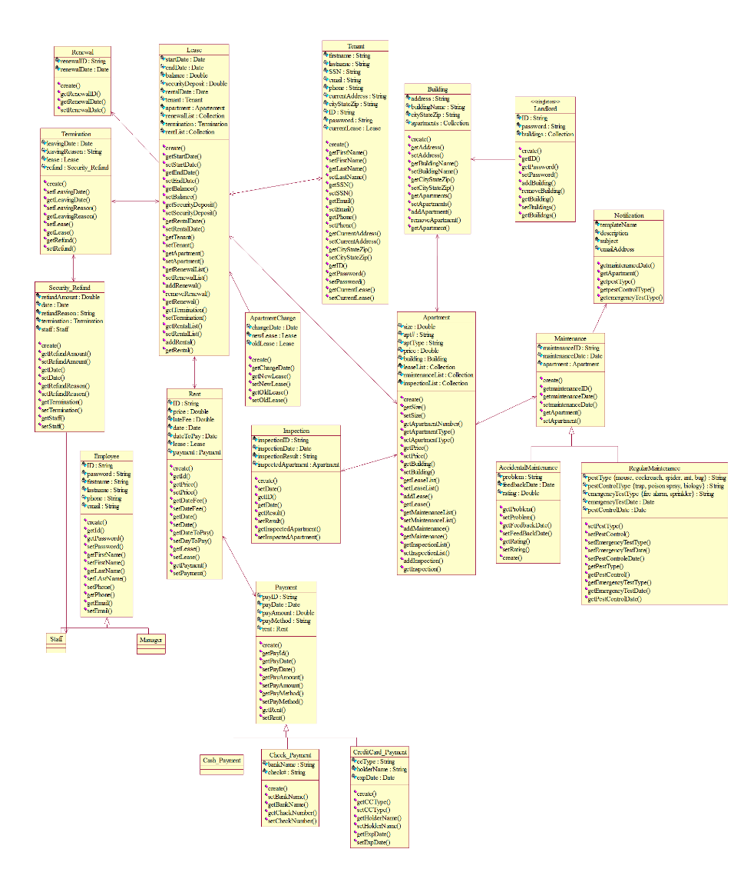
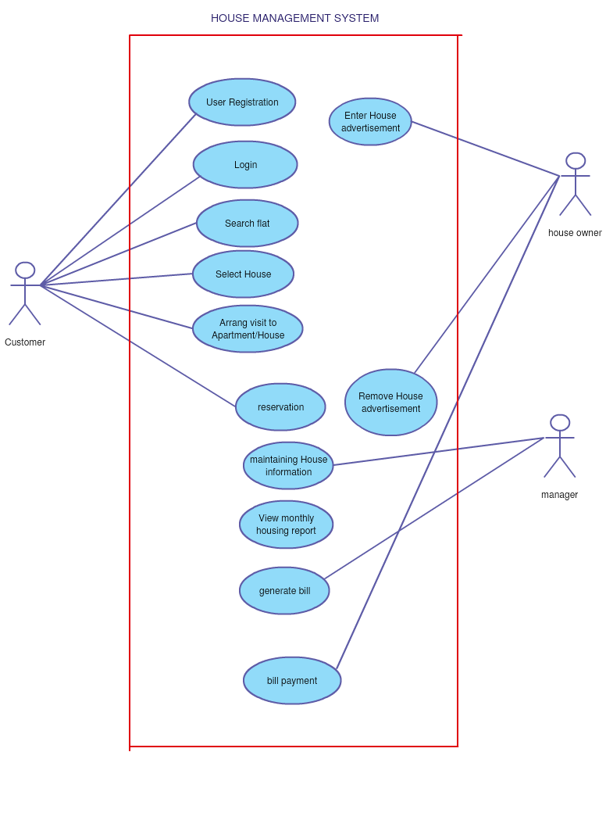
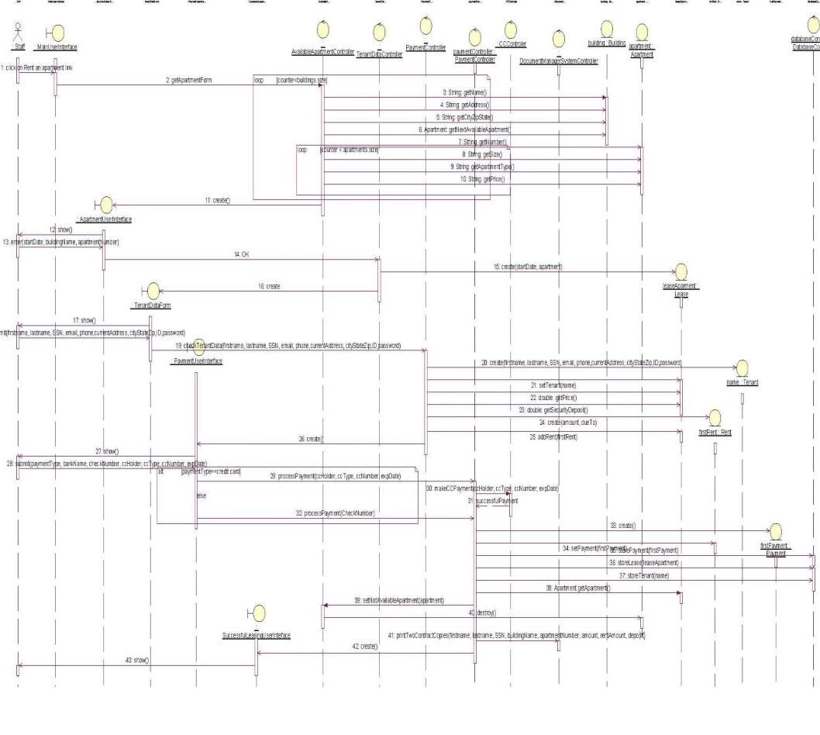
Diagrams

Slide 6

Thank you !

