Slide 1
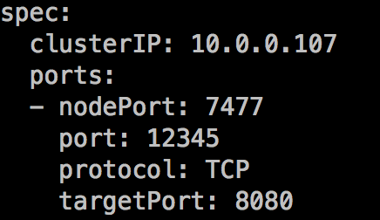
K8s service
ExternalName如果有
x.x.x.x(ExternalIP 如果有)
7477(NodePort)
192.168.99.4(NodeIP)
12345
10.200.2.10(ClusterIP)
Host:
192.168.99.4(外网ip)
8080
Container:
172.16.0.44

