Slide 1


College Management System
Streamline your college's administrative tasks with a powerful C++ application. Manage student records, course enrollment, faculty information, and more in a centralized, efficient system.

Slide 2

Introduction
The College Management System using C++ is a comprehensive software solution designed to streamline the administrative tasks of a college or university. This powerful application offers a suite of features that simplify student, faculty, and course management, enabling educational institutions to operate more efficiently and effectively.

Slide 3
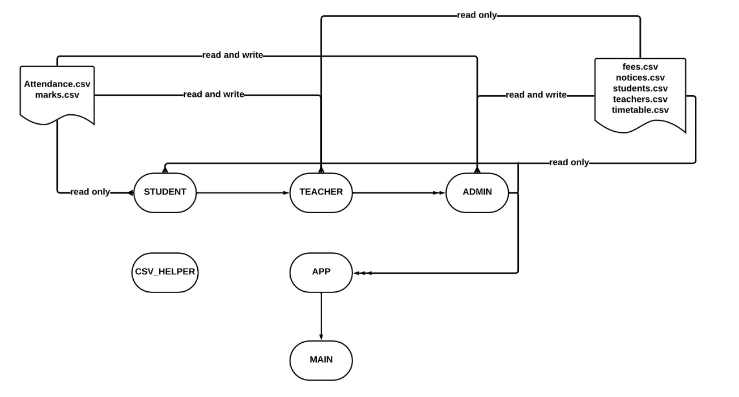
Data Flow Chart

Slide 4

System Requirements
1
Operating System:
2
Compiler:
3
Memory:
Compatible with Windows, macOS, and Linux.
Requires a C++ compiler like GCC, Clang, or Visual C++.
Adequate RAM for smooth performance.
4
Storage:
5
Processor:
6
Concurrency:
Sufficient disk space for CSV data files.
Standard modern processor.
Supports multiple users with concurrency control.
7
Dependencies:
Requires necessary C++ libraries and third-party dependencies.
These requirements form the foundation of the project setup. Additional resources and optimizations may be needed based on specific needs and usage scenarios.

Slide 5
Student Management
Student Registration
Academic Records
Streamlined process for new students to enroll, submit documents, and complete registration. Digitized records for easy access and management.
Maintain detailed academic profiles for each student, attendance, fees, and performance data. Generate reports and transcripts as needed.
Attendance Tracking
Student Communication
Automate attendance tracking to monitor student presence and tardiness. Provide real-time updates and generate attendance reports for administrators.
Facilitate seamless communication between the college, faculty, and students. Send notifications, announcements, and reminders to keep everyone informed.

Slide 6




Faculty / Admin Management
Academic Credentials
Scheduling
Performance Tracking
Compensation
Assign courses and create teaching schedules for faculty, ensuring efficient utilization of resources.
Manage faculty salaries, benefits, and incentives to attract and retain top talent.
Manage faculty profiles, including their educational qualifications, teaching experience, and areas of expertise.
Monitor and assess faculty performance, including student feedback, research output, and professional development.

Slide 7

Database Management using CSV Files
1
Structured Catalog
2
Registration
Maintain a comprehensive database of everything offered at the college, including details like students and teachers' profiles and many other things.
Streamline the course registration process for students and teachers, allowing them to easily sign up for classes and check their schedules.
3
Curriculum Development
Collaborate with faculty to regularly review and update course content, ensuring it aligns with industry standards and student needs.

Slide 8
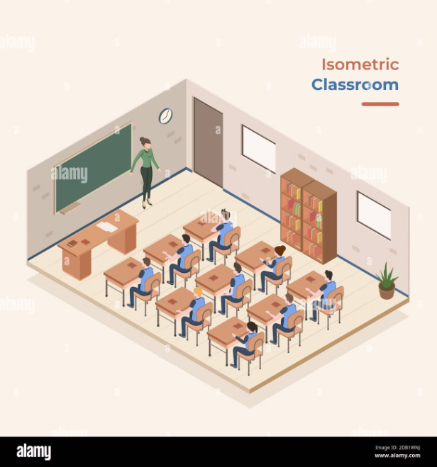
Attendance Tracking
The attendance tracking system in the college management system is essential for monitoring student presence and engagement. It allows faculty to easily record attendance, track absences, and generate reports.
Students can view their own attendance records, while administrators can monitor attendance trends and identify any issues or concerns.

Slide 9
Grading and Evaluation
The college management system includes a robust grading and evaluation module. Students' academic performance is tracked through detailed assessments, quizzes, and exams. Instructors can easily input scores for their respective courses and generate reports for each course.
Customizable grading scales and weighting for assessments
Detailed grade reports and analytics for students and administration

Slide 10
Admin Responsibilities
1
Timetable Management
2
Student and Teacher Management
3
Notice and Announcement
The admin is responsible for updating and managing the college timetable, ensuring that it reflects the most accurate schedule of classes and activities.
The admin is in-charge of uploading important notices and announcements, ensuring that all members of the college community are well-informed about upcoming events and important information.
The admin oversees the process of adding or removing students and teachers from the college database, ensuring that all necessary information is accurately recorded.
The college administration plays a crucial role in the smooth functioning of the institution. They are responsible for managing various aspects of the college, including the timetable, student and teacher information, and important communications. With their expertise and attention to detail, they ensure effective administrative operations and maintain clear communication channels within the college community.

Slide 11
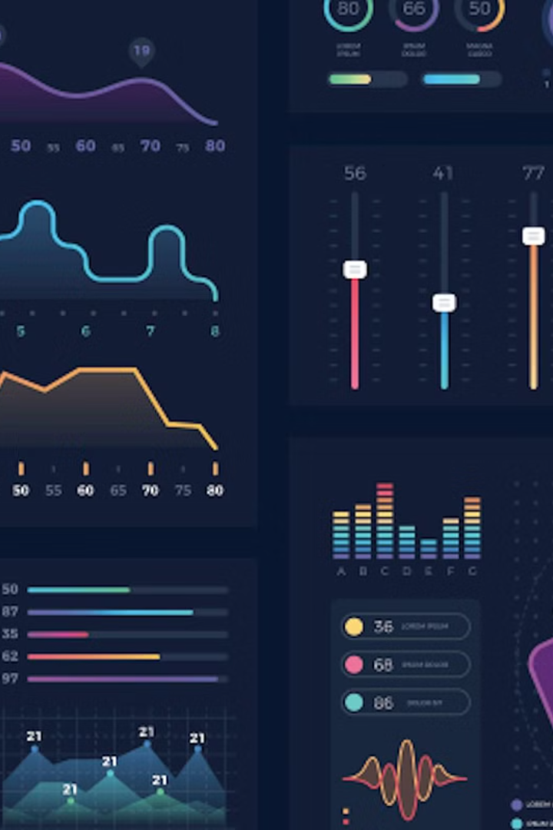
Conclusion
The college management system provides robust reporting and analytics capabilities for data-driven decision making. Customized reports on student performance, faculty productivity, course enrollment, and financial metrics offer valuable insights. The intuitive dashboard presents key performance indicators in an easy-to-understand format, enabling quick identification of trends and anomalies. Overall, the system provides the necessary tools and information for effective management in an educational institution.

