Slide 1
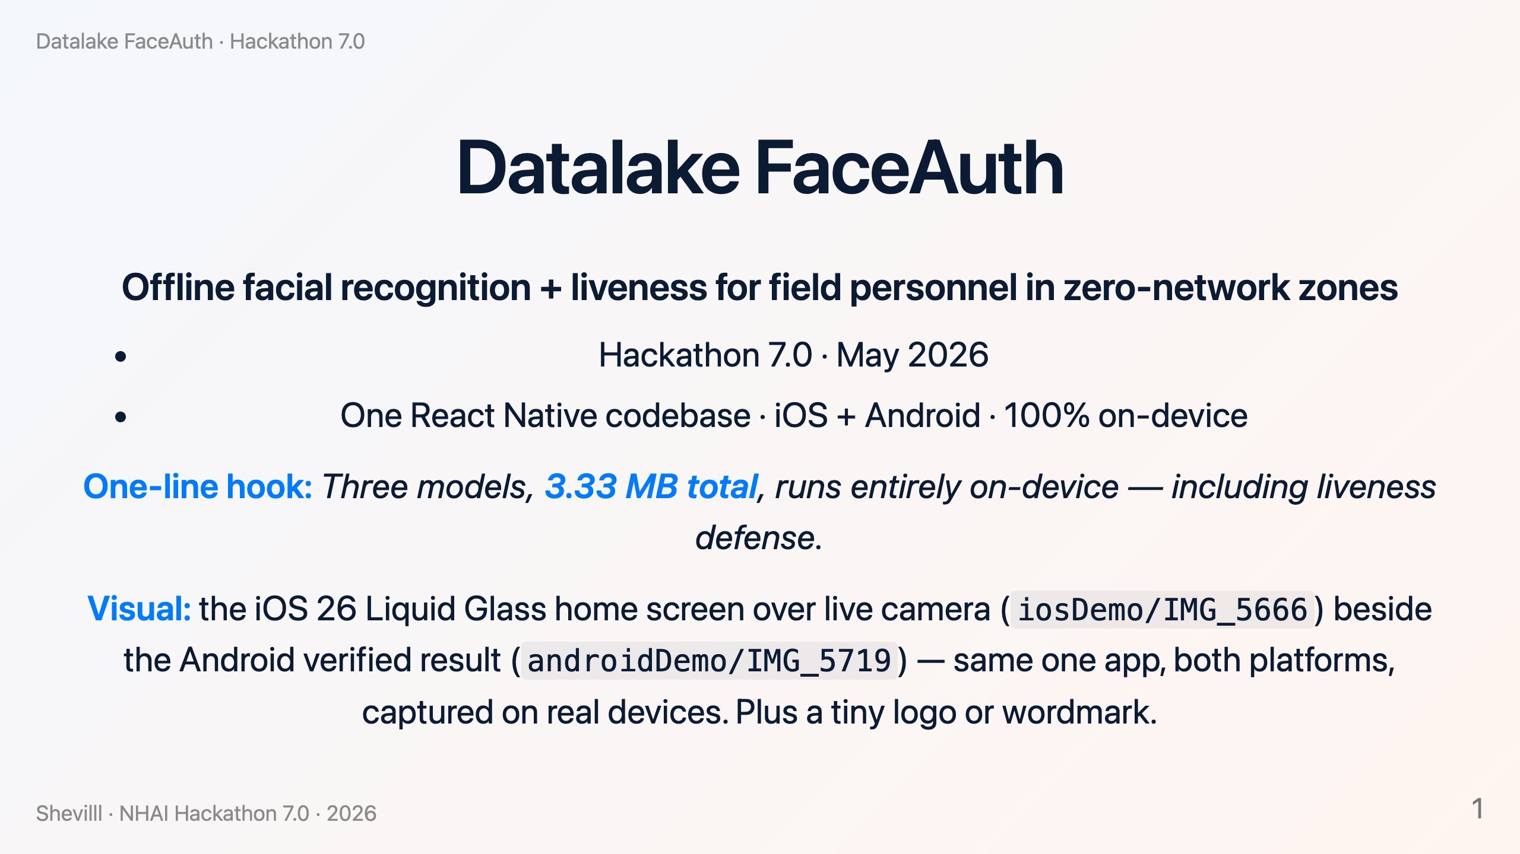
Notes:
Datalake FaceAuth — Hackathon 7.0 Deck. Slide-by-slide content; each `---` is a slide boundary. Convert with: `marp deck.md -o deck.pptx` (or `-o deck.pdf`) using the Marp CLI. **Notes:** are speaker notes; **Visual:** are screenshot/illustration cues. ~12 slides, ~7–9 minute pitch.

Slide 2
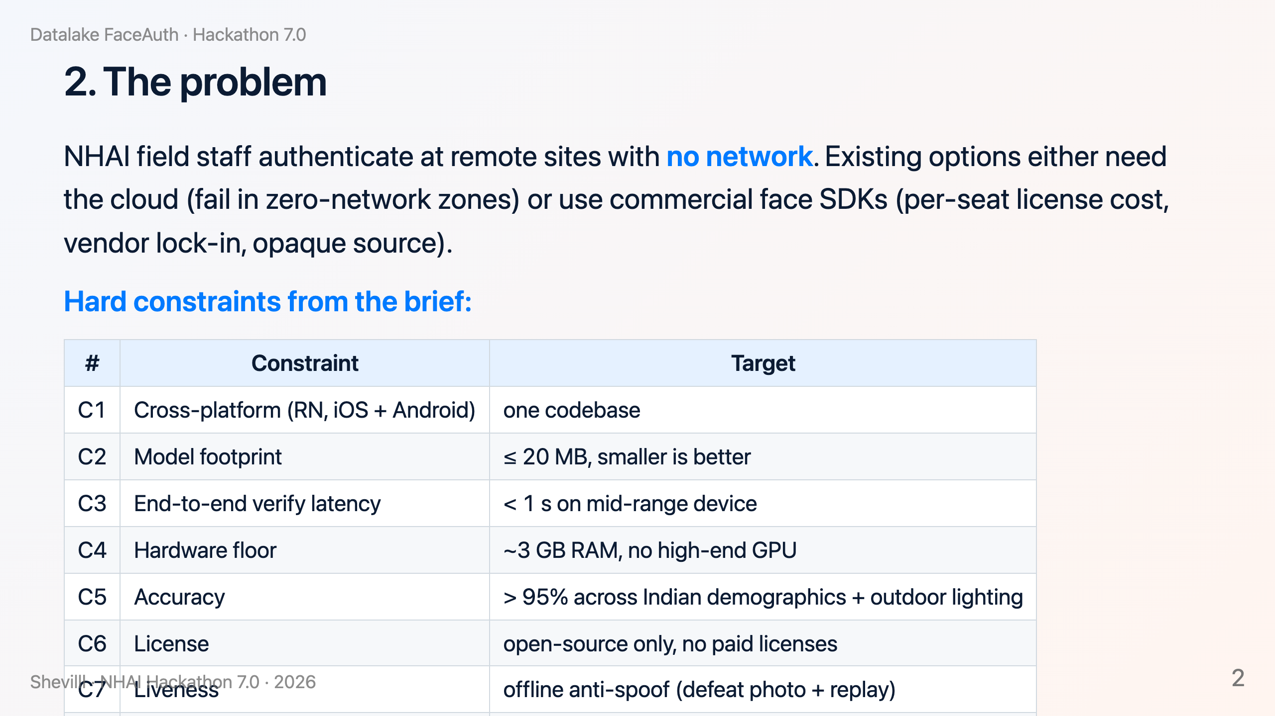

Slide 3
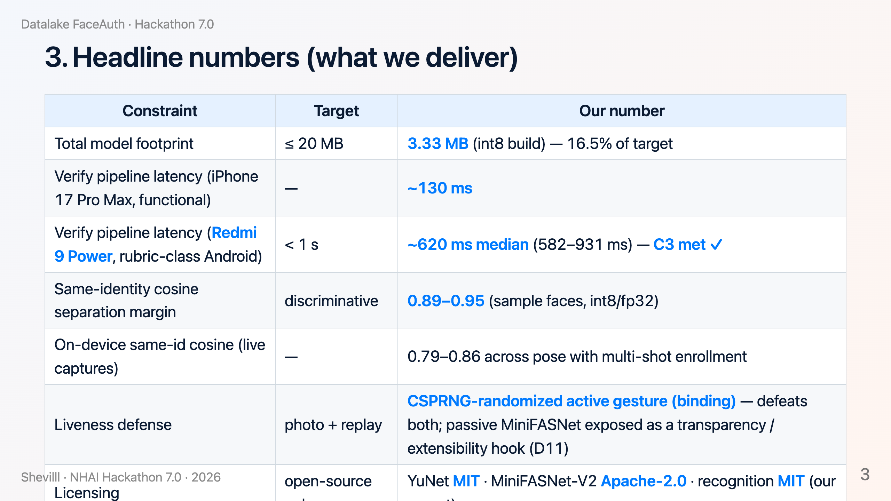

Slide 4
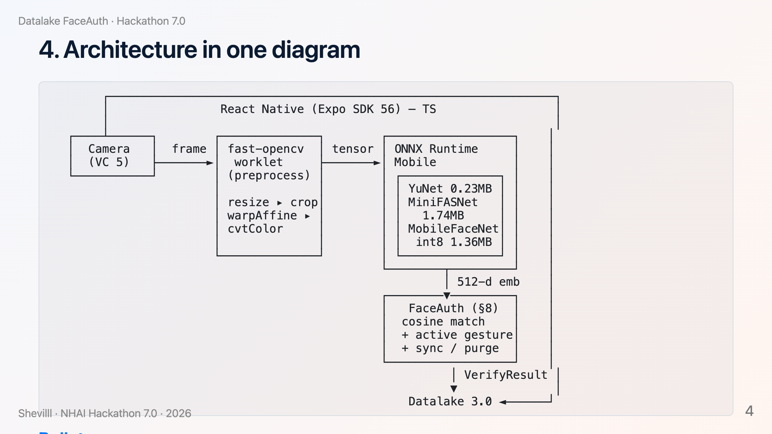

Slide 5
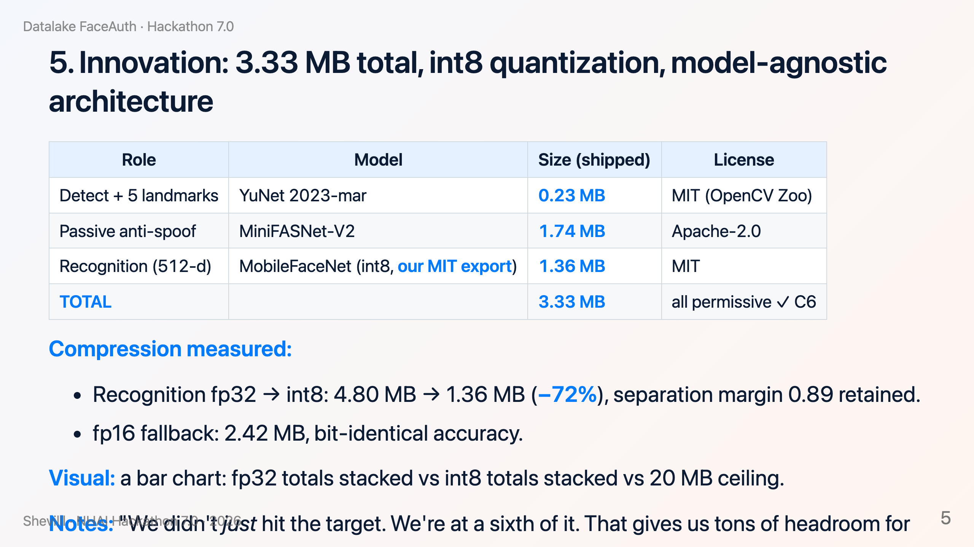

Slide 6
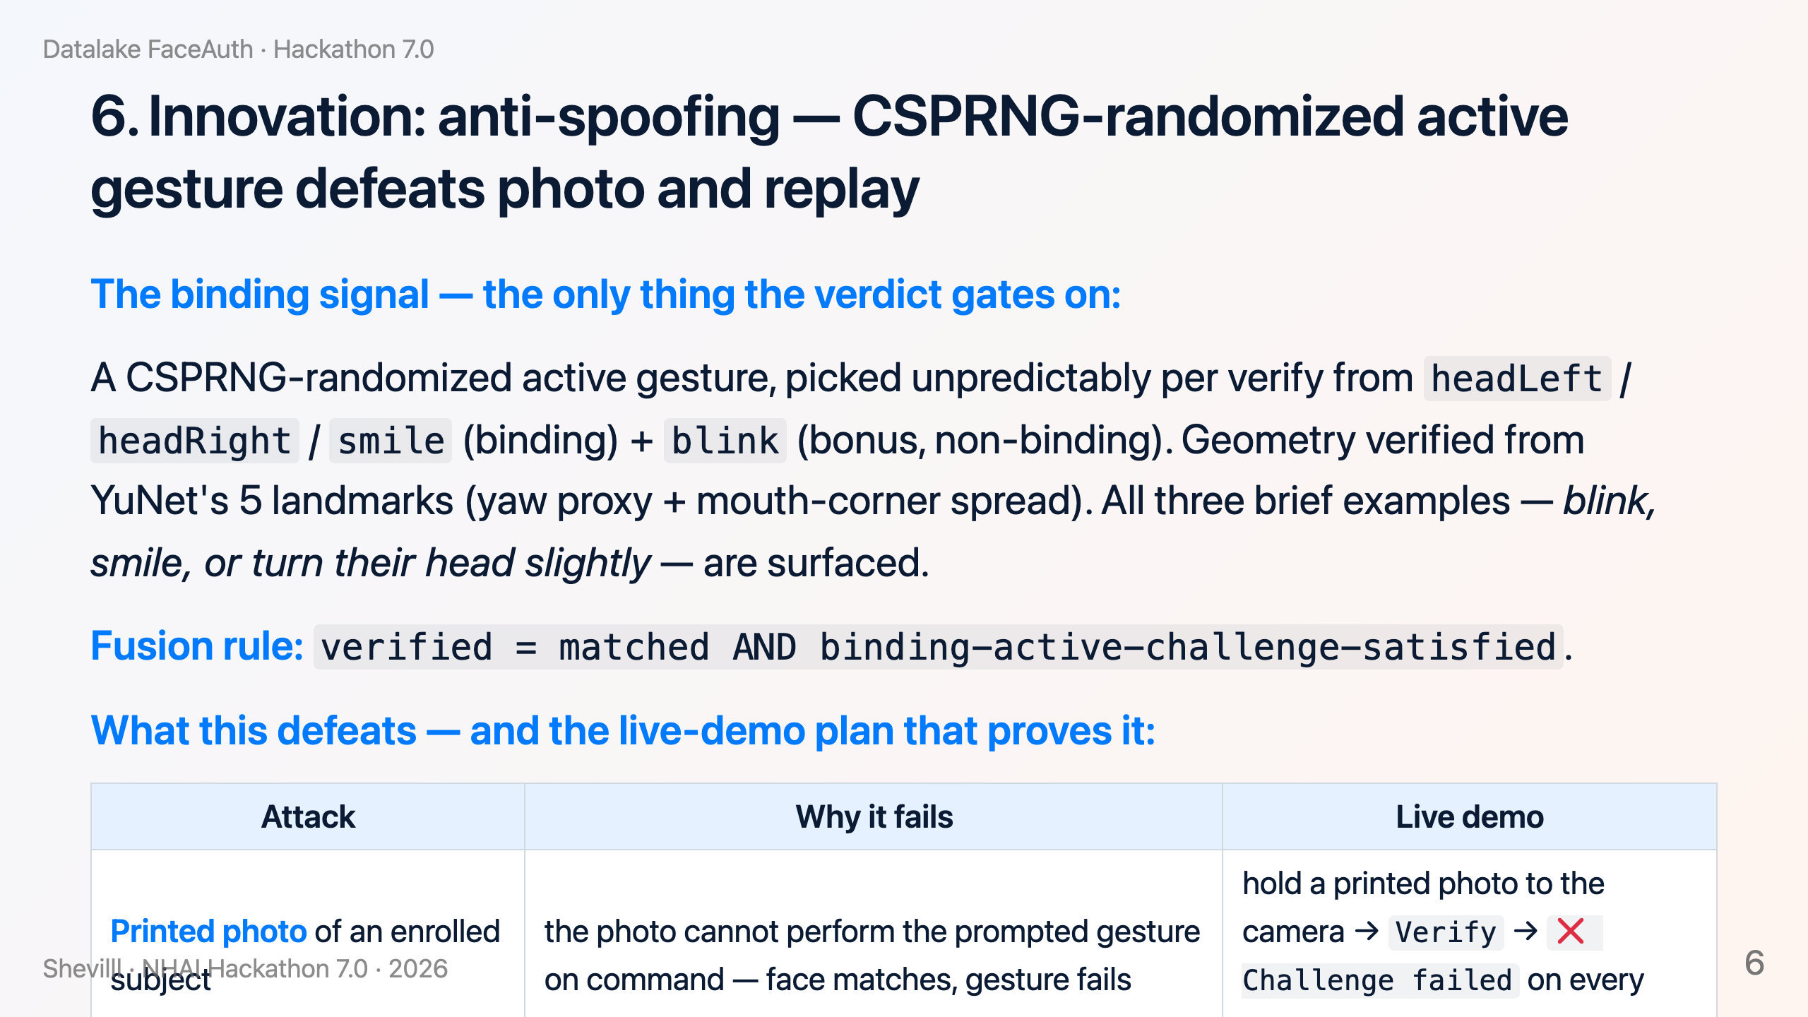

Slide 7
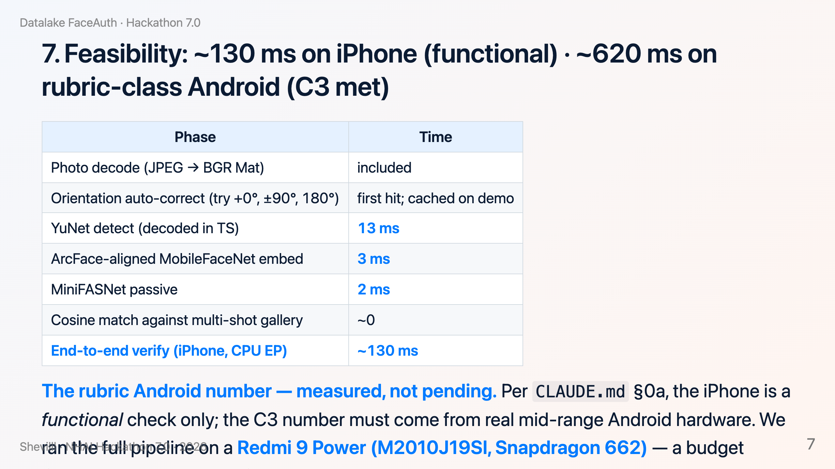

Slide 8
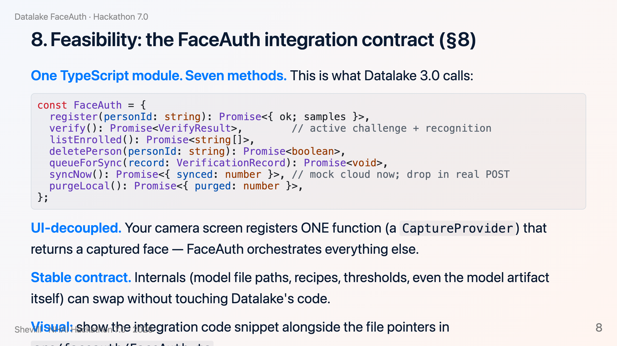

Slide 9
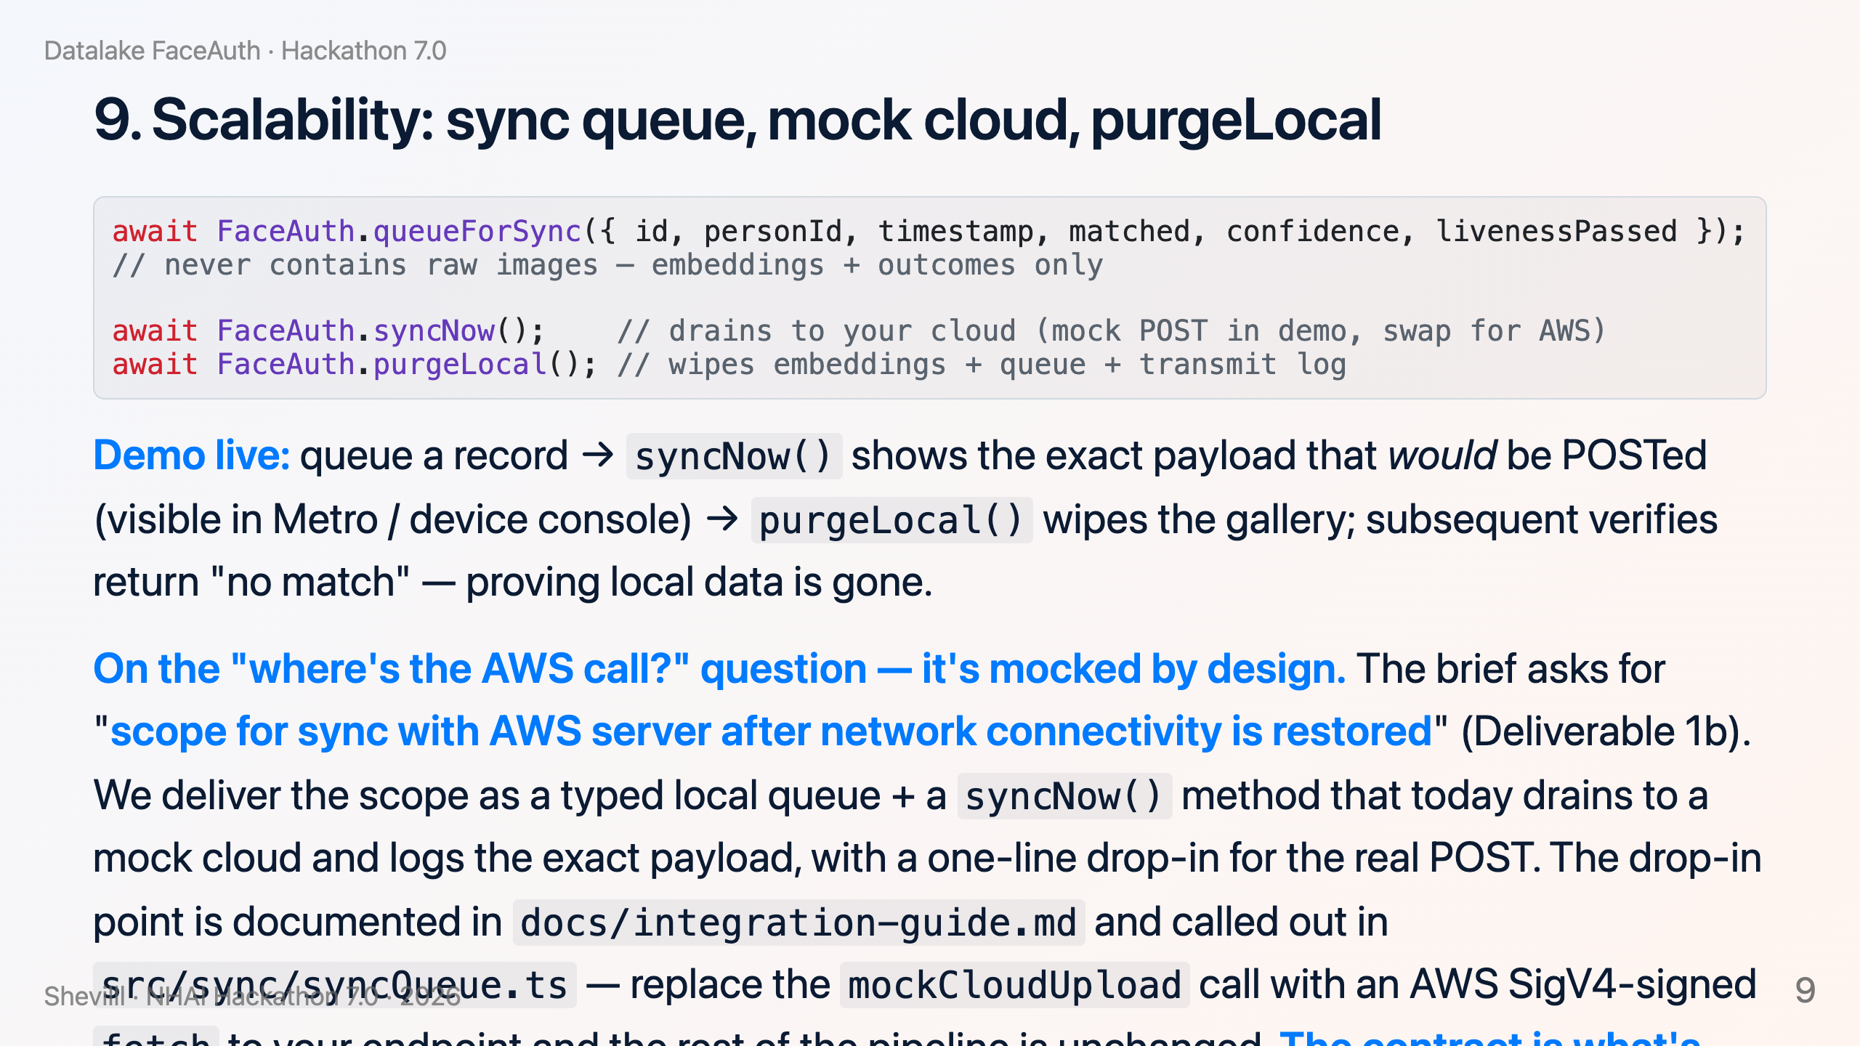

Slide 10
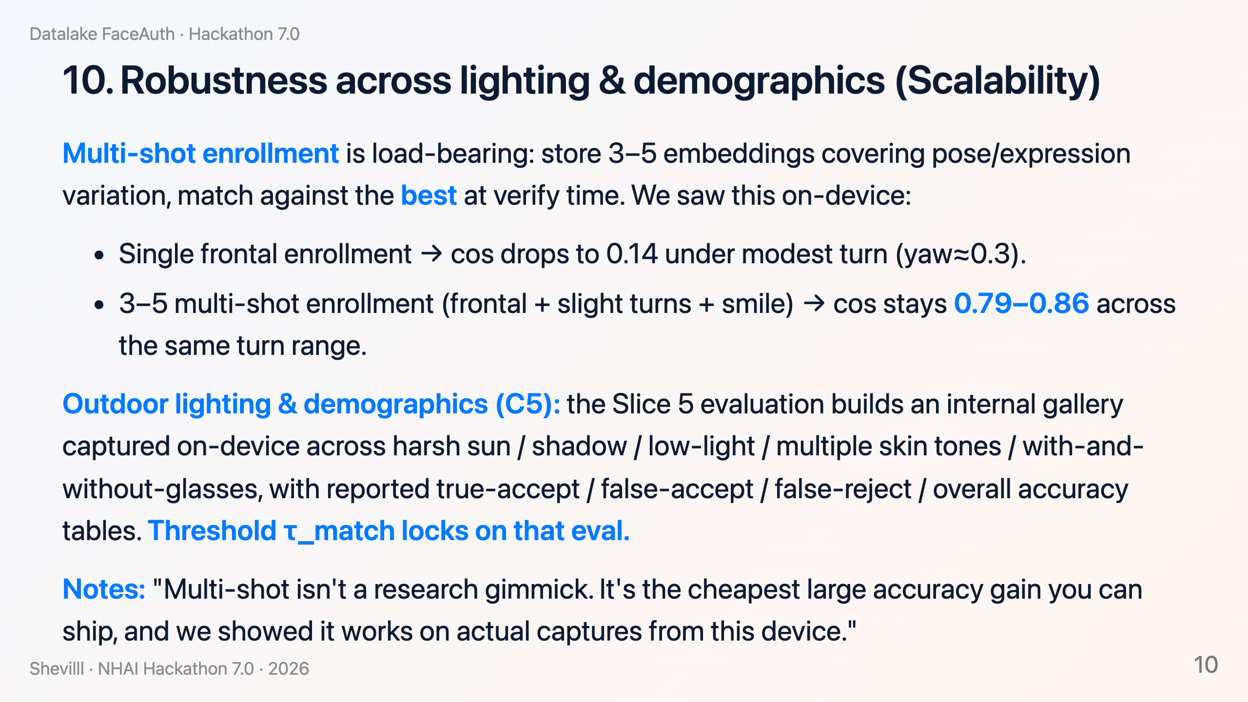

Slide 11
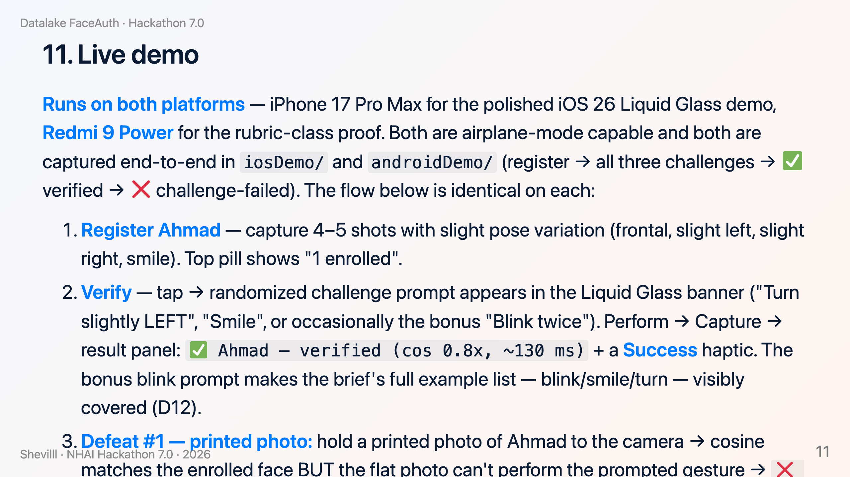

Slide 12
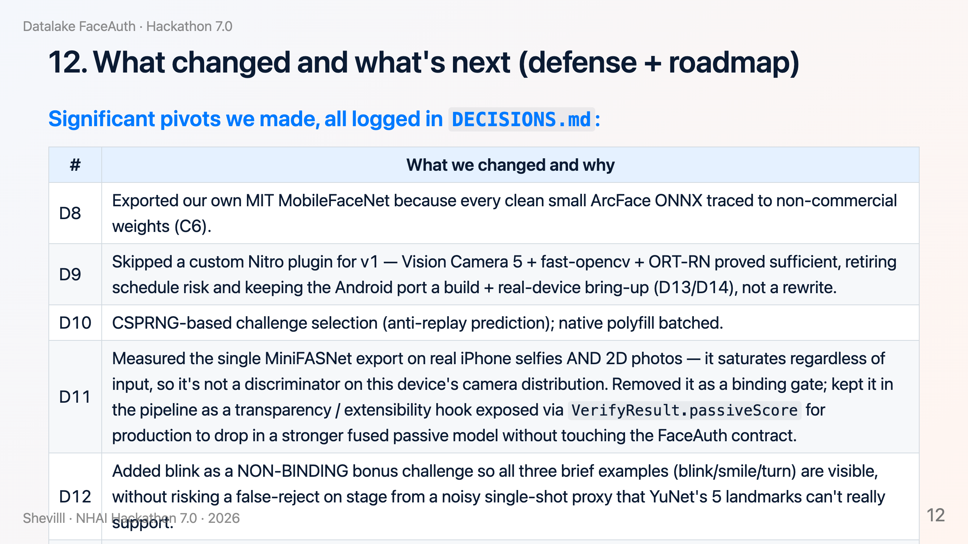

Slide 13
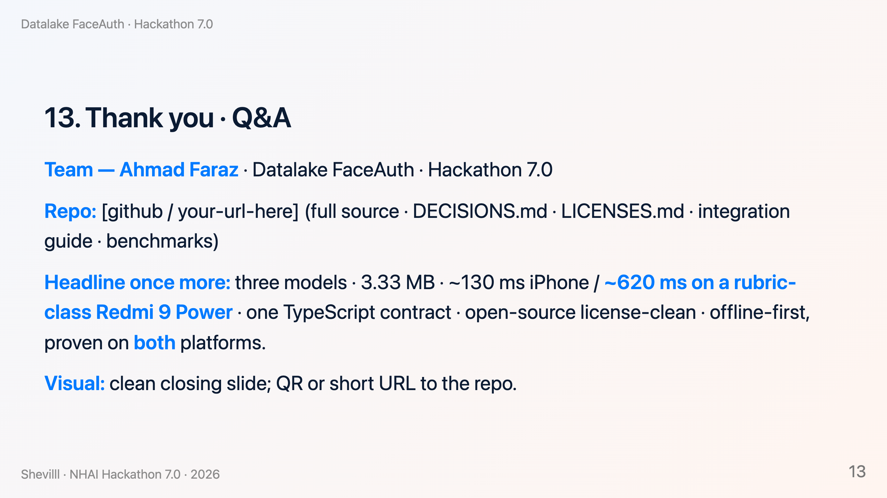

Slide 14
